Slide 1
Image-guided optics connect target selection to Raman spectra
Steerable 785-nm confocal optics and synchronized controls enable repeatable, spatially targeted acquisition.
Confocal microscope
60× water objective, NA 1.2
785-nm laser
Power control
+ shutter
Galvo steering
+ scan optics
Fiber-coupled
spectrograph
sample
785-nm excitation
Raman return
Synchronized acquisition software
Image and select target
Aim, move, and autofocus
Acquire spectrum + time-indexed metadata
1
2
3
785-nm excitation • 60× water immersion, NA 1.2 • Galvo + motorized XY stage • Fiber-coupled spectrograph • DAQ-synchronized control
Notes:
[Sources]
- Original optical schematic and system specifications: user-provided Figures.pptx, slide 1.

Slide 2
Segment and tracking

Slide 3
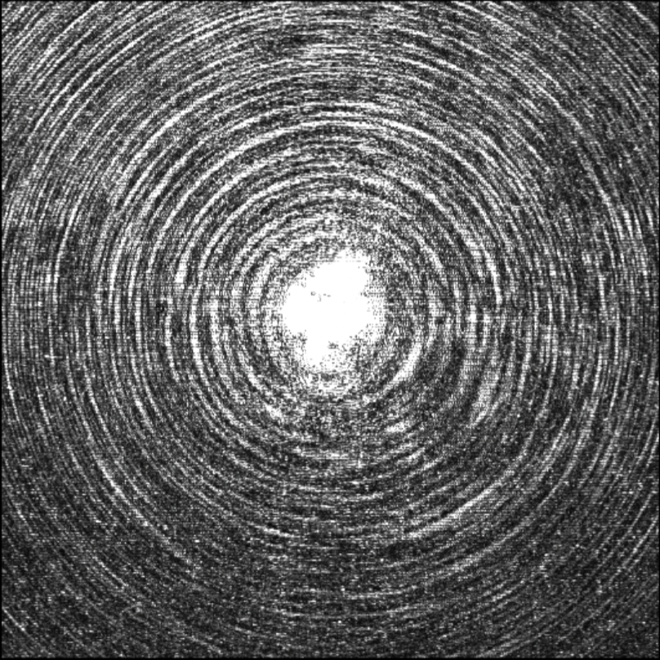
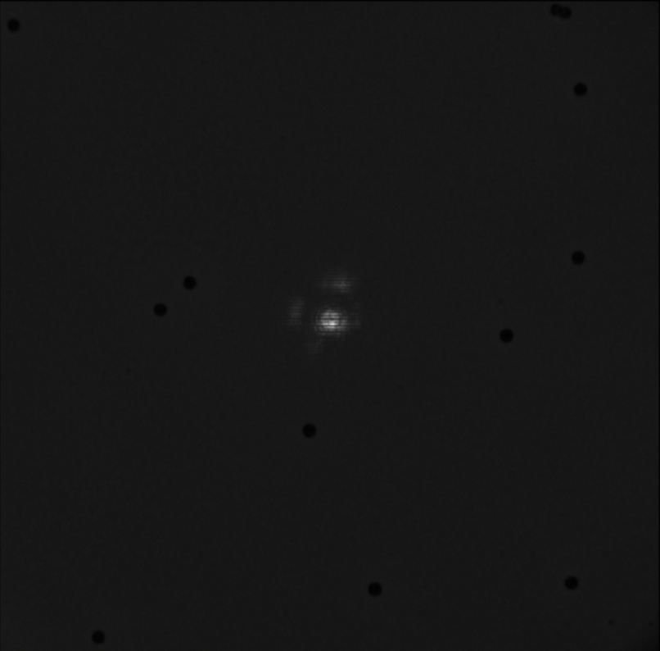
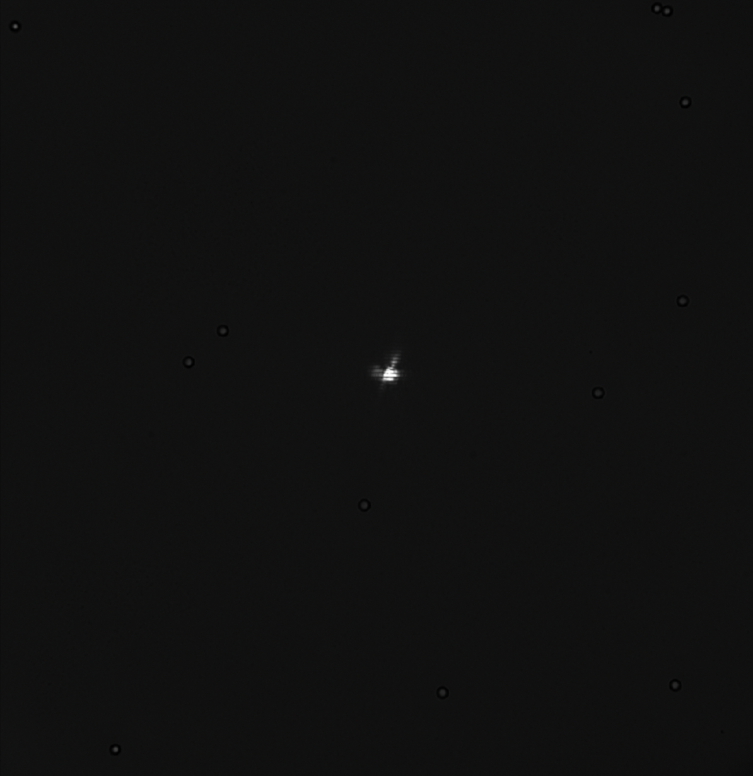
ND Filter Inserted
Laser Autofocus

Slide 4
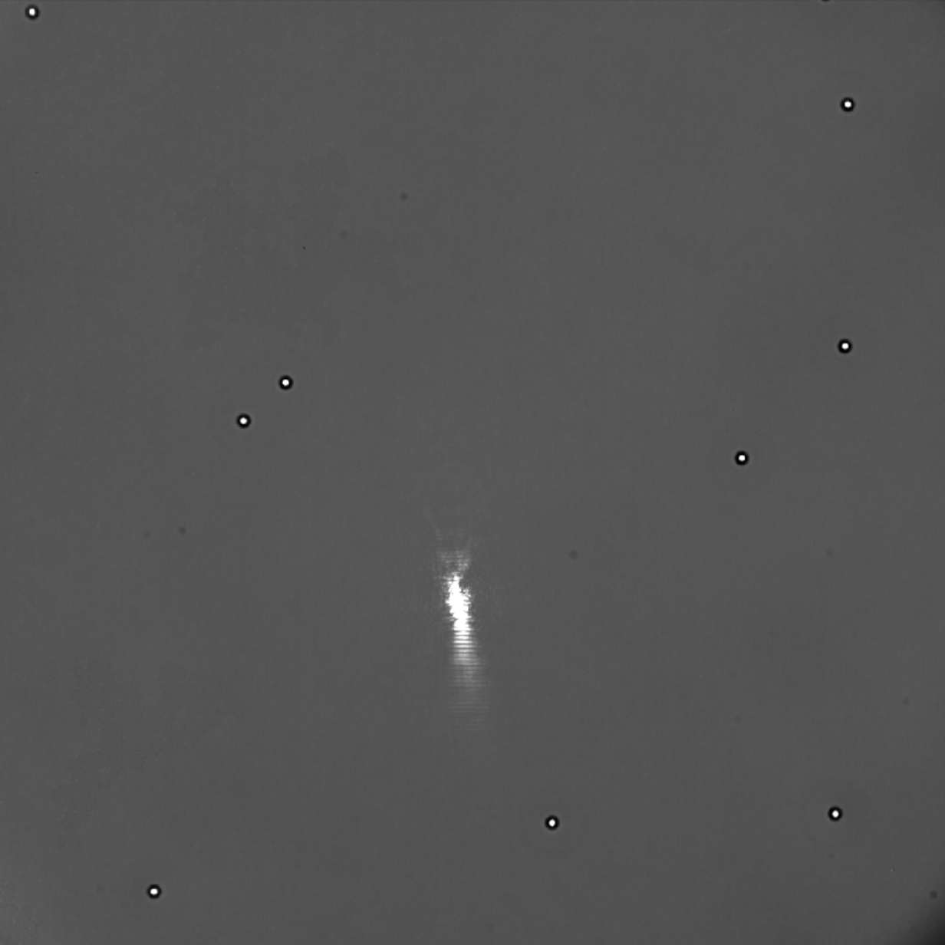
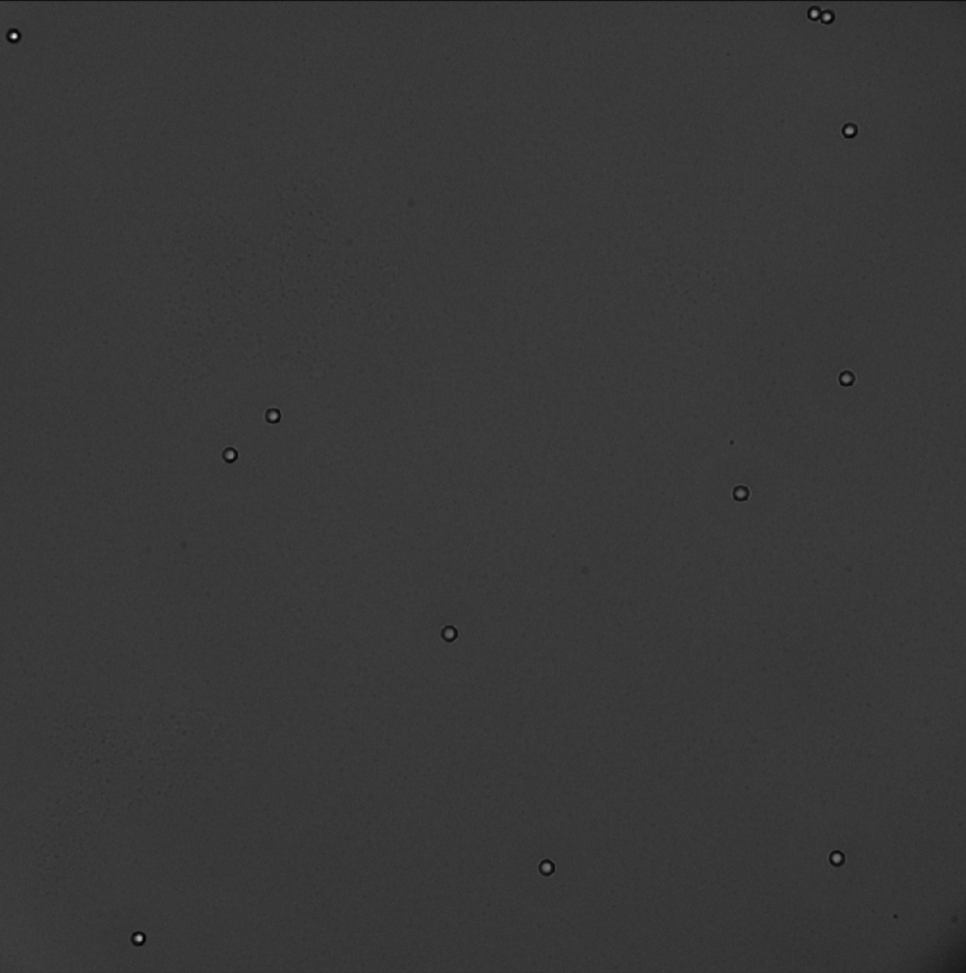
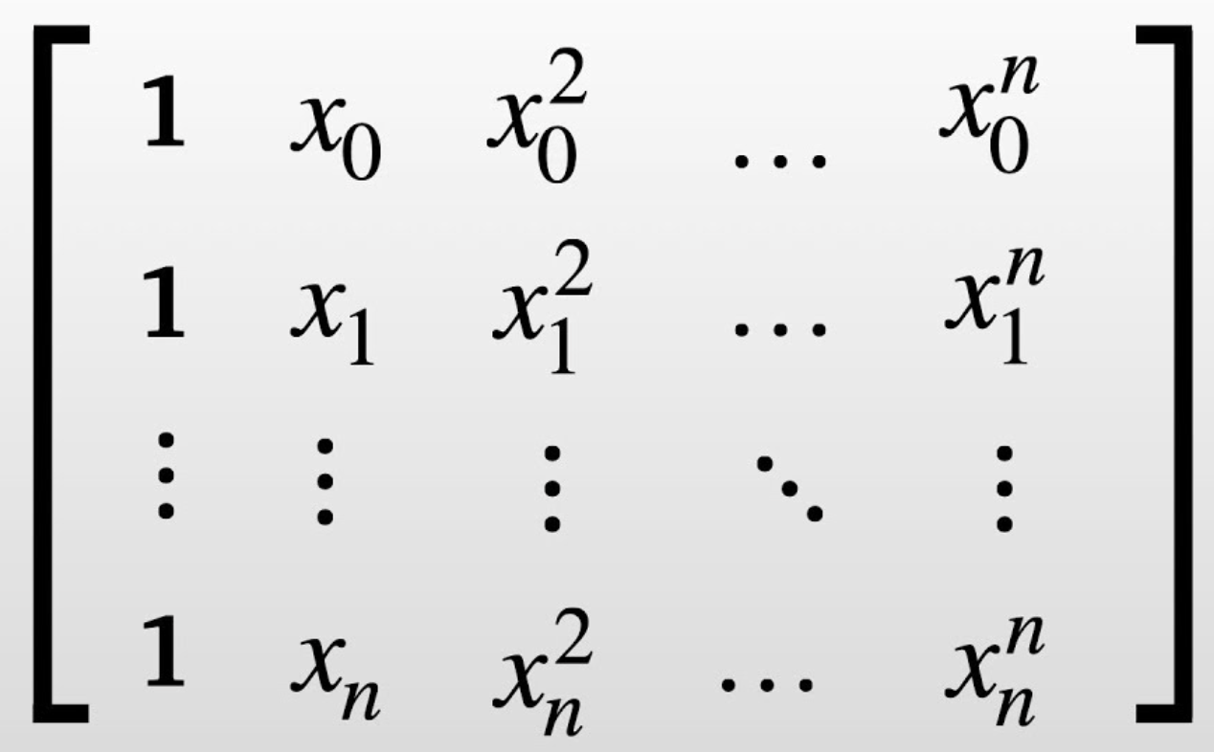
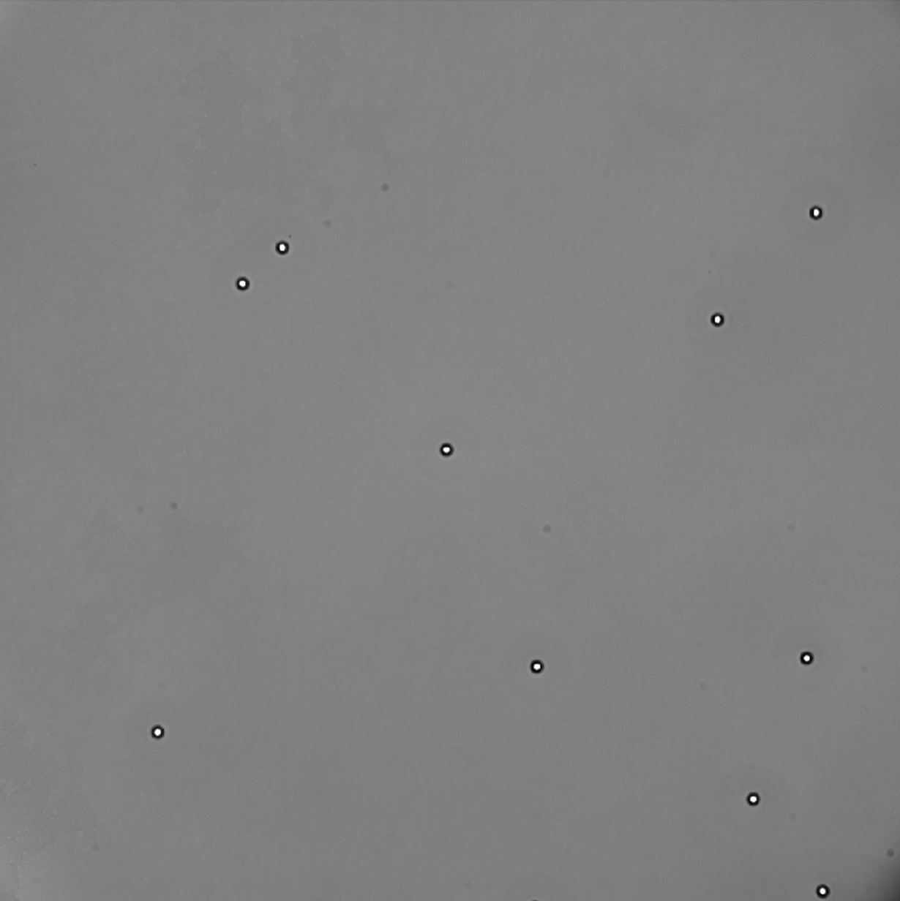
Laser Aiming with Galvanometer
Vandermonde
Matrix
Selection based on live BF
Stage Movement

Slide 5
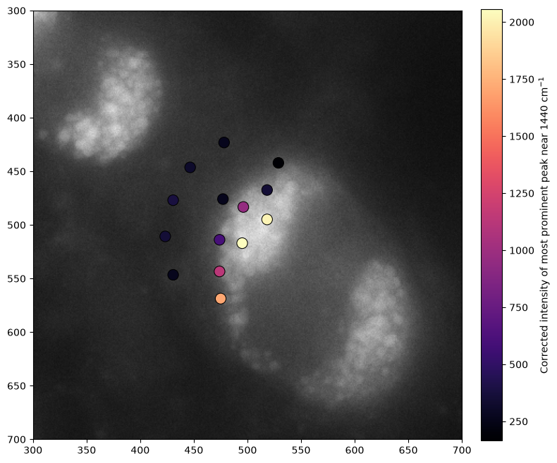
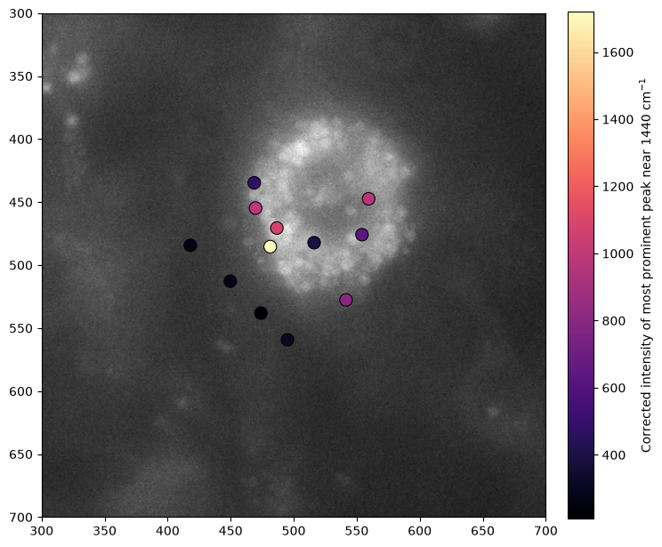
Spatial Heterogeneity of Lipid Signals attained

Slide 6
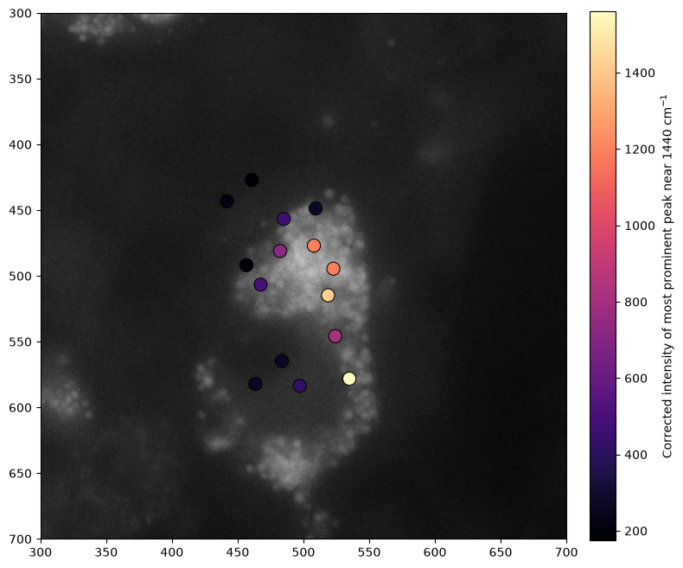
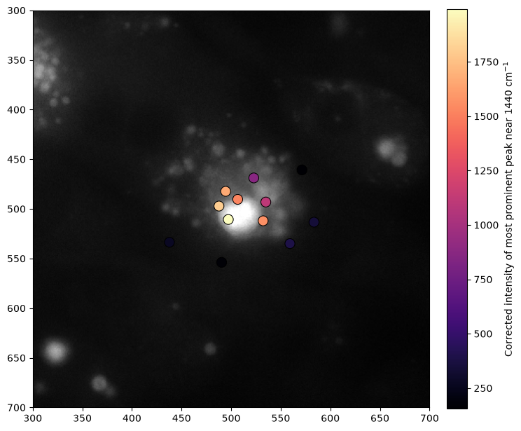
Spatial Heterogeneity of Lipid Signals attained

Slide 7
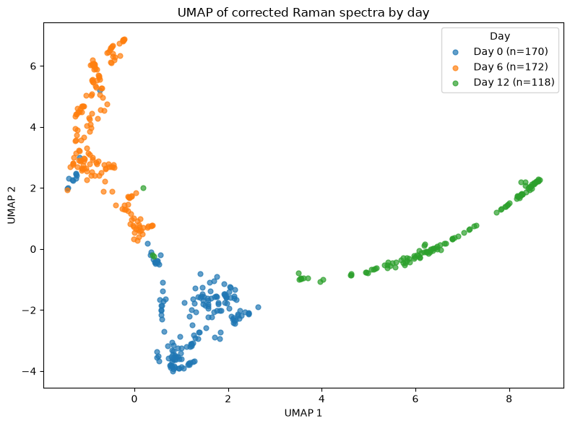
U-MAP clustering of spectra by day label

