Slide 1
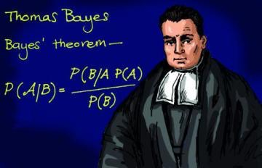
Bayesian search made easy
What is bayesian search?

Slide 2

Outline
What are hyperparameters in machine learning
Grid search
Bayesian optimization
Shameless plug of a tool I wrote

Slide 3
What are hyperparameters?

Slide 4
What are hyperparameters?
Wiki: In the context of machine learning, hyperparameter optimization or model selection is the problem of choosing a set of hyperparameters[?] for a learning algorithm, usually with the goal of optimizing a measure of the algorithm's performance on an independent data set.

Slide 5

What are hyperparameters?
Wiki: In the context of machine learning, hyperparameter optimization or model selection is the problem of choosing a set of hyperparameters[?] for a learning algorithm, usually with the goal of optimizing a measure of the algorithm's performance on an independent data set.

Slide 6
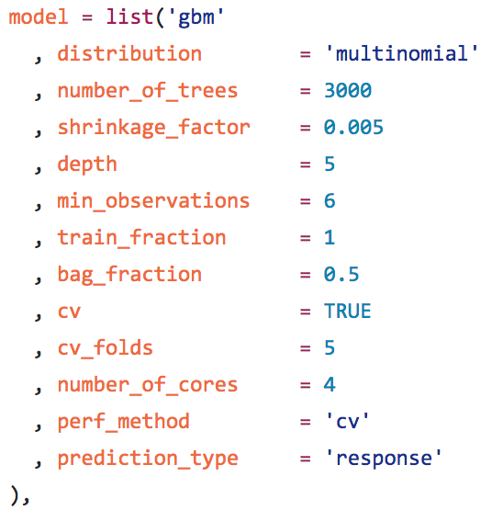
What are hyperparameters?
Why 3000 trees?
Why depth 5?
The more complex your model is, the more knobs it has to tweak

Slide 7
Grid search
Define a set of hyperparameters that you want to optimize and their possible values
Train a model for each set of hyperparameters
Choose the one that scores better in validation

Slide 8
Grid search
Pros
Very understandable
Better than picking a random set of values and calling it a day
Embarrassingly parallel
Cons
Costly
Easy to get stuck in local maxima

Slide 9
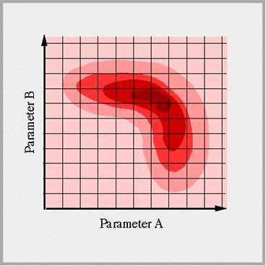
Grid search

Slide 10
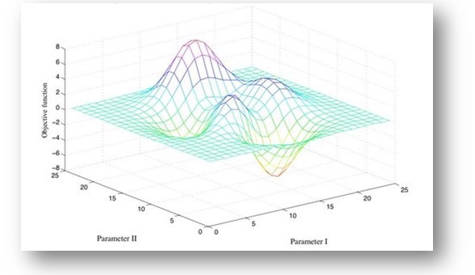
Grid search

Slide 11
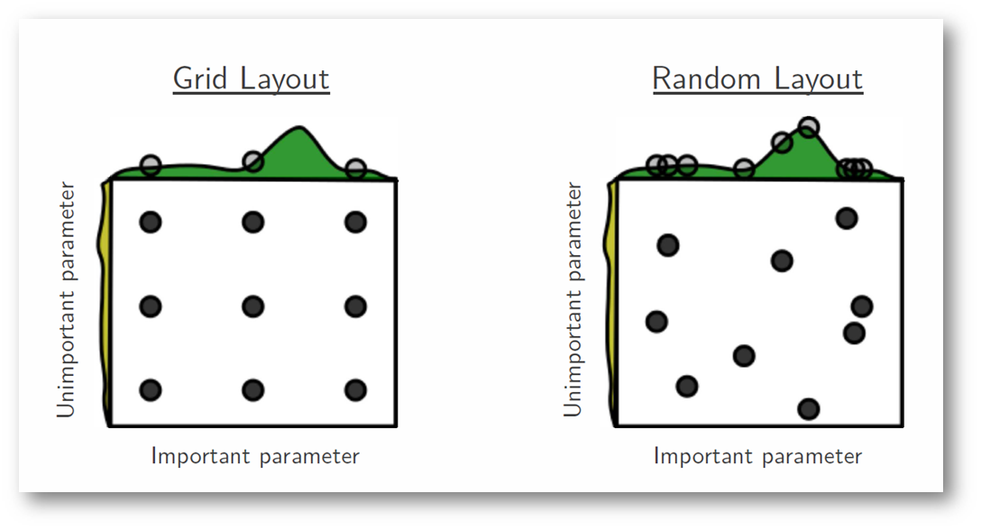
Random search

Slide 12
Random search
Pros
Very simple to implement
Still embarrassingly parallel
Cons
Typically you get better results compared to grid search
You may get unlucky

Slide 13
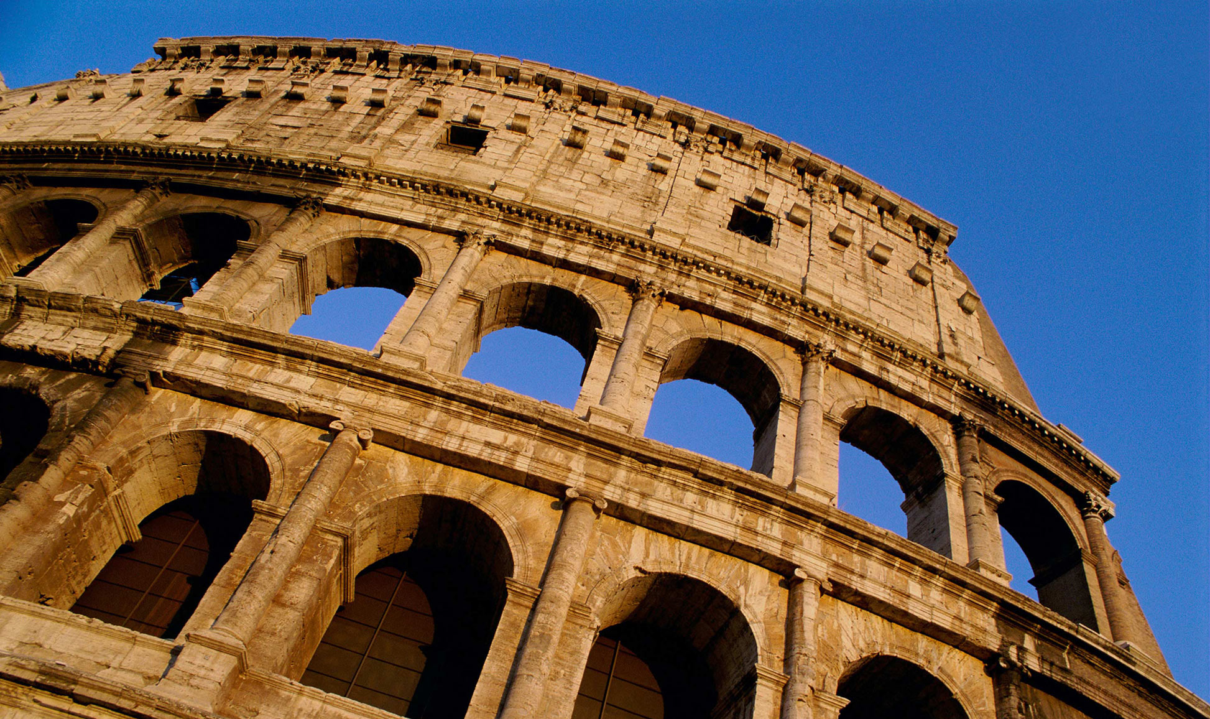
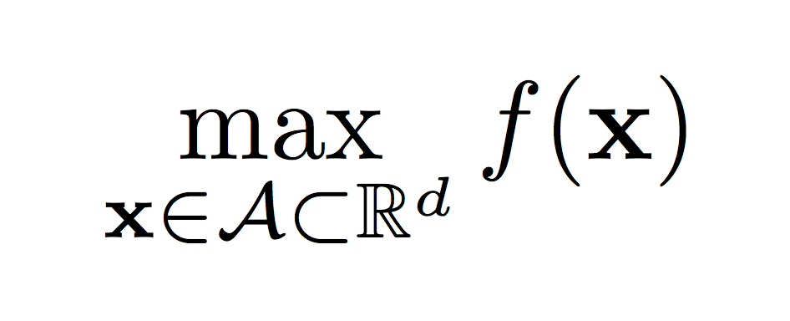
Global optimization

Slide 14
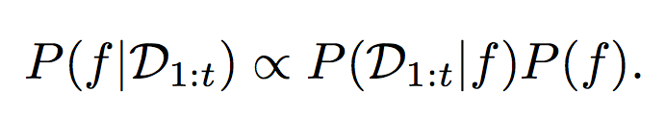
Bayesian optimization using Gaussian processes
Let’s model f - function over the space of hyperparameters that returns metric value of the trained classifier!
Works under assumption that f is Lipschitz-continous

Slide 15
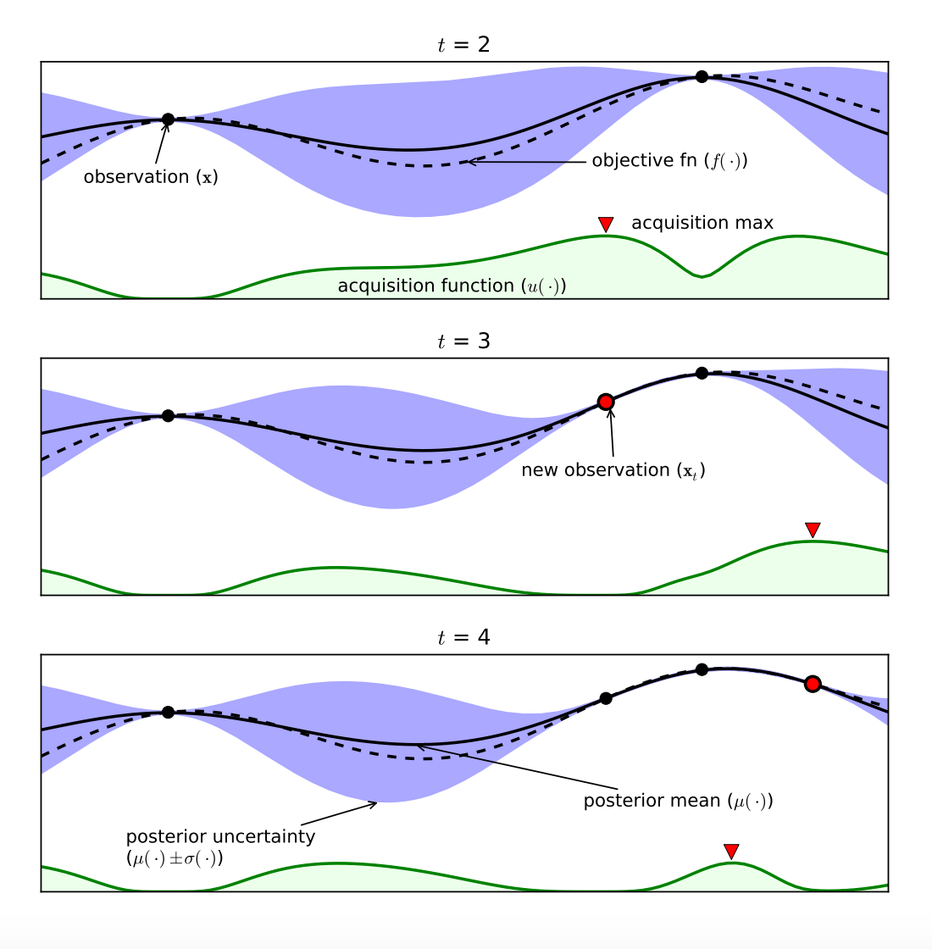
Demo 1D bayesian optimization
https://arxiv.org/pdf/1012.2599

Slide 16
Acquisition functions
Probability of improvement
Expected improvement
Upper confidence bound

Slide 17
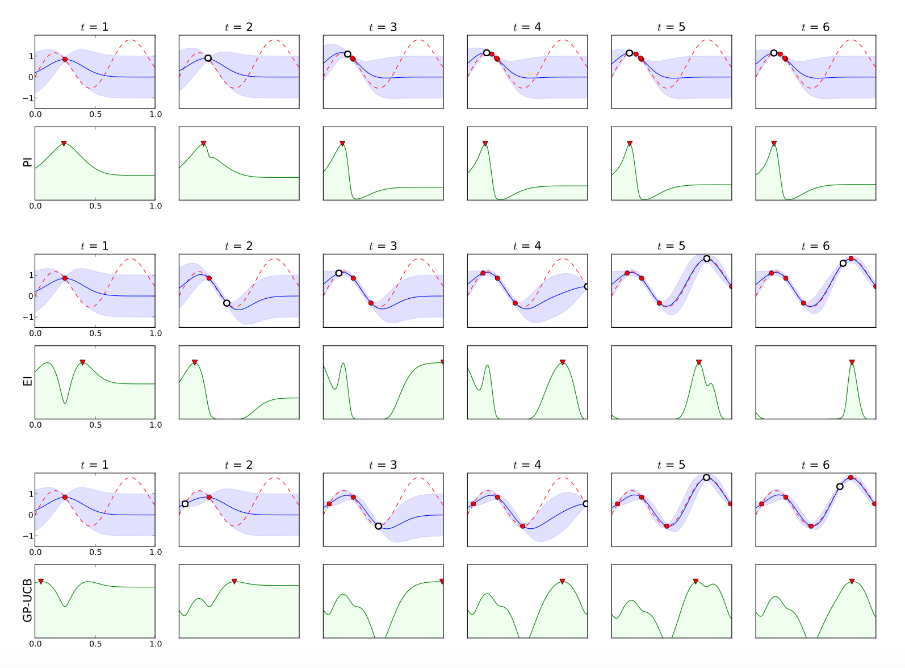
Acquisition functions on a demo 1D problem
https://arxiv.org/pdf/1012.2599

Slide 18
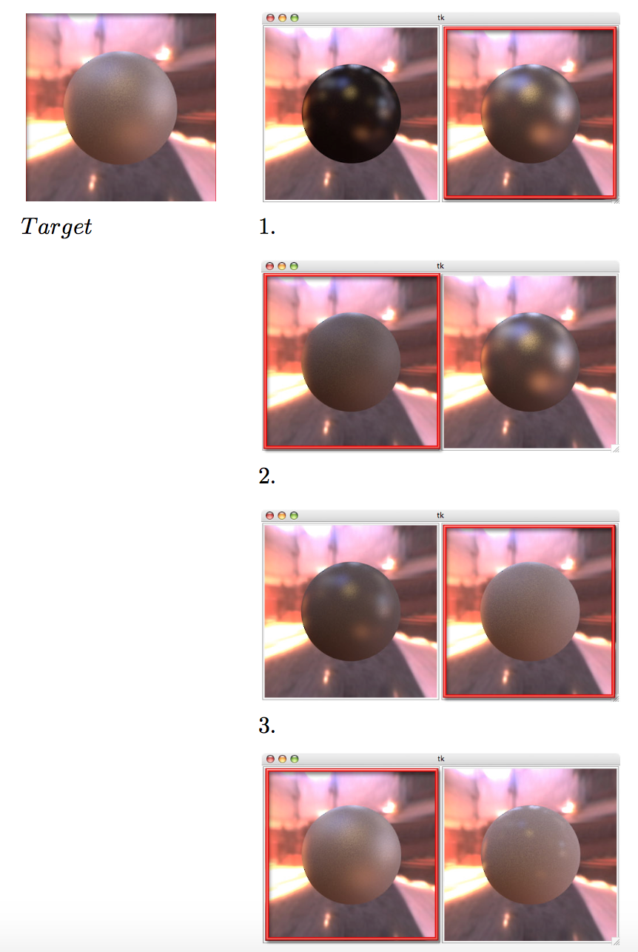
Applications
You can use the same modeling approach for organizing any experiment!

Slide 19
Bayesian search
Pros
Faster convergence
Unlike some other techniques like hyperopt can resume experiment at any time
Cons
Works best when performed sequentially
Someone needs to write it
Someone needs to write it without bugs!

Slide 20
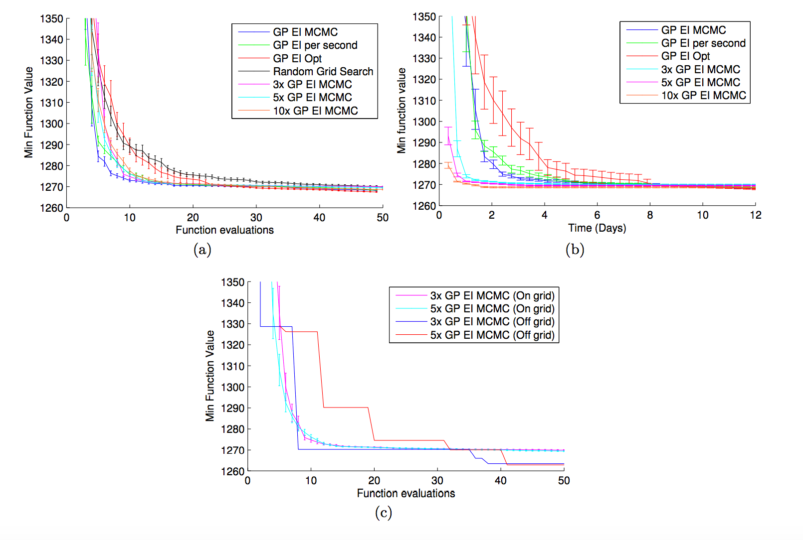
More complex acquisition functions
https://arxiv.org/pdf/1206.2944

Slide 21
How do we parallelize?
Fantasies!
For each pending evaluation, estimate what the metric value will be, and suggest a new sampling point based on this assumption

Slide 22
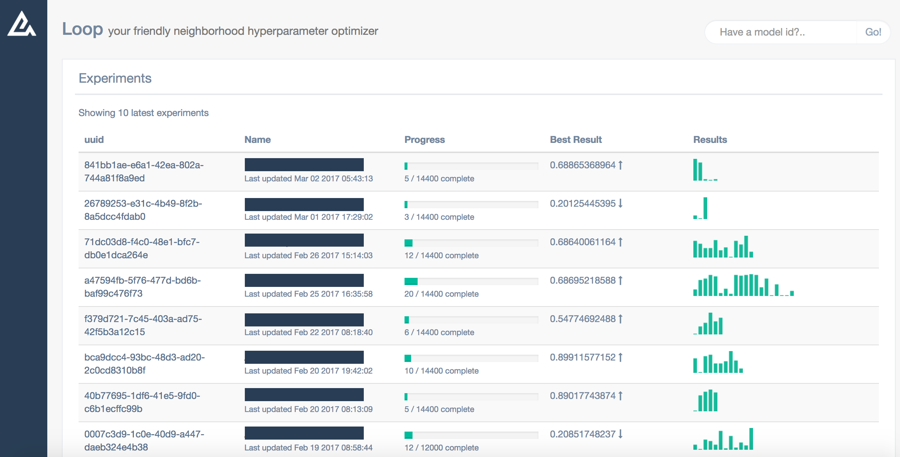
Hyperparameter optimization as a service
https://github.com/avantcredit/loop

Slide 23
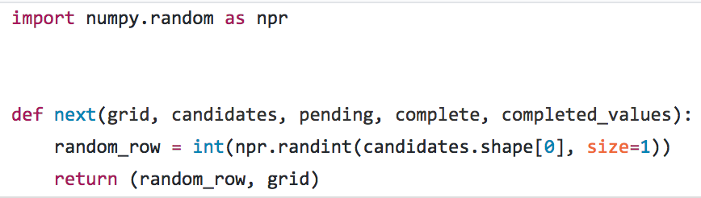
Features
Language agnostic! Use with python, R, spark, C++, paper and pencil. As long as you can make HTTP requests
Easily extensible - contributions very welcome!

Slide 24
How does it work?
create a dense grid - you won’t have to explore the whole thing
repeat desired amount of times:
request a set of hyperparameters to try
train a model
obtain the metric (CV or on holdout set)
report the metric back to the mothership
choose the best model

Slide 25
Links & Credits
https://medium.com/rants-on-machine-learning/smarter-parameter-sweeps-or-why-grid-search-is-plain-stupid-c17d97a0e881#.w29w8b89h
https://arxiv.org/abs/1206.2944
https://arxiv.org/pdf/1012.2599
https://github.com/avantcredit/loop
https://github.com/kirillseva/loopr
https://goo.gl/gLgrwO

