Slide 1
CYBER CRIME AND SECURITY
If we can defeat them sitting at home……who needs to fight with tanks and guns!!!!
Presented By
Nihal Chirayath
Gaurav Kavhar
Kiran Kumbhar
Akash Karan
Vishal Prajapat
Sanzil Madye

Slide 2
CONTENTS
Introduction.
Definition.
History.
Cyber threat evolution.
Categories of cyber crime.
Types of cyber crime.
Prevention.
Security.
Conclusion.

Slide 3

INTRODUCTION
The internet in India is growing rapidly. It has given rise to new opportunities in every field we can think of be it entertainment, business, sports or education.
There’re two sides to a coin. Internet also has it’s own disadvantages is Cyber crime- illegal activity committed on the internet.

Slide 4
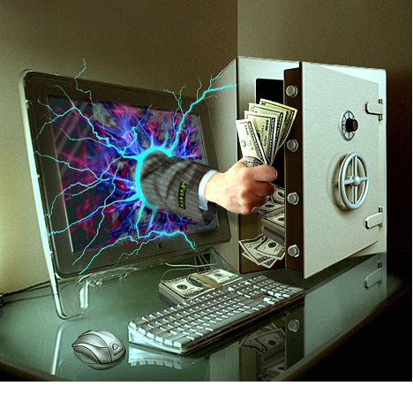
DEFINING CYBER CRIME
Crime committed using a computer and the internet to steal data or information.
Illegal imports.
Malicious programs.

Slide 5
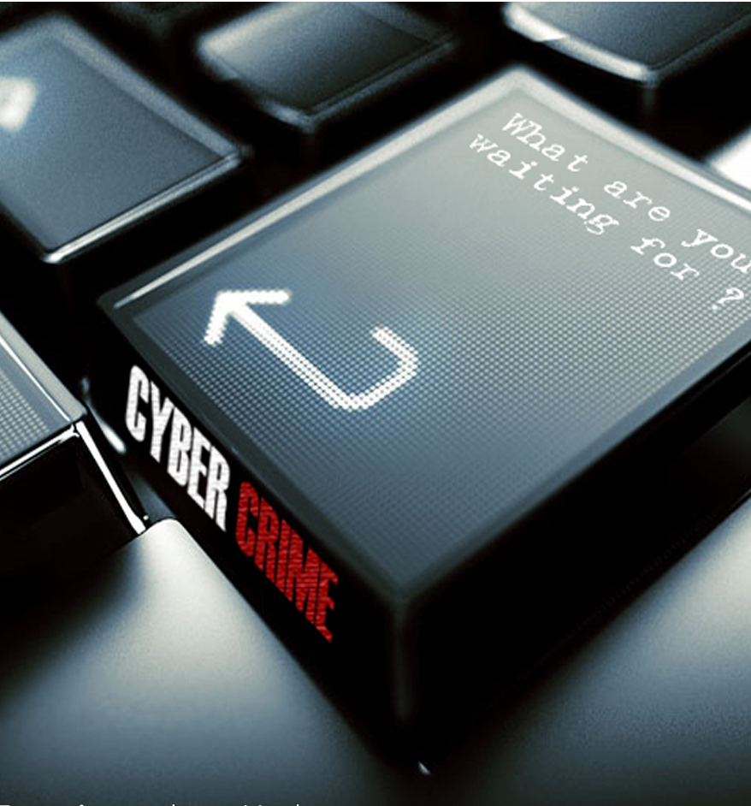
Cyber crime
Cybercrime is nothing but where the computer used as an object or subject of crime..

Slide 6

HISTORY
The first recorded cyber crime took place in the year 1820.

Slide 7
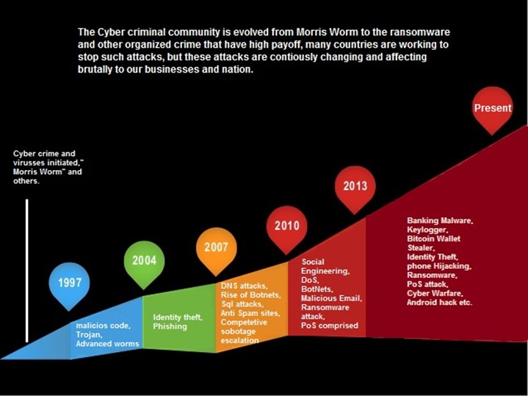
CYBER THREAT EVOLUTION

Slide 8
CATEGORIZATION OF CYBER CRIME
The Computer as a Target
The computer as a weapon

Slide 9
TYPES OF CYBER CRIME
Hacking
Denial of service attack
Virus Dissemination
Computer Vandalism
Cyber Terrorism
Software Piracy

Slide 10

HACKING
Hacking in simple terms means an illegal intrusion into a computer system and/or network.

Slide 11
DENIAL OF SERVICE ATTACK
Act by the criminal, who floods the bandwidth of the victims network.
Is his e-mail box with spam mail depriving him of the services.

Slide 12
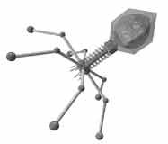
VIRUS DISSEMINATION
Malicious software that attaches itself to other software. (virus, worms, Trojan Horse, web jacking, e-mail bombing etc.)

Slide 13
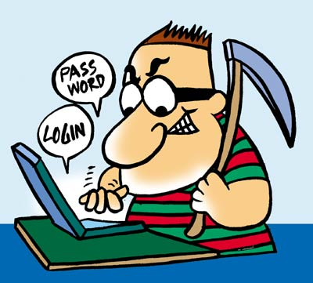
COMPUTER VANDALISM
Damaging or destroying data rather than stealing.
Transmitting virus

Slide 14
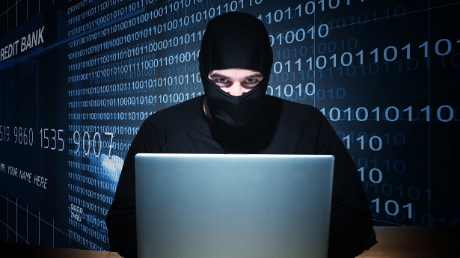
CYBER TERRORISM
Use of Internet based attacks in terrorist activities.
Technology savvy terrorists are using 512-bit encryption, which is impossible to decrypt.

Slide 15

SOFTWARE PIRACY
Theft of software through the illegal copying of genuine programs.
Distribution of products intended to pass for the original.

Slide 16
TYPES OF CYBER ATTACK BY PERCENTAGE
Financial fraud: 11%
Sabotage of data/networks: 17%
Theft of proprietary information: 20%
System penetration from the outside: 25%
Denial of service: 27%
Unauthorized access by insiders: 71%
Employee abuse of internet privileges 79%
Viruses 85%

Slide 17
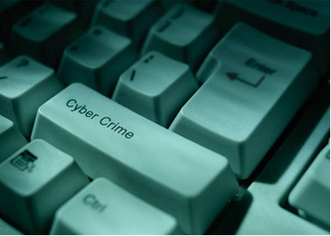
SAFETY TIPS FOR CYBER CRIME
Use antivirus software’s.
Insert firewalls.
Uninstall unnecessary software
Maintain backup.
Check security settings.
Stay anonymous - choose a genderless screen name.
Never give your full name or address to strangers.
Learn more about Internet privacy.

Slide 18

Security

Slide 19
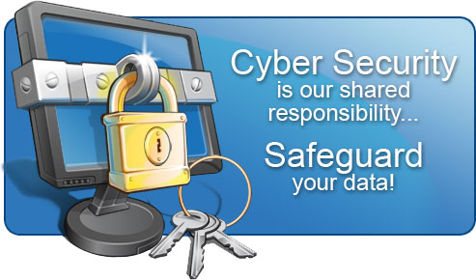
CYBER SECURITY
Internet security is a branch of computer security specifically related to the Internet.
It's objective is to establish rules and measure to use against attacks over the Internet.

Slide 20

ADVANTAGES OF CYBER SECURITY
Defend us from critical attacks.
Browse the safe website.
Internet security process all the incoming and outgoing data on our computer.

Slide 21

CONCLUSION
Technology is destructive only in the hands of people who do not realize that they are one and the same process as the universe.

Slide 22


