Slide 1
Robot Manipulation: Spatial Transformation
Mohammadali Varfan

Slide 2
Introduction
In robot manipulation we want to move objects and parts of the robot around in space
We need to represent positions and orientations of the parts and objects that are involved in that manipulation task
The first step for defining the position is defining a coordination system
We describe the position of a point in our coordination system with a position vector
We also need the orientation of the points in space and for this we attach a coordinate system to that point

Slide 3
Orientation
Orientation defines the relationship between the body “B” frame and the reference frame “A” using a rotation matrix as below
Therefore for describing the position of the body “B” we just need the position of the origin of frame “B” relative to “A” and the rotation matrix

Slide 4
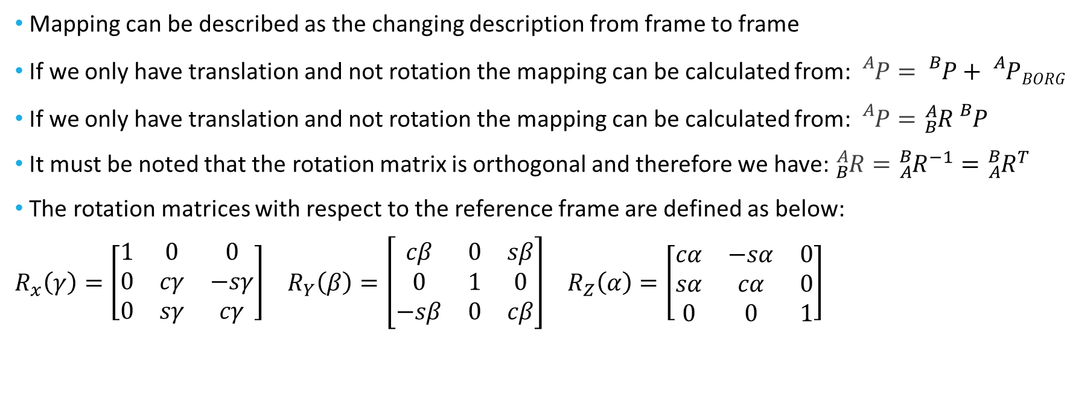
Mapping
Mapping can be described as the changing description from frame to frame
If we only have translation and not rotation the mapping can be calculated from: ${}_{}^{A}P={}_{}^{B}P+{}_{}^{A}PBORG$
If we only have translation and not rotation the mapping can be calculated from: ${}_{}^{A}P={}_{B}^{A}R{}_{}^{B}P$
It must be noted that the rotation matrix is orthogonal and therefore we have: ${}_{B}^{A}R={}_{A}^{B}{R^{−1}}={}_{A}^{B}{R^{T}}$
The rotation matrices with respect to the reference frame are defined as below:
$R_{x}\left(γ\right)=\left[\begin{matrix}1 & 0 & 0 \\ 0 & cγ & −sγ \\ 0 & sγ & cγ\end{matrix}\right]$ $R_{Y}\left(β\right)=\left[\begin{matrix}cβ & 0 & sβ \\ 0 & 1 & 0 \\ −sβ & 0 & cβ\end{matrix}\right]$ $R_{Z}\left(α\right)=\left[\begin{matrix}cα & −sα & 0 \\ sα & cα & 0 \\ 0 & 0 & 1\end{matrix}\right]$

Slide 5
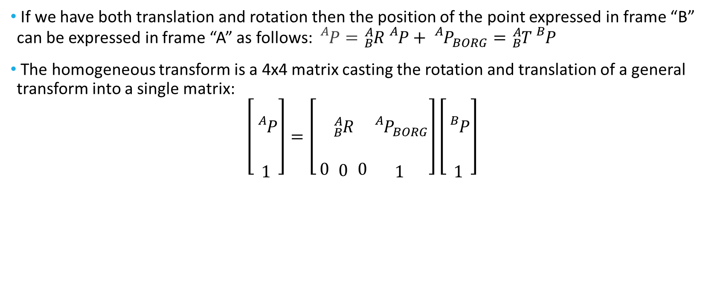
Mapping – General Condition
If we have both translation and rotation then the position of the point expressed in frame “B” can be expressed in frame “A” as follows: ${}_{}^{A}P={}_{B}^{A}R{}_{}^{A}P+{}_{}^{A}{P_{BORG}}={}_{B}^{A}T{}_{}^{B}P$
The homogeneous transform is a 4x4 matrix casting the rotation and translation of a general transform into a single matrix:
$$\left[\begin{matrix} \\ {}_{}^{A}P \\ \\ 1\end{matrix}\right]=\left[\begin{matrix} \\ \\ \\ 0\end{matrix}\begin{matrix} \\ {}_{B}^{A}R \\ \\ 0\end{matrix}\begin{matrix} \\ \\ \\ 0\end{matrix}\begin{matrix} \\ {{}_{}^{A}P}_{BORG} \\ \\ 1\end{matrix}\right]\left[\begin{matrix} \\ {}_{}^{B}P \\ \\ 1\end{matrix}\right]$$

Slide 6
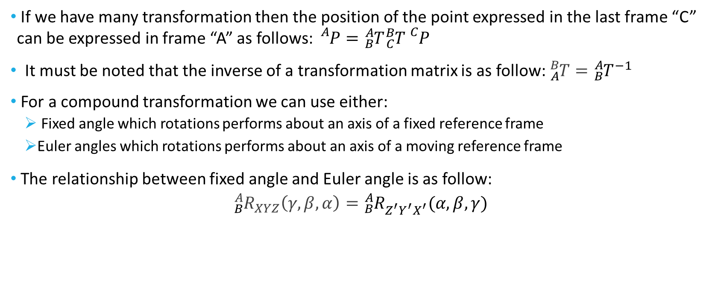
Compound Transformations
If we have many transformation then the position of the point expressed in the last frame “C” can be expressed in frame “A” as follows: ${}_{}^{A}P={}_{B}^{A}T{}_{C}^{B}T{}_{}^{C}P$
It must be noted that the inverse of a transformation matrix is as follow: ${}_{A}^{B}T={}_{B}^{A}{T^{−1}}$
For a compound transformation we can use either:
Fixed angle which rotations performs about an axis of a fixed reference frame
Euler angles which rotations performs about an axis of a moving reference frame
The relationship between fixed angle and Euler angle is as follow:
$${}_{B}^{A}{R_{XYZ}\left(γ,β,α\right)={}_{B}^{A}{R_{Z^{′}Y^{′}X^{′}}^{}(α,β,γ)} }$$

Slide 7
V

Slide 8
V

Slide 9
V

Slide 10
V

Slide 11
V

