Slide 1
Robot Manipulation: Paper
Mohammadali Varfan

Slide 2
Dynamic Movement Control
In dynamic systems a movement trajectory will be generated during the movement from a differential equation
The dynamical system represents a whole flow field instead of a single-trajectory, like splines do
In dynamical systems a few control commands need to be specified, and the differential equation generates the corresponding trajectory, reducing the control load
The main disadvantage of this system is it can be unnatural and poses technical difficulties for new movement targets
This paper proposes a new formulation that overcomes this problem

Slide 3
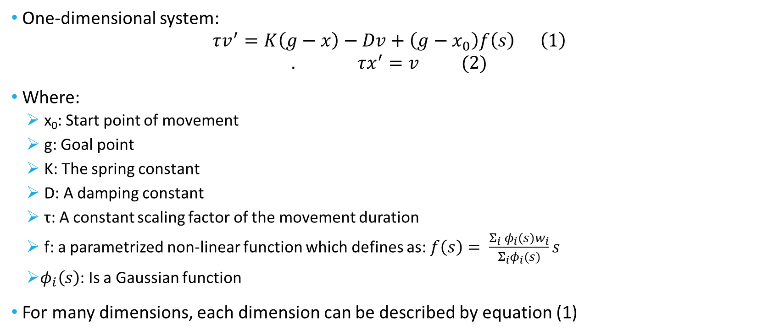
DMS(Dynamic Movement Primitives)
One-dimensional system:
$$τv^{′}=K\left(g−x\right)−Dv+\left(g−x_{0}\right)f\left(s\right) \left(1\right)$$
$$. τx^{′}=v (2)$$
Where:
x₀: Start point of movement
g: Goal point
K: The spring constant
D: A damping constant
τ: A constant scaling factor of the movement duration
f: a parametrized non-linear function which defines as: $f\left(s\right)= \frac{Σ_{i} φ_{i}\left(s\right)w_{i}}{Σ_{i}φ_{i}(s)}s$
$φ_{i}\left(s\right)$: Is a Gaussian function
For many dimensions, each dimension can be described by equation (1)

Slide 4
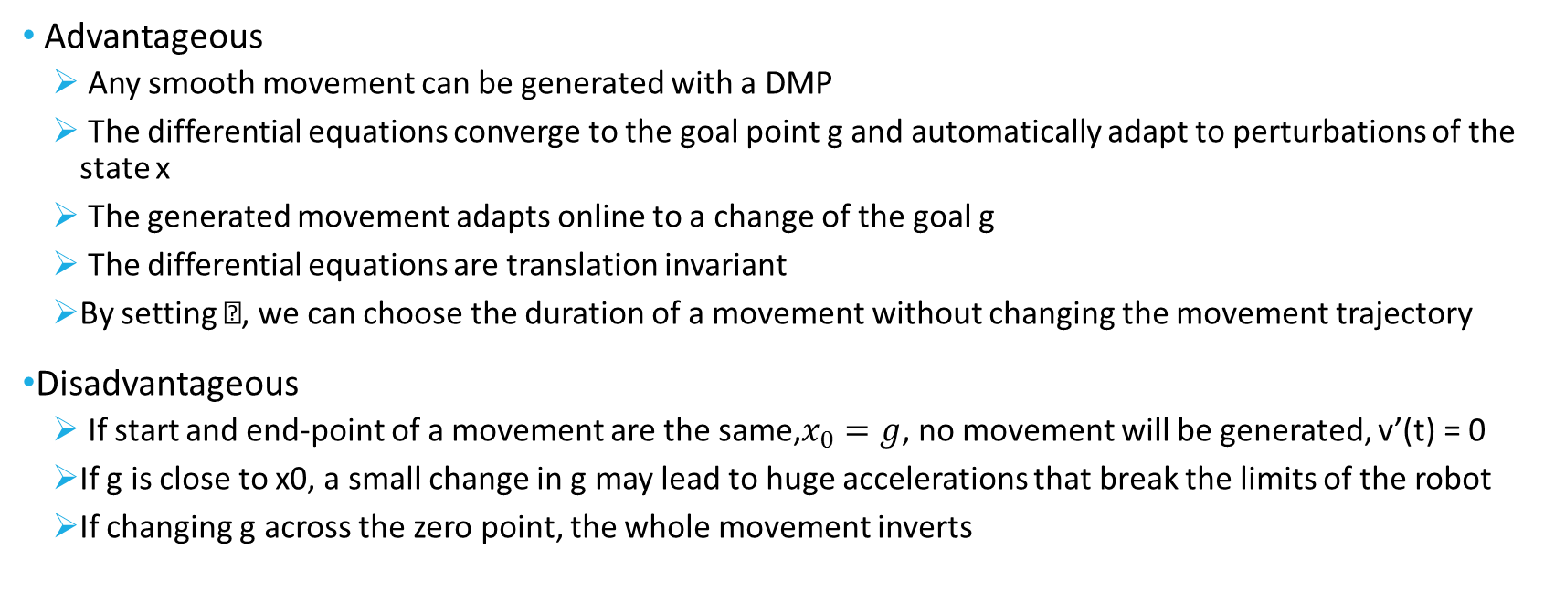
DMS Features
Advantageous
Any smooth movement can be generated with a DMP
The differential equations converge to the goal point g and automatically adapt to perturbations of the state x
The generated movement adapts online to a change of the goal g
The differential equations are translation invariant
By setting , we can choose the duration of a movement without changing the movement trajectory
Disadvantageous
If start and end-point of a movement are the same,$x_{0}=g$, no movement will be generated, v’(t) = 0
If g is close to x0, a small change in g may lead to huge accelerations that break the limits of the robot
If changing g across the zero point, the whole movement inverts

Slide 5
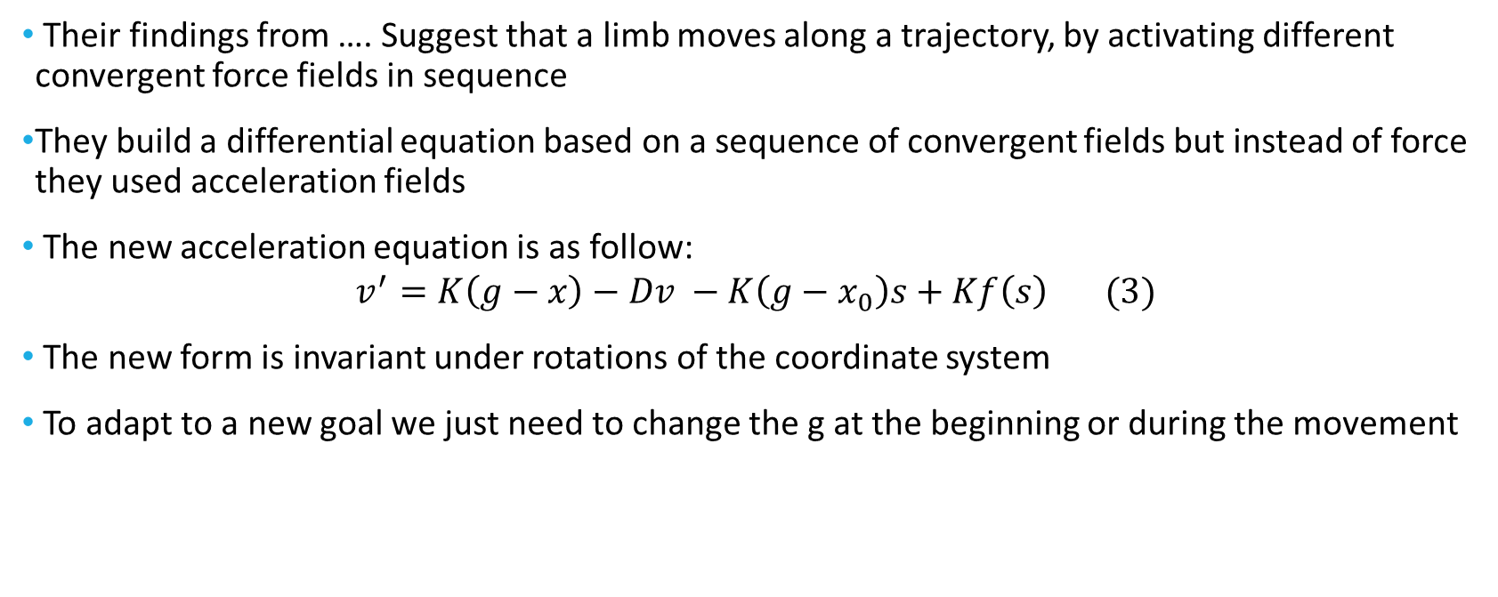
New DMP
Their findings from …. Suggest that a limb moves along a trajectory, by activating different convergent force fields in sequence
They build a differential equation based on a sequence of convergent fields but instead of force they used acceleration fields
The new acceleration equation is as follow:
$$v^{′}=K\left(g−x\right)−Dv −K\left(g−x_{0}\right)s+Kf\left(s\right) (3)$$
The new form is invariant under rotations of the coordinate system
To adapt to a new goal we just need to change the g at the beginning or during the movement

Slide 6
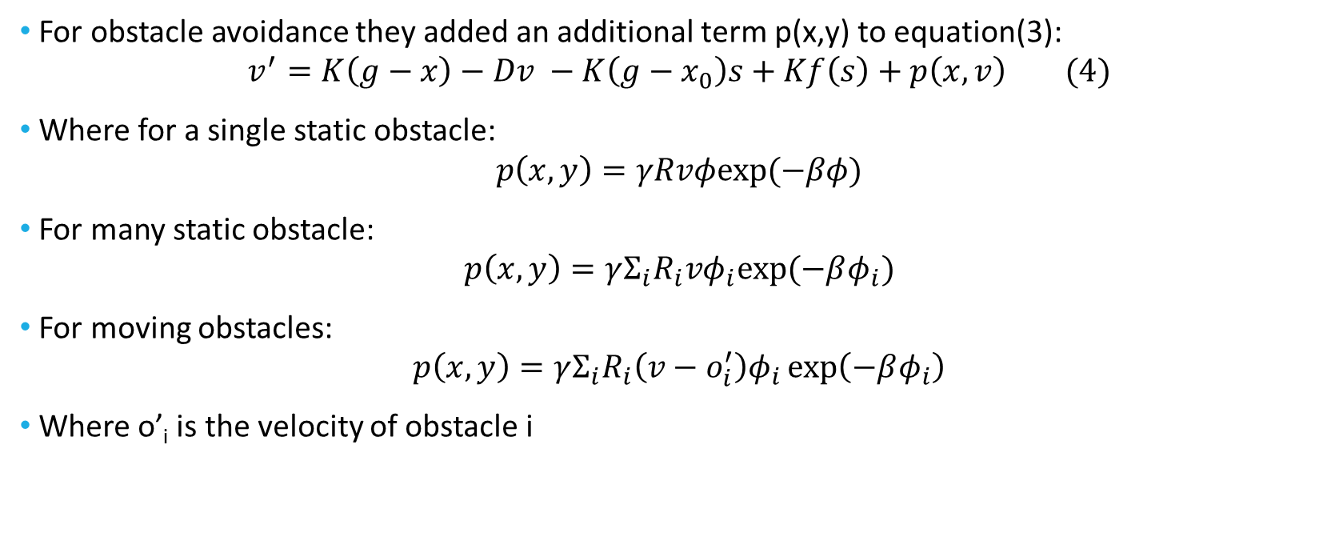
Obstacle Avoidance
For obstacle avoidance they added an additional term p(x,y) to equation(3):
$$v^{′}=K\left(g−x\right)−Dv −K\left(g−x_{0}\right)s+Kf\left(s\right)+p\left(x,v\right) (4)$$
Where for a single static obstacle:
$$p\left(x,y\right)=γRvφexp⁡(−βφ)$$
For many static obstacle:
$$p\left(x,y\right)=γΣ_{i}R_{i}vφ_{i}exp⁡(−βφ_{i})$$
For moving obstacles:
$$p\left(x,y\right)=γΣ_{i}R_{i}\left(v−o_{i}^{′}\right)φ_{i}\exp\left(−βφ_{i}\right)$$
Where o’_{i} is the velocity of obstacle i

