Slide 1
Computer Vision Midterm:
Human Detection Using Thermal Camera
Mohammadali Varfan

Slide 2
Human Detection Using Thermal Camera
- Introduction + pictures
- data flow diagram
- hog
- classifier
- non maximum

Slide 3
introduction
We need human detection in different applications:
- Pedestrian detection in normal and autonomous car
- Surveillance
- Human robot interaction
- Search and rescue

Slide 4
introduction
For these applications Thermal cameras have advantages over RGB cameras:
- Thermal cameras can work much better in low or no light conditions
- We have too much information in RGB cameras that can make the task harder for human detection such as clothes with different colors
- Thermal cameras can show heat sources therefore it is easier to detect humans from objects or printed pictures which is important in human robot interaction because maybe we have many pictures and posters of human in the environment

Slide 5
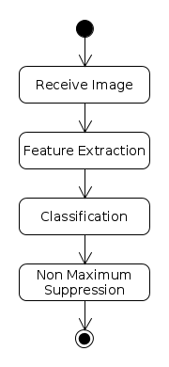

Slide 6
Receive Image
- For this project I will use a Flir A325 thermal camera
- The camera is installed on the ceiling
- Each frame of the video of the camera will be an image that I will run the algorithm on it

Slide 7
Feature Extraction
For doing the classification we need to extract the useful information and forget the irrelevant information
For human detection the cloth color can be considered as an irrelevant information but the head and limbs are the most important information
I use the HOG(Histogram of Oriented Gradient) for feature extraction

Slide 8
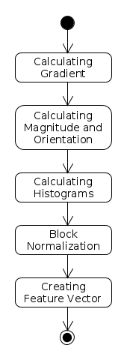

Slide 9
HOG
HOG proposed in [1] and it is as below:
- First horizontal and vertical gradients will be calculated this can be done by implementing horizontal and vertical Sobel filter
- Then we calculate the magnitude and direction of gradient. Gradients fires vertical and horizontal lines and the magnitude fires where there is a sharp change in intensity
- Dividing the picture into cells and calculating the histogram. An 8*8 cell information can be saved into 9
- 16*16 block normalization. Gradients of an image are sensitive to overall lighting and we do this because of that
- By concatenating the normalized histograms we will create the feature vector

Slide 10
HOG pictures
- original picture
- Sobel picture
- magnitude and orientation(visualized one) picture

Slide 11
Classification
- This is a binary classification task
- In most papers they used SVM classifier and I will do the same
- The data for training comes from datasets …. and I will also create my own data set by labeling them

Slide 12
Non maximum suppression
- For testing the system we will slide a fix sized window over the picture and the classifier will decide if there is a human inside the window and because of this it may detects many bounding boxes around one human
- For solving this I will use non maximum suppression to merge all the bounding boxes to one
- That bounding box is our final result

