Slide 1
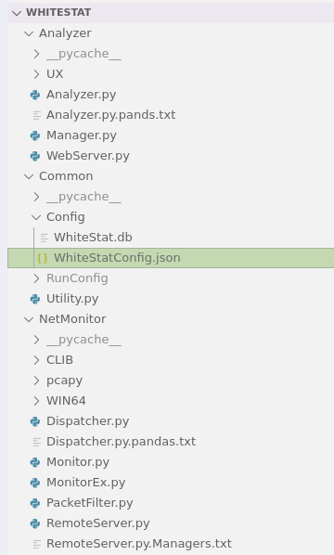
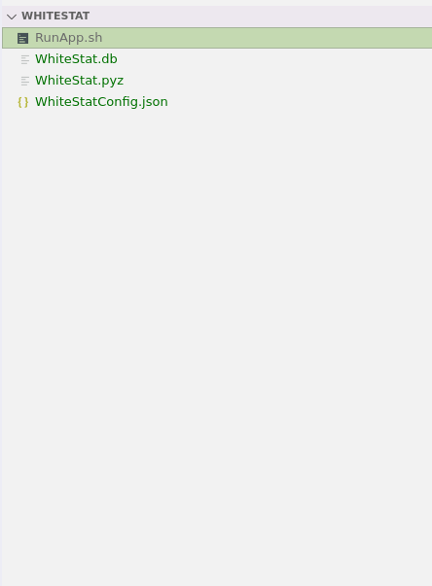
Your Old Python
Deployment
Directory
Your New Python
Deployment
Directory

Slide 2
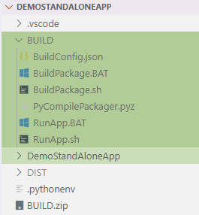
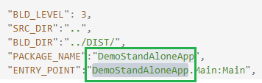
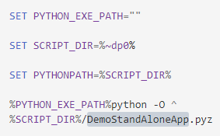

Slide 3
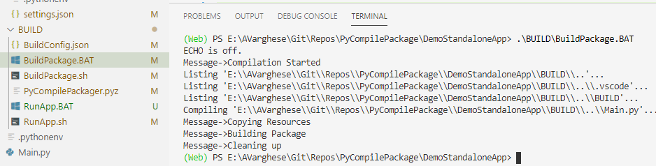


Slide 4
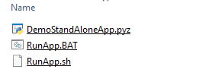
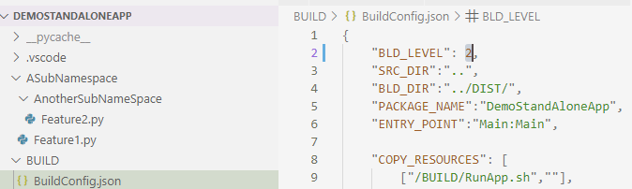

Slide 6
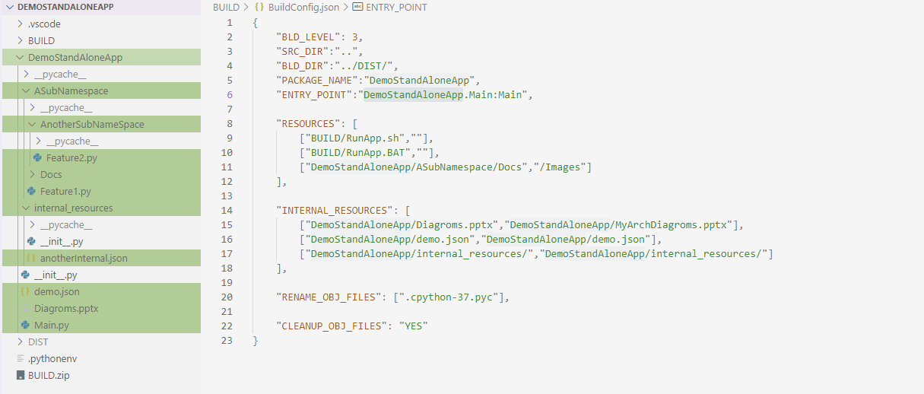
Compile till Feature2.py, i.e.
All Three levels down from Source Directory
Entry Point. i.e Main() in Main.py (Package DemoStandAloneApp)
Copy ‘RunApp.sh’ to BLD_DIR
Copy entire ‘Docs’ to a different BUILD folder
Copy and rename a Single ‘pptx’ File
These are internal resources
Kept only inside the Program
PYZ Archive file
Will rename
File.cpython-37.pyc to File.pyc
For Debugging Purpose.
NO, Will retain the temporary OBJ folder
after build for inspection

