Slide 1
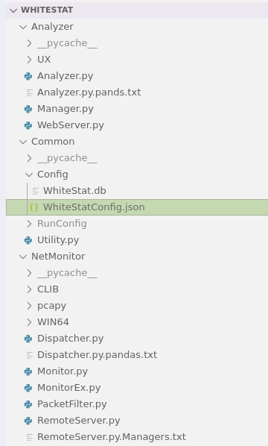
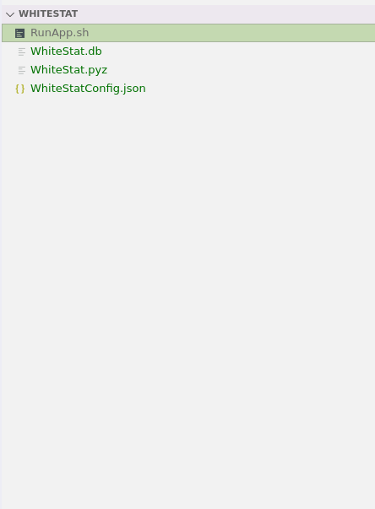
Your Old Python
Deployment
Directory
Your New Python
Deployment
Directory

