Slide 1

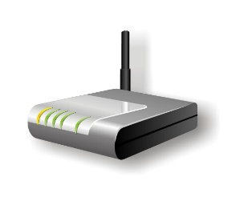


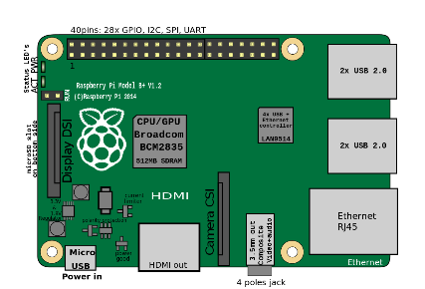



Internet
Router IP: 192.168.1.1/24
Serves DHCP To All Devices
DNS: Raspberry IP
Default GW: Raspberry IP
Route All Internet Traffic
Back To Router IP,
Through IP Forward & SNAT Rules
Raspberry IP: 192.168.1.5
Serves:
DNS, Default GW

Slide 2

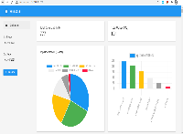



Internet
Router
W: Monitor + Analyzer Role

Slide 3



Internet
Router IP
Packet Capture Info
W: Monitor Role
W: Analyzer Role

Slide 4










Development Environment
VS Code (Modern C++17)
CMAKE
GCC 9 (X64)
Python 3
Source Code in Host (Shared with Bind Mounts)
ARM V7
RaspberryPI 2B+
(Compile/Build)
[GCC armv7]
ARM V8
RaspberryPI 4
(Compile/Build)
[GCC armv8]
Docker Platform (X64)
Qemu User Space Emulator (ARMV7/V8)
Ubuntu 20.04 (Core i5) – Development Box

Slide 5
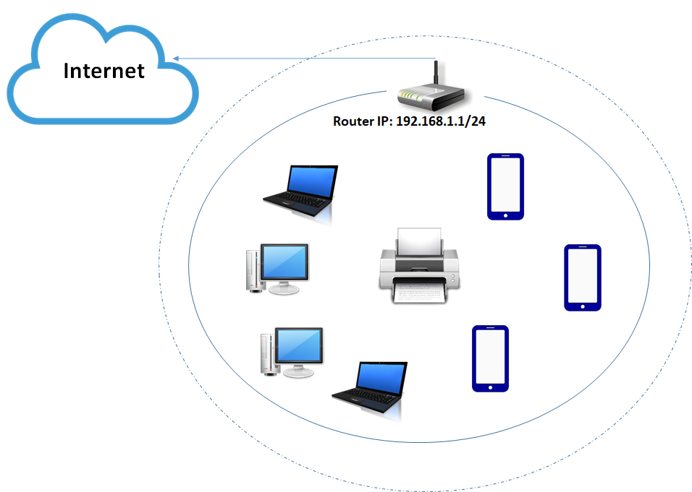
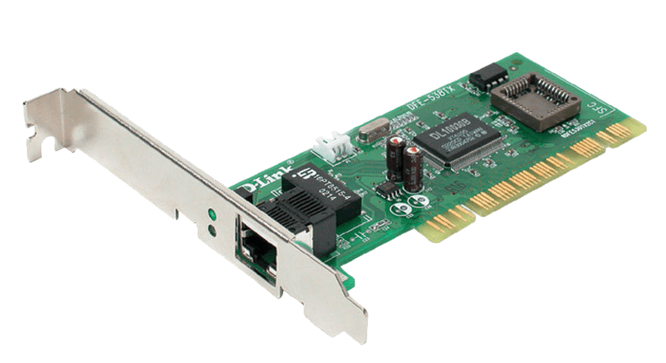




Pi Environment
Host Networking (with Privilaged Mode)
Network Interface Cards Captures (libPcap library)
WhiteStat
MONITOR MODE
WhiteStat
ANALYZER MODE
Bind Mounts
Configurations, Historic Data, Database (sqlite)
Docker Platform
Raspberry Pi 2B+ Debian 10 (Buster)
Default Gateway Device

Slide 6
Internet
Router IP: 192.168.1.1/24

