Slide 1

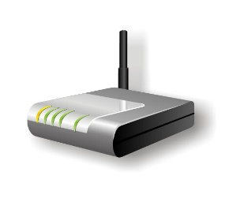


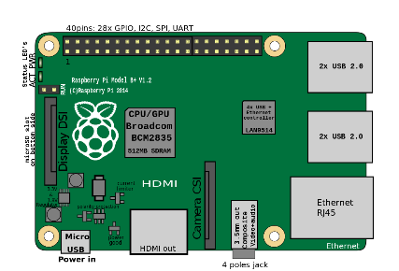



Internet
Router IP: 192.168.1.1/24
Serves DHCP To All Devices
DNS: Raspberry IP
Default GW: Raspberry IP
Route All Internet Traffic
Back To Router IP,
Through IP Forward & SNAT Rules
Raspberry IP: 192.168.1.5
Serves:
DNS, Default GW

Slide 2

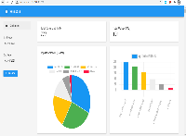



Internet
Router
W: Monitor + Analyzer Role

Slide 3



Internet
Router IP
Packet Capture Info
W: Monitor Role
W: Analyzer Role

