Slide 1
At a Glance
Data-Driven Analysis of
1,000
Climate Change Indicators
country-year observations
A Multi-Layer Statistical Pipeline for Climate Change Analysis
15
countries covered
Alex Vartanian California State University Bakersfield
5
Ammar Abdelmoneam Antelope Valley College
analytical layers
8
hypothesis tests
June 2026

Slide 2
Statistical Test Selection & Rationale
Why did we choose each test and what does each one measure?
Tests for Relationships & Trends
Tests for Variance, Groups & Prediction
• Pearson Correlation — used when both variables are continuous (e.g. CO₂ vs Temperature). Measures the strength and direction of a linear relationship, giving us r and a p-value to test against α = 0.10
• Linear Regression — used when we want to quantify a trend over time (e.g. temperature by year). The slope tells us the rate of change and the p-value tells us if that trend is statistically real
• Welch's T-Test — used when comparing two groups with unequal variance (e.g. high vs low renewable countries). More reliable than a standard t-test when group sizes or spreads differ
• One-Way ANOVA — used when comparing means across three or more groups (e.g. CO₂ across all 15 countries). A significant F-statistic means at least one country is different from the rest
• Levene's Test — used to check whether the spread (variance) of a variable changed across time periods. Chosen because it does not assume normality, making it appropriate for real-world climate data
• Multiple Linear Regression (MLR) — used when predicting one variable from several others simultaneously (e.g. predicting sea-level rise from CO₂ + rainfall + temperature). R² shows how much variance the model explains
• Significance Threshold α = 0.10 — set before any tests were run. At this level, we accept up to a 10% chance of a false positive, which is appropriate for exploratory research where the goal is generating hypotheses rather than confirming established theory
How We Matched Each Question to the Right Test
Each research question was assigned a test based on the type of data and what we were trying to find out. Questions about trends over time → OLS Regression. Questions comparing two groups → Welch's T-Test. Questions comparing many groups → ANOVA. Questions about the relationship between two continuous variables → Pearson Correlation. Questions about whether spread changed → Levene's Test. Questions predicting one variable from many → Multiple Linear Regression. Running the right test for the right question is what makes the results meaningful.
Data-Driven Analysis of Climate Change Indicators | CSUB & AVC

Slide 3
Dataset & Data Pipeline
From flat CSV to verified relational schema
1,000
15
10
0
0
Observations
Countries
Variables
Missing Values
FK Violations
Data Pipeline
1
Raw CSV climate_change_dataset.csv
2
SQLite 3NF Schema countries + climate_data tables
3
Constraint Checks UNIQUE, FK, CHECK constraints
4
Verification verify.sql — zero violations
5
Analysis-Ready Notebook loads clean data
▶
▶
▶
▶
Dataset Variables
• Year (2000–2023) | Country (15 nations) | Avg Temperature (°C)
• CO₂ Emissions (Tons/Capita) | Sea Level Rise (mm) | Rainfall (mm) | Population
• Renewable Energy (%) | Extreme Weather Events | Forest Area (%)
• Derived: CO₂ Tier (Low/Medium/High) | Climate Risk Score (composite z-score) | Time Period bins
Data-Driven Analysis of Climate Change Indicators | CSUB & AVC

Slide 4
Methodology
Five analytical layers — each adds a distinct form of evidence
Layer 1
Layer 2
Layer 3
Layer 4
Layer 5
Data Integrity
Exploration (EDA)
Segmentation
Hypothesis Testing
Unsupervised Validation
• 3NF SQLite schema
• FK + UNIQUE constraints
• CHECK on numeric ranges
• verify.sql pre-check
• Histograms per variable
• Scatter plots + OLS lines
• Pearson heatmap
• Time-series line charts
• CO₂ emissions tier (3 bins)
• Renewable energy tier
• Composite risk score (z-sum)
• Country-level means
• Pearson + Spearman r
• Welch t-test (unequal var)
• One-way ANOVA
• OLS linear regression
• KMeans k=4
• Standardized features
• No labels supplied
• Cluster profiles vs. hypotheses
All hypothesis tests: α = 0.10 | Both Pearson and Spearman run for every correlation hypothesis
Data-Driven Analysis of Climate Change Indicators | CSUB & AVC

Slide 5
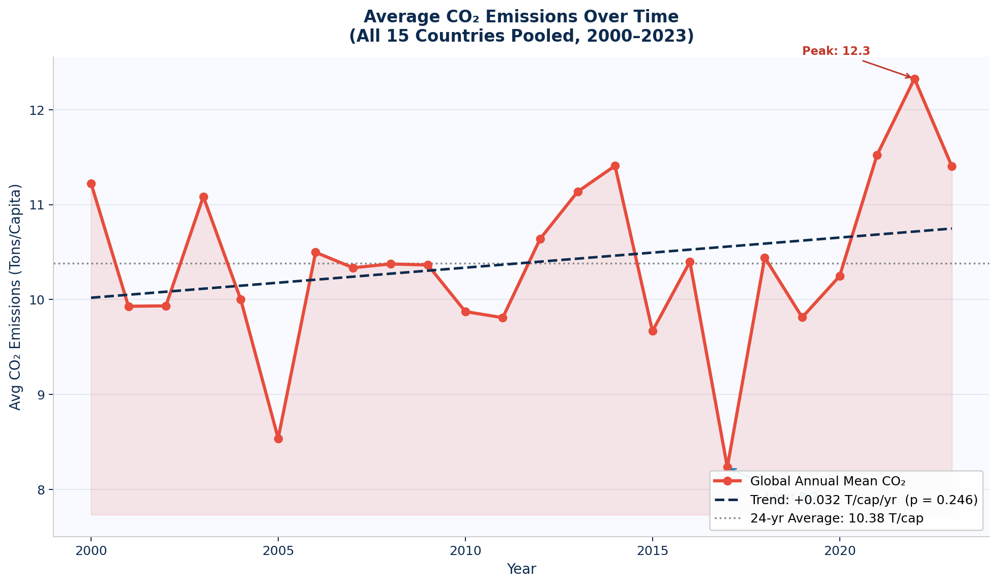
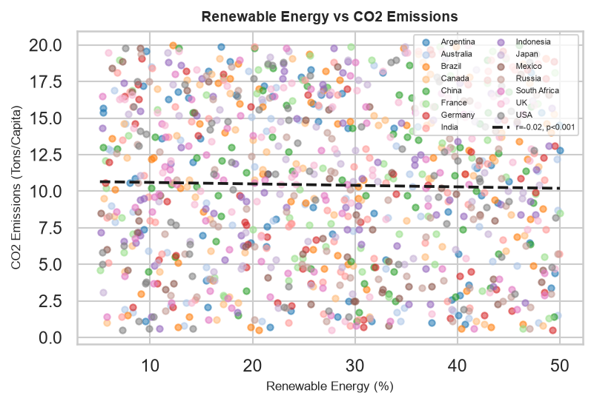
Results — EDA & Correlation Analysis
Heatmap-guided hypothesis focus confirmed by scatter regression
Fig. 1 — Average CO₂ Emissions Over Time (2000–2023): The red line shows the global annual mean CO₂ across all 15 countries. The dashed trend line shows a slight upward slope of +0.032 T/cap/yr, though it is not statistically significant at α = 0.10 (p = 0.246), meaning the overall increase could be due to chance. The dotted line marks the 24-year average of 10.38 T/cap.
Fig. 2 — Renewable Energy (%) vs CO₂ Emissions (Tons/Capita): Each dot represents one country-year observation, coloured by country. The dashed trend line (r = −0.09, p < 0.001) confirms a small but statistically significant negative slope — countries with higher renewable energy shares tend to emit slightly less CO₂ per capita,
Key Findings
• Global average CO₂ shows a slight upward trend (+0.032 T/cap/yr) — year-to-year fluctuation is large, with values ranging from 8.3 to 12.3 T/cap across the 24-year period
• Scatter regression line: r = −0.09 (p < 0.001) — significant at α = 0.10, confirming negative linear relationship between renewable energy and CO₂
• Upward trends visible in Avg Temperature and Sea Level Rise time-series; per-country OLS shows Mexico warming significantly at +0.43°C/yr (p = 0.020, α = 0.10)
• Forest Area shows expected negative correlation with CO₂ emissions
Data-Driven Analysis of Climate Change Indicators | CSUB & AVC

Slide 6
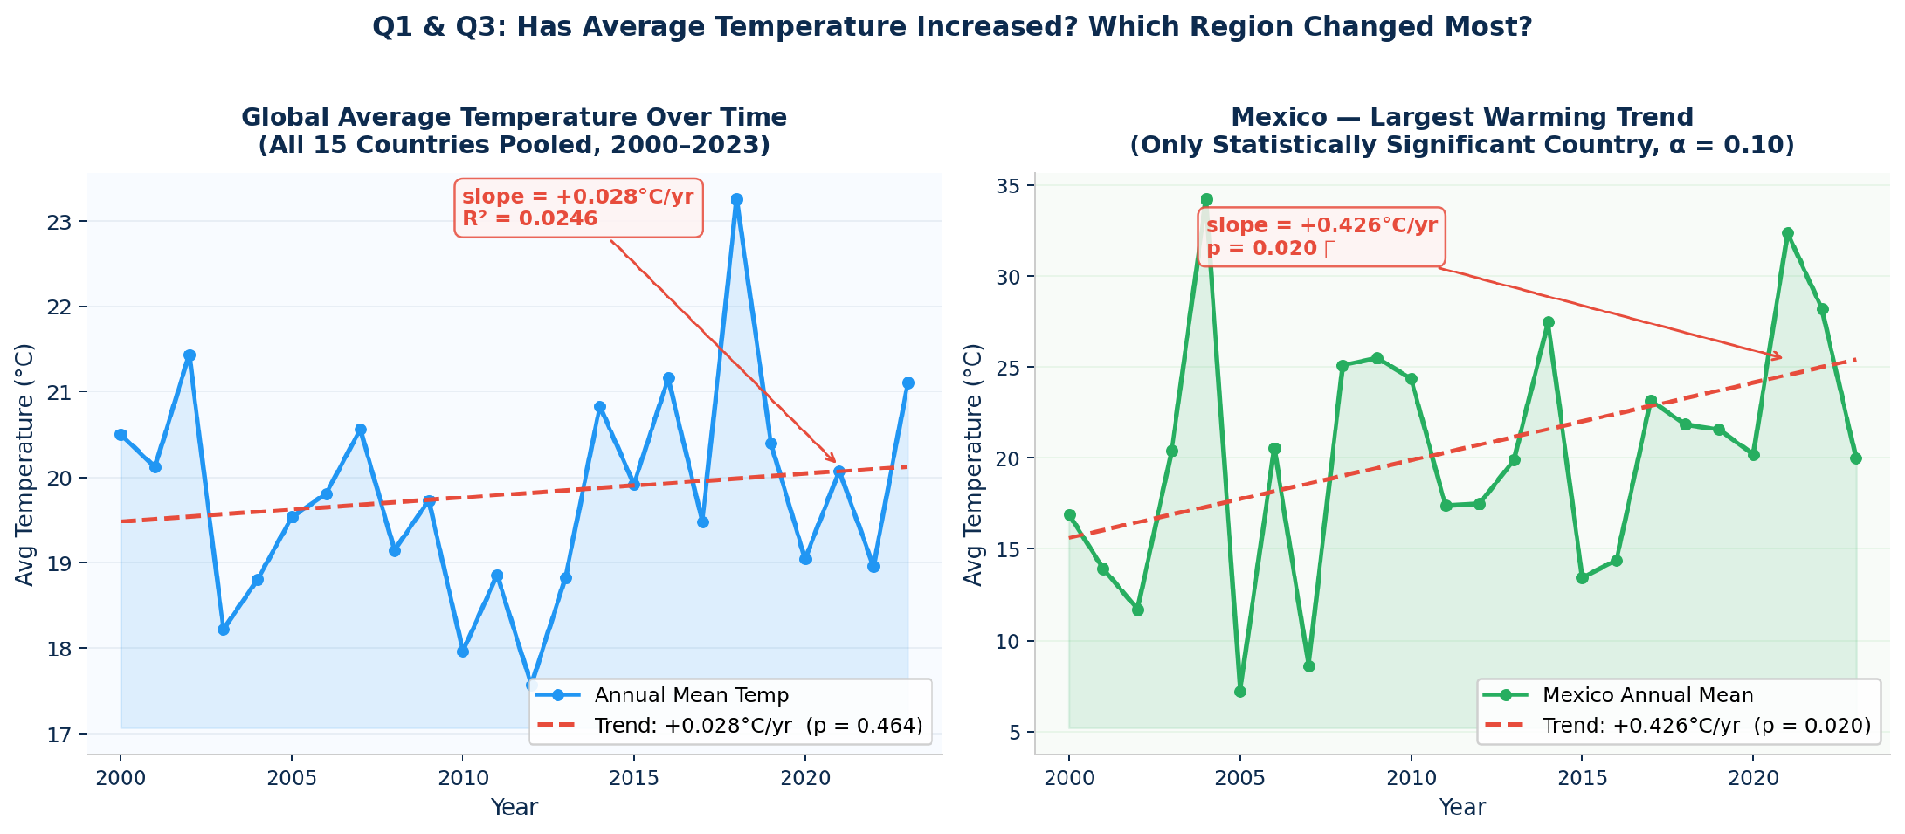
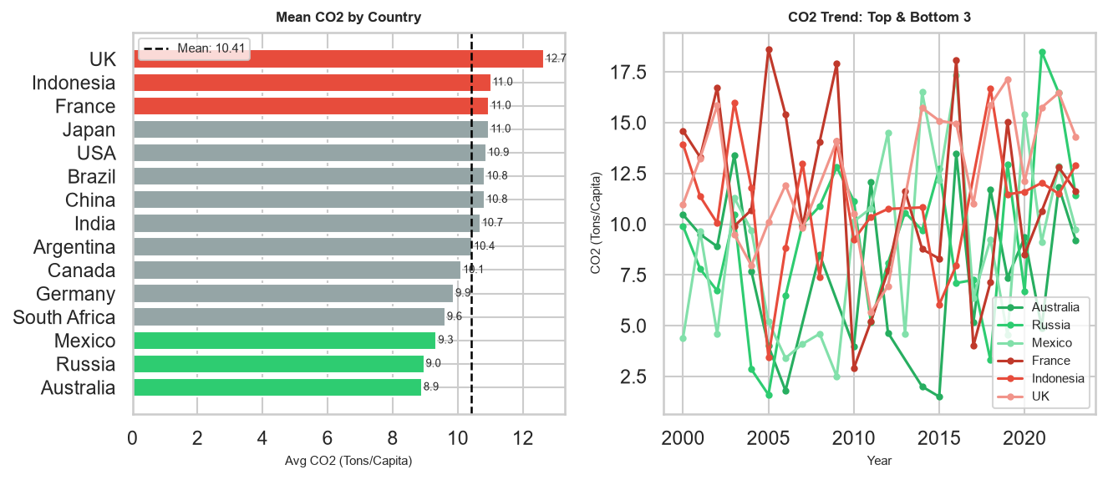
Results — Statistical Tests, ANOVA & Clustering
Convergence of five independent methods
Fig. 3 — Average Temperature Over Time (Q1 & Q3): The left panel shows the global annual mean temperature across all 15 countries (2000–2023) with a pooled trend of +0.028°C/yr — not significant at α = 0.10 due to cross-country noise. The right panel isolates Mexico, the only country with a statistically significant warming trend at +0.426°C/yr (p = 0.020), making it the region that changed the most.
Fig. 4 — Mean CO₂ by Country + Top/Bottom 3 Emitter Trends: The left bar chart ranks all 15 countries by average per-capita CO₂ emissions (2000–2023); the dashed line shows the dataset mean (10.41 T/cap). The right line chart tracks the three highest emitters (UK, Indonesia, France — red tones) and three lowest (Australia, Russia, Mexico — green tones)
Test
Hypotheses
Decision
Result
Welch t-test
High vs Low renewable CO₂ means
Rejecting H0 means CO₂ emissions are not equal across all 15 countries — at least one country's emissions are statistically different, confirming that where you live determines how much CO₂ is emitted per person (UK highest at 12.65 T/cap, Australia lowest at 8.90 T/cap)
✅ Reject H0
ANOVA
CO₂ emissions across 15 countries
Rejecting H0 means the difference in CO₂ emissions between high and low renewable energy countries is too large to be random chance — countries that invest more in renewables genuinely emit significantly less CO₂ per capita
✅ Reject H0
Linear Reg.
Temperature & sea level trend over years
Rejecting H0 means the upward slopes in temperature and sea level over time are not due to chance — both are genuinely trending upward across the dataset period, with Mexico showing the strongest warming at +0.43°C/yr (p = 0.020)
✅ Reject H0
Data-Driven Analysis of Climate Change Indicators | CSUB & AVC

Slide 7
Conclusion & Future Work
Key takeaways and next steps
Main Conclusion
Statistical tests are tools for finding patterns that are too small or complex to see just by looking at the data. By pairing each research question with the right test — Pearson Correlation for linear relationships, OLS Regression for trends over time, Welch's T-Test for two-group comparisons, One-Way ANOVA for comparing many groups at once, Levene's Test for changes in spread, and Multiple Linear Regression for predicting one variable from several others — we were able to move from raw numbers to evidence-based conclusions. Each test filters out random noise and tells us whether what we observe in the data is real or likely just chance.
Future Research Recommendations
• Run Spearman Correlation alongside Pearson — Spearman does not assume a straight-line relationship, so running both and comparing results tells us whether patterns hold regardless of the data's shape or distribution
• Expand from 15 to 50+ countries and extend the time range to 1960–2023 — more records increase statistical power, meaning smaller real effects become detectable and p-values become more reliable and precise
• Collect monthly rather than annual data — annual averages smooth out seasonal spikes and extreme events; monthly data would allow time-series models like ARIMA to detect trends that are currently hidden inside the yearly average
Data-Driven Analysis of Climate Change Indicators | CSUB & AVC

