Slide 1
Digital Portfolio
STUDENT NAME:VASANTHAKUMAR .A
REGISTER NO AND NMID:212405388/031A91220104A9AB9D84F77E3F4DDAB3
DEPARTMENT: BCA
COLLEGE: Apollo Arts And Science College Chennai /
MADRAS UNIVERSITY

Slide 2
PROJECT TITLE
PERSONAL PORTFOLIO WEBSITE USING FRONT-END DEVELOPMENT

Slide 3


AGENDA
Problem Statement
Project Overview
End Users
Tools and Technologies
Portfolio design and Layout
Features and Functionality
Results and Screenshots
Conclusion
Github Link
3/21/2024 Annual Review

Slide 4

PROBLEM STATEMENT
Many developers struggle to present coding projects effectively.
Static resumes fail to show practical programming applications.
Solution: A digital portfolio website highlighting coding projects in Python, C++ & Web Development.

Slide 5

PROJECT OVERVIEW
This portfolio website:
Introduces myself with background & skills.
Highlights three main projects.
Provides contact form for interaction.
Reflects both design & programming strength.

Slide 6

WHO ARE THE END USERS?
Recruiters - to know both technical & soft skills.
Faculty & Peers - for academic presentation.
General Audience - to connect & know my interests.

Slide 7

TOOLS AND TECHNIQUES
HTML, CSS, JavaScript - for Layout & interactivity.
Responsive Web Design - for accessibility.
Creative Typography & Icons - to make it engaging.
CodePen/GitHub - for hosting.

Slide 8
PORTFOLIO DESIGN AND LAYOUT
About Me - short intro with specialization (Python, C++, Web Dev).
Projects Section:
Portfolio Website
Python Student App
C++ Mini Project
Skills Section - Python, C++, Web Development, Problem Solving, Database Basics.
Contact Form - simple and functional.
8

Slide 9
FEATURES AND FUNCTIONALITY
Fully responsive website Layout.
Skills showcased in both technical & problem-solving domains.
Projects demonstrate real coding applications.
Contact form for communication.
Clear and user-friendly navigation.

Slide 10
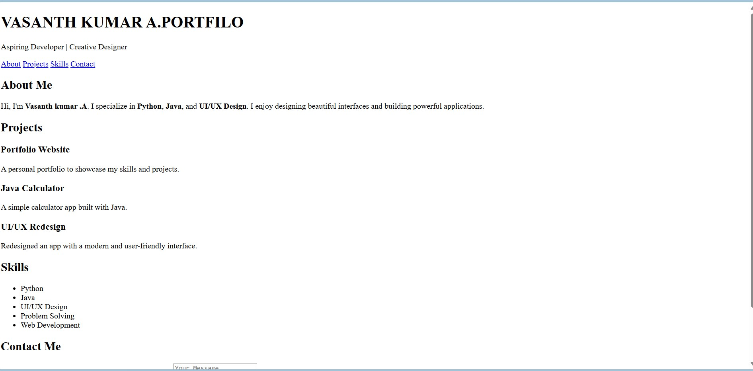
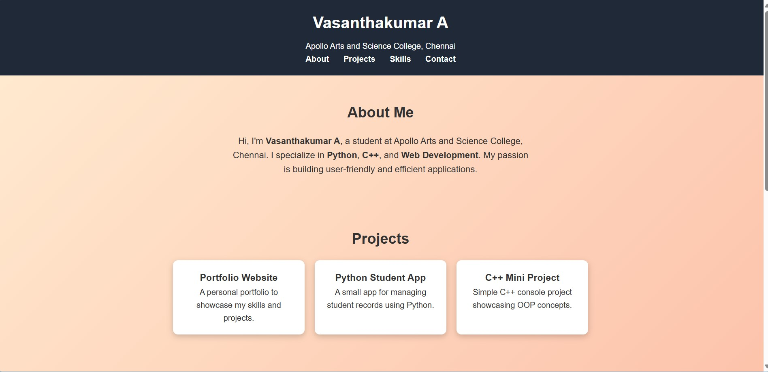
RESULTS AND SCREENSHOTS
BEFORE ADDING CSS : AFTER ADDING CSS:
3/21/2024 Annual Review
10

Slide 11
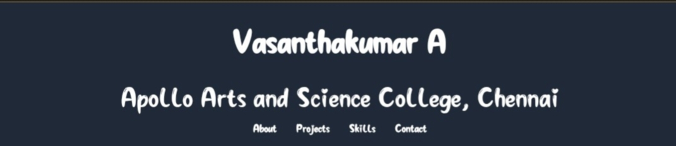
HOME SECTION:

Slide 12
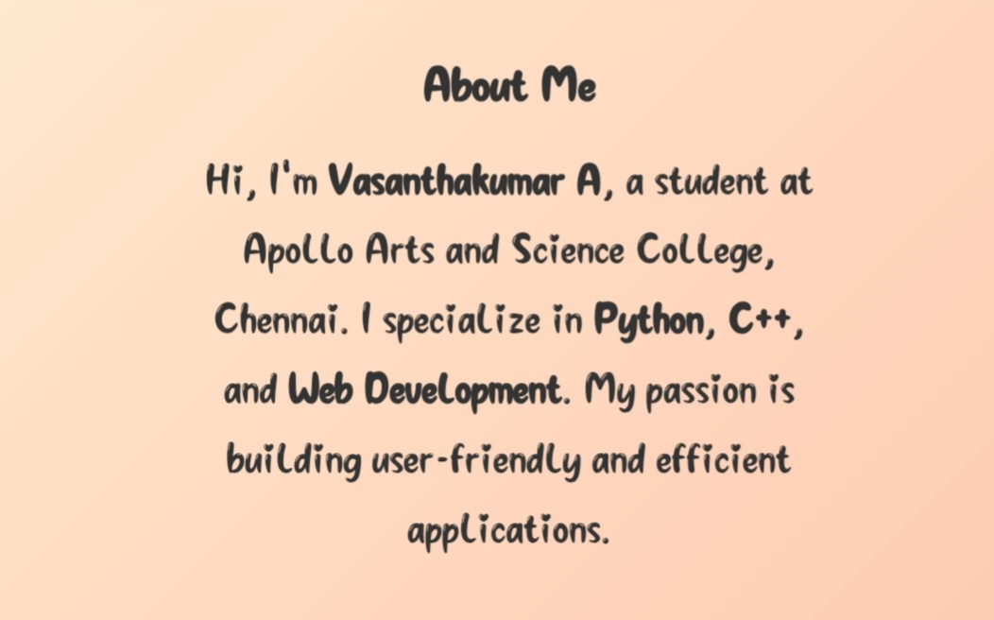
ABOUT SECTION

Slide 13
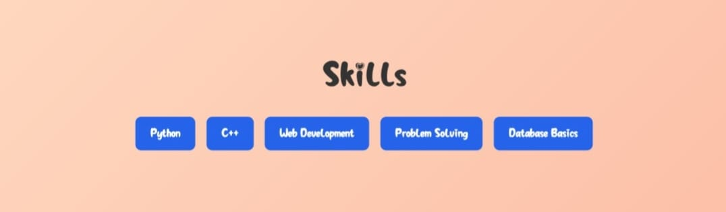
SKILL SECTION:

Slide 14
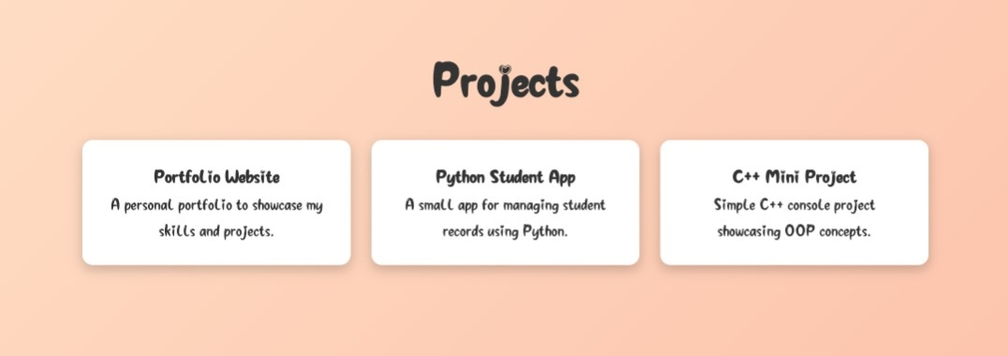
PROJECT SECTION:

Slide 15
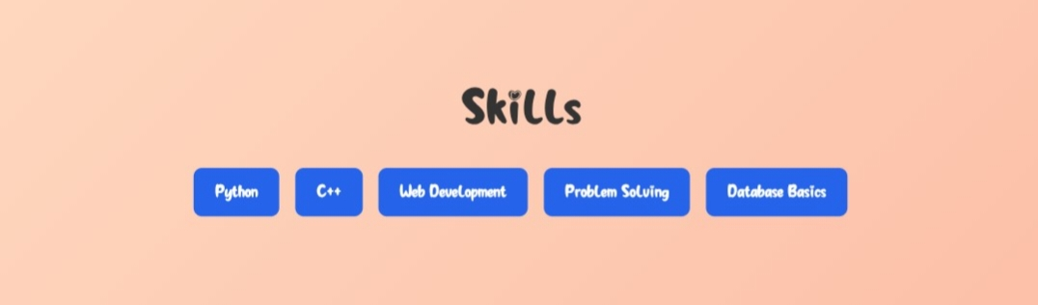
SKILL SECTION:

Slide 16
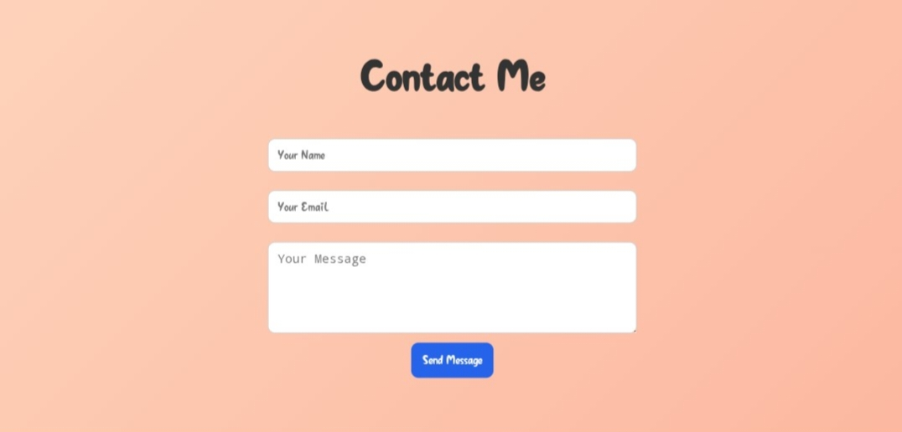
CONTACT SECTION:

Slide 17
CONCLUSION
Designed a portfolio emphasizing Python, C++ & Web DeveLopment.
Combines academic learning with practical project building.
Future scope: Add advanced apps, certifications, and live project demos.
17

Slide 18
GITHUB LINK:
https://avasabca24aascc-dev.github.io/TNSDC-FWD-Digitalportfolio/

