Slide 1
WebBoard: An Online Interactive Tutoring System
Group Name: RSA
Group Members:
Ravinsingh Jain
Ashwin Vasani
Sagar Kalburgi

Slide 2
Group project Description
Idea is to create interactive online tutoring system to over some problems in the current system.
We present an innovative approach to solve the current problem using WebBoard (Online White Board) and light weight plug-in free video facility.
Webboard will provide interactive interface for both instructors and students to use.
Aim to add new features like scribbling on slides, interactive but broadcast conversation in the class.
Recording of the lecture notes and save them on cloud.

Slide 3
Task Distribution
We have divided our task list as below:
  Task 1: Study WebRTC, Own Cloud, and Node.js (1 Week)
  Task 2: Implement server module (1 Week)
  Task 3: WebRTC Module (1 Week)
  Task 4: Instructor GUI (1.5 Week)
  Task 5: Student GUI (1.5 Week)
  Task 6: Create Test Cases. (1.5 Week)
  Task 7: Integration of modules (1 Week)
  Task 8: Test the application (1 Week)
  Task 9: Fixing Bugs (1 Week)
All tasks are divided such that everyone gets equal load
Task Allocation for Ravin: 33.33%
Task Allocation for Ashwin: 33.33%
Task Allocation for Sagar: 33.33%
Detail allocation is given in the slide #7

Slide 4
Technical Details
Software used :-
  Tools: Eclipse or Sublime Text, Emacs, Git
  APIs: OwnCloud, WebRTC, Node.js
  Language: JavaScript, PHP, HTML & CSS.
  We will also be using the ASU cloud infrastructure.

Slide 5
Technical Details
Project Setup:
Node.js based cloud server for recording and Streaming videos
Web or Android Application for instructor
Web or Android Application for student
WebRTC Link

Slide 6
Technical Details
Roadmaps (Milestones) (1/2)
-- Task List:
  Task 1: Study WebRTC, Own Cloud, and Node.js (1 Week)
  Task 2: Implement server module (1 Week)
  Task 3: WebRTC Module (1 Week)
  Task 4: Instructor GUI (1.5 Week)
  Task 5: Student GUI (1.5 Week)
  Task 6: Create Test Cases. (1.5 Week)
  Task 7: Integration of modules (1 Week)
  Task 8: Test the application (1 Week)
  Task 9: Fixing Bugs (1 Week)

Slide 7
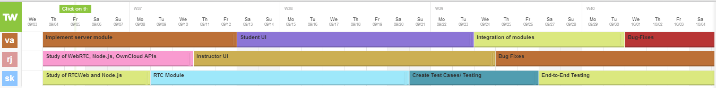
Technical Details
Roadmaps (Milestones) (2/2)
-- Task Allocation
VA: Vasani Ashwin, RJ: Ravinsingh Jain SK: Sagar Kalburgi

Slide 8
Technical Details
Using WebRTC framework for developing lightweight plugin free.
Choosing node.js on the server side to make it highly scalable and faster.
mongoDB for highly scalable database.
Bootstrap for interactive design.

Slide 9
Technical Details
Cloud server will be used for user authorization and saving the video.
The video link between the instructor and the students will be managed by WebRTC
Currently we are planning to support 1-to-many model i.e. one video shared with many

Slide 10
Risks and Benefits
Novel aspects of this project:
  Reduces communication gap between instructor and students.
  Eliminates duplication of efforts for instructor and students.
  Virtual classrooms appear more real.
  Provides a better alternative to hybrid online classes.
  In addition to the video lectures, the notes written on the Webboard by the instructor can be stored on the cloud.

Slide 11
(Continued..)
Risks:
  Might face bandwidth problem
  WebRTC is still in heavy development phase
  Scalabilities issues.
  Not taking care of security part in the project due to time constrain.

Slide 12
Tasks Accomplished by Now
Studied WebRTC, Cloud, and Node.js
WebRTC module implementation on local host
Started discussing the designs of individual modules.

Slide 13
Conclusion
The project aims to better the online learning experience.
Enables better synchronization among the instructor and students.
WebBoard feature will make the online classes more interactive like actually sitting in a class.

Slide 14
Future Scope
The project can be further enhanced by adding real time subtitles for visual impaired students.
A real time language translator can also be incorporated.

Slide 15
Thank You ☺

