Slide 1
WebBoard: An Online Interactive Tutoring System
Group Name: RSA
Group Members:
Ravinsingh Jain
Ashwin Vasani
Sagar Kalburgi

Slide 2
Group project Description
Idea is to create interactive online tutoring system to overcome challenges in the current(present) system.
We present an innovative approach to solve the current problem using WebBoard (Online White Board) and light- weight, state of the art plug-in free video facility.
Aim to add a new features like annotating on slides, interactive broadcast conversation in the class and desktop sharing.
Recording of the lecture notes and save them on cloud for future reference.

Slide 3
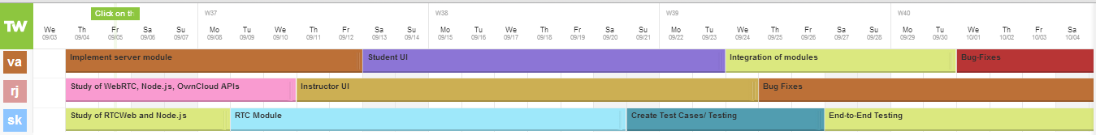
Roadmap
-- Task Allocation
VA: Vasani Ashwin, RJ: Ravinsingh Jain SK: Sagar Kalburgi

Slide 4
Task List/Features
  Task 1: Study WebRTC, Vlab and Node.js
  Task 2: Implement server module
  Task 3: RTC Module
  Task 4: Instructor GUI
  Task 5: Student GUI
  Task6: Virtual machine sharing.
  Task 7: User session management
  Task 8: Allowing only PDF files for uploading.
  Task 6: Create Test Cases
  Task 7: Integration of modules
  Task 8: Test the application.
  Task 9: Fixing Bugs

Slide 5
Investigations
WebRTC APIs- video/audio
ICE, STUN &TURN server- for remote stream management
Node.js – for hosting server
Communication architecture- one-to-one, one-to-many, many-to-many, broadcast
Bootstrap- for UI design
MongoDB- for database

Slide 6
WebRTC?*
Web Real-Time Communication provides plugin free peer to peer framework for video calling and data transfer.
Internal components: getUserMedia, RTCPeerConnection and RTCDataChannels.
Works on top of NAT and Firewall using STUN and TURN.
Works on - Chrome, Firefox, Opera and Android Chrome.
Dynamic source stream support- pre recorded videos, desktop screen sharing and camera/microphone stream.

Slide 7
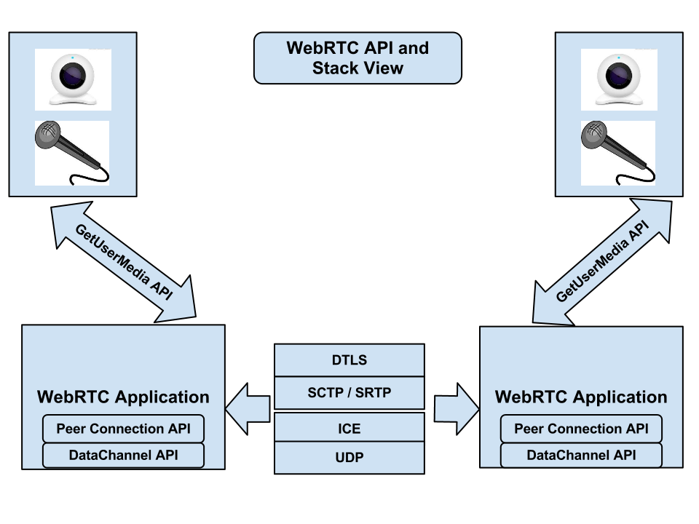
WebRTC APIs*
Reference link on Slide# 20

Slide 8
WebBoard Architecture
Nodejs based cloud server for recording and streaming videos, presentations and virtual machines
Web Application for instructor
Web Application for student
WebRTC Link

Slide 9
One-to-One*
PeerA
OutStreamofA
PeerB
InStreamofA
1- input stream and 1- output stream for each peer

Slide 10
Many-to-Many*
PeerA
OutStreamofA
PeerB
InStreamofA
InStreamofA
InStreamofB
PeerC
OutStreamofB
OutStreamofA
2-input stream and 2-output stream for each peer

Slide 11
One-to-Many (our solution)*
PeerA
OutStreamofA
PeerB
InStreamofA
InStreamofA
PeerC
Peer A: 2 input streams and 2- output stream
Peer B & C: 1- input and 1-output streams each
OutStreamofA

Slide 12
Technical Details*
Bootstrap for interactive design.
Heroku cloud application platform, because of its adaptability.
MongoDB for highly scalable database.
node.js server on scalable cloud is used for authorization and saving the video and lecture notes.
Currently we upload a PDF, convert it into an image and display it in canvas as a slideshow.

Slide 13
Technical Details(Virtual classroom)*
Using meeting.js for one-to-many WebRTC implementation.
Using firebase.js for WebRTC signaling
Using HTML5 canvas and sections for encapsulating videos elements.
Currently using only single classroom but can be scaled to multiple classrooms.
Supporting event based dynamic stream addition and removal.

Slide 14
Technical Details(WebBoard)*
Implemented the WebBoard considering minimum bandwidth usage.
Using piggybacking to send all data in a single stroke.
APIs are designed for HTML5 canvas
Present implementation supports one-way interactive screen, but we have APIs have been provided to support both the modes.
Canvas drawings can be recorded in the form of videos.

Slide 15
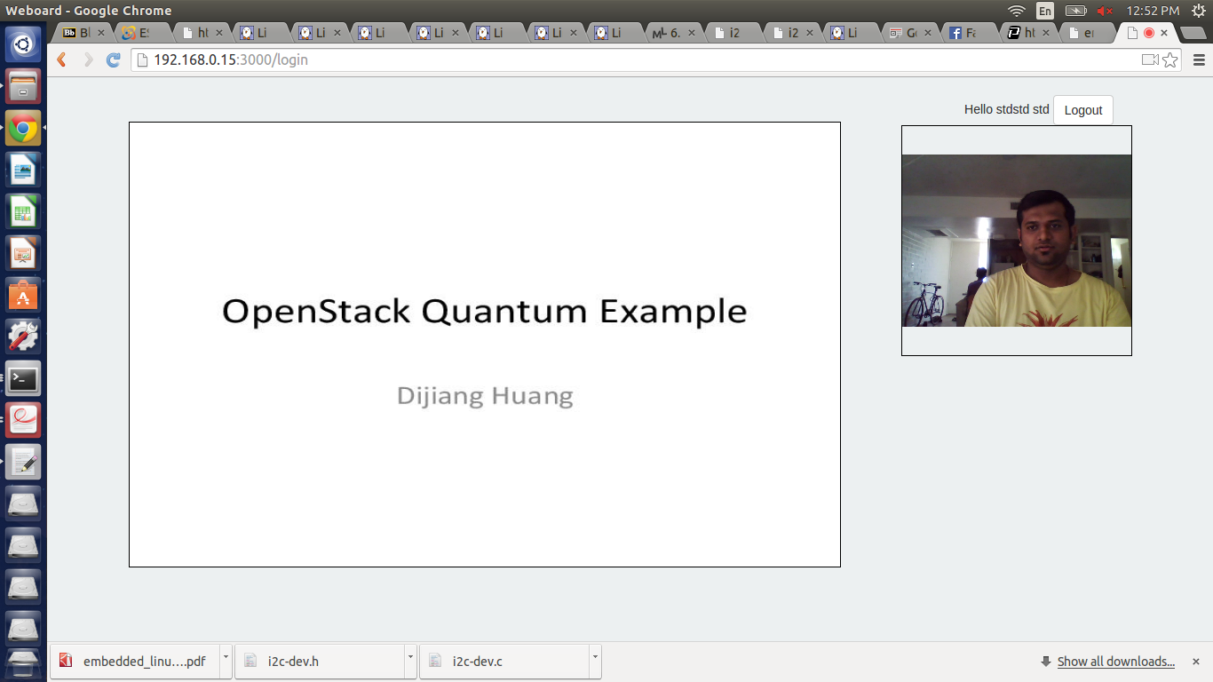
Demo(1/6)*
Student Screen

Slide 16
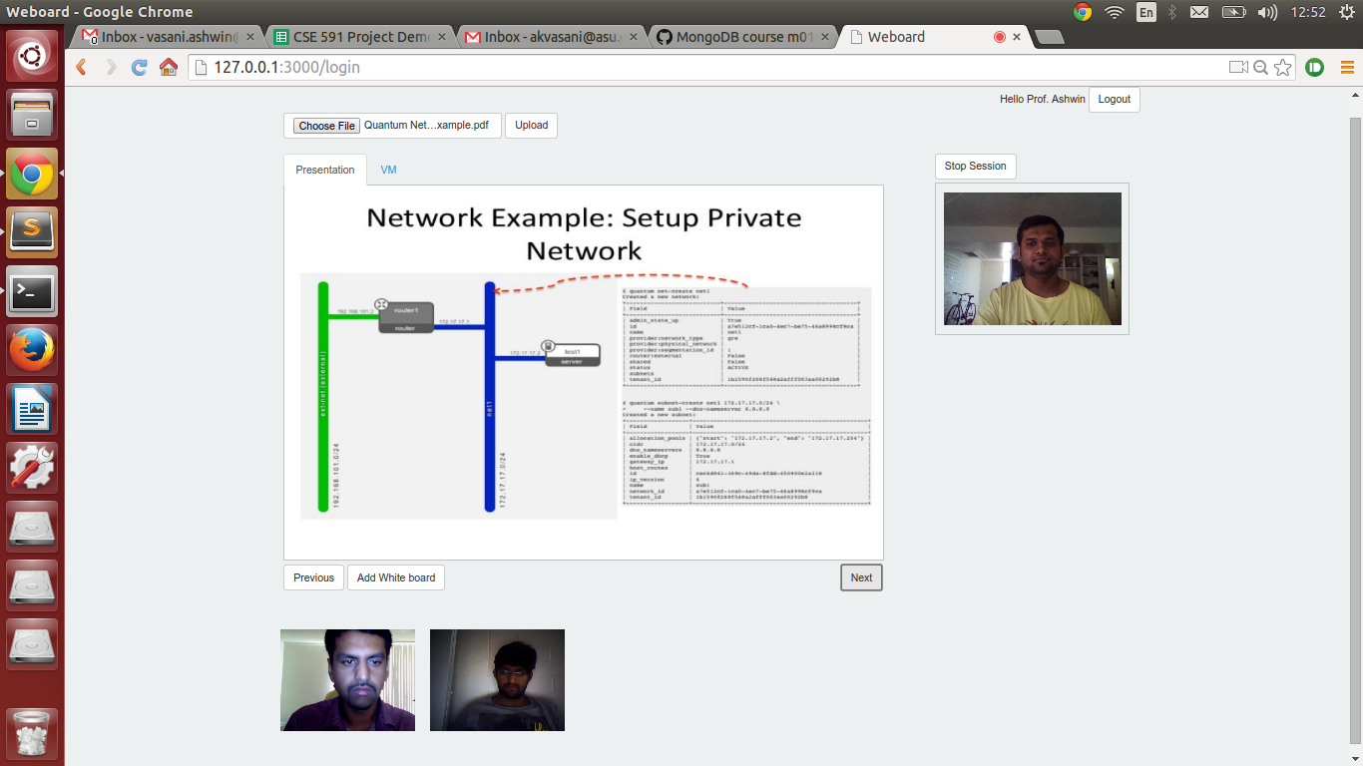
Demo(2/6)*
Interactive Class

Slide 17
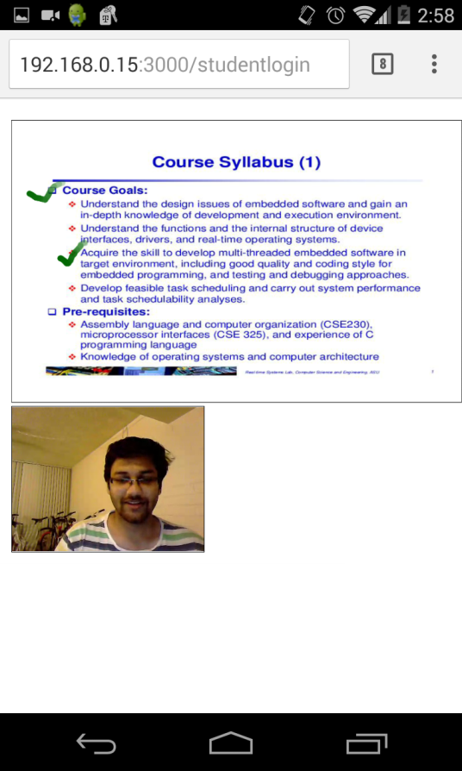
Demo(3/6)*
Application demo on Android Chrome Brower

Slide 18
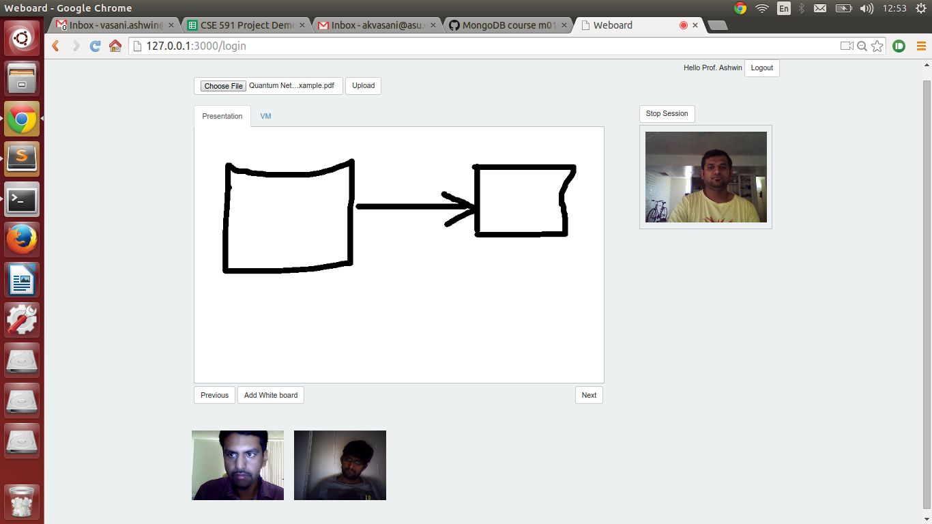
Demo(4/6)*
White Board feature

Slide 19
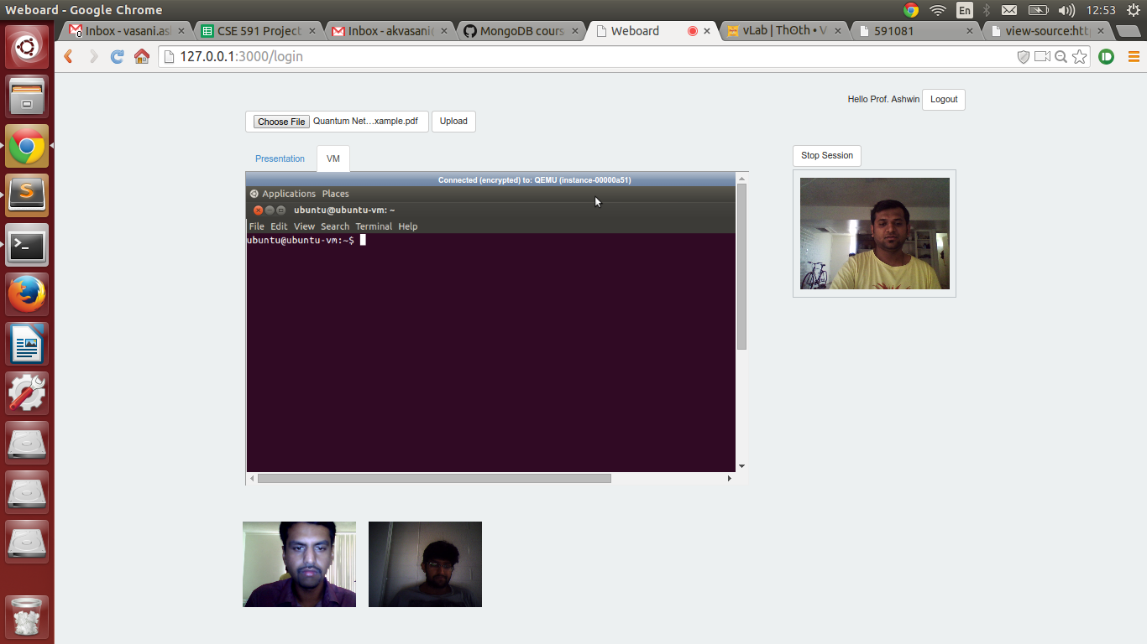
Demo(5/6)*
Sharing Virtual Machine

Slide 20
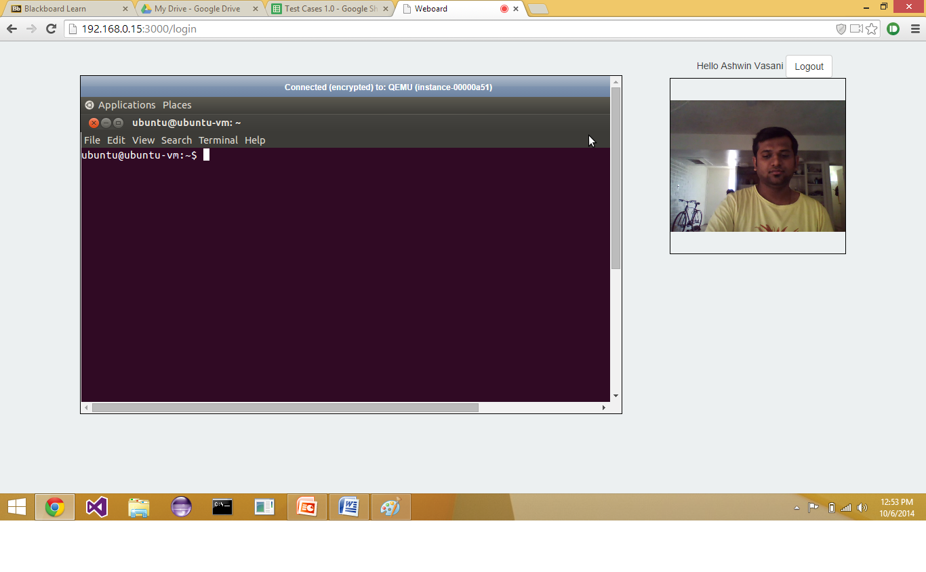
Demo(6/6)*
Virtual Machine shared to student

Slide 21
Risks and Benefits
Novel aspects of this project:
  Reduces communication gap between instructor and students.
  Eliminates duplication of efforts for instructor and students.
  Virtual classrooms appear more realistic.
  Provides a better alternative to hybrid online classes.
  In addition to the video lectures, the notes written on the WebBoard by the instructor can be stored on the cloud.

Slide 22
(Continued..)
Risks:
  Might face bandwidth problem
  WebRTC is still in heavy development phase
  Scalabilities issues.
  Not taking the security part in the project due to time constrain.
  Session maintenance might be a risk.
  Using third party Google stun server.
  Browser compatibilities(Does not work with old browser versions).

Slide 23
Tasks accomplished
Studied WebRTC, Cloud, and Node.js
Implemented WebRTC server module.
Started discussing the designs of individual modules.
Implemented GUI for student and instructor.
Tested the video streaming between instructor and student.
Tested annotation on slides and its live streaming at the student side.
User Registration completed: user can register either as instructor or as student.

Slide 24
(Continued…)
Password security: passwords are hashed before getting stored in database
User authentication done: A user cannot access home page without logging in.
Session maintenance: If a user opens a new tab while being logged in to WebBoard system, she will be redirected to her home page.
Restrict to PDF files: WebBoard system allows the instructor to upload only PDF files.

Slide 25
(Continued…)
White Board: Using this feature, instructor can add virtual white board between any pair of slides, where she can make notes.
Virtual machine: Instructor can share her virtual machine screen with the students, for e.g. in case of live demonstration.

Slide 26
Software
Software used:
  Tools: Sublime Text editor, Git
  APIs: WebRTC API, Node.js
  Language: JavaScript, HTML & CSS
  Framework: Bootstrap
  We would also be using the ASU cloud infrastructure vlab.
  Deployment testing server- Heroku cloud application platform.

Slide 27
Conclusion
The project aims to better the online learning experience.
Enables better synchronization among the instructor and students.
WebBoard feature will make the online classes more interactive like actual sitting in a class.

Slide 28
Future Scope
The project can be further enhanced by adding real time subtitles for visually impaired students.
A real time language translator can also be incorporated.
Desktop sharing on cloud using WebRTC .

Slide 29
Commercial applications of WebRTC
Hip Chat
MailChimp
Amazon MayDay
SnapChat
Chromecast
TokBox
VLine

Slide 30
References
http://www.webrtc.org/
http://tools.ietf.org/html/draft-ietf-rtcweb-data-channel-07
https://www.webrtcexample.com/
https://myasucourses.asu.edu
Lezli Kubo, “The Rise of Online Education: Exploring the Phenomenon”
http://nodejs.org/
www.htmlrocks.com
http://www.tmcnet.com/tmc/whitepapers/documents/whitepapers/2013/9187-webrtc-reach-web-with-new-conversation-experience.pdf

Slide 31
Thank You ☺

