Slide 1
WHY AND WHAT IS KUBERNETES OPERATOR
Kubernetes has been very good at managing stateless applications without any custom intervention.
But think of a a database running on several nodes. If a majority of nodes go down, you’ll need to restore the database from a specific point following some steps .
An Operator is basically a Kubernetes Custom Controller managing one or more CRs . Kubernetes introduced CRDs that gives more granular/extensive control over the application.

Slide 2
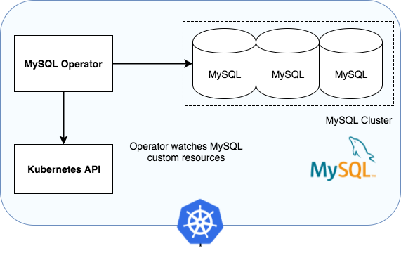
MYSQL KUBERNETES OPERATOR

Slide 3
HOW OPERATOR TAKES CONTROL?
Operator watches over the Object of kind ‘Cluster’ and reads from the parameters to create, scale a MySql Innodb Cluster from it’s own .
MySql Kubernetes Operator has ability to create MySql Innodb Cluster with different desired configurations such as: a) Desired numbers of replicas b) Custom Root Password c) Cluster members attached to persistent volume d) Custom my.cnf file

