Slide 1

Final project
Scraping Iranian state-sponsored media

Slide 2

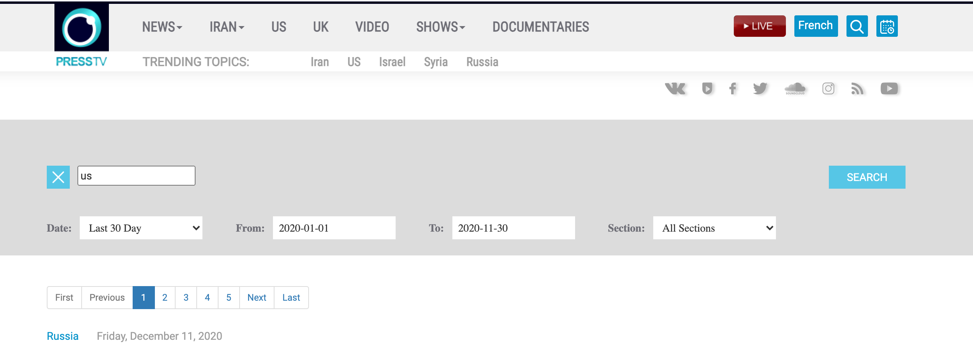
Goal
Plan A: scrape Jan through Nov 2020 from IRIB and PressTV
Plan B: scrape Jan through Nov 2020 from IRIB
Plan C: scrape Jan through Jun 2020 from IRIB
Plan D: write code that could work for Jan-Nov but test on a small sample

Slide 3
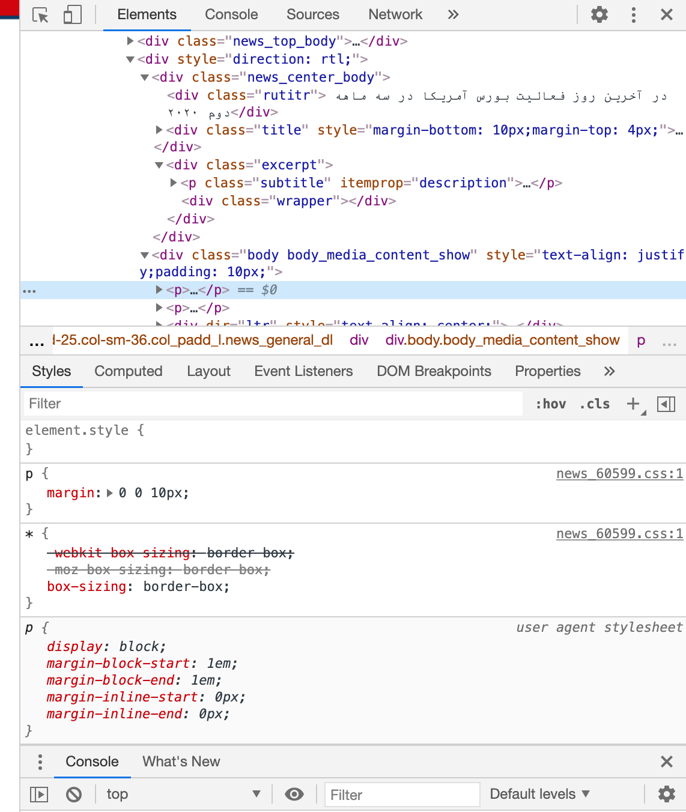
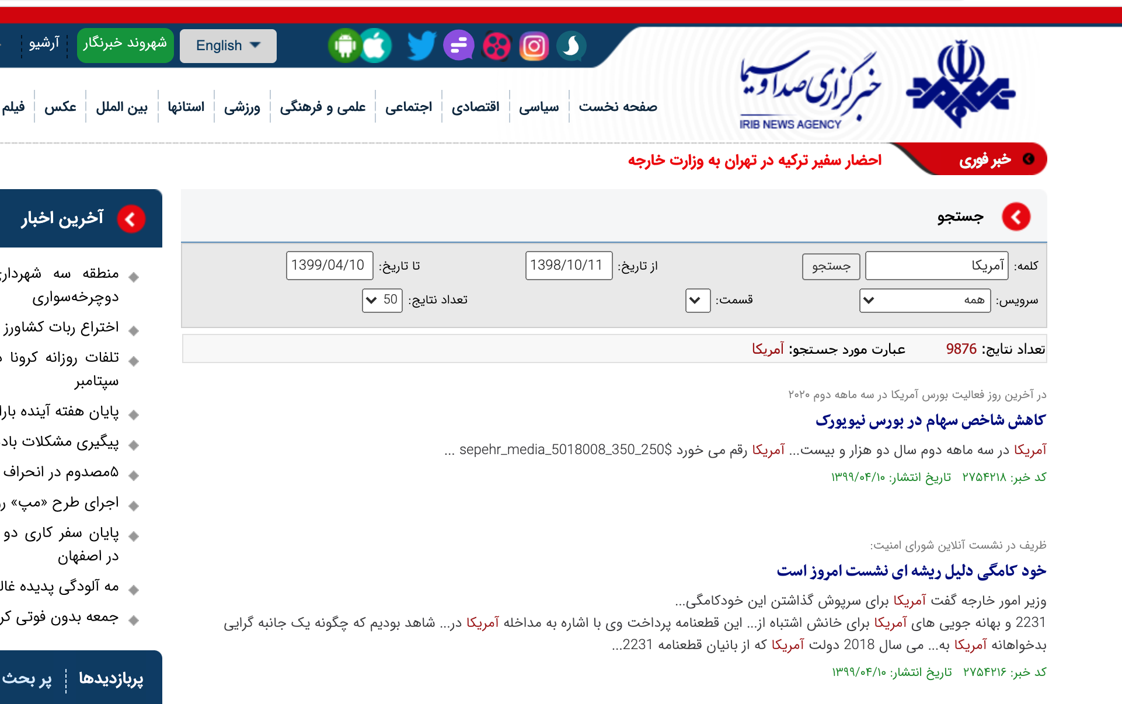
Scraping
CSS selector was not accurate
Incredibly slow
Farsi URL (UTF-8 package)

Slide 4
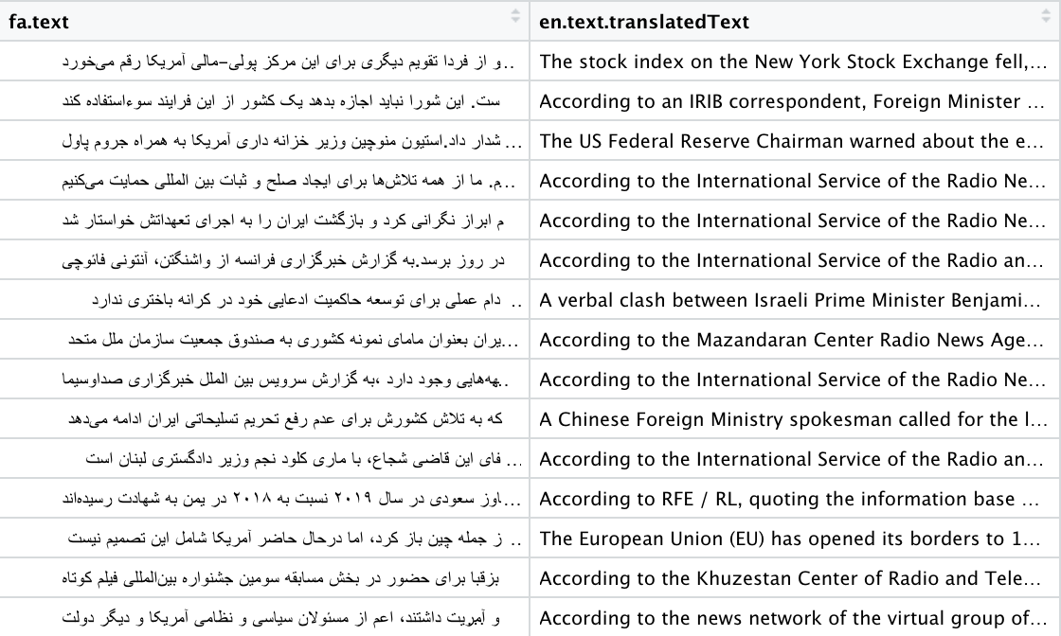
Translation
translateR (disaster)
googleLanguageR (still disaster, but less)
Picks its own column names and will not be told otherwise
Will give you 2 additional columns for every one column you want
Writing to csv is super wonky

Slide 5
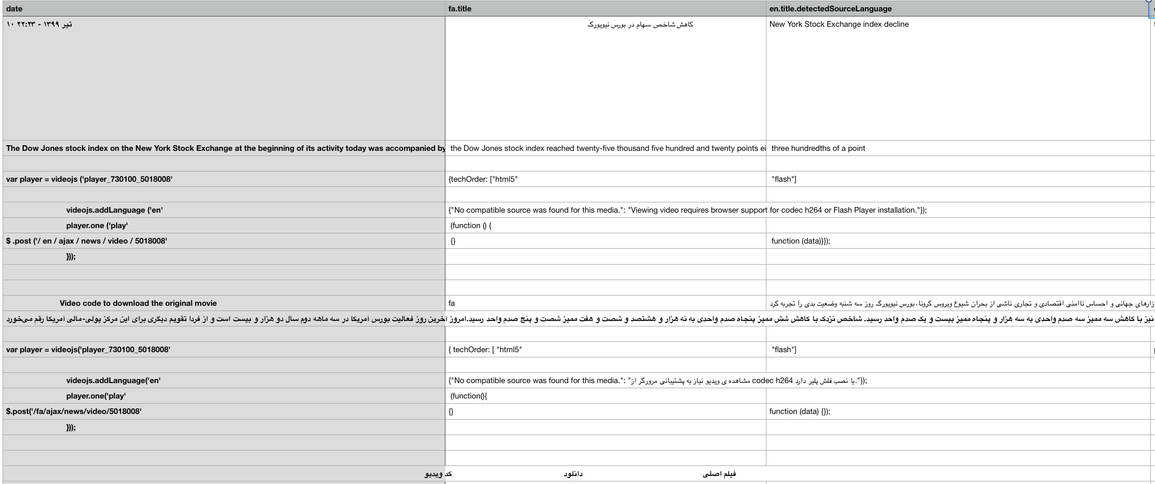

Slide 6
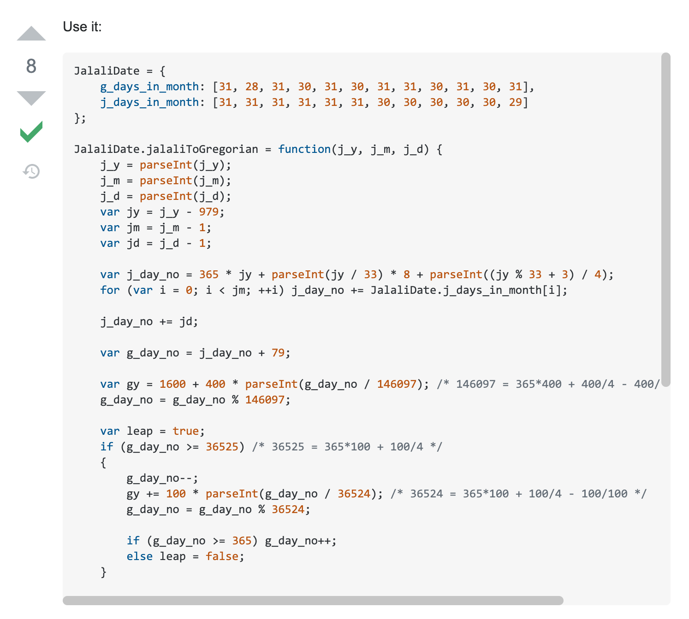
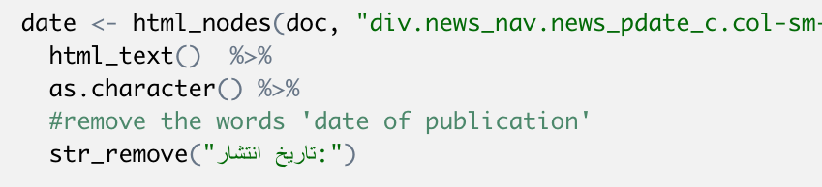
More non-ASCII issues
Dates
Translating numbers = ok
Translating calendars = not ok
Writing code in Farsi

