Slide 1


Computer Aided Diagnosis
Skin Lesion Classification
Manuel Ojeda
Alexandru Vasile

Slide 2
OUTLINE
Problem Statement
Preprocessing
Feature Extraction
Conclusion
Feature Engineering
Classification
Results

Slide 3
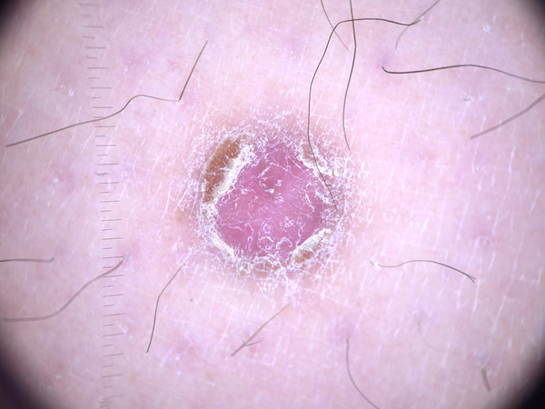
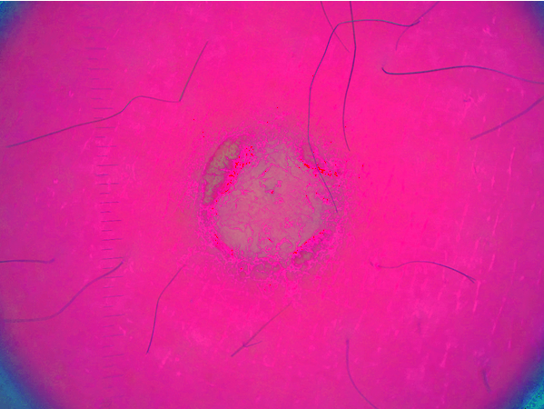
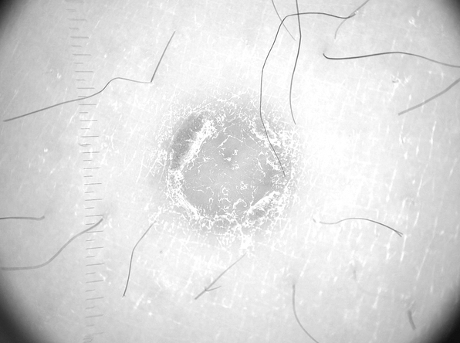
Preprocessing -color space-
RGB
HSV
Value
3

Slide 4
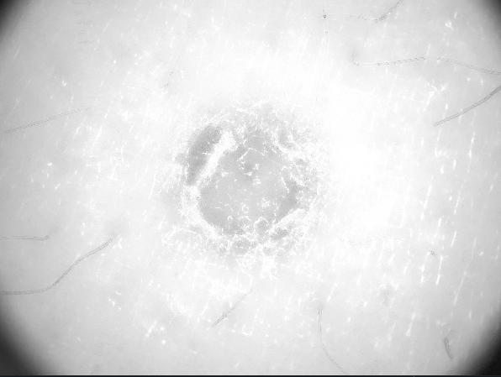

Preprocessing -filtering-
Value
Hairless
AD Filtered
Grayscale
Morph.
4

Slide 5
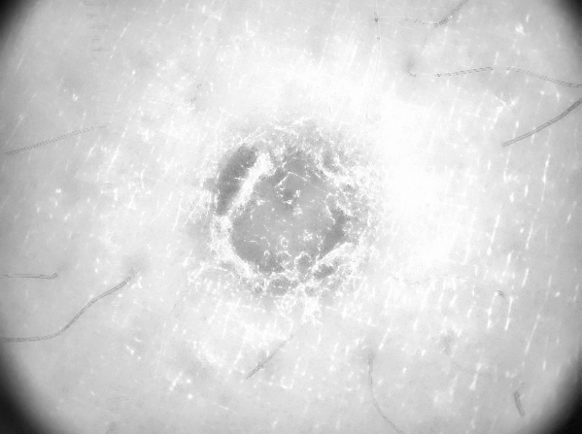
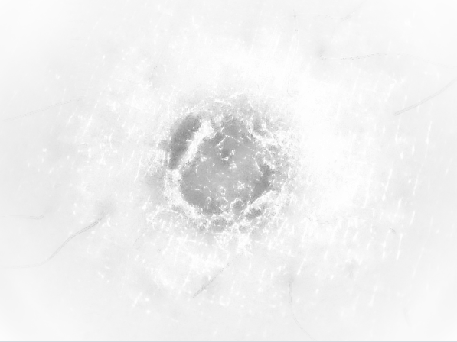
Preprocessing -contrast-
AD Filtered
Contrast Enhanced
Vignetted Image
CLAHE
5

Slide 6
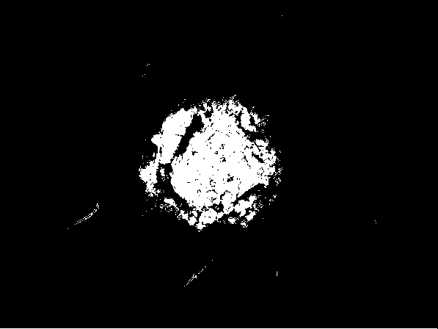
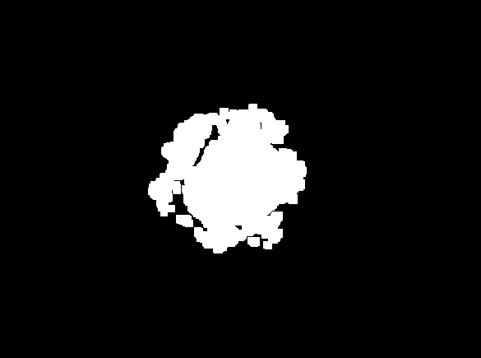
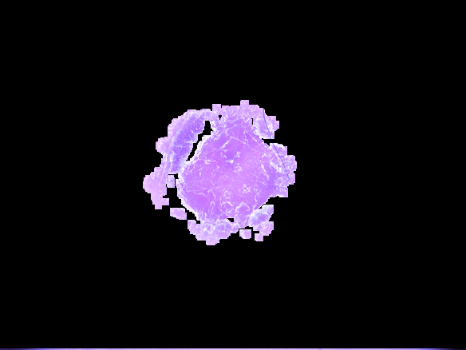
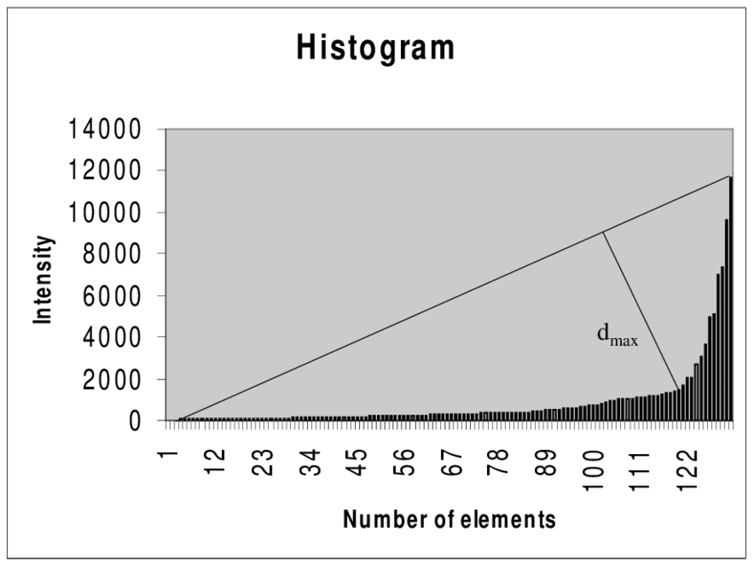
Preprocessing -binary-
Thresholded Image (triangle method)
Final Result
(HSV Image)
Opening + Eroding
 | Accuracy
w/o p.p. | 62-65%
with p.p. | 75.91%
6

Slide 7
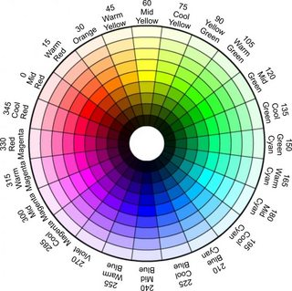
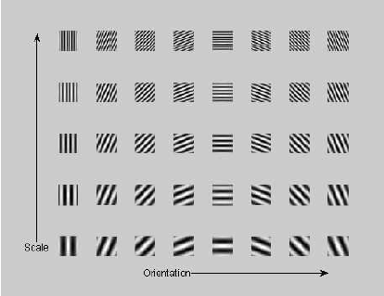
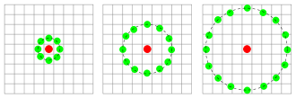
Feature Engineering -feature extraction-
7

Slide 8
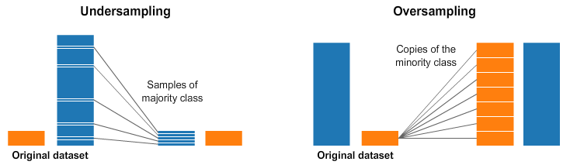
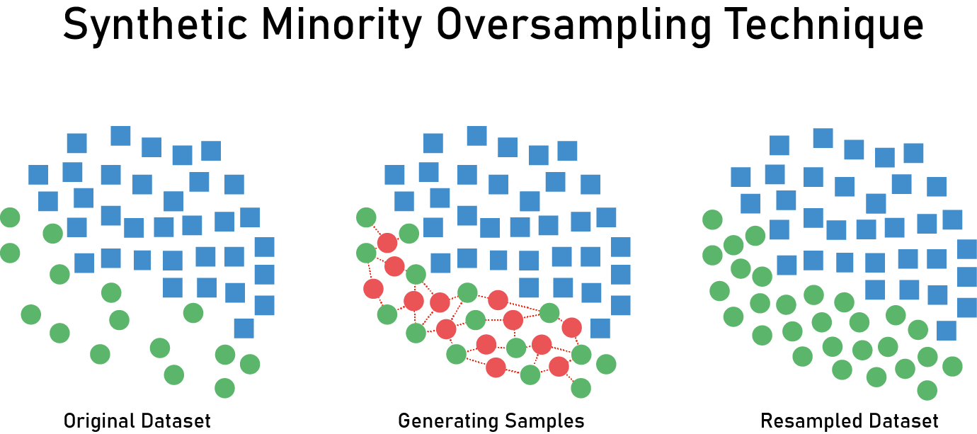
Feature Engineering
8
Notes:
SelectKBest removes all but the highest scoring features. It’s a kind of univariate feature selection which works by selecting the best features based on univariate statistical tests.
The methods based on F-test estimate the degree of linear dependency between two random variables.

Slide 9
Classification -binary-
SVC
C: 100
Acc: 67.00%
kNN
Naïve Bayes
Decision Tree
Gradient Boosting
Random Forest
Gamma: 0.001
kernel: rbf
# neighbours: 30
Acc: 72.60%
criterion: gini
criterion: friedman_mse,
criterion: entropy
Acc: 58.41%
Acc: 69.08%
max_depth: 15 max_features: auto
Acc = 62.16%
loss: exponential
learn_rate: 0.1
max_depth: 3
max_features: auto
n_estimators: 100
Acc : 75.91%
max_depth: 50
max_features: auto
n_estimators: 1000
9

Slide 10
Classification -binary-
FP: 0.50%
FN: 19%
TP: 44.91%
TN: 31.00%
Confusion Matrix
10

Slide 11
Classification -multiclass-
Number of features: 600
kNN
Num neighbors: 15
Accuracy: 53.00%
SVC
C: 100
Gamma: 0.001
Decision tree
Max depth: 8
Criterion: entropy
Random forest
Extra trees
Max Depth: 35
Accuracy: 53.00%
Max features: auto
Accuracy: 51.00%
Num estimators: 250
Accuracy: 57.00%
Max Depth: 20
Num estimators: 250
Accuracy:61.40 %
11

Slide 12
Classification -multiclass-
Number of features: 1500
kNN
Num neighbors: 30
Accuracy: 54.00%
SVC
C: 10
Gamma: 0.001
Decision tree
Max depth: 20
Criterion: entropy
Random forest
Extra trees
Max Depth: 20
Accuracy: 55.00%
Max features: auto
Accuracy: 50.00%
Num estimators: 400
Accuracy: 59.00%
Max Depth: 35
Num estimators: 100
Accuracy: 58.00%
12

Slide 13
Classification -multiclass-
Confusion Matrix
 | bcc | bkl | mel
bcc | 9.4% | 7.4% | 3.2%
bkl | 2.4% | 19.8% | 17.8%
mel | 1.8% | 8.2% | 30%
13

Slide 14
Classification -multiclass-
Experiments with different configurations
 | W/O Kbest | W/O scaler | W/O cv | W under sampling | W over sampling | W SMOTE
Accuracy | -10 % | -5 % | -4 % | -5 % | -4 % | -2 %
14

Slide 15
Conclusions
Performance is improved with using feature selection
Extracting features from a segmented image is better
Class imbalance mitigation attempts drove the performance down
Working on the V cannel of HSV is recommended
When working with big datasets, you have to be creative
Combination of Color and Texture descriptors
Ensemble learning worked better than individual classifiers
Automating classification pipeline with Grid Search
15

Slide 16
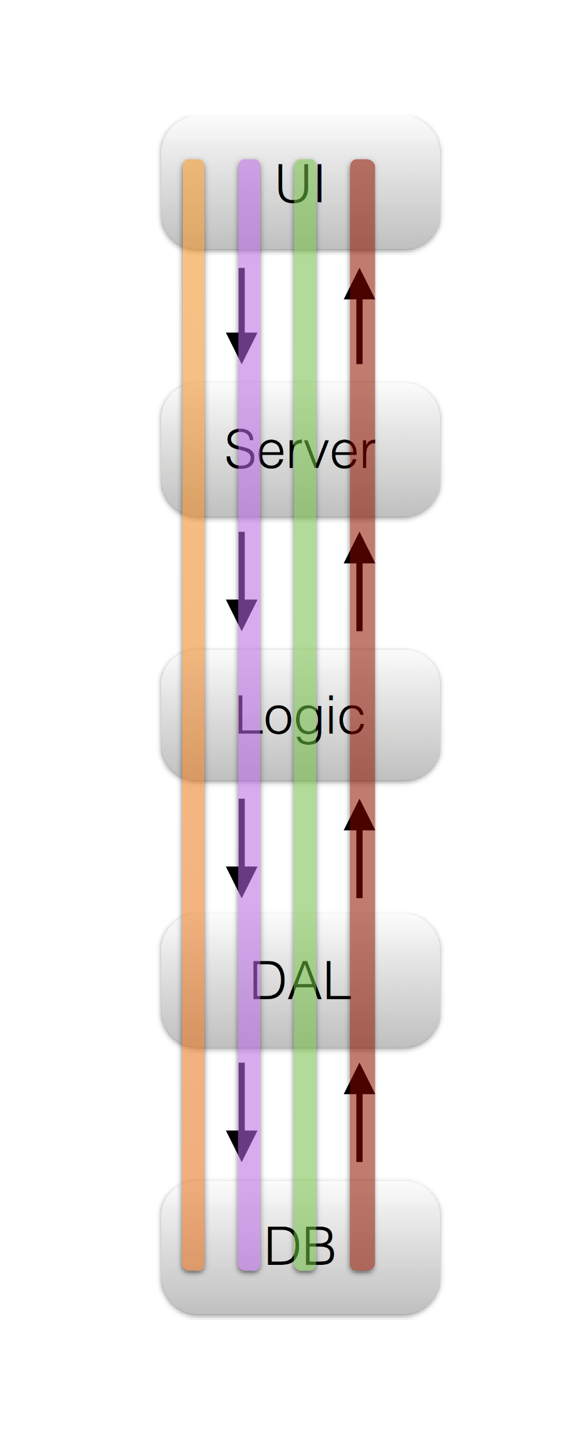

Project Management
Lines of code: 1463
Time in deployment: 2 (long) days, 3 (long) nights
16

Slide 17


THANK YOU!

Slide 18
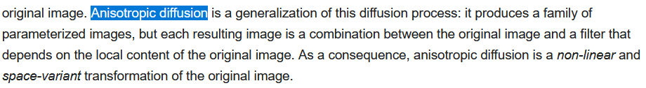
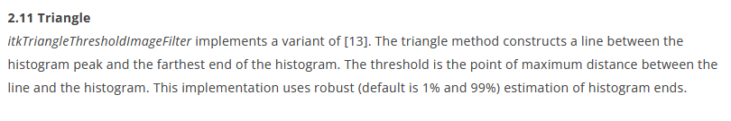

Slide 19
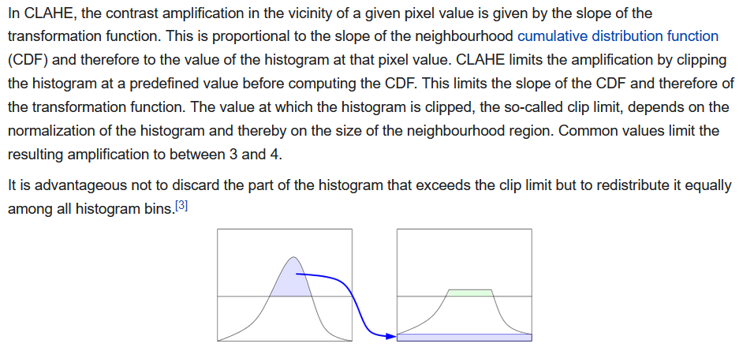

Slide 20


Slide 21
SelectKBest removes all but the highest scoring features. It’s a kind of univariate feature selection which works by selecting the best features based on univariate statistical tests.
The methods based on F-test estimate the degree of linear dependency between two random variables.

