Slide 1


Computer Aided Diagnosis
Skin Lesion Classification
Project Proposal:
Manuel Ojeda
Alexandru Vasile

Slide 2
OUTLINE
Problem Statement
Preprocessing
Feature Extraction
Conclusion
Feature Engineering
Classification
Results

Slide 3
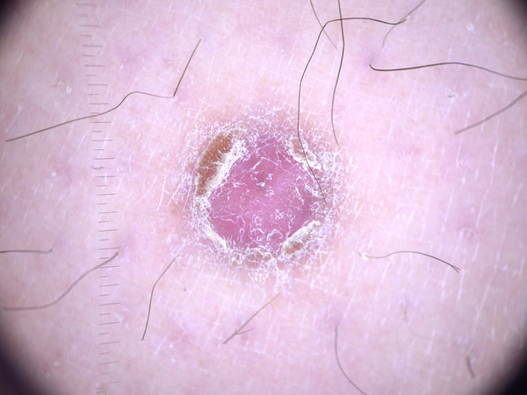
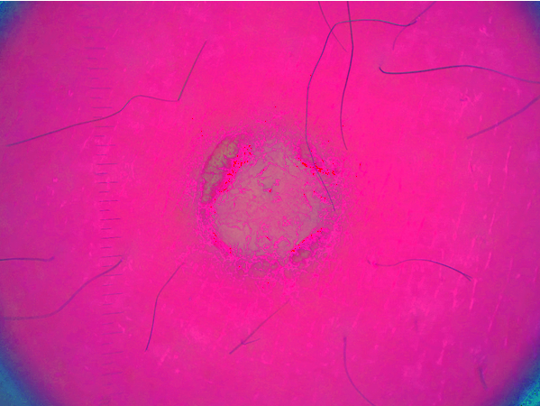
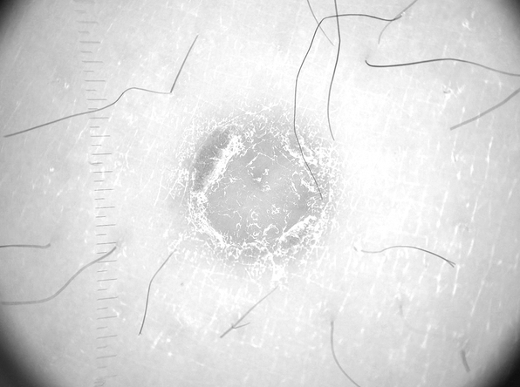
Preprocessing -color space-
RGB
HSV
Value
3

Slide 4
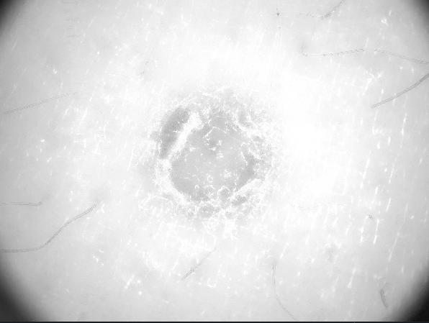

Preprocessing -filtering-
Value
Hairless
AD Filtered
Grayscale
Morph.
4

Slide 5
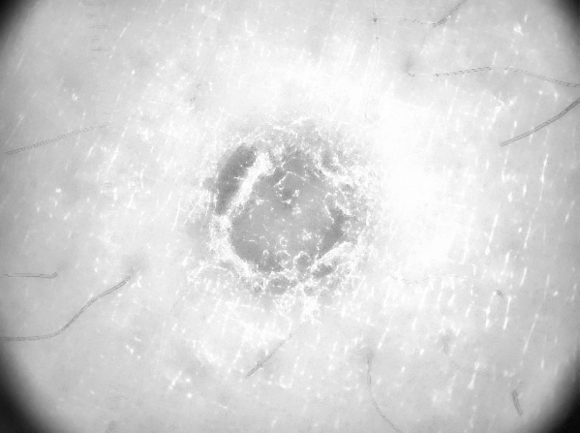
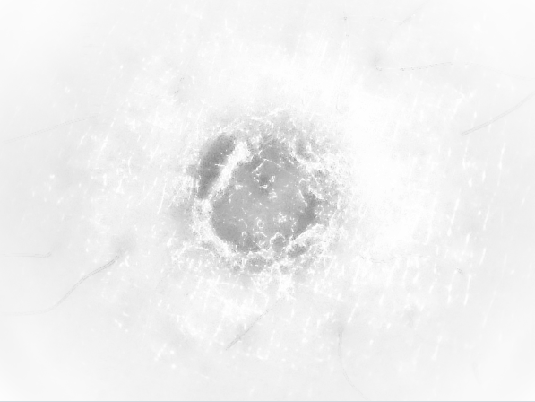
Preprocessing -contrast-
AD Filtered
Contrast Enhanced
Vignetted Image
CLAHE
5

Slide 6
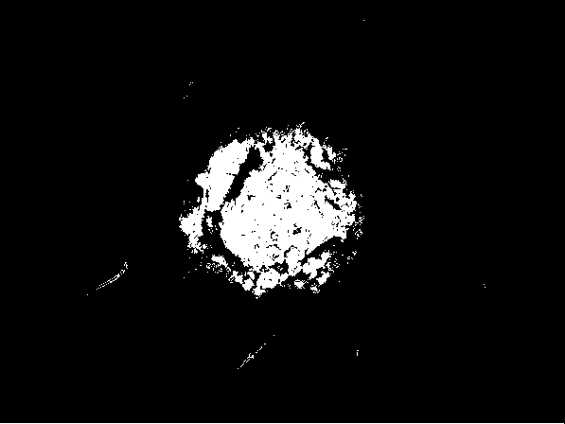

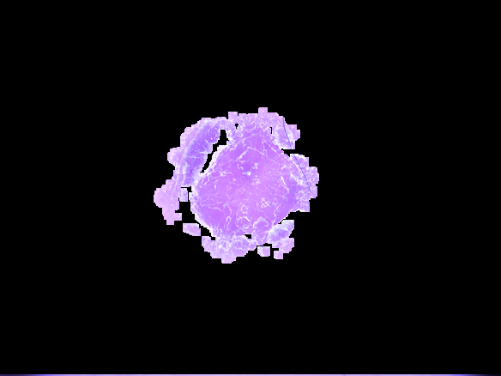
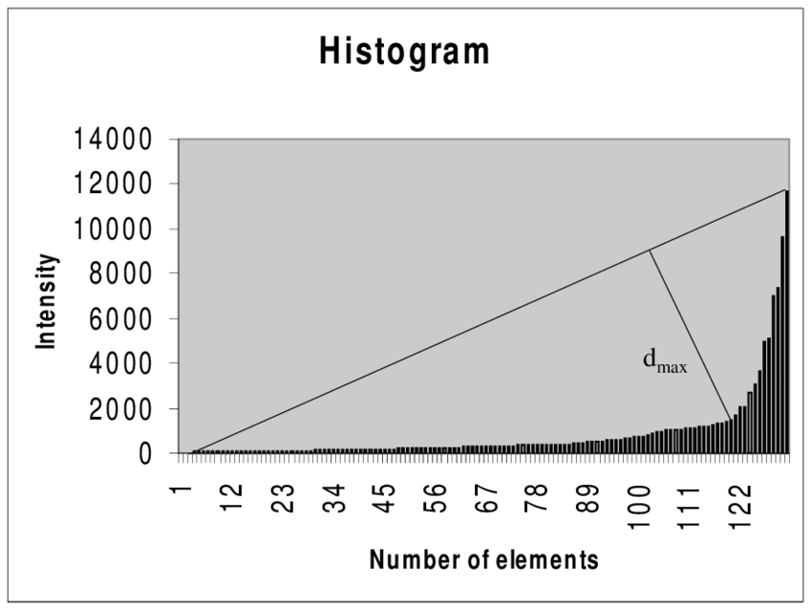
Preprocessing -binary-
Thresholded Image (triangle method)
Final Result
(HSV Image)
Opening + Eroding
6

Slide 7
Feature Extraction
Train the network with normal images (features)
Labels: entities’ names
Predict on Rorschach Images
Compare it to human interpretation
Pre-train the network with Rorschach Figures (features)
Labels: entities’ names
Predict on Rorschach Images
Compare the interpretation of the model partially trained on groups of students
Presentation about psychology, correlation between human brain structure and deep learning
7

Slide 8
Feature Engineering
8

Slide 9
Classification -binary-
9

Slide 10
Classification -multiclass-
10

Slide 11

Results
11

Slide 12
Conclusion
12

Slide 13
THANK YOU!

