Slide 1


Computer Aided Diagnosis
Skin Lesion Classification
Manuel Ojeda
Alexandru Vasile

Slide 2
OUTLINE
Problem Statement
Preprocessing
Feature Extraction
Conclusion
Feature Engineering
Classification
Results

Slide 3
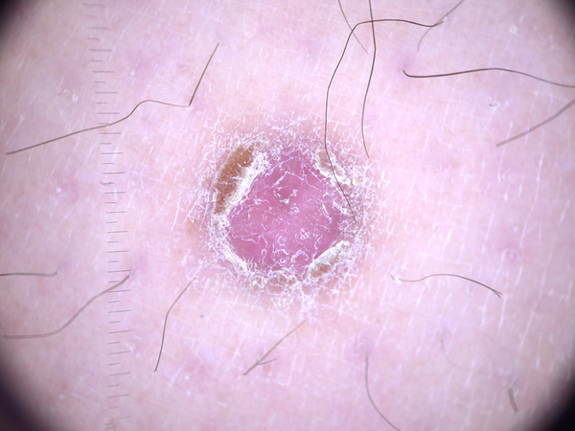
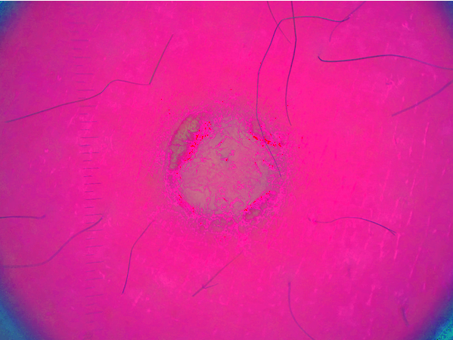
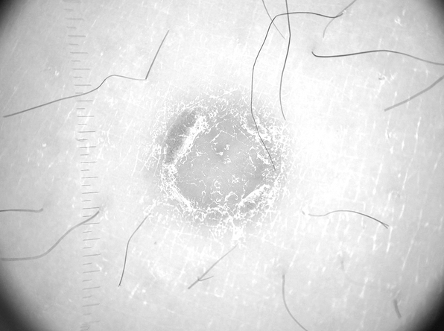
Preprocessing -color space-
RGB
HSV
Value
3

Slide 4
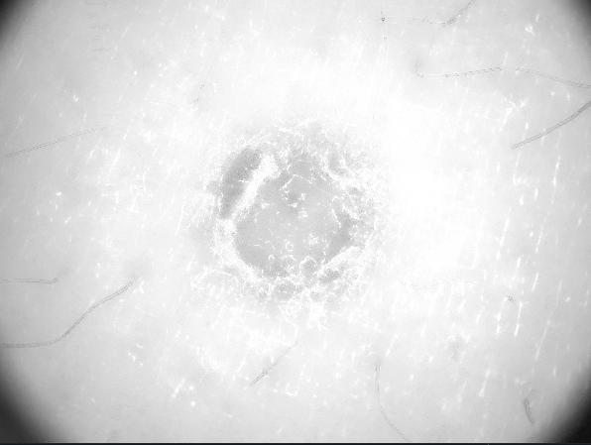

Preprocessing -filtering-
Value
Hairless
AD Filtered
Grayscale
Morph.
4

Slide 5
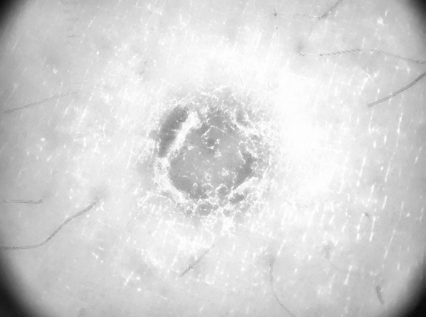
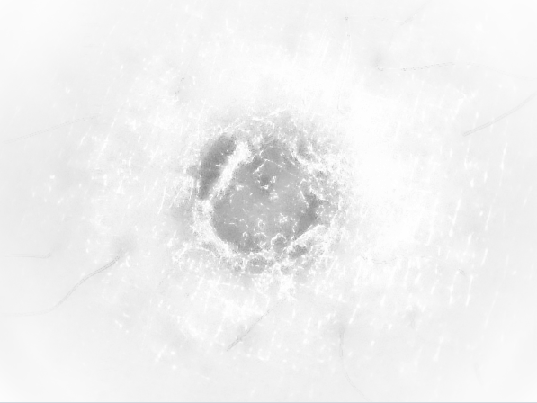
Preprocessing -contrast-
AD Filtered
Contrast Enhanced
Vignetted Image
CLAHE
5

Slide 6
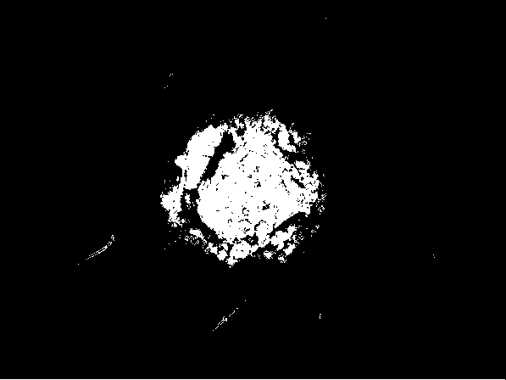
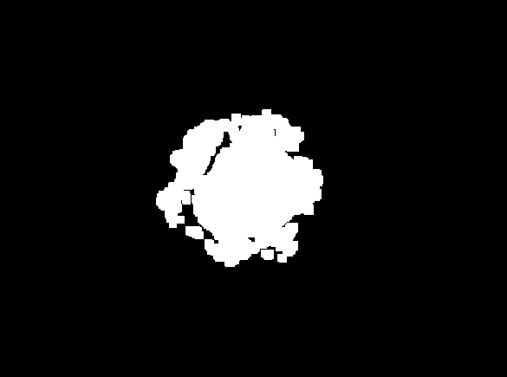
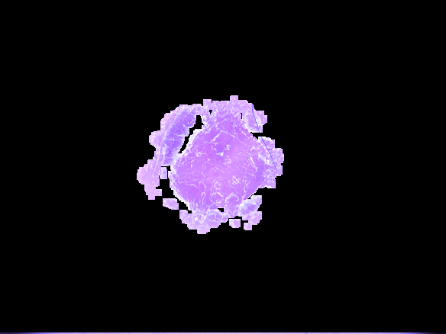
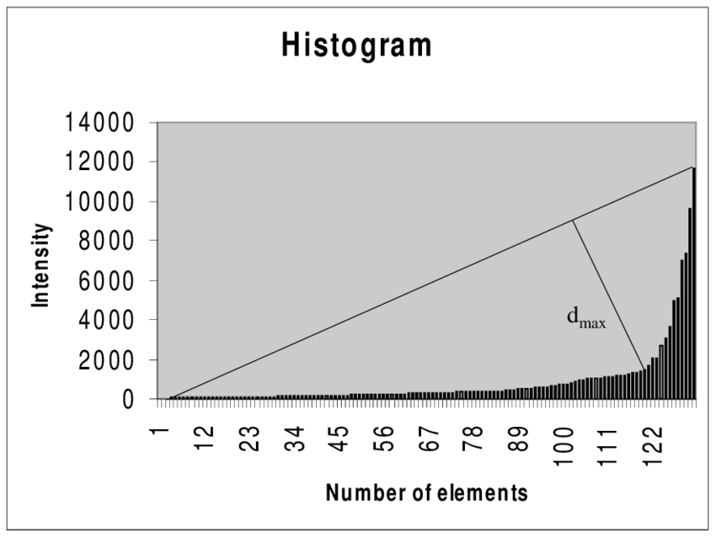
Preprocessing -binary-
Thresholded Image (triangle method)
Final Result
(HSV Image)
Opening + Eroding
 | Accuracy
w/o p.p. | 62-65%
with p.p. | 75.91%
6

Slide 7
Feature Extraction
Train the network with normal images (features)
Labels: entities’ names
Predict on Rorschach Images
Compare it to human interpretation
Pre-train the network with Rorschach Figures (features)
Labels: entities’ names
Predict on Rorschach Images
Compare the interpretation of the model partially trained on groups of students
Presentation about psychology, correlation between human brain structure and deep learning
7

Slide 8
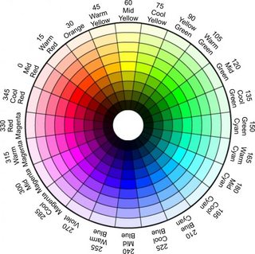
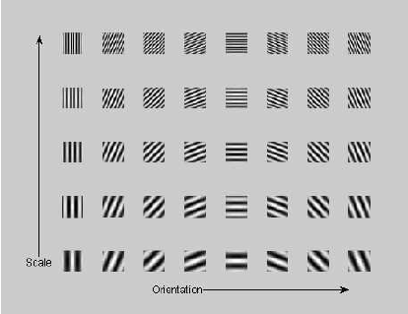
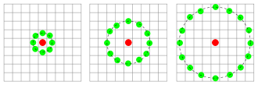
Feature Engineering -feature extraction-
8

Slide 9
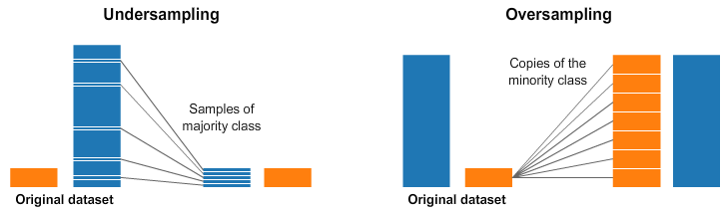
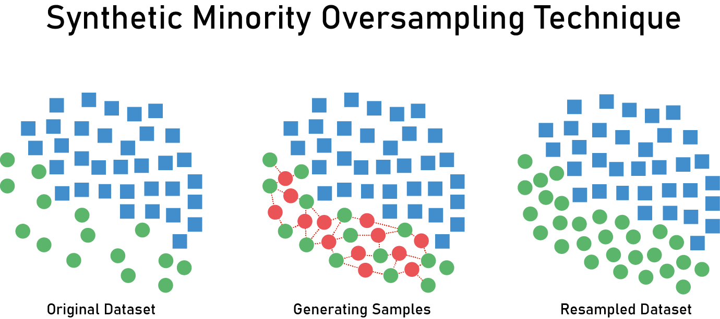
Feature Engineering
9
Notes:
SelectKBest removes all but the highest scoring features. It’s a kind of univariate feature selection which works by selecting the best features based on univariate statistical tests.
The methods based on F-test estimate the degree of linear dependency between two random variables.

Slide 10
Classification -binary-
Best parameters for SVC with DD for are = {'C': 100, 'gamma': 0.001, 'kernel': 'rbf'}
Accuracy SVC with DD is = 0.67
0.67
Best parameters for kNN are = {'n_neighbors': 30}
Accuracy kNN is = 0.7266666666666667
Naive Bayes classifier: 0.5841666666666666
Best parameters for DecisionTreeClassifier are = {'criterion': 'gini', 'max_depth': 15, 'max_features': 'auto'}
Accuracy Random forest is = 0.6908333333333333
0.6908333333333333
Best parameters for Gradient boosting are = {'criterion': 'friedman_mse', 'learning_rate': 0.1, 'loss': 'exponential', 'max_depth': 3, 'max_features': 'auto', 'n_estimators': 100}
Accuracy Gradient boosting is = 0.6216666666666667
0.6216666666666667
Best parameters for Random forest are = {'criterion': 'entropy', 'max_depth': 50, 'max_features': 'auto', 'n_estimators': 1000}
Accuracy Random forest is = 0.7591666666666667
0.7591666666666667
10

Slide 11
Classification -binary-
SVC
C: 100
Acc: 67.00%
kNN
Naïve Bayes
Decision Tree
Gradient Boosting
Random Forest
Gamma: 0.001
kernel: rbf
# neighbours: 30
Acc: 72.60%
criterion: gini
criterion: friedman_mse,
criterion: entropy
Acc: 58.41%
Acc: 69.08%
max_depth: 15 max_features: auto
Acc = 62.16%
loss: exponential
learn_rate: 0.1
max_depth: 3
max_features: auto
n_estimators: 100
Acc : 75.91%
max_depth: 50
max_features: auto
n_estimators: 1000
11

Slide 12
Classification -binary-
FP: 0.50%
FN: 19%
TP: 44.91%
TN: 31.00%
Confusion Matrix
12

Slide 13
Classification -multiclass-
Number of features: 600
kNN
Num neighbors: 15
Accuracy: 0.53
SVC
C: 100
Gamma: 0.001
Decision tree
Max depth: 8
Criterion: entropy
Random forest
Extra trees
Max Depth: 35
Accuracy: 0.53
Max features: auto
Accuracy: 0.51
Num estimators: 250
Accuracy: 0.57
Max Depth: 20
Num estimators: 250
Accuracy: 0.614
13

Slide 14
Classification -multiclass-
Number of features: 1500
kNN
Num neighbors: 30
Accuracy: 0.54
SVC
C: 10
Gamma: 0.001
Decision tree
Max depth: 20
Criterion: entropy
Random forest
Extra trees
Max Depth: 20
Accuracy: 0.55
Max features: auto
Accuracy: 0.50
Num estimators: 400
Accuracy: 0.59
Max Depth: 35
Num estimators: 100
Accuracy: 0.58
14

Slide 15
Classification -multiclass-
Confusion Matrix
 | bcc | bkl | mel
bcc | 9.4% | 7.4% | 3.2%
bkl | 2.4 | 19.8% | 17.8%
mel | 1.8% | 8.2% | 30%
15

Slide 16
Classification -multiclass-
Experiments with different configurations
 | W/O Kbest | W/O scaler | W/O cv | W under sampling | W over sampling | W SMOTE
Accuracy | -10 pts | -5 pts | -4 pts | -5 pts | -4 pts | -2 pts
16

Slide 17
Conclusions
Performance is improved with using feature selection
Extracting features from a segmented image is better
Class imbalance mitigation attempts drove the performance down
Working on the V cannel of HSV is recommended
When working with big datasets, you have to be creative
Combination of Color and Texture descriptors
Ensemble learning worked better than individual classifiers
Automating classification pipeline with Grid Search
17

Slide 18


THANK YOU!
Lines of code: 730
Time in deployment: 2 (long) days, 3 (long) nights

Slide 19
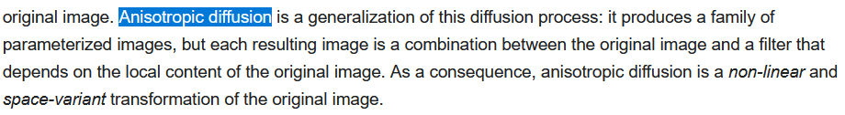
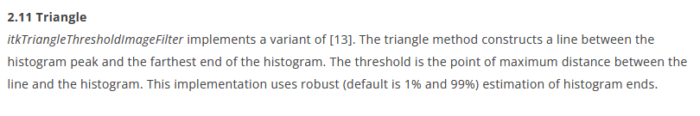

Slide 20
