Slide 1


Computer Aided Diagnosis
Skin Lesion Classification
Project Proposal:
Manuel Ojeda
Alexandru Vasile

Slide 2
OUTLINE
Problem Statement
Preprocessing
Feature Extraction
Conclusion
Feature Engineering
Classification
Results

Slide 3
Preprocessing
The Rorschach test is a psychological test in which subjects' perceptions of inkblots are recorded and then analysed using psychological interpretation, complex algorithms, or both
Some psychologists use this test to examine a person's personality characteristics and emotional functioning
It has been employed to detect underlying thought disorder, especially in cases where patients are reluctant to describe their thinking processes openly
The test is named after its creator, Swiss psychologist Hermann Rorschach
3

Slide 4
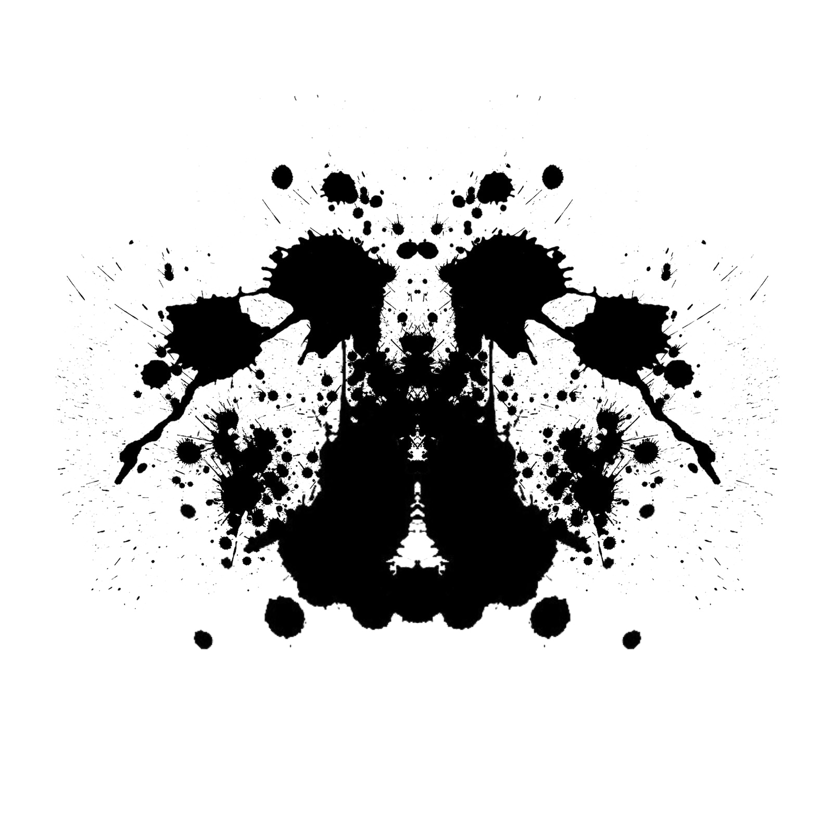
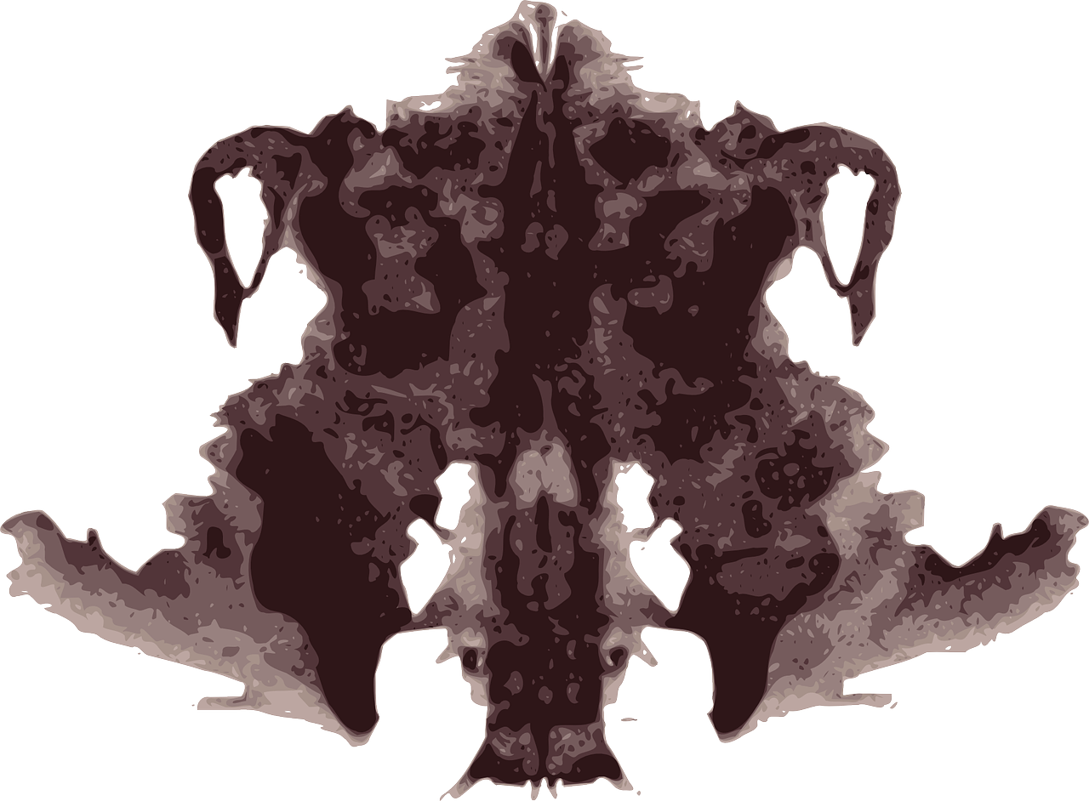
Rorschach Test
4

Slide 5
Feature Extraction
Train the network with normal images (features)
Labels: entities’ names
Predict on Rorschach Images
Compare it to human interpretation
Pre-train the network with Rorschach Figures (features)
Labels: entities’ names
Predict on Rorschach Images
Compare the interpretation of the model partially trained on groups of students
Presentation about psychology, correlation between human brain structure and deep learning
5

Slide 6



Feature Engineering
6

Slide 7
Classification
7

Slide 8
Technologies
8

Slide 9
THANK YOU!

