Slide 1


Computer Aided Diagnosis
Skin Lesion Classification
Project Proposal:
Manuel Ojeda
Alexandru Vasile

Slide 2
OUTLINE
Problem Statement
Preprocessing
Feature Extraction
Conclusion
Feature Engineering
Classification
Results

Slide 3
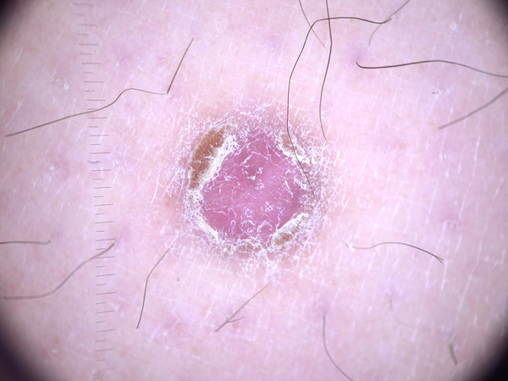
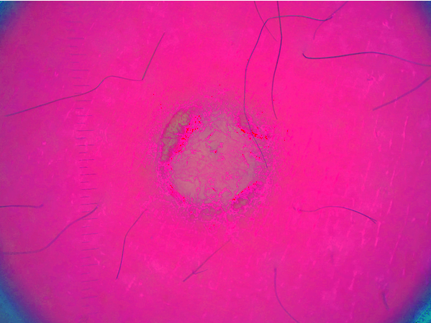
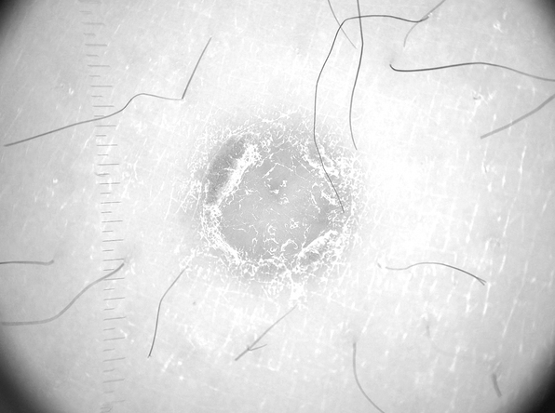
Preprocessing -color space-
RGB
HSV
Value
3

Slide 4
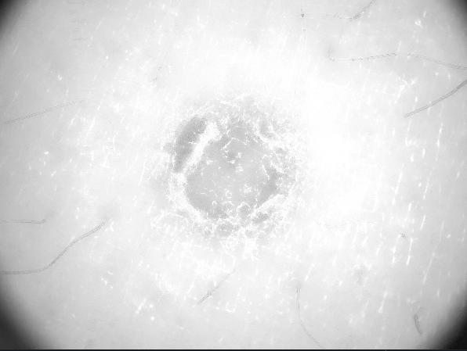

Preprocessing -filtering-
Value
Hairless
AD Filtered
Grayscale
Morph.
4

Slide 5
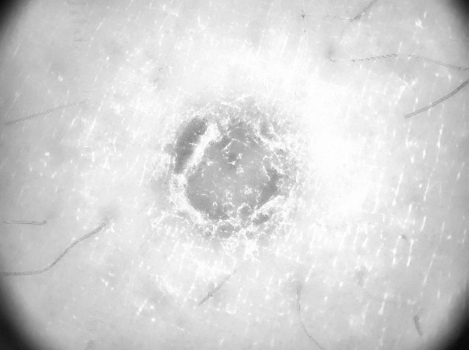
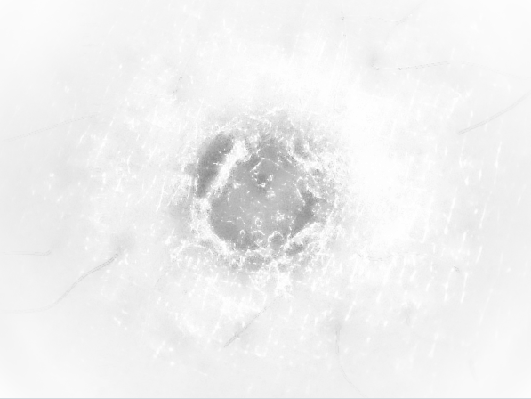
Preprocessing -contrast-
AD Filtered
Contrast Enhanced
Vignetted Image
CLAHE
5

Slide 6
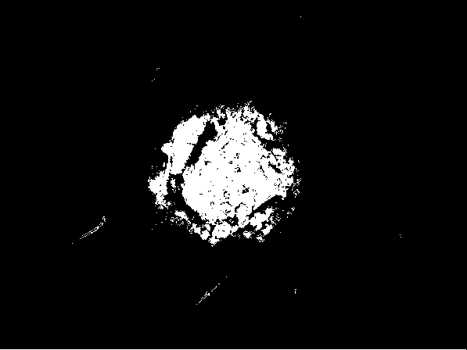
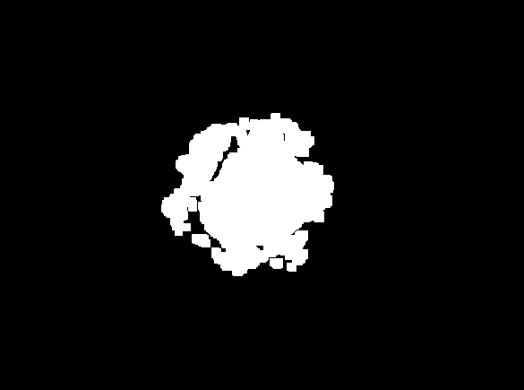
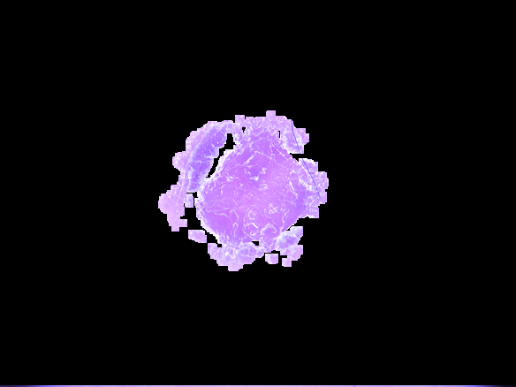
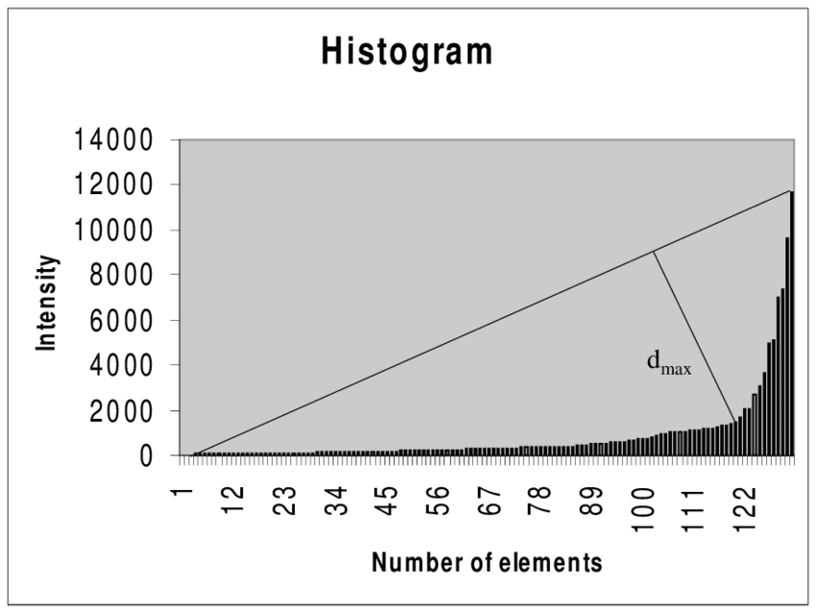
Preprocessing -binary-
Thresholded Image (triangle method)
Final Result
(HSV Image)
Opening + Eroding
6

Slide 7
Feature Extraction
Train the network with normal images (features)
Labels: entities’ names
Predict on Rorschach Images
Compare it to human interpretation
Pre-train the network with Rorschach Figures (features)
Labels: entities’ names
Predict on Rorschach Images
Compare the interpretation of the model partially trained on groups of students
Presentation about psychology, correlation between human brain structure and deep learning
7

Slide 8
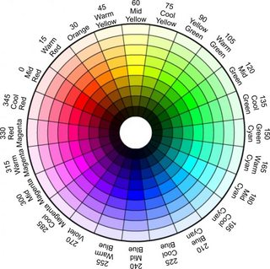
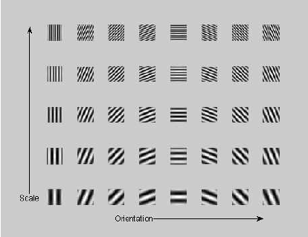
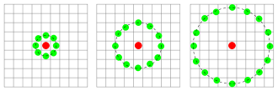
Feature Engineering -feature extraction-
8

Slide 9
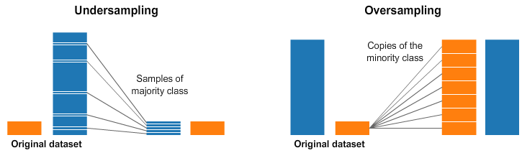
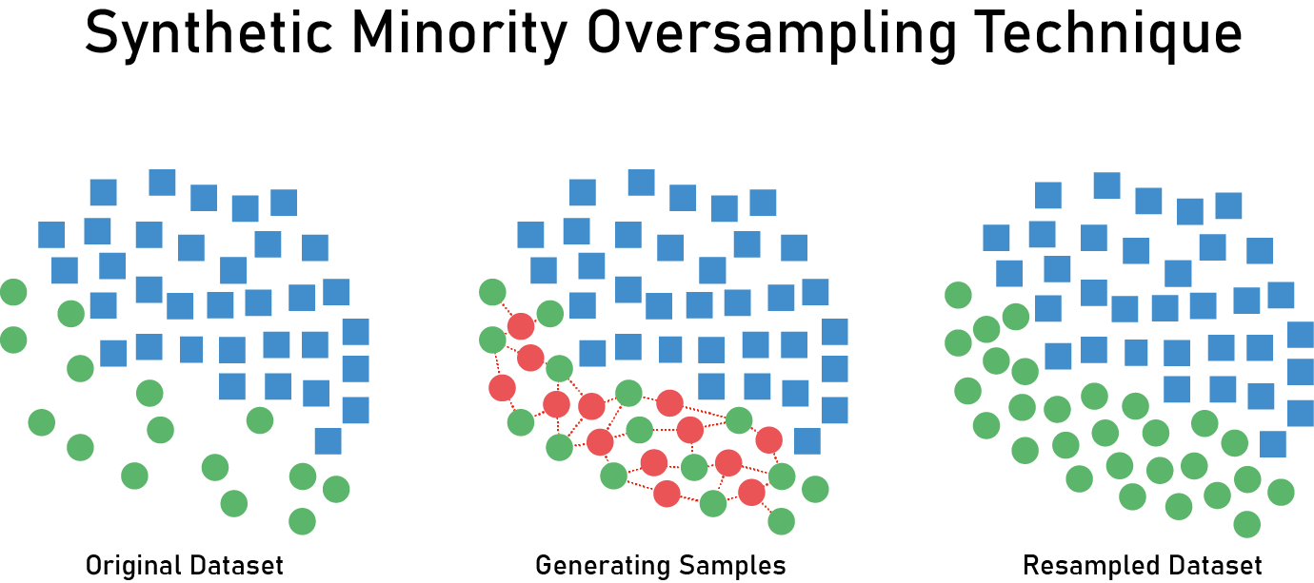
Feature Engineering
9

Slide 10
Classification -binary-
Best parameters for SVC with DD for are = {'C': 100, 'gamma': 0.001, 'kernel': 'rbf'}
Accuracy SVC with DD is = 0.67
0.67
Best parameters for kNN are = {'n_neighbors': 30}
Accuracy kNN is = 0.7266666666666667
Naive Bayes classifier: 0.5841666666666666
Best parameters for DecisionTreeClassifier are = {'criterion': 'gini', 'max_depth': 15, 'max_features': 'auto'}
Accuracy Random forest is = 0.6908333333333333
0.6908333333333333
Best parameters for Gradient boosting are = {'criterion': 'friedman_mse', 'learning_rate': 0.1, 'loss': 'exponential', 'max_depth': 3, 'max_features': 'auto', 'n_estimators': 100}
Accuracy Gradient boosting is = 0.6216666666666667
0.6216666666666667
Best parameters for Random forest are = {'criterion': 'entropy', 'max_depth': 50, 'max_features': 'auto', 'n_estimators': 1000}
Accuracy Random forest is = 0.7591666666666667
0.7591666666666667
10

Slide 11
Classification -multiclass-
kNN
SVC
Decision tree
Max depth: 8
Dsf
sdf
sdf
11

Slide 12
Conclusions
Performance is matched or improved with using feature selection
Extracting the features from a segmented image yielded better results than form the whole image
Using class imbalance mitigation methods drove the performance down
Working on the V cannel of HSV is recommended
When working with big datasets, you have to be creative
Using a combination of Color and Texture descriptors
Ensemble learning works better than individual classifiers
Automating classification pipeline with Grid Search
12

Slide 13

THANK YOU!

