Slide 1


Distributed Programming and Networking
SYSTEM FOR MANAGING PATIENTS’ MEDICAL INFORMATION
Project Proposal:
Alexandra Albu
Manuel Ojeda
Alexandru Vasile

Slide 2
OUTLINE
Overview
React
Other Technologies
Structure
Express

Slide 3
OVERVIEW -Proof of Concept-
Model for a Medical Database
Medical Dashboard
Patient Management System
ML-powered patient data analysis
3

Slide 4
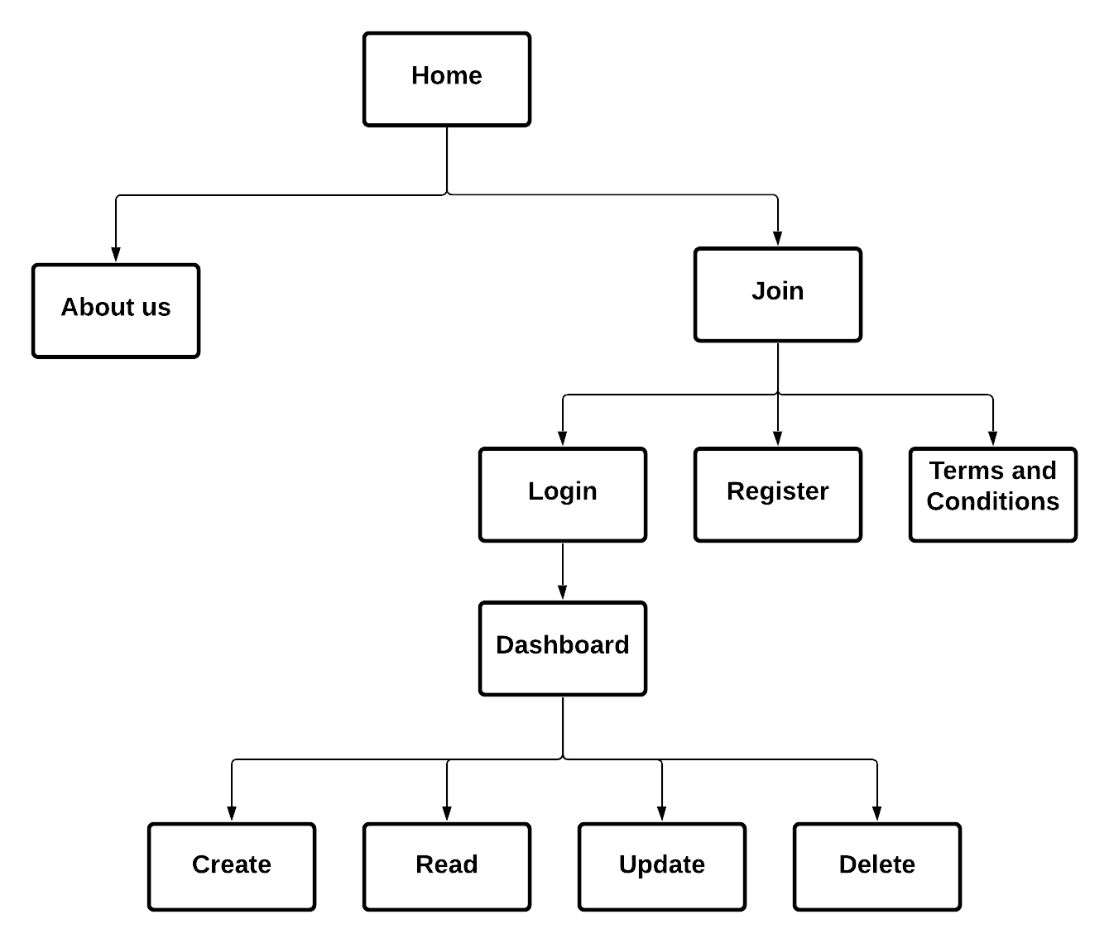
STRUCTURE
4

Slide 5
REACT
JavaScript library for building user interfaces
Encapsulated components with their own state
Development of new features using existing code
Component logic written in JS instead of templates
5

Slide 6
REACT
Handling events like with plain HTML
Other applications can be embedded in React
Can power mobile apps by using React Native
6

Slide 7
EXPRESS
Routing and middleware web framework for Node.js
Routing = how the endpoints (URIs) respond to users’ request
A route method is derived from HTTP methods: GET and POST
Each route can have one or more handler functions
7

Slide 8
EXPRESS
Middleware functions have access to the request object (req) and response object (res)
They can change the request and the response objects
They can also end the request-response cycle
They can call the next middleware function in the stack
8

Slide 9
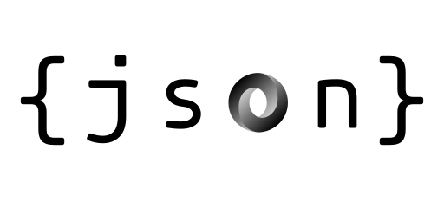




TECHNOLOGIES
9

Slide 10




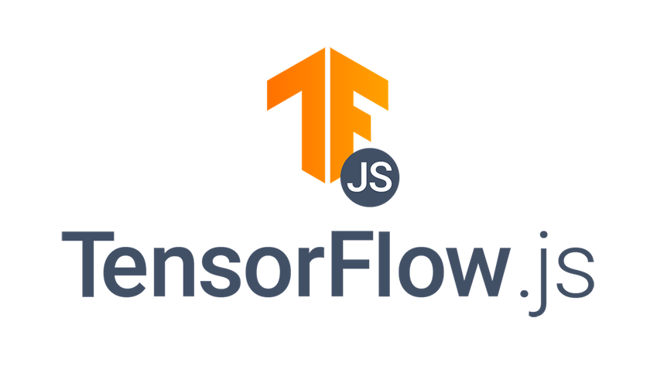

TECHNOLOGIES
10

Slide 11
THANK YOU!

