Slide 1




DISTRIBUTED PROGRAMMING
AND
NETWORKING
MedBase
MedBase
Professor: Mario Molinara
Team: Alexandra Albu
Manuel Ojeda
Alexandru Vasile
Cassino
2021

Slide 2
DISTRIBUTED PROGRAMMING
AND
NETWORKING
MedBase
MedBase
Professor: Mario Molinara
Team: Alexandra Albu
Manuel Ojeda
Alexandru Vasile
Cassino
2021

Slide 3
Contents
Mission
Features
Technologies
Contribution
Demo

Slide 4

MISSION
Aid medical staff by providing a centralised database.
We save lives by predicting chances of patient cardiac arrest risk.

Slide 5

FEATURES
Responsive Pages
Intuitive Navigation
Register Doctors
Login
CRUD for patients' data
Deep Learning for Cardiac Arrest Risk

Slide 6
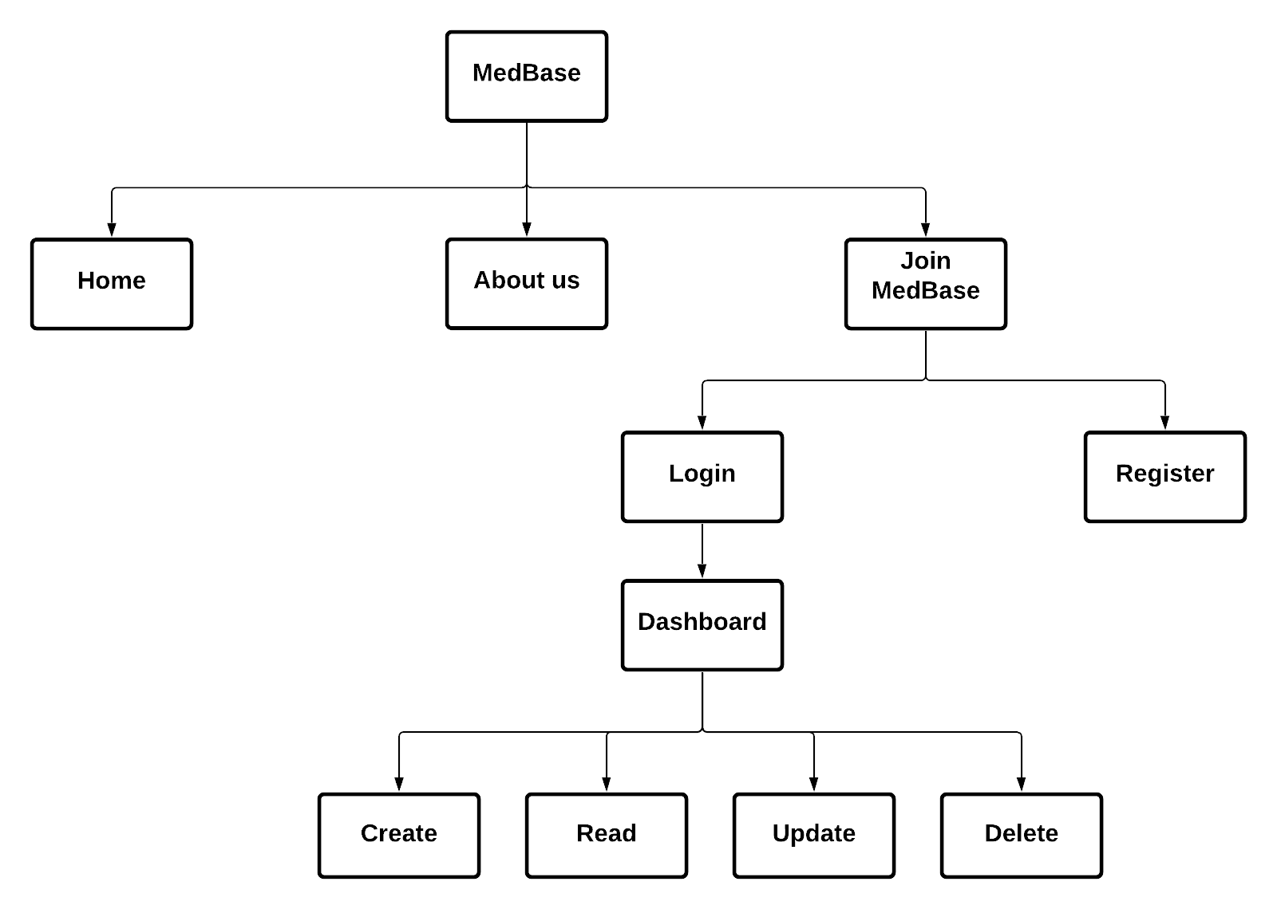

Slide 7


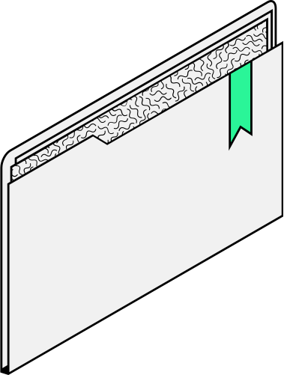
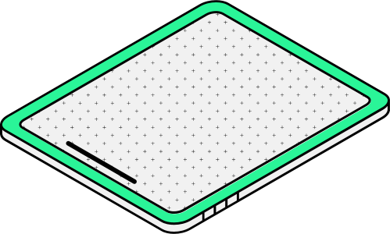
Technologies

Slide 8





Frontend
Technologies

Slide 9




Backend
Technologies

Slide 10

Do you have any questions?

Slide 11
THANK YOU!

