Slide 1


Distributed Programming and Networking
Project proposal: System for managing patients’ medical information
Manuel Ojeda
Alexandra Albu
Alexandru Vasile

Slide 2
Outline
Abstract
Mockups
Client-side languages
Server-side languages
Timetable

Slide 3
Abstract

Slide 4
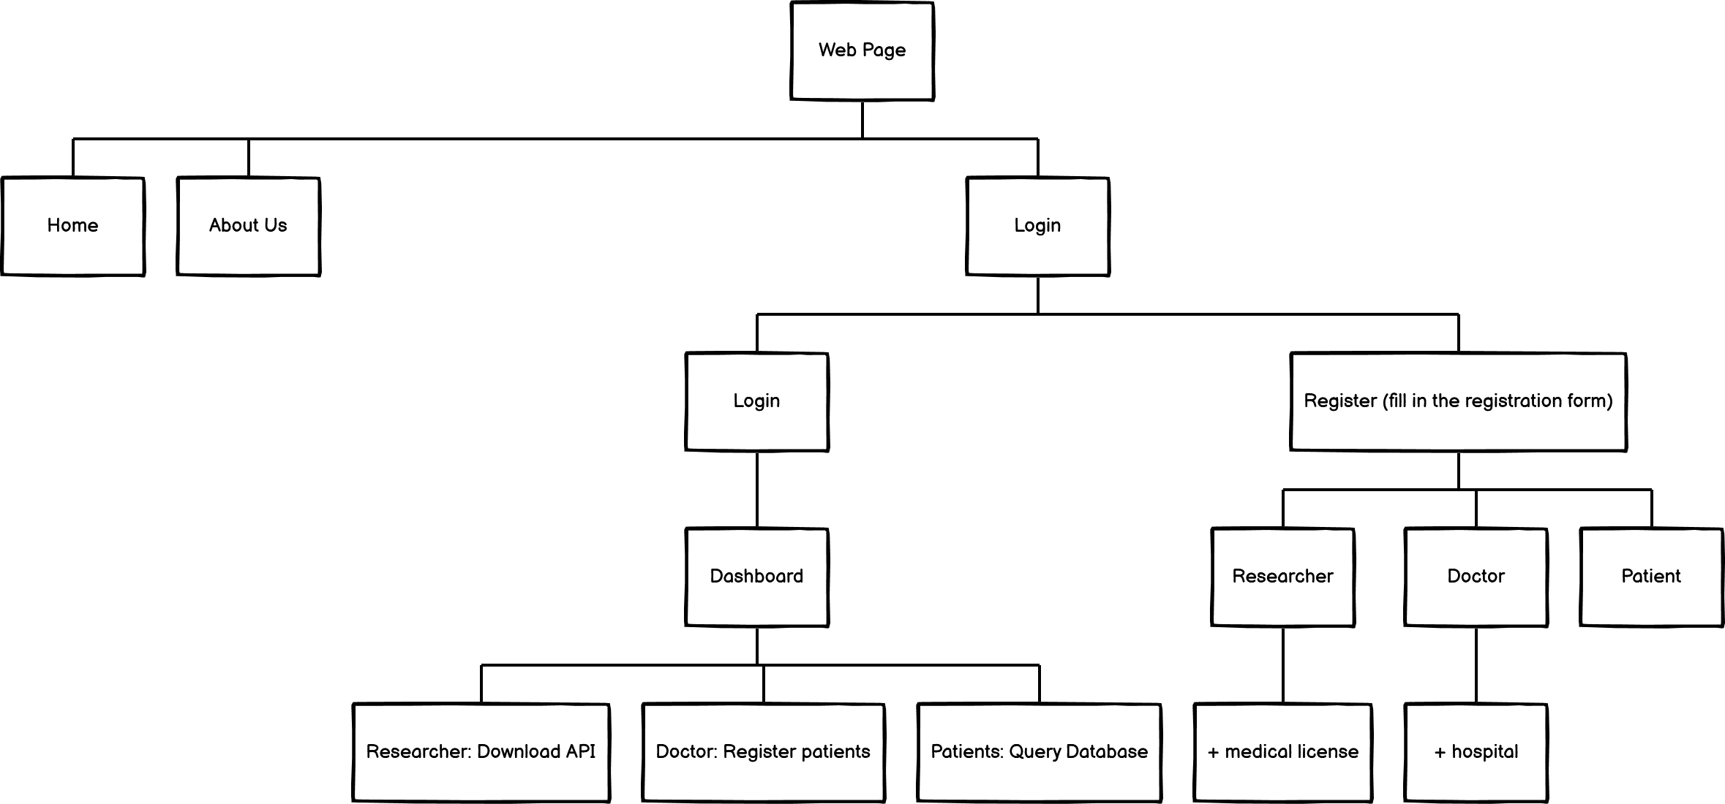
Flowchart

Slide 5
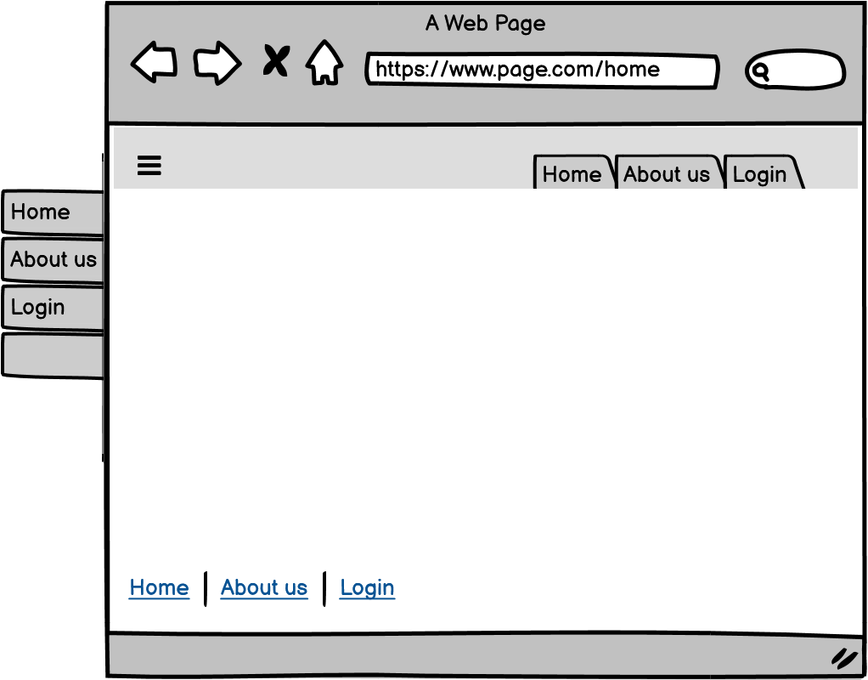
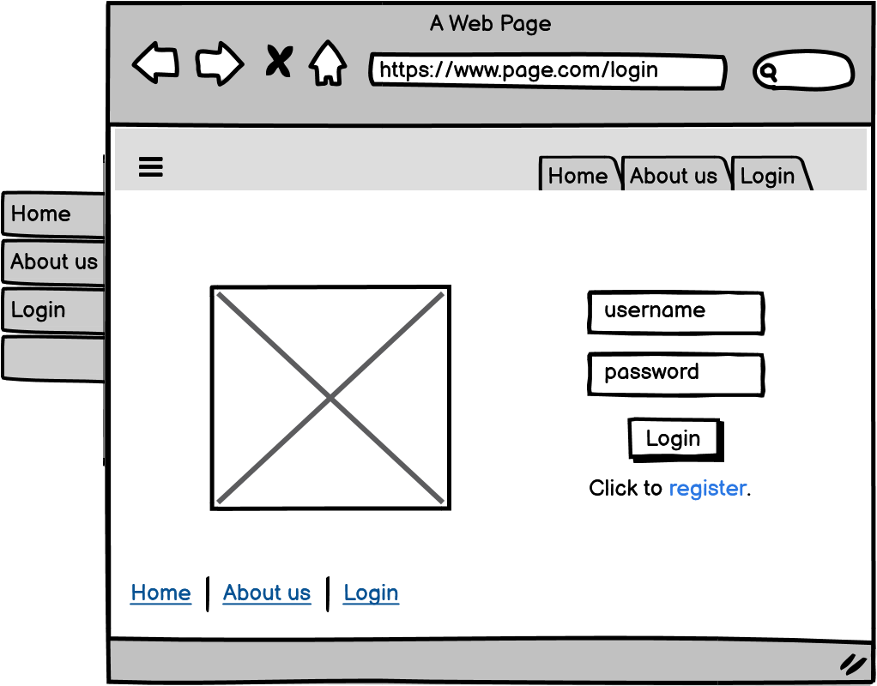

Slide 6
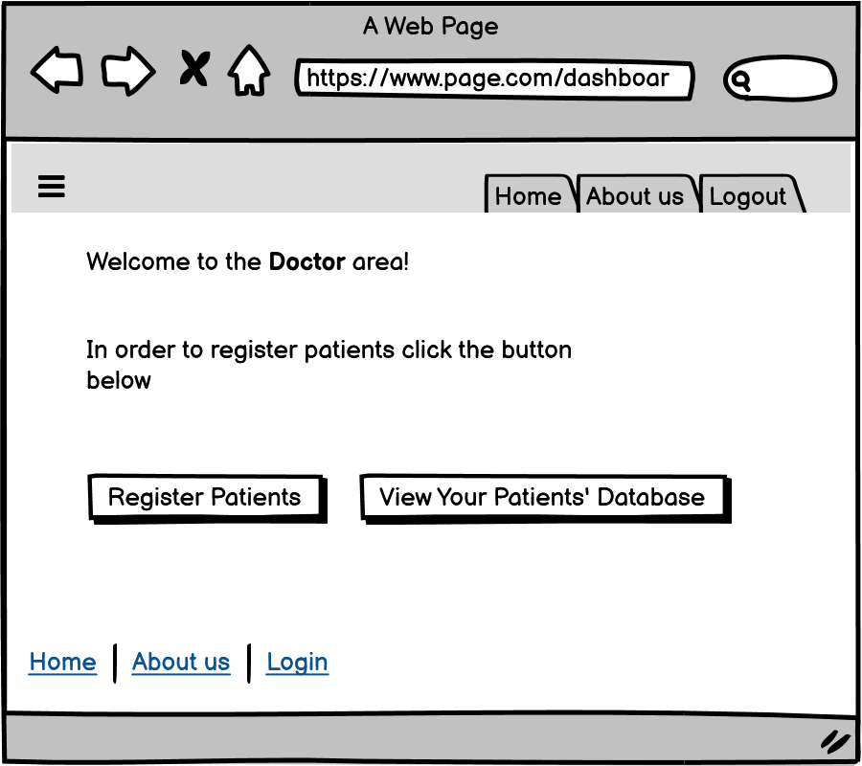
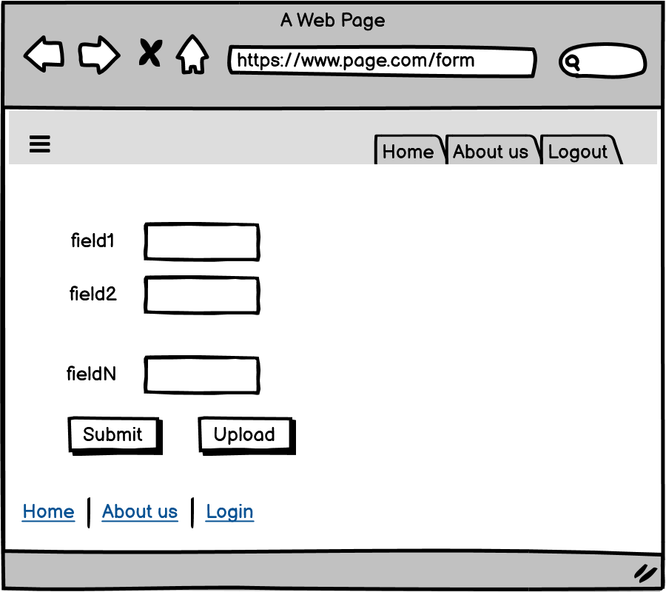

Slide 7
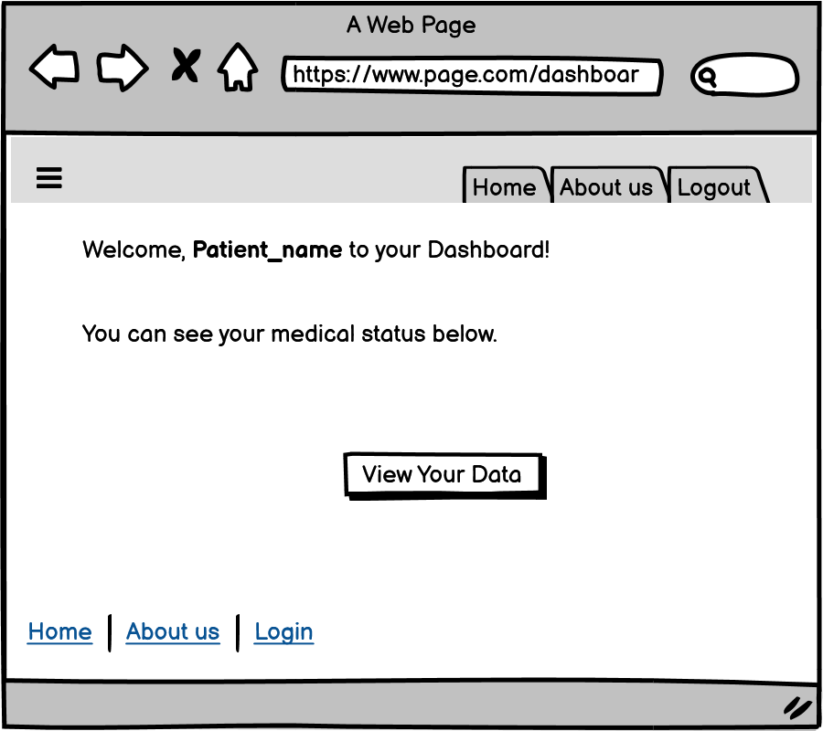
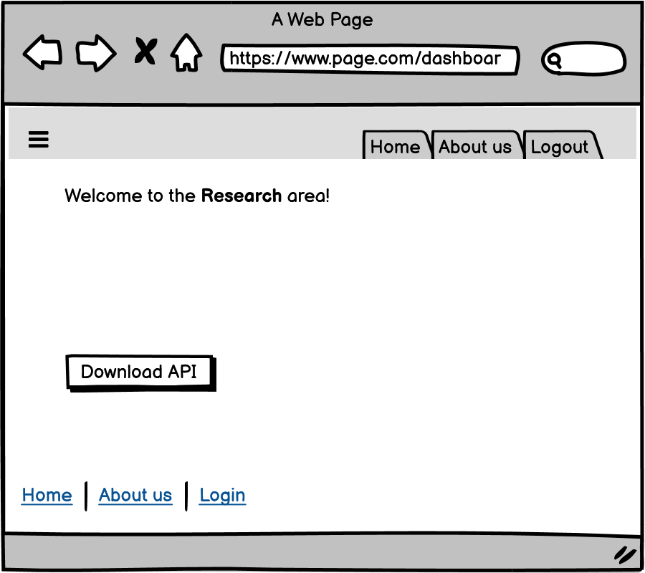

Slide 8
Must | Should | Could
home | different register pages | help chatbot
about us | dashboard for: patients, doctors, researchers | mobile version
login
medical information submision form

Slide 9




Languages to be used

Slide 10
Timetable
ACTIVITY | BEGINNING | END | DURATION | 3 | 4 | 5 | 6 | 7 | 8 | 9 | 10 | 11 | 12 | 13 | 14 | 15 | 16 | 17 | 18 | 19 | 20 | 21 | 22 | 23 | 24 | 25 | 26 | 27 | 28 | 29 | 30 | 31 | 1 | 2 | 3 | 4
Project Proposal | 3. may. 2021 | 7. may. 2021 | 5
CLIENT SIDE | 8. may. 2021 | 22. may. 2021 | 15
JAVASCRIPT | 8. may. 2021 | 12. may. 2021 | 5
JSON | 13. may. 2021 | 17. may. 2021 | 5
HTML | 18. may. 2021 | 22. may. 2021 | 5
SERVER SIDE | 23. may. 2021 | 31. may. 2021 | 15
NODE.JS | 23. may. 2021 | 27. may. 2021 | 5
MONGODB | 28. may. 2021 | 31. may. 2021 | 5
Final revision | 1. jun. 2021 | 4. jun. 2021 | 4

Slide 11
THANK YOU!

