Slide 1
Distributed Programming and Networking – AA 2020/2021
Project proposal: Title of the project
Authors: John Doe, Paolino Paperino
(johndoe@xxx.com , paolinopaperino@yyy.com)

Slide 2
Outline
Abstract (500 words maximum)
Mockup of the application with a brief description
Client side languages, environment and technologies
Server side languages, environment and teghnologies
Timetable (hint: SCRUM framework, https://www.scrum.org/ )

Slide 3
Abstract
500 words maximum

Slide 4
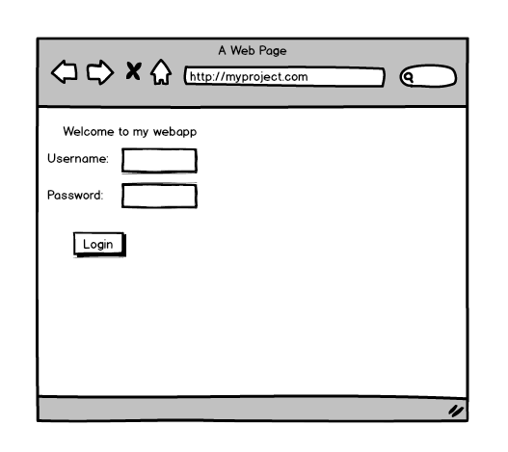
Mockup
Login (Must have)
There are different solutions for mockup creation. One of this is Balsamiq: https://balsamiq.com/
With indication of MoSCoW attributes : https://en.wikipedia.org/wiki/MoSCoW_method (all “Must have” and “Should have” at least have to be realized!)

Slide 5
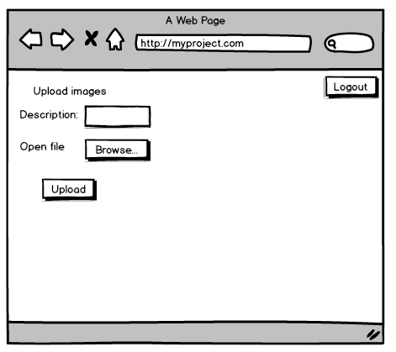
Mockup
Upload of multimedia (Must have)
There are different solutions for mockup creation. One of this is Balsamiq: https://balsamiq.com/
With indication of MoSCoW attributes : https://en.wikipedia.org/wiki/MoSCoW_method (all “Must have” and “Should have” at least have to be realized!)

Slide 6
Mockup
User info update (Should have)
There are different solutions for mockup creation. One of this is Balsamiq: https://balsamiq.com/
With indication of MoSCoW attributes : https://en.wikipedia.org/wiki/MoSCoW_method (all “Must have” and “Should have” at least have to be realized!)

Slide 7
Client side
Languages, environment and technologies
Javascript
XML
Etc.

Slide 8
Server side
Languages, environment and technologies
Firebase
Node.js
MongoDB
Spring/Struts2
Etc.

Slide 9
Timetable
Timetable (based on SCRUM or GANTT diagram or other models …)
Number of sprint (for SCRUM)
Backlog (collection of user stories) (for SCRUM)
Sprint backlog (for SCRUM)
…
This is only for who knows SCRUM!!

Slide 10
Thank you
FOR YOUR ATTENTION

