Slide 1


Distributed Programming and Networking
SYSTEM FOR MANAGING PATIENTS’ MEDICAL INFORMATION
Project Proposal:
Alexandra Albu
Manuel Ojeda
Alexandru Vasile

Slide 2
OUTLINE
Abstract
Mockups
Client-side languages
Server-side languages
Timetable

Slide 3
ABSTRACT
As healthcare advances more and more into this digital era, medical data proliferates in the form of electronic records. This phenomenon brings along the need for healthcare databases. These replace old formats of data documentation like paper documents, file folders and filing cabinets. They are fast, secure and convenient and they can provide real-time access to patient data from virtually anywhere in the world. Today, this kind of databases are used as a foundation for transactional systems: patient satisfaction systems, patient ID, administration, billing and payment processing, HR, education and, the focus of this project, research.
AI technology has tremendous potential in the medical world with applications like Computer-Aided Diagnosis or cell image segmentation. In particular, Deep Learning, a branch of Machine Learning dealing in large architectures capable of hierarchical learning, benefits a lot from being trained with large amounts of data. As stated before, now more then ever, this data exists but is disproportionately distributed throughout the world. Access to significantly large medical datasets is notoriously hard to gain and many teams of researchers are forced to wait a long time for said datasets or, in the worst case, completely shift their interest away from the medical world. We believe that data availability is something that can benefit companies large and small, hospitals, but most importantly, patients.
3

Slide 4
ABSTRACT
Medical databases are as useful as the applications that run on them, so having a centralized global medical database on which most of the medical applications in the world can become the most useful variant of this concept.
This project represents a web gateway into such a system. With the deluge of data we are faced with and the above-mentioned advances in AI, this kind of initiative has become very popular in the scientific community in various fields: from material science to genetics or mechanical engineering. The issue that we hope to address in this project is the ease of access to healthcare databases by prototyping an application that allows for quick and easy access for doctors, patients and researchers to such a database..
From a real-world-value point of view, this project is valuable for its developers because it can scale with later parcourse through academia: by working on such this proof-of-concept now, the members of this team will be more familiar with this kind of initiatives when the need will arise to work with such frameworks in our future.
4

Slide 5
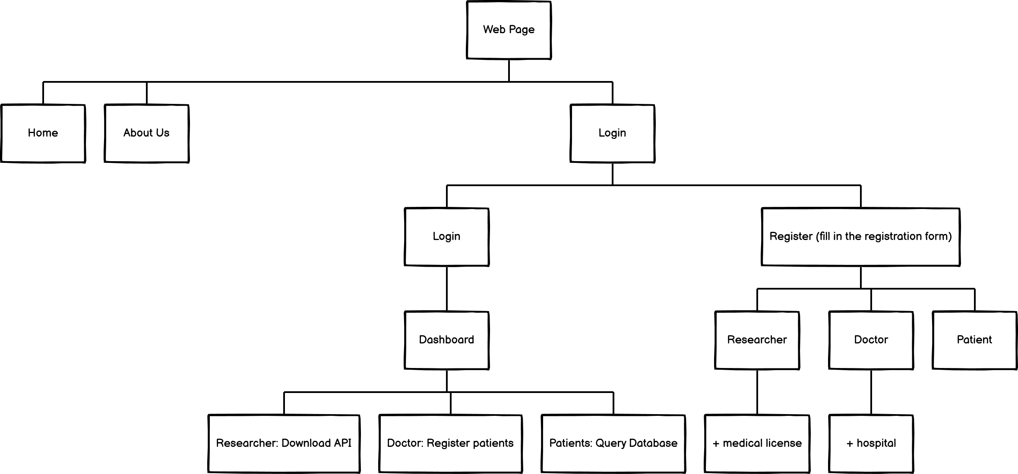
STRUCTURE
5

Slide 6
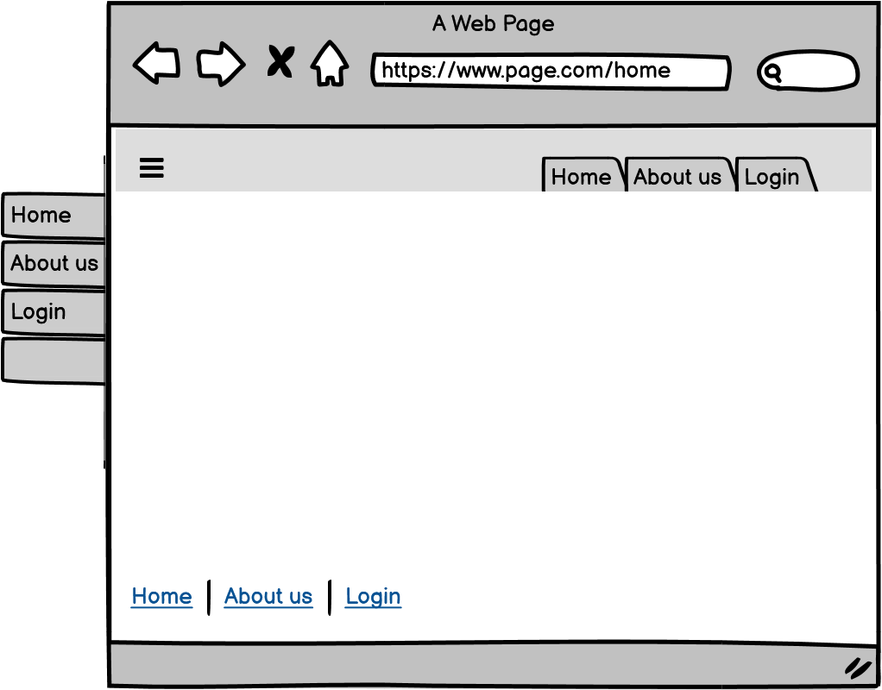

MOCKUPS -PRIMARY-
6

Slide 7
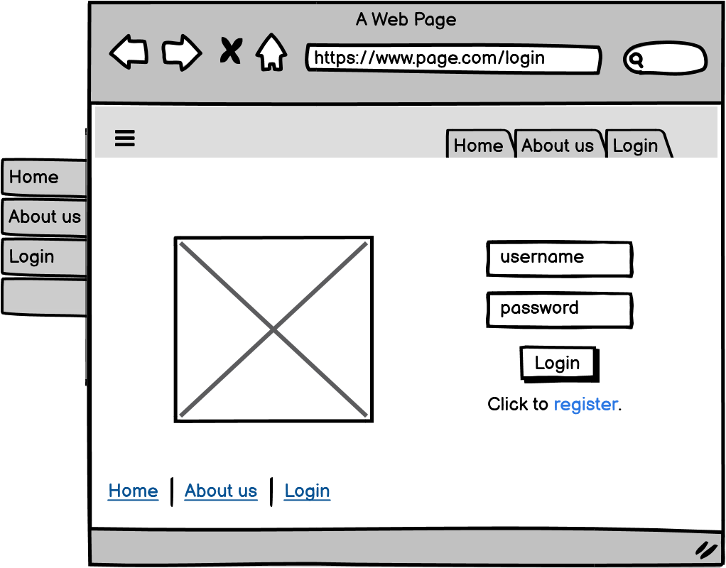
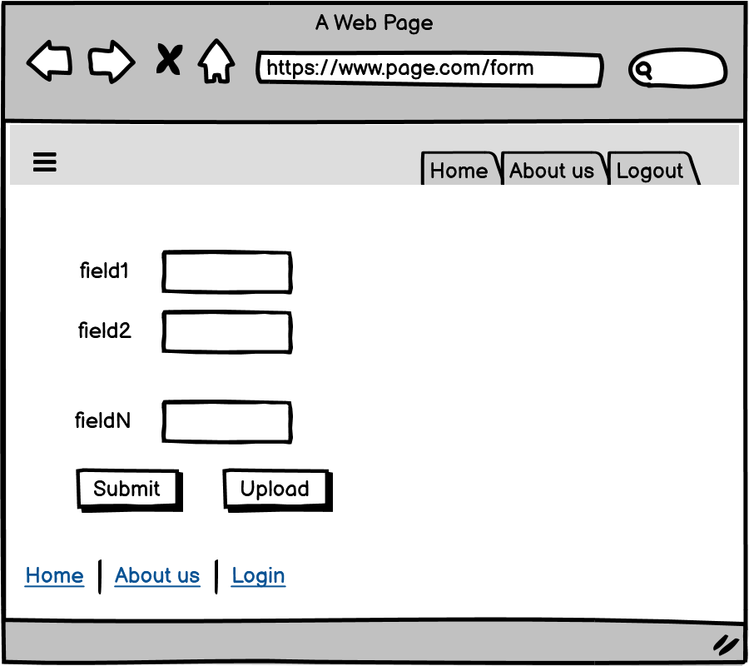
MOCKUPS -FORMS-
7

Slide 8
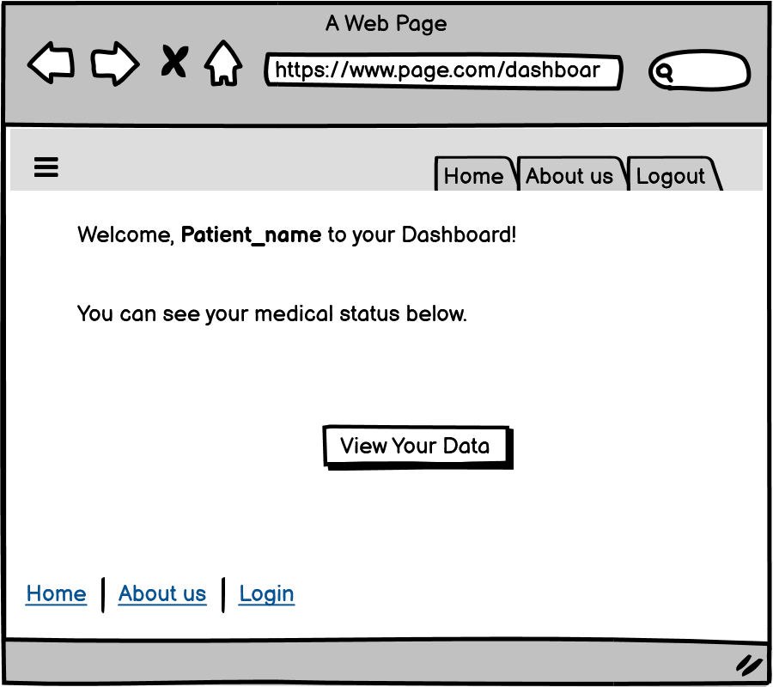
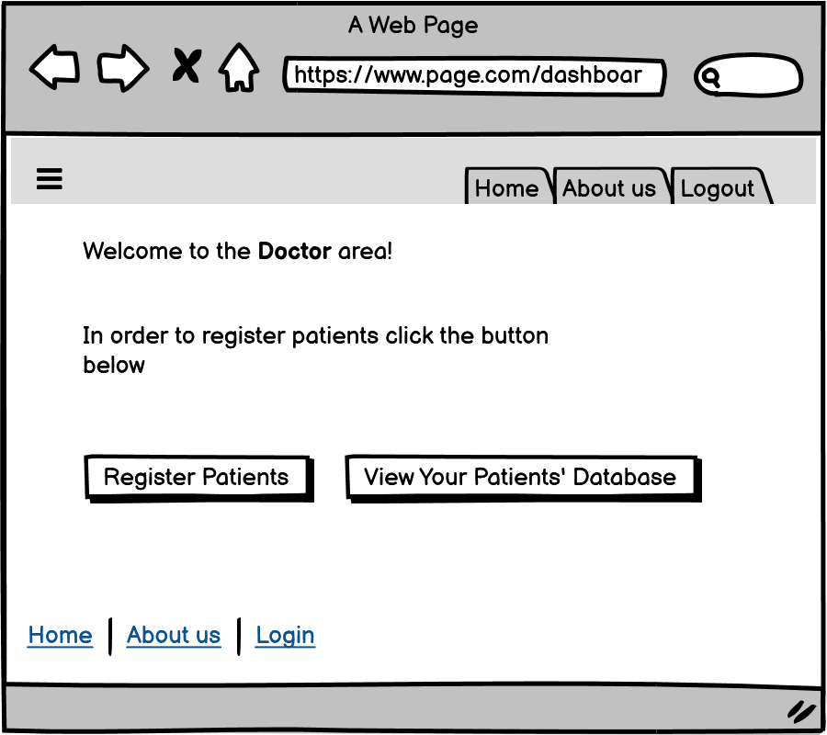
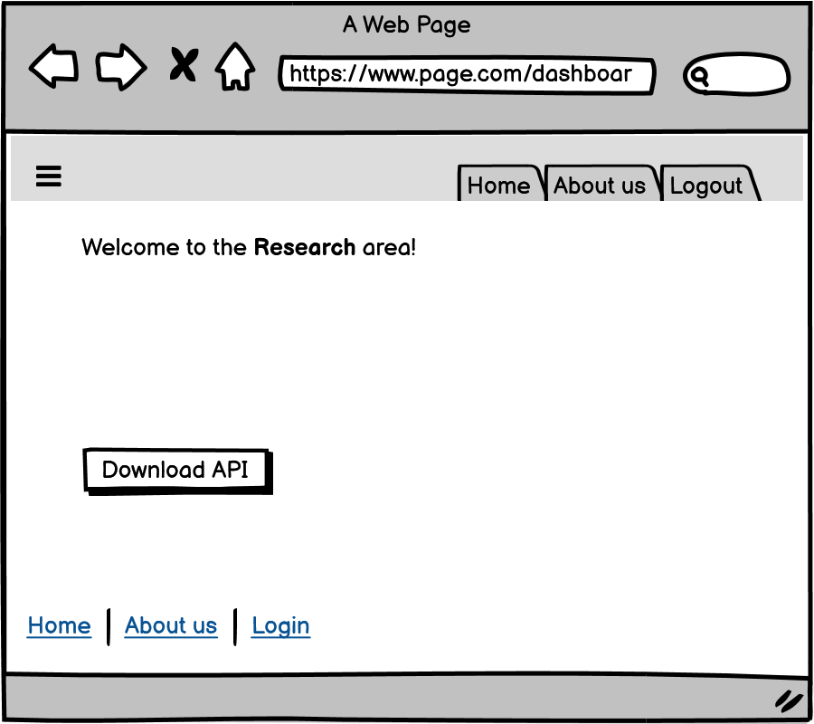
MOCKUPS -CLIENT VIEW-
8

Slide 9
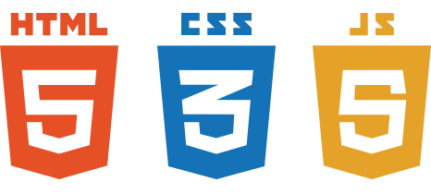
CLIENT-SIDE LANGUAGES
9

Slide 10
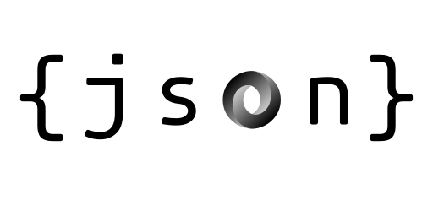

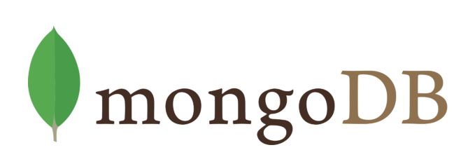
SERVER-SIDE LANGUAGES
10

Slide 11
TIMETABLE
ACTIVITY | BEGINNING | END | DURATION | 3 | 4 | 5 | 6 | 7 | 8 | 9 | 10 | 11 | 12 | 13 | 14 | 15 | 16 | 17 | 18 | 19 | 20 | 21 | 22 | 23 | 24 | 25 | 26 | 27 | 28 | 29 | 30 | 31 | 1 | 2 | 3 | 4
Project Proposal | 3. may. 2021 | 7. may. 2021 | 5
CLIENT SIDE | 8. may. 2021 | 22. may. 2021 | 15
JAVASCRIPT | 8. may. 2021 | 12. may. 2021 | 5
JSON | 13. may. 2021 | 17. may. 2021 | 5
HTML | 18. may. 2021 | 22. may. 2021 | 5
SERVER SIDE | 23. may. 2021 | 31. may. 2021 | 15
NODE.JS | 23. may. 2021 | 27. may. 2021 | 5
MONGODB | 28. may. 2021 | 31. may. 2021 | 5
Final revision | 1. jun. 2021 | 4. jun. 2021 | 4
11

Slide 12
THANK YOU!

