Slide 1
Classification challenge on Alzheimer’s Disease using MRIs and Gene Expression data
May 17, 2021
(version 2)

Slide 2
The problem
AD affects about 50M people in the world*
→ need for early diagnosis
AD (macro-)stages
CN (Cognitively normal): no deficit
MCI (Mild Cognitive Impairment): few deficits
AD (Alzheimer’s Disease): dementia
*[WHO2019]

Slide 3
“Hints” from different types of data
Demographic (age, gender, instruction, …)
Clinical evaluation (cognitive tests)
CSF (Cerebrospinal fluid)
Medical imaging (MRIs, PETs, DTIs, …)
Transcriptomics (gene expression, …)

Slide 4
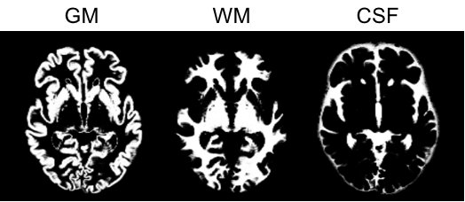

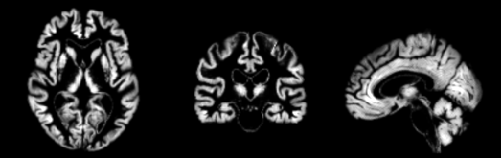
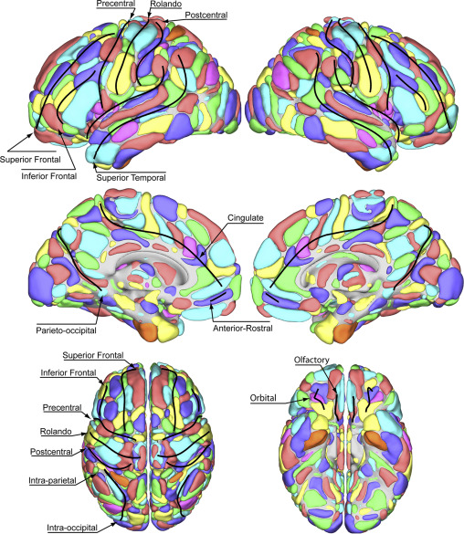
Features from MRIs
Inter-subject registration (group template)
Tissue segmentation, bias correction and spatial normalization
Average grey matter densities obtained from each anatomical region defined in an atlas
All images mapped to a common space (MNI), providing a voxel-wise correspondence across subjects
AICHA Atlas

Slide 5
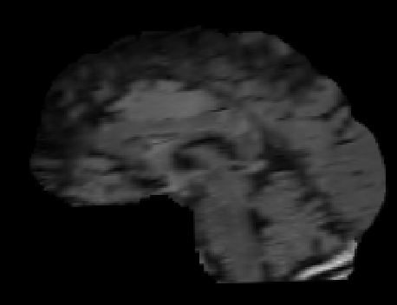
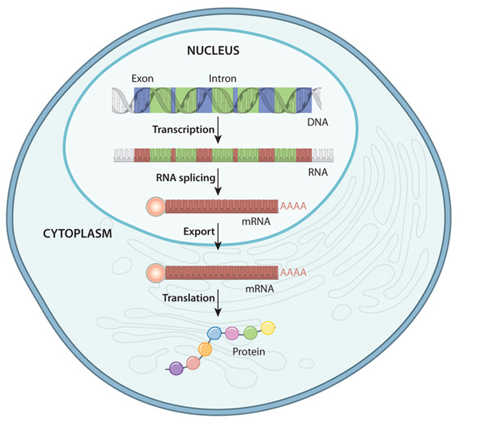
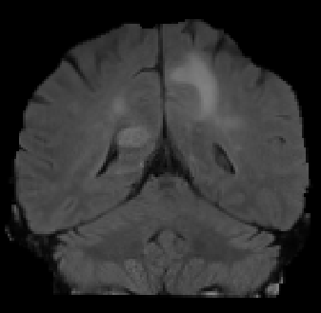
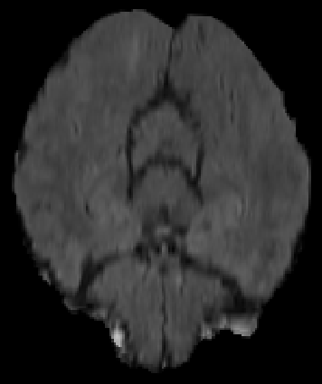
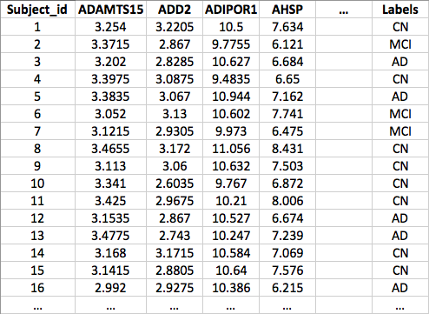
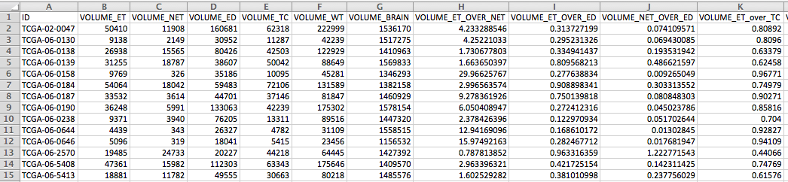
Combined Data
MRI data
GE data

Slide 6
You will receive
3 training datasets for 3 different binary classification problems. These are to be used for training 3 separate classifiers, experimenting different classifiers, feature selection methods, etc. and validating them through cross-validation
3 test datasets (one for each binary problem) to test the classifier and provide the obtained predictions

Slide 7
Training data
1) ADCNtrain.csv: training data for binary classification problem to discriminate AD vs. CN patients
First column: Subject_id (ID of the patient)
Columns from 2 to 566: MRI+GE features
Last column: Label (patient classification: ‘AD’ or ‘CN’)
Overall 234 patients: 34 AD and 200 CN
2) ADMCItrain.csv: training data for binary classification problem to discriminate AD vs. MCI patients
First column: Subject_id (ID of the patient)
Columns from 2 to 596: MRI+GE features
Last column: Label (patient classification: ‘AD’ or ‘MCI’)
Overall 376 patients: 34 AD and 342 MCI
3) MCICNtrain.csv: training data for binary classification problem to discriminate MCI vs. CN patients
First column: Subject_id (ID of the patient)
Columns from 2 to 421: MRI+GE features
Last column: Label (patient classification: ‘MCI’ or ‘CN’)
Overall 542 patients: 342 MCI and 200 CN

Slide 8
Example of training dataset
Subject_id | Background | G_frontal | … | ADIPOR1 | AHSP | … | Labels
ADCN_001 | 3.254 | 3.2205 |  | 10.5 | 7.634 |  | CN
ADCN_002 | 3.3715 | 2.867 |  | 9.7755 | 6.121 |  | CN
ADCN_003 | 3.202 | 2.8285 |  | 10.6265 | 6.684 |  | AD
ADCN_004 | 3.3975 | 3.0875 |  | 9.4835 | 6.65 |  | CN
ADCN_005 | 3.3835 | 3.067 |  | 10.944 | 7.162 |  | AD
ADCN_006 | 3.052 | 3.13 |  | 10.6015 | 7.741 |  | CN
ADCN_007 | 3.1215 | 2.9305 |  | 9.973 | 6.475 |  | CN
ADCN_008 | 3.4655 | 3.172 |  | 11.0555 | 8.431 |  | CN
ADCN_009 | 3.113 | 3.06 |  | 10.632 | 7.503 |  | CN
ADCN_010 | 3.341 | 2.6035 |  | 9.767 | 6.872 |  | CN
… | … | … | … | … | … | … | …

Slide 9
Test data
1) ADCNtest.csv: test data for binary classification problem to discriminate AD vs. CN patients
First column: Subject_id (ID of the patient)
Columns from 2 to 566: MRI+GE features
Overall 58 patients
2) ADMCItest.csv: test data for binary classification problem to discriminate AD vs. MCI patients
First column: Subject_id (ID of the patient)
Columns from 2 to 596: MRI+GE features
Overall 94 patients
3) MCICNtest.csv: test data for binary classification problem to discriminate MCI vs. CN patients
First column: Subject_id (ID of the patient)
Columns from 2 to 421: MRI+GE features
Overall 136 patients

Slide 10
Your submission will consist of
For each binary classification problem
Two RData files whose name are formatted as:
StudentRegistrationNumber_FamilyName_challenge2_*res.Rdata StudentRegistrationNumber_FamilyName_challenge2_*feat.Rdata
where * denotes the classification problem (ADCN, ADMCI, or MCICN)
1.a) The first file will contain two columns
the ID of the test observation;
the predicted label.
1.b) The second file will contain the column index in the training data files (from 2 to end-1) of the selected features.
A presentation in PDF with up to 6 pages, in which you describe how you obtained the model. It is NOT mandatory to choose the same classification model for the three different binary problems; just choose the one that leads to the most promising results.
The R macro (script) named solution.R used to obtain the results.

Slide 11
The winner is…
For each binary problem, the results will be ranked according to
AUC (e.g., auc R function from pROC) and
MCC (e.g., mcc R function from mltools)
Therefore, for each of the three problems there will be two winners, one for each metric

Slide 12
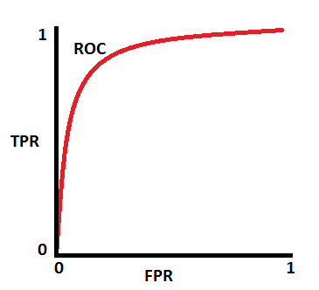
Metrics
Percentage of correctly classified samples
Percentage of negative samples correctly identified
Percentage of positive samples correctly classified (Recall or TPR)
Percentage of positive samples correctly classified, considering the set of all the samples classified as positive
Compromise between sensitivity and precision
Uses the ROC curve to exhibit the trade-off between the classifier's TP and FP rates
Correlation coefficient between observed
and predicted binary classifications

Slide 13
Example results
Average performance of 10 iterations of 5-fold CV on the training datasets:
 | Acc | Sens | Spec | Prec | F1 | AUC | MCC
AD vs CN | 0.934 | 0.661 | 0.980 | 0.870 | 0.735 | 0.935 | 0.717
AD vs MCI | 0.919 | 0.370 | 0.973 | 0.592 | 0.441 | 0.854 | 0.421
MCI vs CN | 0.600 | 0.660 | 0.498 | 0.694 | 0.675 | 0.604 | 0.156
B) Performance on the test datasets using a
classifier trained on the training data:
 | Acc | Sens | Spec | Prec | F1 | AUC | MCC
AD vs CN | 0.948 | 0.875 | 0.960 | 0.778 | 0.824 | 0.973 | 0.795
AD vs MCI | 0.915 | 0.500 | 0.953 | 0.500 | 0.500 | 0.929 | 0.453
MCI vs CN | 0.544 | 0.663 | 0.340 | 0.633 | 0.648 | 0.549 | 0.003

