Slide 1
Pod 00: Prerequisites
Get set up before your first Learning Pod — do this on your own time
Pre-work | Time needed: 20–30 minutes

Slide 2
Pre-requisites before Session 1
1. Download Claude Code (if you want to use it in command-line, also get warp.dev)
2. Login to Claude Code with your team’s account
3. Create a github account. It will be as important as your Google account.
That’s it.
If you set it up correctly, we will all be able to collaborate on Claude Code projects when we start the learning pod.
Setup details follow. If you already have one or more of these tools, skip to the next step.

Slide 3
Step 1: Claude Code
Takes approx 5-10 min

Slide 4
Understanding Claude’s Offerings
Offering | What can it do? | Relevant to this course?
Claude.ai | Similar to chatgpt.com – you send some text, it sends back text | No, it’s useless for problem solving. We don’t want answers, we want results.
Claude for Desktop | Desktop App that lives in your machine. It can access all data in your machine, and run code on your behalf. | Yes, but only the “Code” tab, not “Cowork” and definitely not “Chat”. AI doing things for you is dangerous (it could wipe out your hard disk). So, Anthropic has built multiple versions with differing level of guardrails. My only problem with this is it often tells me to do the thing instead of doing the thing. But the “Code” tab gets you 95% of the way there. So if you feel any fear / friction in getting started, just use this. It’s not much different from using any other desktop application (word / excel / whatever)
Claude Code CLI | This is what “Claude for Desktop” is using in the backend. It is the most configurable, reliable, powerful way to get AI to do things for you. | Yes. This is legit. Command line interfaces give you complete control of your computer. Using claude via commandline gives claude complete control of your computer. Your computer can access But people find terminal / commandline irritating, and I won’t force you to do it.
Either use the “Code” tab in the Claude Desktop app (easier, faster). Or, install Claude Code via terminal (harder, better).

Slide 5
Decide your final setup
Situation | Suggested setup | Why?
I’m not technically proficient (eg. haven’t built a complex Excel file / Slack automation / n8n workflow ) | Just get the Claude Desktop app – Step 1a | Very Easy, you can upgrade later.
I’m am technically proficient (eg. have built a complex Excel file / Slack automation / n8n workflow) | Try getting Claude Code – Steps 1a, 1b, 1c | More powerful (slightly), is more transparent about what AI is doing, and will force you to become more technical over time (good)
Both choices are fine. But if you use the desktop app, make sure you’re using the “Code” tab – not “Chat”, not “Cowork”.
Hereafter, we’ll refer to both as “Claude Code”. Do whatever works best for you.

Slide 6
Step 1a (Easy) : Claude Desktop

Slide 7
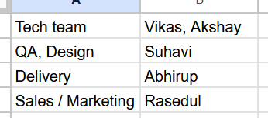
1a. Install Claude Desktop
1. Go to claude.ai/download and click Download for your OS
2. Install it, open the app, and sign in with your Claude Pro or Max account
3. Go to the “Code” tab. It should ask you to select a folder to work in. Select desktop, and test, “Can you describe what you see in this folder”
If you don’t have a claude account, check with the relevant person on your team

Slide 8
Step 1b (Harder) : Claude Code via Terminal
Optional
SKIP TO SLIDE 14 IF YOU WANT TO STICK TO THE GUI

Slide 9
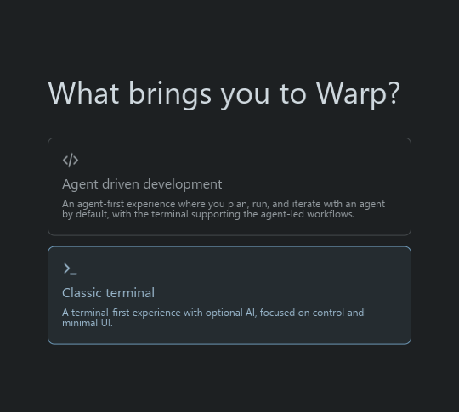
Install Warp
We would like to interact with Claude in an environment it’s purpose-built for. Text-only.
You need a text-only tool. Your laptop comes with one – it’s called “Terminal” and you’ll often see this setup referred to as “Claude Code on Terminal”.
But the default terminal is a bit hard to use, so we’ll use Warp instead 1. Go to warp.dev and click Download (we will need it to paste commands to our PC)
2. Open the downloaded file and follow the install prompts. Opt for default, agent-less mode
3. Open Warp — you should see a dark window with a text box at the bottom 4. If it launches, great. We’ll install Claude code for terminal and then come back here.

Slide 10
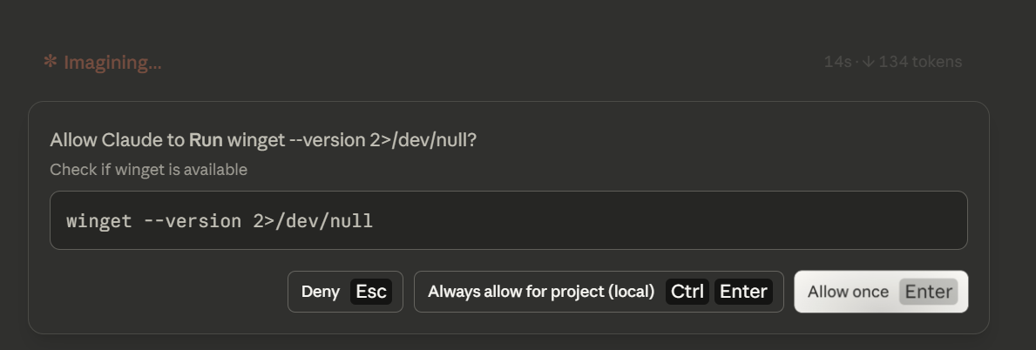
Copy This Prompt into the “Code” Tab (not Cowork)
I need you to install Claude Code so I can use it via command line. I’m using warp.dev (not native terminal / PowerShell). Detect my operating system, install everything that is needed (including Node.js etc if missing), and walk me through each step one at a time. If some installations are needed, just do them. Do not ask me to run bash commands. You can do it, do it. Only ask me to do anything if it’s literally impossible for you to run the command yourself. If you do ask me to run a command, be extremely precise in what you want me to launch, run, do etc.
Keep in mind I want to launch Claude CLI on warp.dev (not native terminal), it might add its own pathing issues. In general, I anticipate endless pathing issues (particularly on windows). Do not even think about telling me you are done without verifying that typing "claude" in warp while working in any directory will launch claude cli without issues.
You will be prompted to click “Yes” a few times. Just do it.

Slide 11
Launch CLI
• Follow each step Claude Desktop gives you — if anything fails, paste the error back and ask Claude to help (typically more painful on Windows than on Mac, but struggle through it and try to follow its instructions – it’s good practice for where we’re going)
• When done: open Warp, type `claude`, press Enter — you should see a welcome message.
• If it asks you to sign in, follow the prompts — it opens your browser

Slide 12
Troubleshooting
Problem | What to do
`claude: command not found` | Close Warp completely, reopen it, try again
`npm: command not found` or `Permission denied` | Paste the exact error into Claude Desktop and ask what to do
Can't sign in to Claude | Make sure you have an active Pro or Max subscription at claude.ai
Warp not installed | Download free from warp.dev
Tried everything, still stuck | Screenshot the error and message #d-ai-learning-pod. I will figure it out.

Slide 13
Step 2: Create a GitHub Account
Takes approx 5-10 min

Slide 14
What is GitHub?
• Think of it like Google Drive, but for code — it's where all course materials live and where your Claude projects will get saved
• It remembers every version, forever — unlike Word which overwrites your file each time you save, GitHub keeps the full history so you can always roll back if something breaks
• It handles teamwork automatically — if two people edit different parts of the same project, GitHub merges the changes without them overwriting each other
• You don't need to touch it directly — Claude Code manages all of this for you; you just need an account so your work saves to the right place

Slide 15
How to Create Your Account
1. Go to github.com in your browser
2. Click Sign Up
3. Use your @orennow.com email address
4. Pick a username — suggestion: your first name or `firstname-oren` (e.g., `ijaz-oren`)
5. Complete the verification steps (a simple puzzle, then click the link in your @orennow.com email)

Slide 16
What's Next?
See you at 6pm, 1st April for Pod 01
We will start working with Claude together.
If you get stuck, message #d-ai-learning-pod on Slack

