Slide 1
Optimal Number of Data Repetitions in Data Encoding Introduction & Motivation
Motivations:
No-Cloning Theorem:
Classical circuits / NN can have fan-out (output of one node / neuron etc. can be the (copied) input to several others)
To get similar effect in QNN: multiple independent redundant encodings
Complex target functions require more information:
Easy way for representing nonlinearity
Trade-off between expressivity (distinguish finer variations of the input data) and practicality
Too few: Underfitting (lack of nonlinearity etc.)
To Many: Overfitting (noise amplification etc.)
Key references (papers and codes):
“Input Redundancy for Parameterized Quantum Circuit”
“Effect of data encoding on the expressive power of variational quantum-machine-learning models” (a more general paper then the above)
“Data re-uploading for a universal quantum classifier”
Tutorial
“Nonlinear transformations in quantum computation”
Notes:
Research of paper 1: Get the minimum number of redundant encodings required for PQCs to approximate (or reproduce) a target function

Slide 2
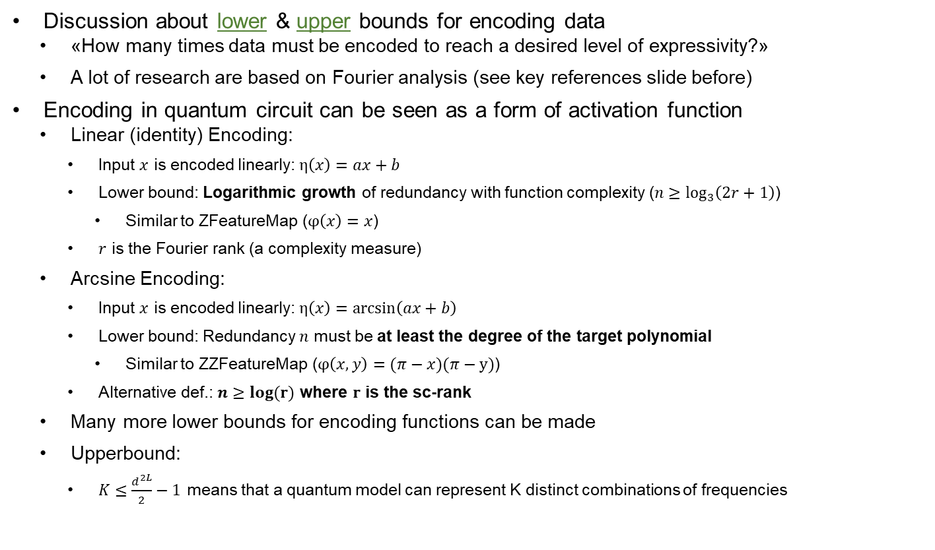
Optimal Number of Data Repetitions in Data Encoding Current State of the Field
Discussion about lower & upper bounds for encoding data
«How many times data must be encoded to reach a desired level of expressivity?»
A lot of research are based on Fourier analysis (see key references slide before)
Encoding in quantum circuit can be seen as a form of activation function
Linear (identity) Encoding:
Input $x$ is encoded linearly: $η\left(x\right)=ax+b$
Lower bound: Logarithmic growth of redundancy with function complexity ($n≥\log_{3}\left(2r+1\right)$)
Similar to ZFeatureMap ($φ\left(x\right)=x$)
$r$ is the Fourier rank (a complexity measure)
Arcsine Encoding:
Input $x$ is encoded linearly: $η\left(x\right)=\arcsin\left(ax+b\right)$
Lower bound: Redundancy $n$ must be at least the degree of the target polynomial
Similar to ZZFeatureMap ($φ\left(x,y\right)=(π−x)(π−y)$)
Alternative def.: $n≥log(r)$ where $r$ is the sc-rank
Many more lower bounds for encoding functions can be made
Upperbound:
$K≤\frac{d^{2L}}{2}−1$ means that a quantum model can represent K distinct combinations of frequencies
Notes:
PQCs:
Input Data -> Encoding to quantum state -> Quantum circuit processing (parameterizied) -> Approximate targe function f_target
Paper: Input Redundancy for Parameterized Quantum Circuits
Decision Considerations:
Existing input redundancy
Fourier-rank

Slide 3
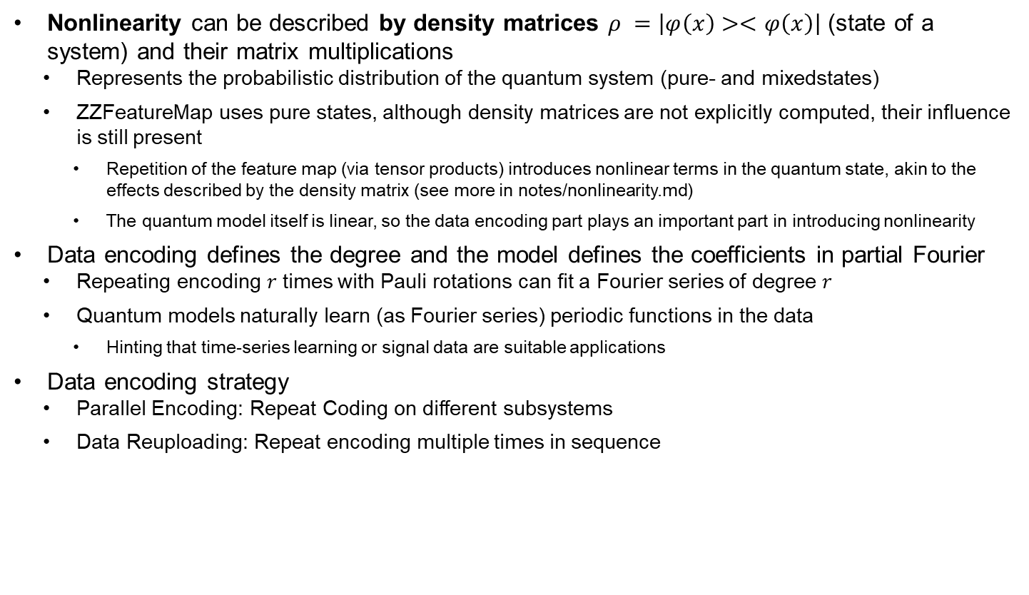
Optimal Number of Data Repetitions in Data Encoding Current State of the Field
Nonlinearity can be described by density matrices $ρ =\left|φ\left(x\right)><φ\left(x\right)\right|$ (state of a system) and their matrix multiplications
Represents the probabilistic distribution of the quantum system (pure- and mixedstates)
ZZFeatureMap uses pure states, although density matrices are not explicitly computed, their influence is still present
Repetition of the feature map (via tensor products) introduces nonlinear terms in the quantum state, akin to the effects described by the density matrix (see more in notes/nonlinearity.md)
The quantum model itself is linear, so the data encoding part plays an important part in introducing nonlinearity
Data encoding defines the degree and the model defines the coefficients in partial Fourier
Repeating encoding $r$ times with Pauli rotations can fit a Fourier series of degree $r$
Quantum models naturally learn (as Fourier series) periodic functions in the data
Hinting that time-series learning or signal data are suitable applications
Data encoding strategy
Parallel Encoding: Repeat Coding on different subsystems
Data Reuploading: Repeat encoding multiple times in sequence
Notes:
More notes on nonlinearity see notes folder

Slide 4
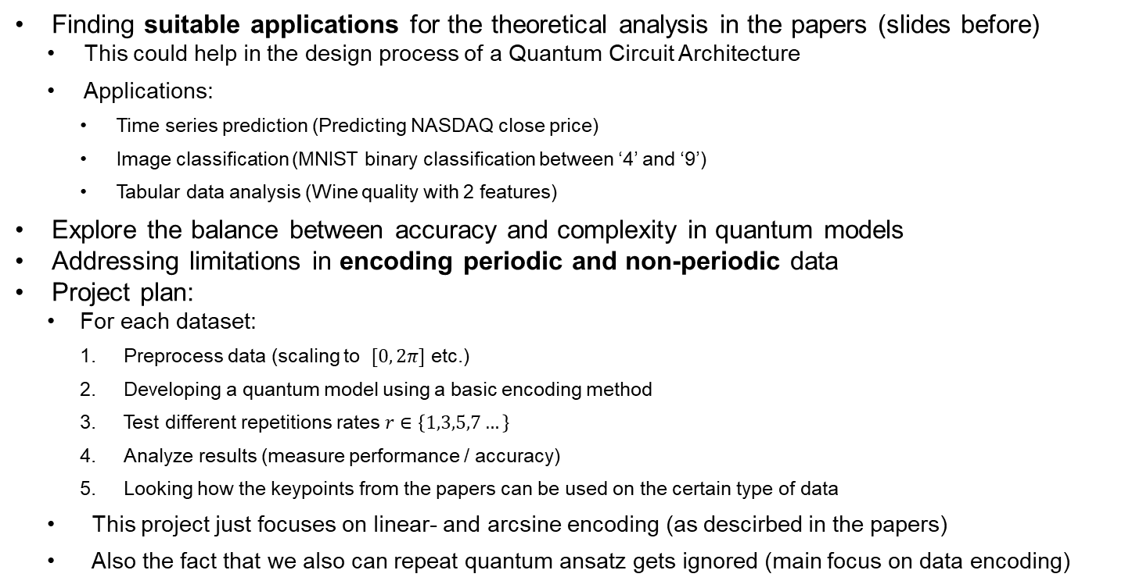
Optimal Number of Data Repetitions in Data Encoding Project Motivation & Process
Finding suitable applications for the theoretical analysis in the papers (slides before)
This could help in the design process of a Quantum Circuit Architecture
Applications:
Time series prediction (Predicting NASDAQ close price)
Image classification (MNIST binary classification between ‘4’ and ‘9’)
Tabular data analysis (Wine quality with 2 features)
Explore the balance between accuracy and complexity in quantum models
Addressing limitations in encoding periodic and non-periodic data
Project plan:
For each dataset:
Preprocess data (scaling to $[0, 2π]$ etc.)
Developing a quantum model using a basic encoding method
Test different repetitions rates $r∈\left\{1,3,5,7…\right\}$
Analyze results (measure performance / accuracy)
Looking how the keypoints from the papers can be used on the certain type of data
This project just focuses on linear- and arcsine encoding (as descirbed in the papers)
Also the fact that we also can repeat quantum ansatz gets ignored (main focus on data encoding)
Notes:
Expected outcomes:
Timeseries: Using an arcsine activation r>1 should give better results since they capture more frequencies
Images: I expect that linear function will work best for image classification
Tabular: Linear encoding might be sufficient for simple datasets where feature ordering does not impact the model

Slide 5
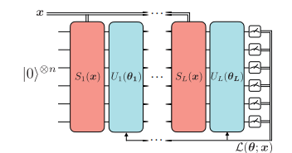
Optimal Number of Data Repetitions in Data Encoding Quantum Circuit Architectures Overview
Time series data (NASDAQ Close price)
Single qubit (for simplicity; extensible with other features like moving window avg etc.)
Uses an EstimatorQNN (NN Regressor); Trying both serial and parallel encoding methods and the encoding/ansatz scheme
Image data (MNIST classification)
a QSVM for binary classification between value 4. and 5.
Also using different feature maps and quantum kernel
Tabular data (Wine quality)
Using QSVM with multiclasses: Using FidelityQuantumKernel and ZZFeatureMap (no differentiation between parallel and sequential). Amount of Features: 2 (reduced because of executiontime)
Notes:
Goal: Write $f\left(x\right)$ as a partial Fourier series $f\left(x\right)=\sum_{n∈Ω}{c_{n}e^{inx}}$ series
Image from: Quantum computing models for artiﬁcial neural networks

Slide 6
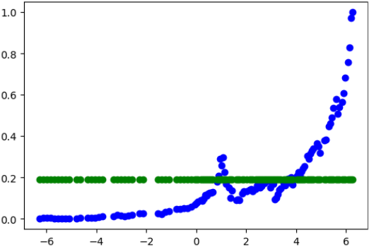
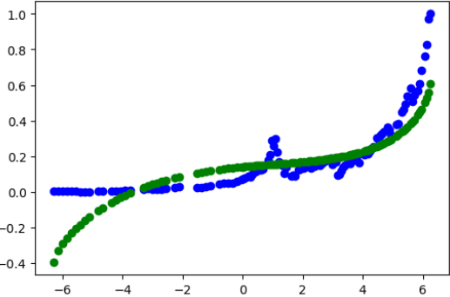
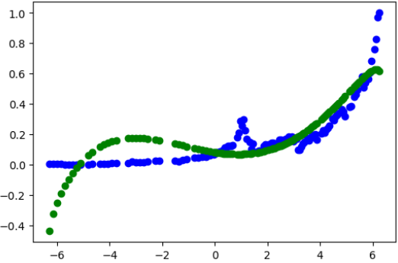
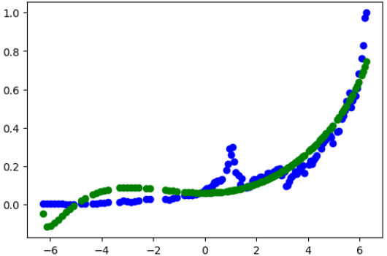
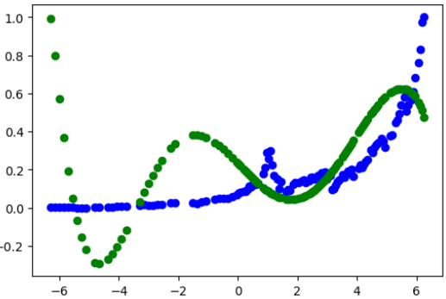
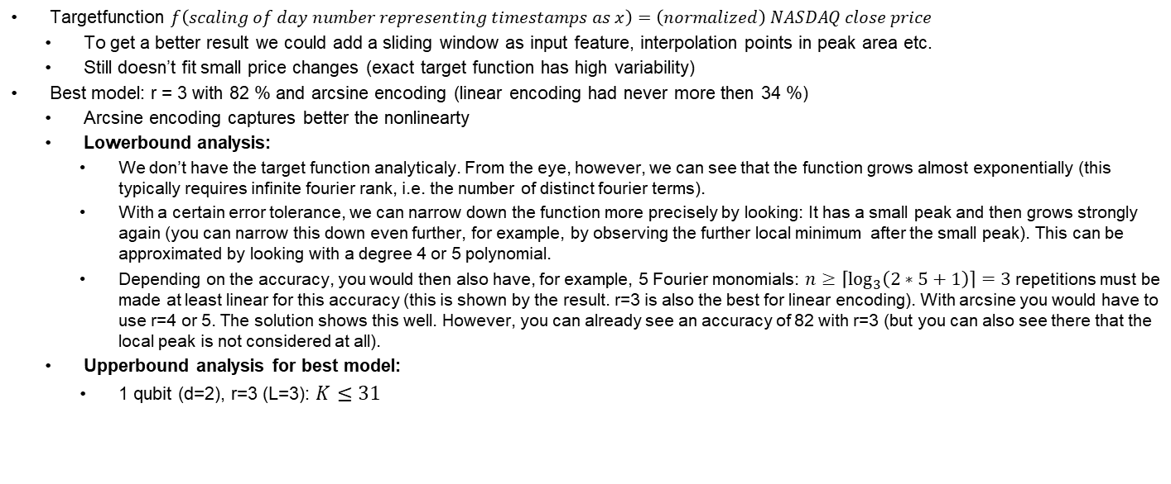
Optimal Number of Data Repetitions in Data Encoding Dataset 1: NASDAQ Close Price Prediction
Targetfunction $f\left(scaling of day number representing timestamps as x\right)=\left(normalized\right) NASDAQ close price$
To get a better result we could add a sliding window as input feature, interpolation points in peak area etc.
Still doesn’t fit small price changes (exact target function has high variability)
Best model: r = 3 with 82 % and arcsine encoding (linear encoding had never more then 34 %)
Arcsine encoding captures better the nonlinearty
Lowerbound analysis:
We don’t have the target function analyticaly. From the eye, however, we can see that the function grows almost exponentially (this typically requires infinite fourier rank, i.e. the number of distinct fourier terms).
With a certain error tolerance, we can narrow down the function more precisely by looking: It has a small peak and then grows strongly again (you can narrow this down even further, for example, by observing the further local minimum after the small peak). This can be approximated by looking with a degree 4 or 5 polynomial.
Depending on the accuracy, you would then also have, for example, 5 Fourier monomials: $n≥\left\lceil \log_{3}\left(2∗5+1\right)\right\rceil =3$ repetitions must be made at least linear for this accuracy (this is shown by the result. r=3 is also the best for linear encoding). With arcsine you would have to use r=4 or 5. The solution shows this well. However, you can already see an accuracy of 82 with r=3 (but you can also see there that the local peak is not considered at all).
Upperbound analysis for best model:
1 qubit (d=2), r=3 (L=3): $K≤31$
Effect of data re-uploading (serial) with arcsine encoding
0 %
82 %
-14 %
r=1
r=3
r=4
r=7
74 %
81 %
r=5
Notes:
Tried out a lot of different types of models: Here we have the best one for the serial time QNN

Slide 7
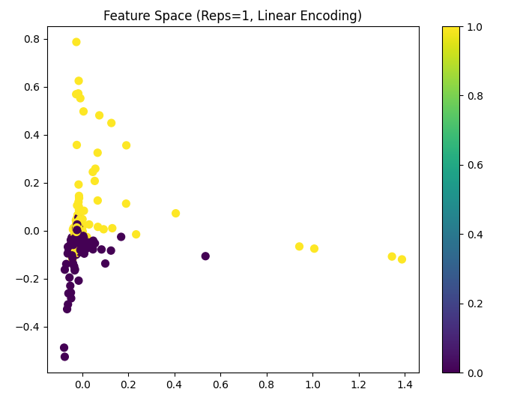
Optimal Number of Data Repetitions in Data Encoding Dataset 2: MNIST Digit Binary Classification
Trying to use different featuremaps: ZFeatureMap, ZZFeatureMap and PauliFeatureMap
ZZFeatureMap and PauliFeatureMap uses psi(x,y), and therefore it is not well suited for arcsine/linear comparision (because we dont want to use arcsine with psi(x,y)).
For a better comparision we take ZFeatureMap, which only uses psi-identity
Linear encoding is better suited (then arcsine) with 80 % accuracy in r=1 (images with low frequency components)
Arcsine encoding is better if images are more complex (more details, images with low frequency components), because of more complex behaviour
Accuracy Plateau: Increasing rep rates (1,3,…,15) does not improve accuracy (in
Resource Cost: Higher rep rates increase computation time and memory usage (MemoryError).
Optimal rep rate: 1-3 is sufficient for optimal performance (regarding to all featuremaps)
Dataset and task (classify 4 and 5) may not be complex enough that benefit from increased circuit complexity (i.e. higher rep rates)
The target function, which the quantum kernel is trying to approximate, might «saturate» atfter a certain point (adding more reps doesn’t provide additional capacity to represent the data better)
Similar of adding more layers to a classical NN when optimal performance is already achieved
Low reps are enough: Data set features are «clear» and there arent alot of different details
Decision boundary might not require non-linearity, as edges or shapes may already be distinguishable with simpler transformations
Theoretical analysis:
Encodings:
Linear encoding: As the image complexity grows (more detailed etc.), Fourier rank r increases logarithmically
Arcsine encoding may require a higher redundancy (repetition rate) to match the target degree
Images having a feature vector (multi features) can also be represented as 2D Fourier
High freq component capture edges, textures and low freq components capture overall shape and structures
The required Fourier rank (redundancy) grows with the image resolution and detail

Slide 8
Optimal Number of Data Repetitions in Data Encoding Dataset 3: Wine quality
Using multiple features (tried with 2, 5 and 8 features from the dataset)
All experiments gave the same accuracy around 80% (also tried each with different rep numbers)
Using ZZFeatureMap without special encoding function
The experiments took a long time, the higher the rep number was
We can parallelize the multifeatured training logic / SVC training :

Slide 9
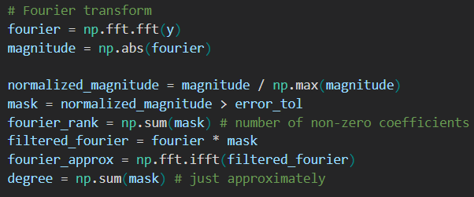
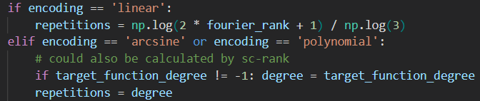
Optimal Number of Data Repetitions in Data Encoding Results (Keyfindings) & Generalizability
Time Series Data (fits pretty well to the tested lowerbound analysis)
Temporal dependencies (past influences future)
More encoding reps improves expressivity, capturing complex sequential relationships
However, we have to watch out for overfitting (in the algorithm below or in code we can set the optimal approx. precision)
Image data
Complex but can be captured with simpler feature maps (edges, shapes etc.)
This can be tested by using a harder image classification task
More encoding reps doesn’t necessarily improve performance (features already well represented)
Can fit well for lowerbound analysis because images often have spatial correlations (for example neighbour pixels are similar)
When images have smooth transitions the fourier rank (so also the redundancy) can be lowered
Tabular data
No temporal (non seq) dependencies -> Repetition has less impact (Simpler models often suffice)
Doesn’t have the same type of targetfunction (model only needs to understand how the independent features relate to the target label)
Finding an optimal data encoding repetition algorithm:
Intuitiv approach: Trial-and-error with repetition nums from 1-n and take with best score
Lowerbound algorithm for time series based on FFT to approximate target function:
Transforms the signal into the frequency domain
Computes the magnitude of each frequency component
Normalizes and applies a threshold to filter out small frequencies (this controls the expressivity)
Reconstructs an approximation of the original signal using only the significant frequency components (used for plotting)
Calculation taken from paper 1 and 2 of first slide
For multi feature we can repeat the above steps over all features and make the Fourier transformation (this gives different repetition numbers for every feature, if we want a different accuracy (tolerance) for different features)
Notes:
You can find the code and examples in optimal_data_encoding.ipynb.

Slide 10
Optimal Number of Data Repetitions in Data Encoding Challenges & Reflection (Lessons Learned)
Data encoding is (maybe the most?) important part in a QML model (for example to introduce nonlinearity into a quantum model etc.)
Finding target function in a complex model (therefore also the fourier rank etc.) is challenging especially using kernels etc.
Encoding defines the degree / frequence and the model defines the coefficents
Encoding defines how many repetitions (or layers) are needed to represent the degree of the function.
Model (quantum circuit) learns the actual coefficients of the function (slope, intercept, etc.) during the training process (so repeating ansatz influences those)
The number of repetitions depends a lot on the encoding function.
What I would do differently if I could start over again:
Reading the papers more carefully. I had to reread them quite a lot.
Trying out the QNN version for Wine Quality. That we would have a nice similarity comparison to time serie dataset.
Not investing too much time on training (take smaller datasets etc.)

