Slide 1
U.S. Traffic Sign Recognition Using Deep Learning Networks
By: peter Mollica

Slide 2
Abstract
Traffic Sign Recognition (TSR) from video images is an integral part of the driver support functions needed to make intelligent vehicles a reality. TSR is composed of two components: detection and classification. The focus of the proposed research is recognition of U.S traffic signs based on the LISA dataset, the largest publicly available U.S traffic sign dataset in the world, comprising over 20,000 images. Detection methods involving Integral Channel Features and Aggregate Channel features have achieved state-of-the art performance. Our proposed research consists of a comparative study of the performance of Integral Channel Features and Aggregate Channel features versus using Convolutional Neural Networks (CNN). Our aim is to explore the detection performance of the CNN by varying the convolutional layers, max-pooling layers, and the fully-connected layers. We will evaluate our detection performance by using the PASCAL measure, which is a standard metric for this application.

Slide 3
Overview
Introduction
Traffic Sign Recognition Overview
Related Work
Background
Sliding Window Detector
Current State-of-the-Art Detection Performance
Experiments & Data
Data
Experimental Setup
Summary of Baseline Results
Timeline for Future Work

Slide 4
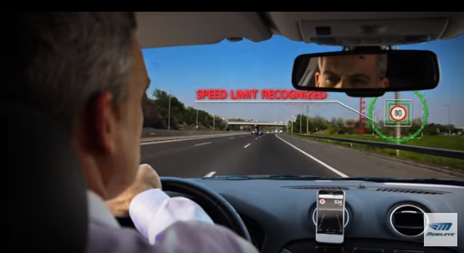
Introduction
Motivation:
Fully Autonomous Vehicles
Google’s self-driving car project
Advanced Driver Assistant Systems
Mobileye

Slide 5
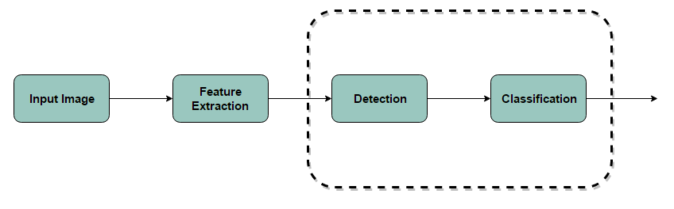
Introduction – TSR Overview
Traffic Sign Recognition (TSR):
Detection
Classification

Slide 6
Introduction – TSR Overview
U.S and European traffic sign datasets (publicly available):
European (Vienna Convention):
BTSD (Belgium Traffic Sign Data set) (2010)
STS (Swedish Traffic Sign Data set) (2011)
GTSRB (German Traffic Sign Recognition Benchmark) (2011)
United States
LISA (Laboratory for Intelligent and Safe Automobiles) (2012)
Extension (2014)
 | BTSD | STS | GTSRB | LISA
# of Classes | 62 | 7 | 43 | 47
# of Super Classes | 3 | N/A | 3 | 4
# of Annotations | 6864 | 3488 | 1206 | 11,527
#of Images | 9006+ | 4000 | 900 | 20,000+

Slide 7
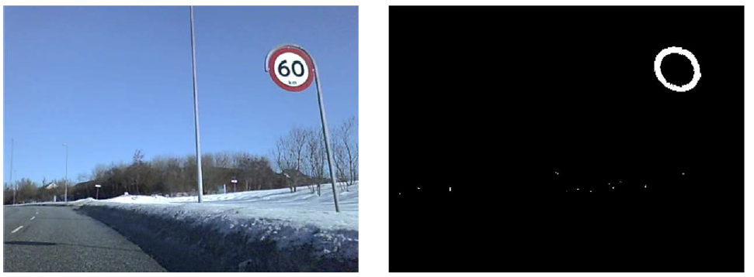
Introduction – Related Work
Early approaches used static color and shape characteristics for detection:
Vazquez-Reina (2005) transformed the image into HIS color space and used thresholding in order to extract the traffic signs.
Gonzalez (2008) located edges of closed contours with specific aspect ratios and used a Hough shape detector.
Problems: illumination changes, damaged or worn signs and occlusions

Slide 8
Introduction – Related Work
Learning – based approaches became more popular:
Creusen (2010) used HOG features with an SVM on a smaller self-generated dataset with good detection results.
Overett (2011) used Various HOG features with a cascade classifier on a small New Zealand dataset with state-of-the-art detection performance.
Problem: hard to evaluate performances of different methods when they are not evaluated on the same data set.
This lead to the German Traffic Sign Recognition Benchmark competition (2013)
Detection
Classification

Slide 9
Introduction – Related Work
Impressive Performances were achieved on the GTSRB datasets, however this does do not necessarily mean these methods will generalize to U.S traffic signs.
This led to the creation of the LISA dataset (Mogelmose 2012) largest publicly available U.S traffic sign dataset.
Mogelmose demonstrated state-of-the-art performance on the LISA dataset using Aggregate Channel Features.

Slide 10
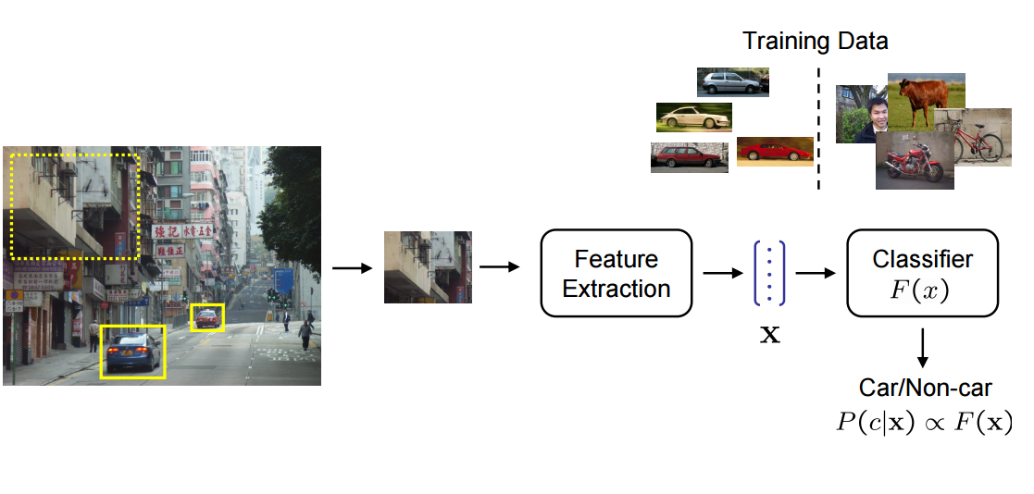
Background – Sliding Window Detector
Most object recognition systems will typically implement a sliding window detector.
The idea is to train a classifier on a certain size image patch.
Slide a window across different scales of the input image.
Extract features from the window.
Feed the features to a classifier and determine if it is or isn’t the object we are looking for.
Then apply non-maximum suppression.

Slide 11
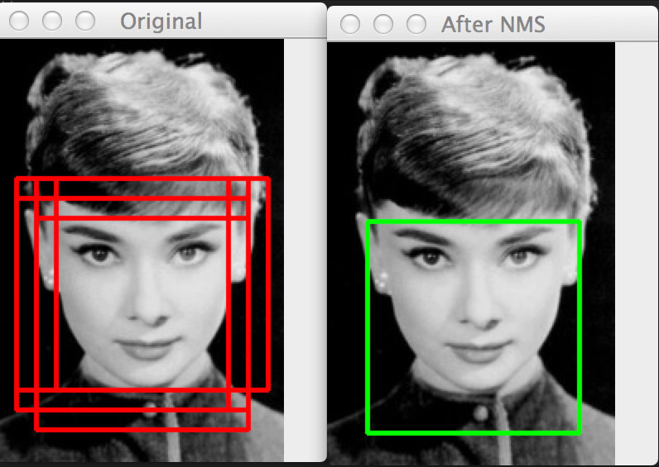
Background – Sliding Window Detector
Non-maximum suppression:
Multiple windows may detect the same object.
Want to suppress the overlapping windows.
Only select the window with the highest response from the overlapping windows.

Slide 12
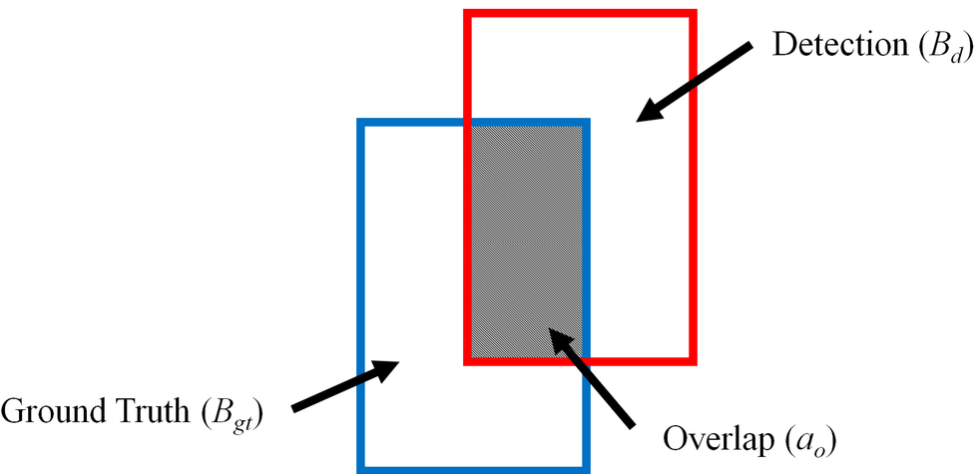

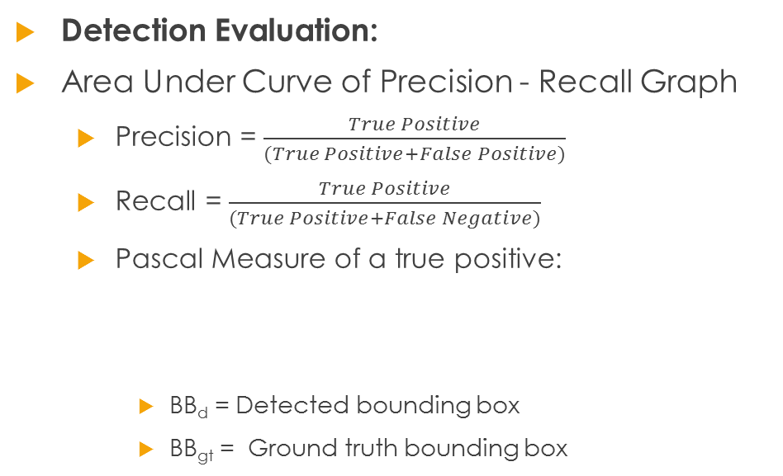
Background – Sliding Window Detector
Detection Evaluation:
Area Under Curve of Precision - Recall Graph
Precision = $\frac{True Positive}{(True Positive+False Positive)}$
Recall = $\frac{True Positive}{(True Positive+False Negative)}$
Pascal Measure of a true positive:
BB_{d} = Detected bounding box
BB_{gt} = Ground truth bounding box
 | $$a_{0}≡\frac{area\left({BB}_{d} ∩ {BB}_{gt}\right)}{area\left({BB}_{d} ∪ {BB}_{gt}\right)}>0.5$$

Slide 13
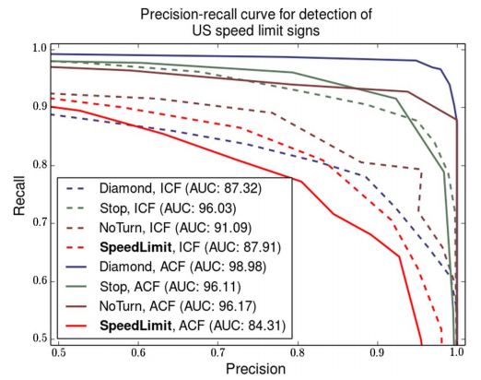
Background - Current State-of-the-Art Detection Performance
Mogelmose (2015) has shown that Integral Channel Features (ICF) and Aggregate Channel features have achieved state-of-the-art detection performance for U.S traffic Signs.
This method will be used as our baseline comparison.
 | LISA Dataset
 | Speed Limit | Warning | No Turn | Stop | Mean AUC
ACF (Mogelmose 2015) | 84.31 | 98.98 | 96.17 | 96.11 | 93.89
ICF (Mogelmose 2015) | 87.91 | 87.32 | 91.09 | 96.03 | 90.59

Slide 14
Background – Integral Images
An integral image, introduced by Viola and Jones (2001) for face recognition, is a quick way of calculating rectangular features by summing the pixel values in a given rectangular region of an image.
Represented Mathematically as:
ii(x,y) is the integral image
i(x’,y’) is the original image
 | $$ii\left(x,y\right)= \sum_{x^{′}≤x, y′≤y}{i(x^{′}, y^{′})}$$

Slide 15
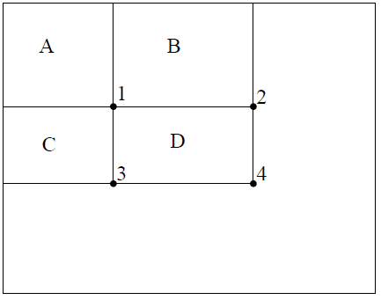
Background – Integral Image
Example: if want to calculate the sum of pixels in rectangle D, we only need the four corners values of the integral image. Then solve for:
D = 4+1-(2+3)

Slide 16
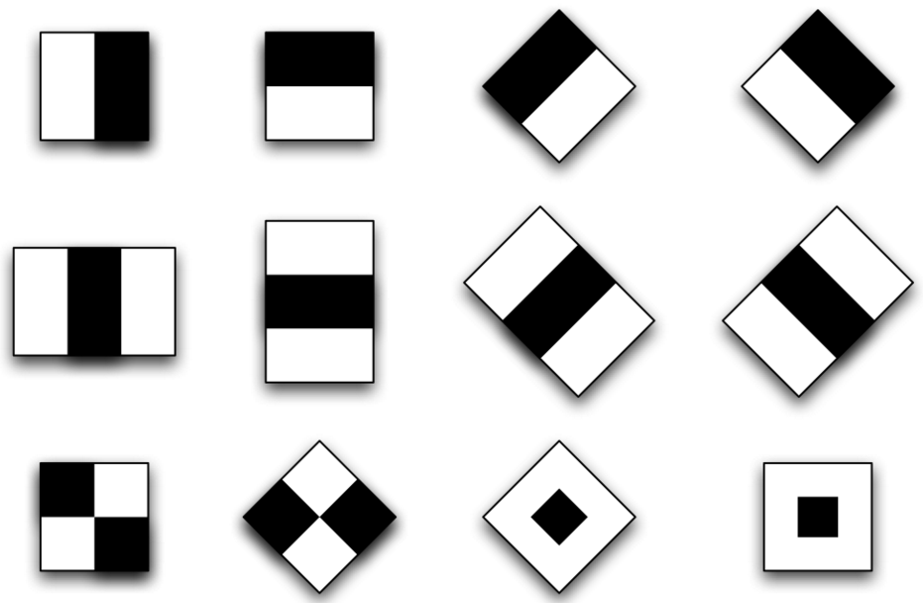
Background – ICF / ACF
Idea behind Integral and Aggregate Channel Features:
Transform the input image into multiple image channels.
Transform the new image channels into integral images.
Extract first order or higher order features out of the integral images.
Haar-like features, HOG features, Gabor features etc.
Train an AdaBoost classifier.
Difference between ICF and ACF is that ICF channels typically use Haar-like features and ACF uses summed blocks of pixels at various scales.

Slide 17
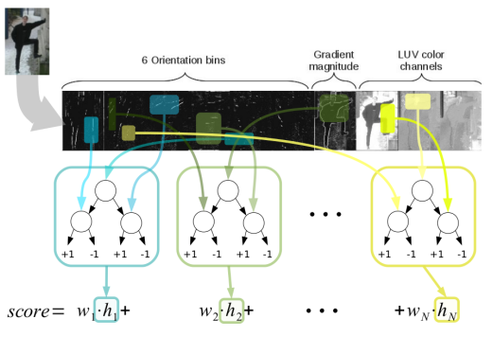
Background – ICF / ACF

Slide 18
Experiments & Data
Proposal: The aim of this work is to do a comparative study of the current state-of-the-art methods for traffic sign detection and classification and compare them to different deep learning architectures.
Ideally, design a single classifier that will be able to perform both the detection and classification of U.S traffic signs.
The work proposed by Mogelmose (2015) for detection will be replicated and used as the baseline measurement

Slide 19
Experiments - Data
Original LISA Traffic Sign Dataset |  | LISA-TS Extension |  |  | GTSD
 |  | Training Set | Testing Set | Combined
Number of classes: | 47 | 31 | 17 | 35 | 4
Number of annotations: | 7855 | 3672 | 2422 | 6094 | 1206
Number of images: | 6610 | 3307 | 2331 | 5638 | 900
Sign Sizes, longest edge: | 6 – 168 pixels | 23–222 pixels | 25–222 pixels | 23–222 pixels | 16-128 pixels
Image Sizes: | 640x480 to 1024x522 | 1280x960 | 1280x960 | 1280x960 | 1360x800
Videos Included: | Yes | Yes | Yes | Yes | No

Slide 20
Experiments – Experimental Setup
Experimental Setup: Baseline Setup – Data Preparation
First step of any machine learning or computer vision task is data preparation.
The LISA dataset was separated as followed:
 | LISA-TS |  | LISA-TS Extension |  | Total
 | Positive | Negative | Positive | Negative | Positive | Negative
Training | 6284 | 12000 | 2939 | 6000 | 9223 | 18000
Validation | 1571 | 3000 | 735 | 1500 | 2306 | 4500

Slide 21
Experiments – Experimental Setup
Experimental Setup: Baseline Setup – Feature Extraction and Training
ICF:
10 Channels used:
6 gradient channels in varying directions
1 unoriented gradient magnitude channel
3 LUV color space channels
Haar-Like features
Trained using an AdaBoost classifier with 200 depth-2 decision trees as weak learners.
ACF:
Features: summing up of blocks of pixels at various scales and locations

Slide 22
Experiments – Experimental Setup
Deep Learning Architecture
Convolutional Neural Network (CNN)
Number of Filters in the Convolutional Layer
The total number of layers (depth)
A committee of CNN’s vs. a Single CNN

Slide 23
Summary of Baseline Results
Detection Results
 | LISA Dataset |  |  |  |  | GTSD Dataset
 | Speed Limit | Warning | No Turn | Stop | Mean AUC | Prohibitory | Danger | Mandatory | Mean AUC
ACF (Mogelmose 2015) | 84.31 | 98.98 | 96.17 | 96.11 | 93.89 | 99.86 | 100.00 | 98.38 | 99.41
ICF (Mogelmose 2015) | 87.91 | 87.32 | 91.09 | 96.03 | 90.59 | 99.58 | 99.15 | 98.52 | 99.08
8bit-MCT AdaBoost (Lim 2014) | 81.43 | 21.22 | 57.63 | 65.81 | 56.52 | N/A | N/A | N/A | N/A
Boosted_ICF (Houben 2013) | N/A | N/A | N/A | N/A | N/A | 100.00 | 100.00 | 96.98 | 98.99
HOG + SVM (Liang 2013) | N/A | N/A | N/A | N/A | N/A | 100.00 | 98.85 | 92.00 | 96.95
HOG_LDA_SVM (Wang 2013) | N/A | N/A | N/A | N/A | N/A | 100.00 | 99.95 | 93.99 | 97.98

Slide 24
Summary of Baseline Results
Classification Results
 | GTSD Dataset
 | Blue | End_of | Red-Round | Red_other | Speed | Danger | Other | All
Committee of CNN | 99.89% | 99.72% | 99.74% | 99.93% | 99.47% | 99.07% | 99.22% | 99.46%
Random Forests | 99.27% | 87.50% | 97.16% | 99.13% | 95.95% | 92.08% | 98.73% | 96.14%
LDA on HOG 1 | 96.10% | 74.72% | 93.10% | 96.67% | 91.44% | 90.61% | 98.43% | 93.18%
LDA on HOG 2 | 97.18% | 85.83% | 96.39% | 96.80% | 95.37% | 93.73% | 98.63% | 95.68%

Slide 25
Timeline for Future Work
April:
Extract baseline features from the LISA dataset for detection task
Address any action items
May:
Build the AdaBoost Classifier.
Evaluate classifier performance
June:
Begin building basic CNN architecture
Build larger architecture

Slide 26
Timeline for Future Work
July:
Evaluate performance
Experiment with different variations of CNNs
August:
Evaluate the Performance of new CNNs designs
September-December
Address any issues that may arise
Finish a complete and final draft of thesis
Successfully defend thesis

Slide 27
Questions?

Slide 28
References
Bishop, C. (2007). "Pattern Recognition and Machine Learning" (2nd ed). New York, New York, USA: Springer.
Dalal, N. and Triggs, B. (2005) "Histograms of oriented gradients for human detection," Computer Vision and Pattern Recognition, 2005. CVPR 2005. IEEE Computer Society Conference on, San Diego, CA, USA, 2005, pp. 886-893 vol. 1. doi: 10.1109/CVPR.2005.177
Dollár, P., “Piotr’s Computer Vision Matlab Toolbox (PMT).” [Online]. Available: http://vision.ucsd.edu/\ignorespacespdollar/toolbox/doc/index. html
Dollar, P., Appel, R., Belongie, S., and Perona, P. (2014), "Fast Feature Pyramids for Object Detection," in IEEE Transactions on Pattern Analysis and Machine Intelligence, vol. 36, no. 8, pp. 1532-1545, Aug. 2014. doi: 10.1109/TPAMI.2014.2300479
Dollár, P., Tu, Z., Perona, P., and Belongie S. (2009), “Integral channel features,” in Proc. BMVC, vol. 2, no. 3, p. 5, 200
Everingham, M., Gool, L., Williams, C., Winn, J., and Zisserman, A. (2010). The Pascal Visual Object Classes (VOC) Challenge. Int. J. Comput. Vision 88, 2 (June 2010), 303-338. DOI=http://dx.doi.org/10.1007/s11263-009-0275-4
Freund, Y. and Schapire, R.E. (1996), ``Experiments with an new boosting algorithm, Machine Learning: Proceedings of the Thirteenth International Conference, Morgan Kauffman, SanFrancisco, pp.148-156 (1996). Introduced AdaBoost
Friedman, J., Hastie, T., and Tibshirani, R. (2000), “Additive LogisticRegression: A Statistical View of Boosting,” Annals of Statistics,vol. 38, no. 2, pp. 337-374, 2000.
Forsyth, D. and Ponce, J. (2012). Computer Vision a Modern Approach (2nd ed., p. 549). New York, New York, USA: Pearson
Houben, S., Stallkamp, J., Salmen, J., Schlipsing, M., and Igel, C. (2013), "Detection of traffic signs in real-world images: The German traffic sign detection benchmark," Neural Networks (IJCNN), The 2013 International Joint Conference on, Dallas, TX, 2013, pp. 1-8. doi: 10.1109/IJCNN.2013.6706807
Krizhevsky, A., Sutskever, I., and Hinton, G. (2012), Imagenet classification with deep convolutional neural networks. In NIPS, 2012. 1, 2, 3, 4
Li, F., Karpathy, A., and Johnson, J. (2015), "CS231n: Convolutional Neural Networks for Visual Recognition," www. http://cs231n.stanford.edu/
Li, F., Karpathy, A., and Johnson, J. (2015), "CS231n: Convolutional Neural Networks for Visual Recognition," www. http://cs231n.stanford.edu/

Slide 29
References
Lim, K., Lee, T., Shin, C., Chung, S., Choi, Y., and Byun, H., (2014). Real-time illumination-invariant speed-limit sign recognition based on a modified census transform and support vector machines. In Proceedings of the 8th International Conference on Ubiquitous Information Management and Communication (ICUIMC '14). ACM, New York, NY, USA, , Article 92 , 5 pages. DOI=http://dx.doi.org/10.1145/2557977.2558090
Liu, W., Wu, Y., Lv, J., Yuan, H., and Zhao, H. (2012) "U.S. speed limit sign detection and recognition from image sequences," Control Automation Robotics & Vision (ICARCV), 2012 12th International Conference on, Guangzhou, 2012, pp. 1437-1442.doi: 10.1109/ICARCV.2012.6485388
Loy, G. and Barnes, N. (2004), “Fast shape-based road sign detection for a driver assistance system,” in Proc. IEEE/RSJ Int. Conf. IROS, 2004, vol. 1, pp. 70–75
Mogelmose, A., Liu, D., and Trivedi, M. M. (2015), "Detection of U.S. Traffic Signs," in IEEE Transactions on Intelligent Transportation Systems, vol. 16, no. 6, pp. 3116-3125, Dec. 2015. doi: 10.1109/TITS.2015.2433019
Mogelmose, A., Liu, D., and Trivedi, M. M. (2014), "Traffic sign detection for U.S. roads: Remaining challenges and a case for tracking," Intelligent Transportation Systems (ITSC), 2014 IEEE 17th International Conference on, Qingdao, 2014, pp. 1394-1399. doi: 10.1109/ITSC.2014.6957882
Mogelmose, A., Trivedi, M. M., and Moeslund, T. B. (2012), "Vision-Based Traffic Sign Detection and Analysis for Intelligent Driver Assistance Systems: Perspectives and Survey," in IEEE Transactions on Intelligent Transportation Systems, vol. 13, no. 4, pp. 1484-1497, Dec. 2012.doi: 10.1109/TITS.2012.220942
Staudenmaier, A., Klauck, U., Kreßel, U., Lindner, F., and Wöhler, C. (2012) “Confidence measurements for adaptive Bayes decision classifier cascades and their application to US speed limit detection,” in Proc. Pattern Recognit., ser. Lecture Notes in Computer Science, vol. 7476, pp. 478–487, 2012.
Vázquez-Reina, A., Lafuente-Arroyo, S., Siegmann, P., Maldonado-Bascón, S., and Acevedo-Rodríguez, F. (2005), “Traffic sign shape classification based on correlation techniques,” in Proc. 5th WSEAS Int. Conf. Signal Process., Comput. Geometry Artif. Vis., 2005, pp. 149–154.
Viola, P. and Jones, M. (2001), "Rapid object detection using a boosted cascade of simple features," Computer Vision and Pattern Recognition, 2001. CVPR 2001. Proceedings of the 2001 IEEE Computer Society Conference on, 2001, pp. I-511-I-518 vol.1. doi: 10.1109/CVPR.2001.990517
Wang, G., Ren, G., Wu, Z., Zhao, Y., and Jiang, L. (2013), “A robust, coarse-to- fine traffic sign detection method,” in Proc. IEEE IJCNN, Aug. 2013, pp. 1–5.
United Nations (1978), "Vienna Convention on road signs and signals,“
Zimmerman, A (2012), "Category-level Localization", Visual Geometry Group University of Oxford, http://www.robots.ox.ac.uk/~vgg

Slide 30
Biography
Peter Mollica is currently a Master's Degree candidate in Temple University’s Department of Electrical and Computer Engineering. He graduated with a Bachelor's in Computer Engineering from Temple University in 2014. He joined the Institute for Signal and Information Processing where he is pursuing his interest in machine learning and computer vision with applications in intelligent transportation systems.

Slide 31
BACKUP SLIDES

Slide 32
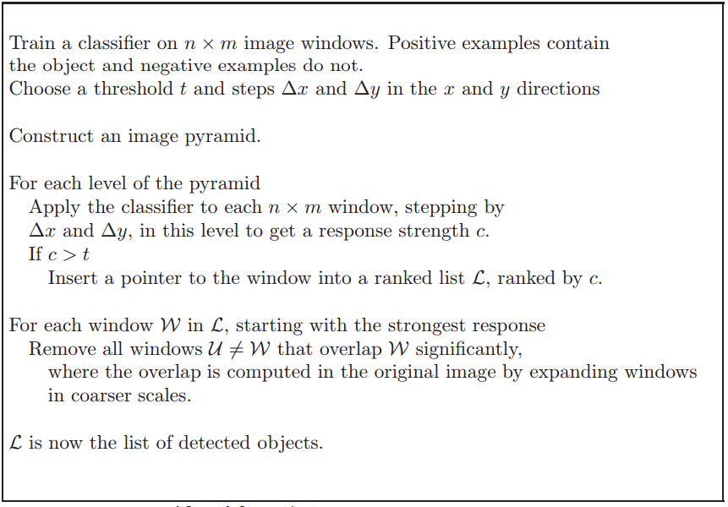
Sliding Window Detector Algorithm

Slide 33
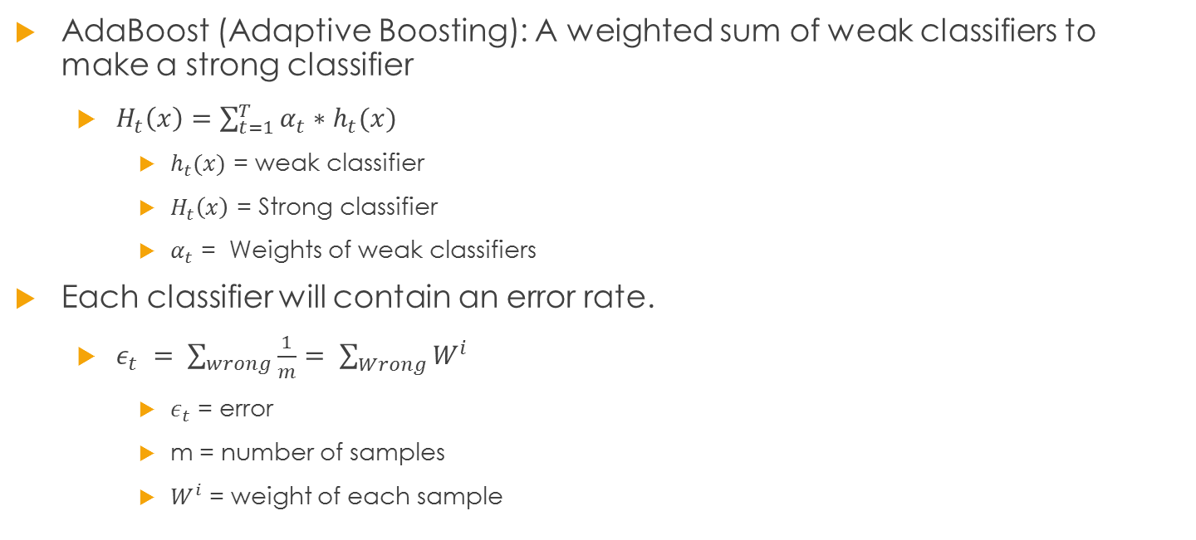
Background – AdaBoost Classifier
AdaBoost (Adaptive Boosting): A weighted sum of weak classifiers to make a strong classifier
$H_{t}\left(x\right)=\sum_{t=1}^{T}{α_{t}∗h_{t}(x)}$
$h_{t}(x)$ = weak classifier
$H_{t}\left(x\right)$ = Strong classifier
$α_{t}$ = Weights of weak classifiers
Each classifier will contain an error rate.
$ε_{t} = \sum_{wrong}{\frac{1}{m}}= \sum_{Wrong}{W^{i}}$
$ε_{t}$ = error
m = number of samples
$W^{i}$ = weight of each sample

Slide 34
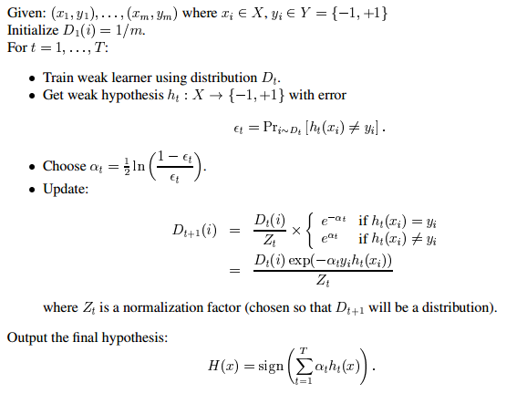
Background – AdaBoost Classifier

Slide 35
AdaBoost Example
Training set: 10 points (represented by plus or minus) Original Status: Equal Weights for all training samples

Slide 36
AdaBoost Example (cont)

Slide 37
AdaBoost Example (cont)

Slide 38
AdaBoost Example (cont)

Slide 39
AdaBoost Example (cont)

Slide 40
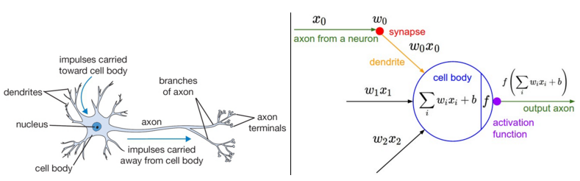
Background – Deep Learning
Feed Forward Neural Networks: Modeled after the biological neural system.
Basic computational unit of the Nervous system is the Neuron:
Dendrites = Input (x).
Synapses = Weights associated with the input (w).
Axon = Activation function output (f(wx)).

Slide 41
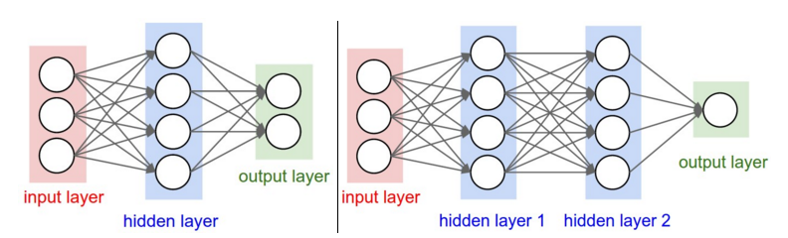
Background – Deep Learning
Feed Forward Neural Network:
Interconnection of neurons, where the output of one neuron is the input of another.

Slide 42

Background – Deep Learning
Feed Forward Neural Network:
Goal is to minimize the mean square error (MSE) of the weights:
The weights of each nueron are optimized using a method called gradient decent.
 | $$MSE(w)= \frac{1}{2n}\sum_{i=1}^{n}{{\left(y_{i}−nn(x_{i}, w)\right)}^{2}}$$

Slide 43

Background – Deep Learning
Feed Forward Neural Network:
Gradient Descent: The idea of gradient decent is to find the direction of steepest decent in a local area. This is done by taking the derivate of the mean squared error with respect to each parameter.
 | For t=1:n $$w^{t+1}= w^{t}− α∗∇MSE(w^{t})$$

Slide 44
Background – Deep Learning
Convolutional Neural Network (CNN): very similar to feedforward neural networks but are specialized for processing data with a grid-like topology, such as images.
A basic CNN is composed of 3 main layers:
Convolutional Layer
Pooling Layer
Fully-Connected Layer

Slide 45
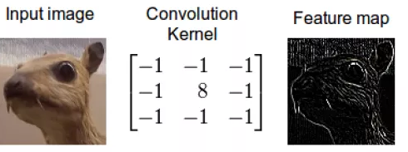
Background – Deep Learning
Convolutional Neural Network:
Convolutional Layer – creates new images or feature maps through multiple convolutions with a different number of filters.
Each filter has a weight associated with it (similar to a neuron), which is also learned through gradient descent.

Slide 46
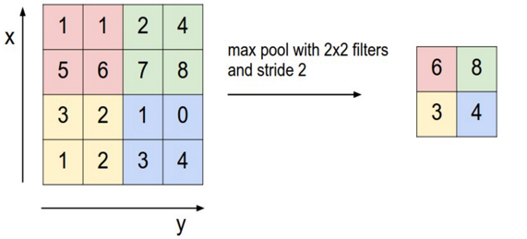
Background – Deep Learning
Convolutional Neural Network:
Pooling Layer: The pooling layer will come after the convolutional layer and is used to reduce the size/dimensionality of the feature maps.
The most common form of pooling is a max 2x2 filter with a stride of 2 pixels.

Slide 47
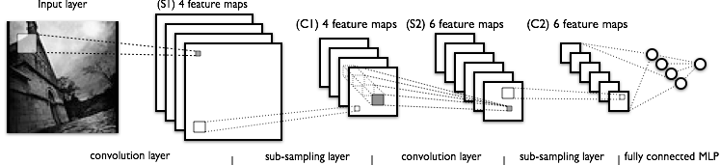
Background – Deep Learning
Convolutional Neural Networks:
Fully-Connected Layer: Can be thought of as a traditional feedforward neural network.
A complete architecture can be seen below:

