Slide 1

Do NFL Combine Stats Predict Rookie WR Success?
Costa Tsakopoulos, Charlie Vitner, Jackson Weber, Ava Weisheit, Tyler Wirges

Slide 2


Identify Current Issues from Various Perspectives

Slide 3
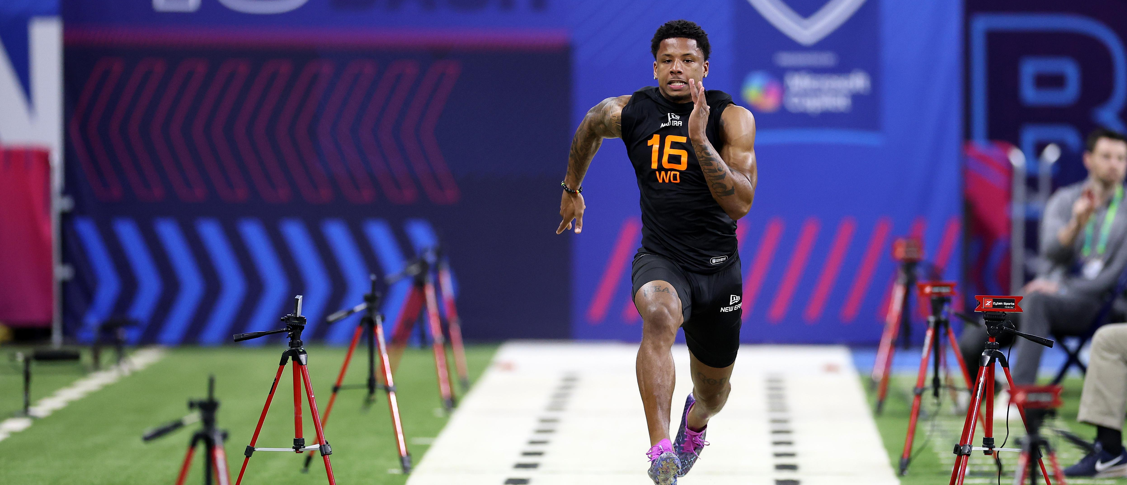
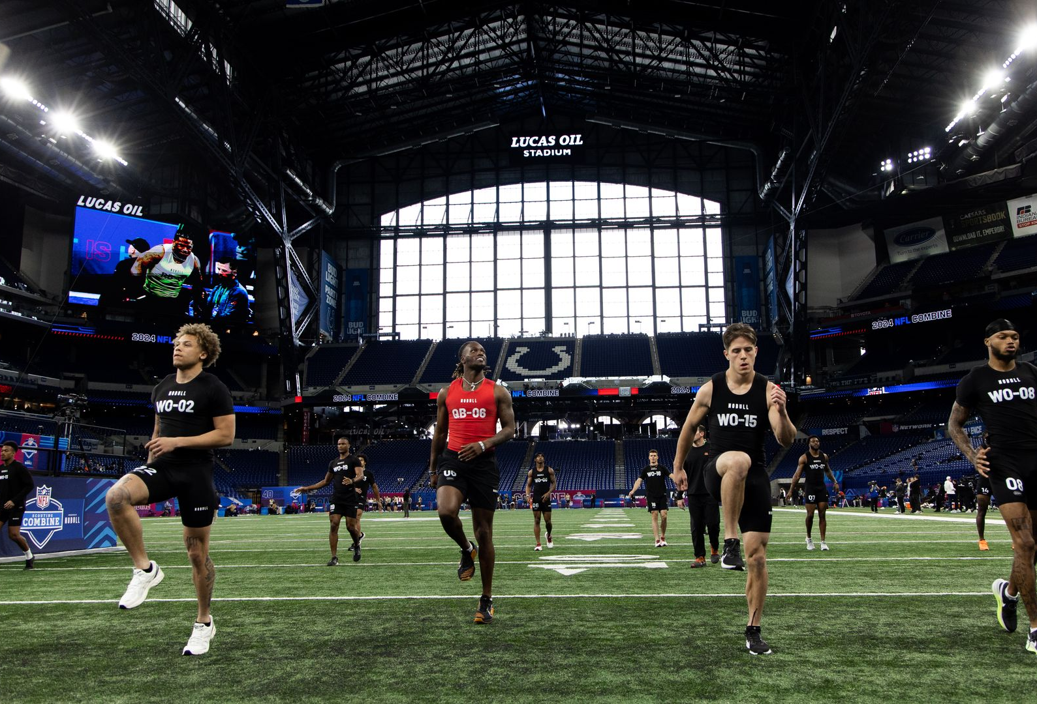
What is the nfl combine?
Combine = one of the most publicized evaluation events
40‑yard dash, vertical, shuttle treated as predictors of instant success
Especially for WRs, athleticism is assumed to translate to early production

Slide 4
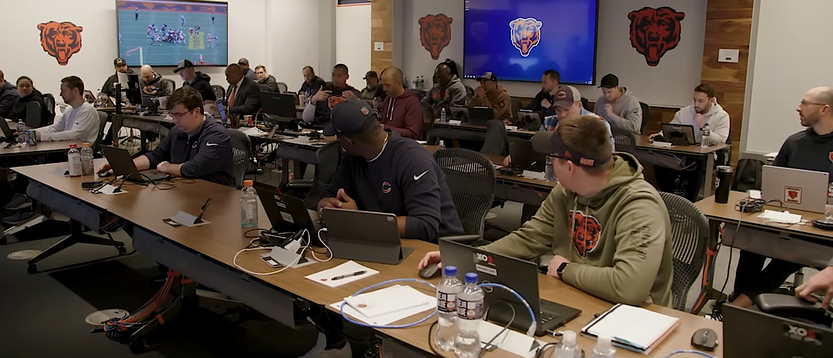
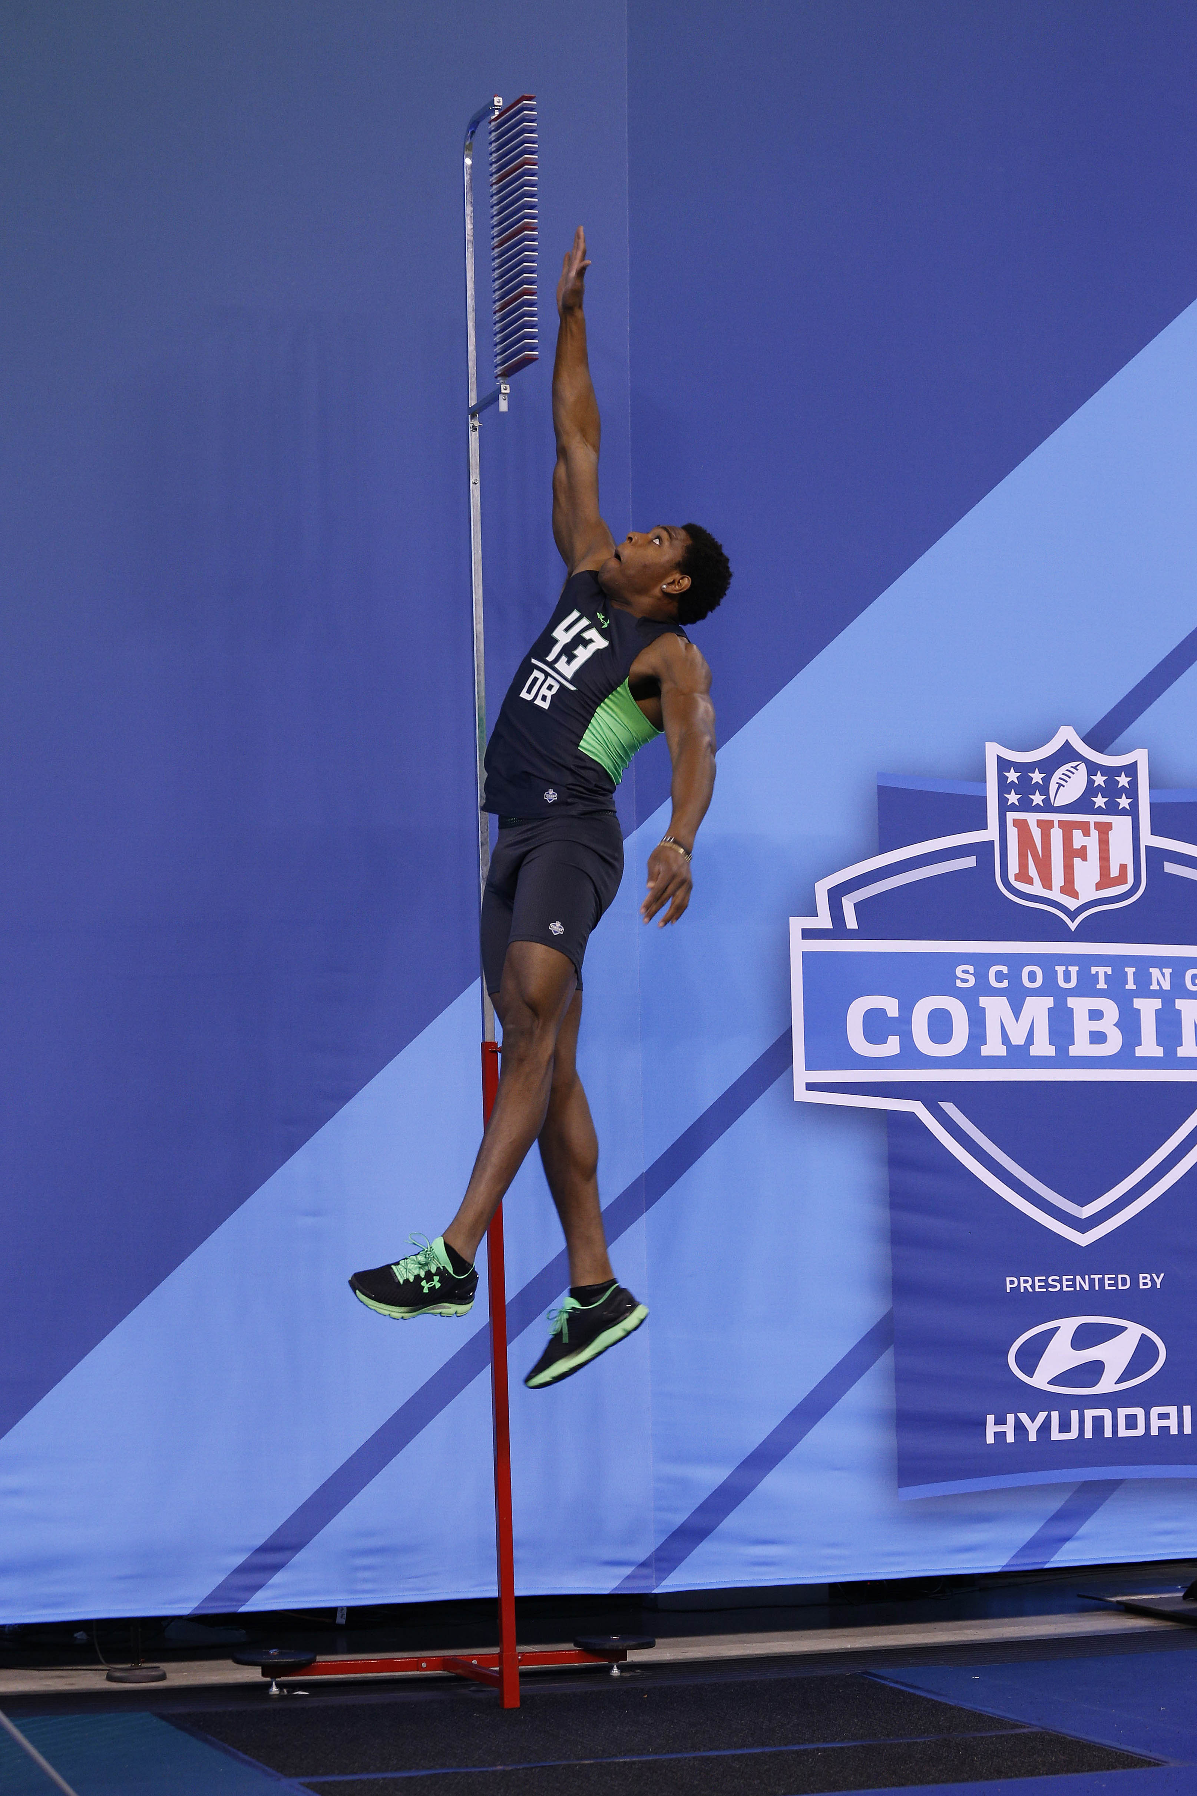
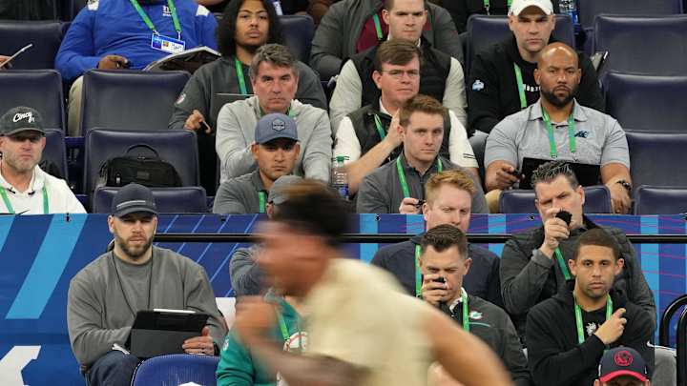
The Problem
Combine only shows a small slice of a player
Teams rely on film, interviews, analytics
Do these tests actually matter once rookies hit the field?

Slide 5
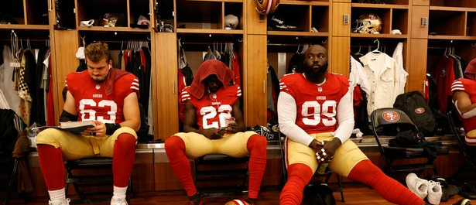
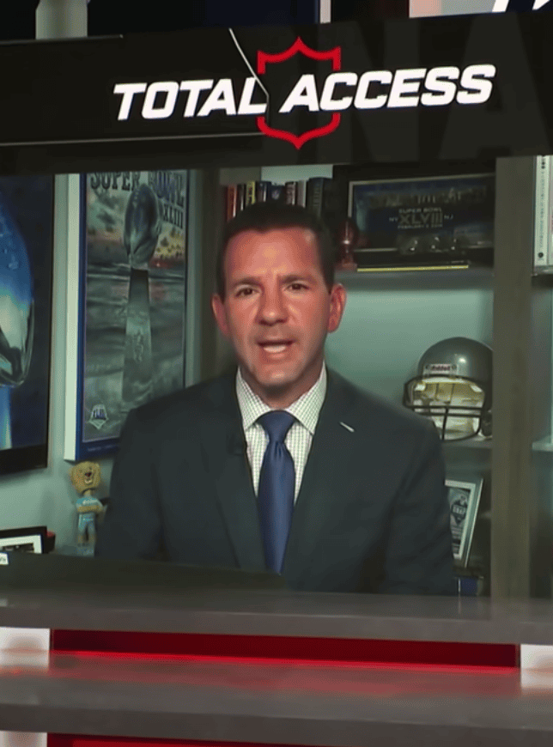
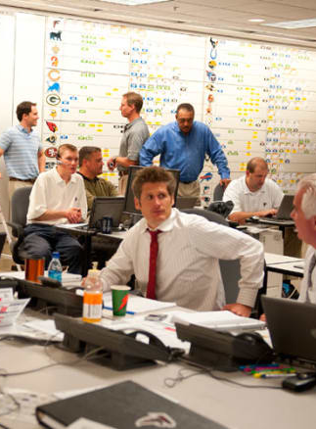
Who This Matters To
Front Office/Coaches:
Draft decisions shape roster + future
Need to know if Combine metrics are actually useful
Players:
Combine results influence draft position + opportunity
Want to know what really drives early success
Fans/Media/Business:
Combine hype shapes narratives and expectations
Understanding what actually predicts performance cuts through noise

Slide 6
Are combine stats actually correlated to a
contributing rookie year? Should they be taken into
account when drafting players, or are there other
things that matter more?
^{Our Research question:}

Slide 7
Analyze the Current Issue

Slide 8
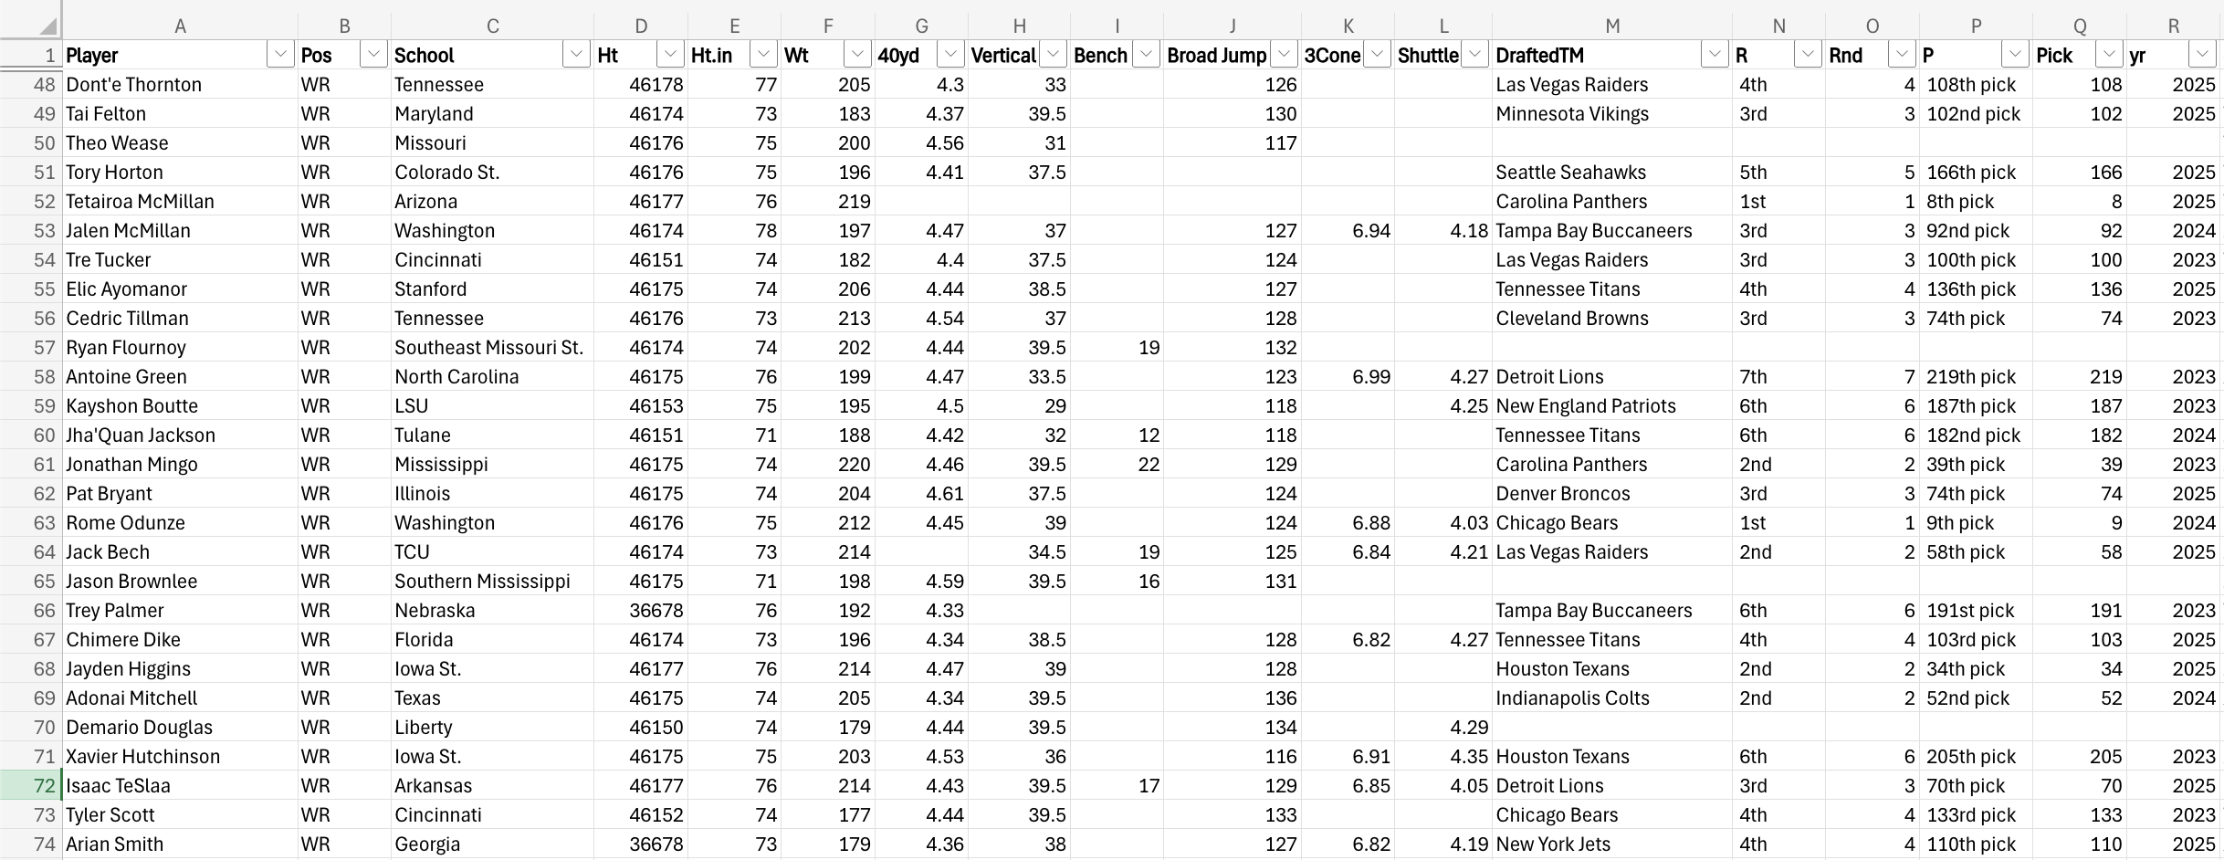
A PeEk at the Data : DRAFT Data
All data sourced from Pro-Football-Reference.com
3 seasons of NFL Draft combine data (2023–2025)
Matched to each player's rookie season statistics
Dataset required significant cleaning
Notes:
Heights imported as dates
Draft team, round, and pick stored in a single column
Name formatting inconsistencies (missing suffixes, nicknames)

Slide 9
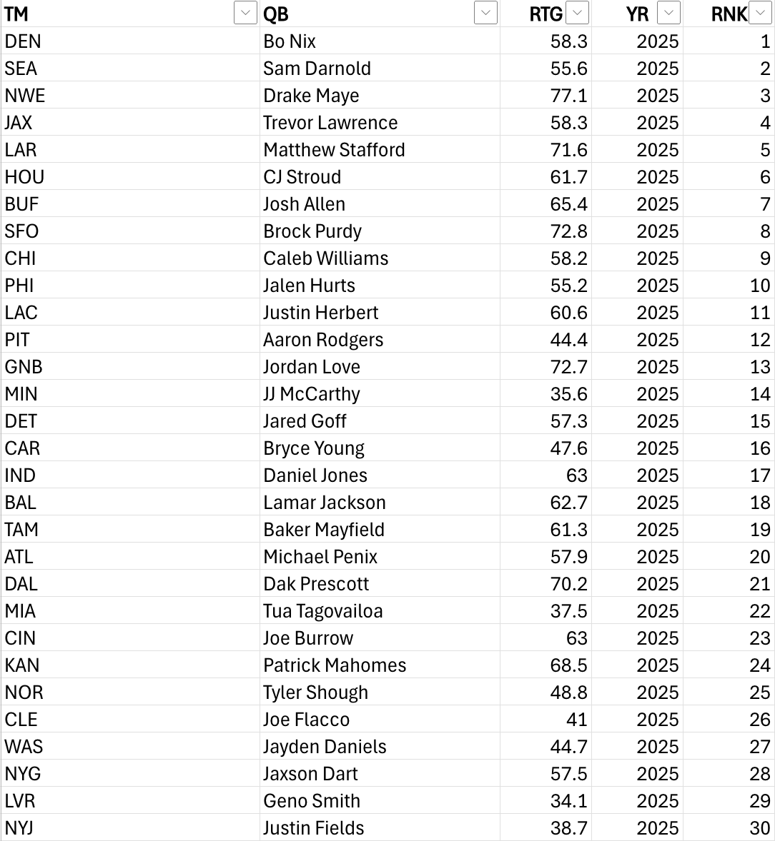
A PeEk at the Data : QB / Team / QBR Data
Added TeamQB tab:
each team's end-of-season ranking, primary QB, and QB's QBR
Manually input QBR from PFR

Slide 10
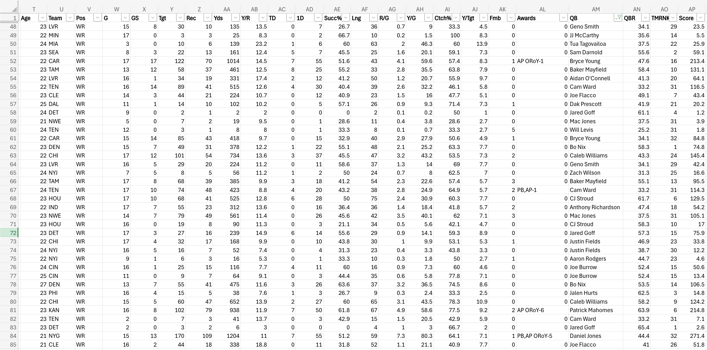
A PeEk at the Data : Season Stats Data

Slide 11
Final Dataset
36 usable columns per player
Target variable:
composite Score (1 pt/reception, 0.1 pts/yard, 6 pts/TD)
Considered adjusting Score for QB quality and team strength
Score vs. QBR: r = 0.099
Score vs. Team Rank: r = -0.029
Both near zero — no meaningful relationship found
Raw Score kept as final target variable

Slide 12
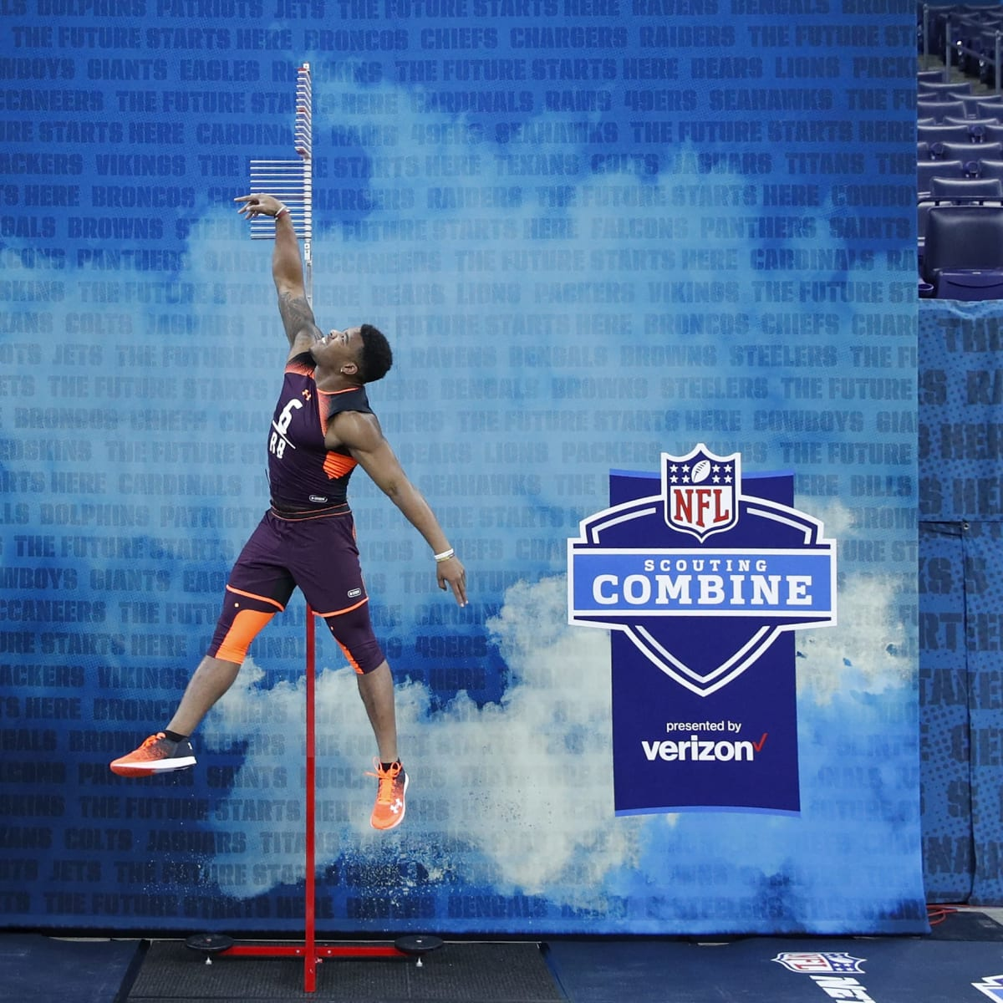
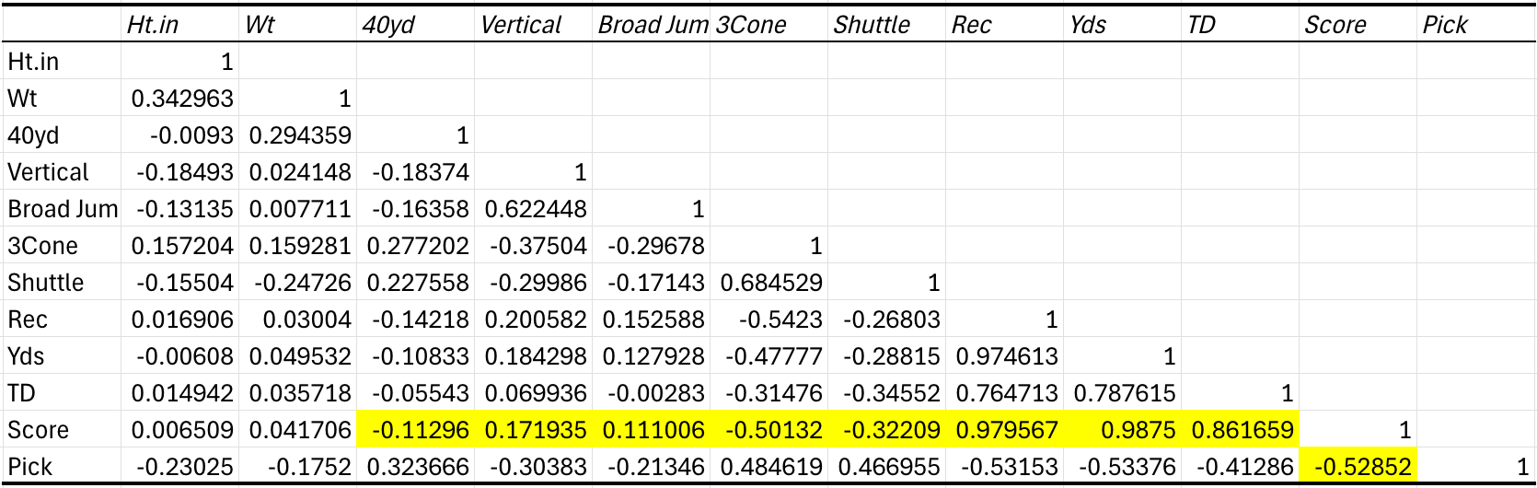
Correlation Findings:
40-yard dash (r = -0.11), vertical jump (r = 0.17), and broad jump (r = 0.11)
Show minimal association with performance
3-cone (r = -0.50) and shuttle (r = -0.32) show higher signals
NOTE: smaller sample size, so correlations may be inflated
Biggest predictor of success?
Draft Pick (r = -0.53)

Slide 13
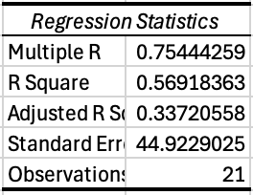
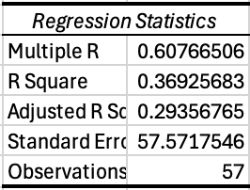
Regression Findings
Full regression with Ht, Wt, and Combine Stats
Ht, Wt, Combine Stats without Shuttle
Too many Variables
Not Enough Data
Potentially Overfit the Model
“Pick” was only significant p-value
Not Enough Data with Shuttle
Lower R Squared
More Data = Better Representation
“Pick” was only significant p-value

Slide 14

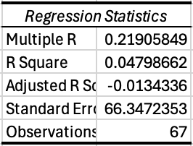
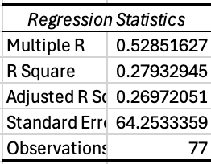
Regression findings cont.
Regression with only draft statistics AND without height
Regression with only pick
Regression with only draft statistics
Lowest R Square
Draft Stats Alone are Horrible Predictors
Removed highest p-value (Ht.)
Still Does Not Help
Draft Stats are Bad Predictors
Highest # of Observations
Combine Metrics Do Not Add Meaningful Explanatory Power

Slide 15
Identify Possible Solutions or Benefits

Slide 16
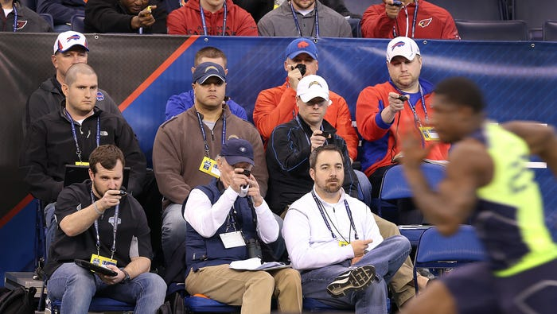
Coaches
Focus on personalized development plans to attend to the strengths and weaknesses of each player
Prioritize skill growth to help the rookies attain their full potential
Have patience with the players as every player takes different amounts of time to develop

Slide 17
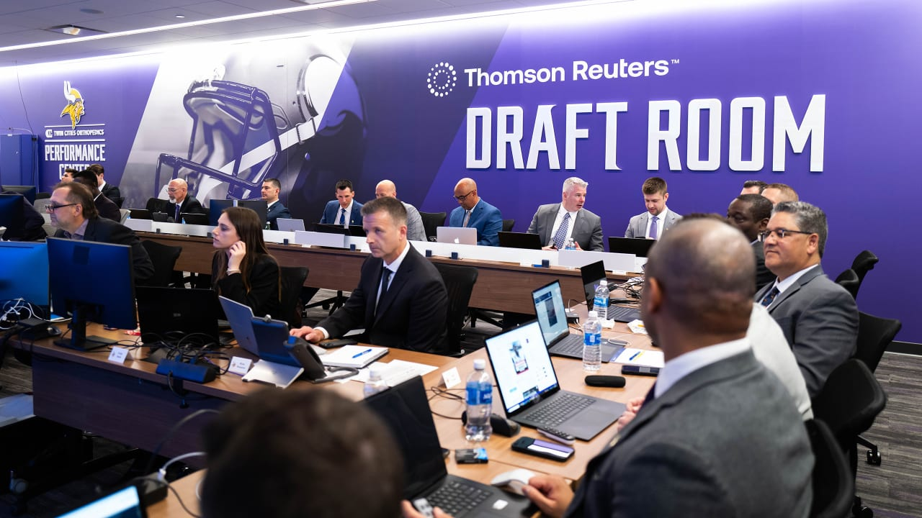
Front Office
Evaluate prospects on their raw talents and traits
Ignore how well they performed in a college system if they did

Slide 18
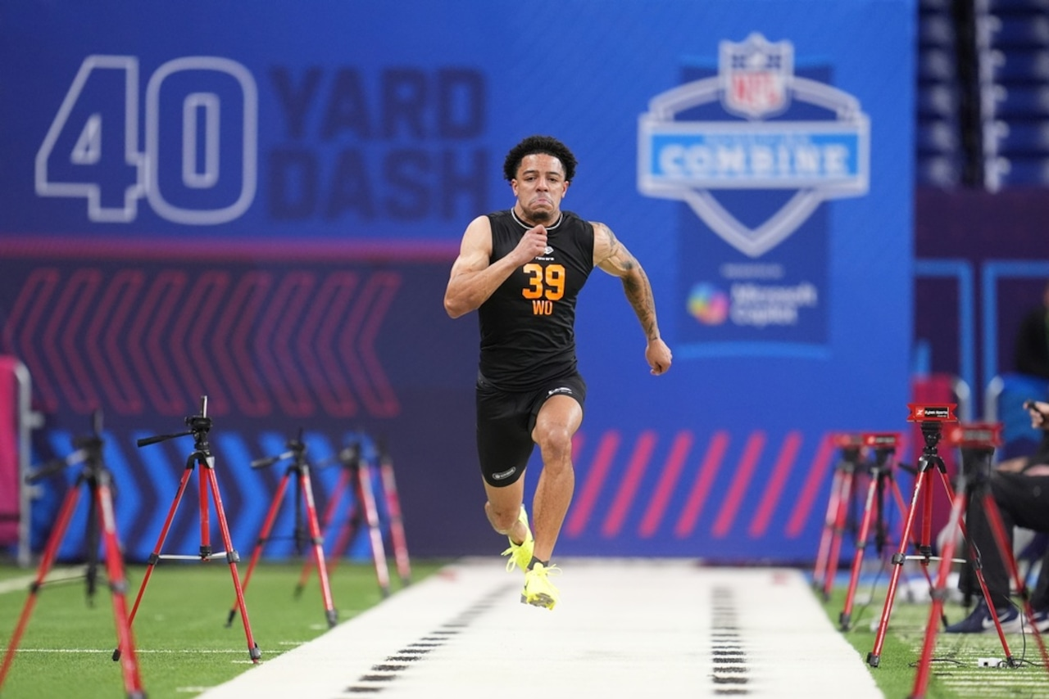
Players
Prioritize going to great coaching environments
Don’t only look at team success for preferred destinations

Slide 19
Consequences and Side Effects After Applying a Solution

Slide 20
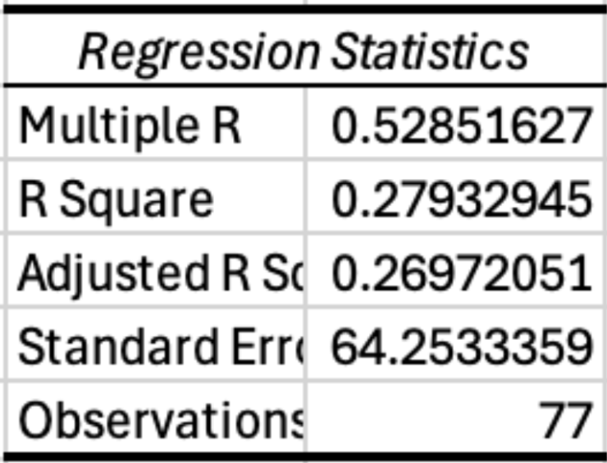
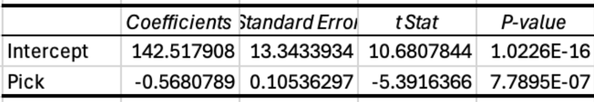
Conclusions
Combine metrics alone explain nearly none of rookie WR performance (R² = 0.048)
Draft pick position explains 27% of rookie WR variance — the strongest predictor in our dataset
Every spot earlier in the draft is associated with a 0.568 point increase in rookie Score
73% of rookie WR performance remains unexplained — suggesting factors like scheme fit, coaching, and football IQ matter more than measurable athleticism

Slide 21
Consequences / Side Effects
Over relying on Combine Statistics
Teams may overdraft athletic players who lack football skill
Teams may pass on productive players who test poorly
Millions in draft capital misallocated based on measurements that don't predict success

Slide 22
Recommendations

Slide 23
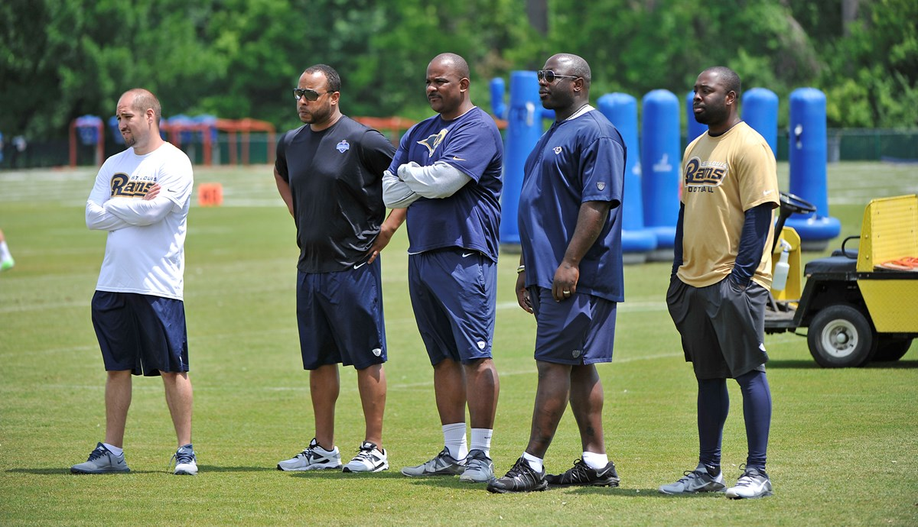
Suggestions
Use NFL Draft Combine metrics to supplement scouting observations
Hold Private workouts and attend collegiate pro days
Not much change is required
These Combine metrics should be used when researching later round talents, even undrafted free agents.

Slide 24
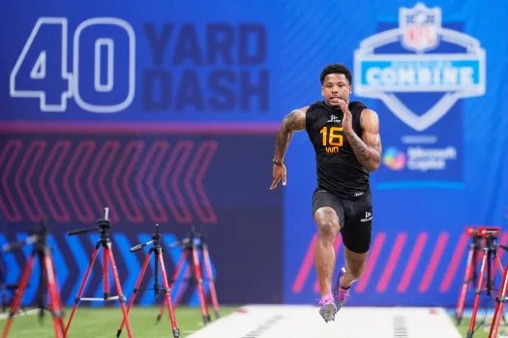
How we can improve the models
More data from more Combines
Have the league require Draft Combine attendees to participate in all events
Take into account the different archetypes of Wide Receivers and offensive schemes

Slide 25
Thank You
Any Questions?
Data Sources:
Combine Data : https://www.pro-football-reference.com/draft/2025-combine.htm
Performance Data : https://www.pro-football-reference.com/years/2025/receiving.htm
Team Data : https://www.nfl.com/standings/league/2025/reg
QB Data : https://www.pro-football-reference.com/years/2025/passing.htm

