Slide 1
Design Documents and Functional Specifications
Venkata Bhardwaj Avasarala
Vipul reddy madadi
Varun Kumar reddy cheekolu
Prasanthi rani bhogaraju

Slide 2


Design Documents
Bhardwaj

Slide 3
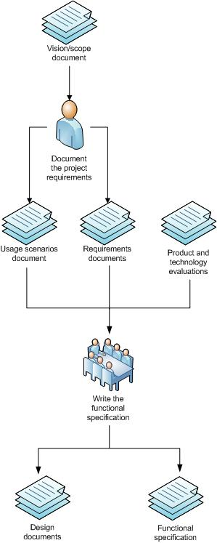
Fig: Functional Specification and Design Documents Flow Chart Retrieved from https://i-technet.sec.s-msft.com/dynimg/IC75237.jpg
Bhardwaj

Slide 4
Goals of Good Docs
Capture design consensus
Primary vision conduit between departments
Aid in scheduling
Offer focus
Give visibility to future dependencies and design conflicts
Bhardwaj

Slide 5
Know your target
People interested in a design doc:
Design team. To achieve design consensus.
Programming team. To build the game.
Producers. To schedule and go get money.
QA. To build test plans.
External partners. To reach quota of annoying demands.
Bhardwaj

Slide 6

Keep it short
Kill the fluff
1
Kill empty sections
2
Kill ‘cut and paste’ stuff
3
Kill unnecessary text of obvious systems
4
Programmers almost always want a short bullet list
5
They kind of like checking things off of lists
6
Bhardwaj

Slide 7
Prioritize the design
Give the features a priority, break them into phases
Be sure document clearly separates out later phase features.
Phase 1: Prototype feature
(necessary to validate or demo the game)
Phase 2: Core feature.
(features and tools that hold up content creation go here)
Phase 3: Must be in shipped product
(includes features that depend on priority 2 features)
Phase 4: Wishlist, possibly expansion
Phase 5: Yeah, right
Prasanthi

Slide 8
Separate Code from Content
Don’t make people hunt for the information they want.
Separate content into appendices, or into tables.
Prasanthi

Slide 9
Invest in a good Format
Use
Use a team template
Change
Change the font
Use
Use horizontal lines
Use
Use callout boxes for example
Use
Use bullet lists
Don’t be
BUT don’t be a slave to your format
Prasanthi

Slide 10
Use Clear Terminology
Use
plain English
Avoid
wonky terms
Avoid
company-specific terms
Use
new terms consistently
Consider
a glossary
Prasanthi

Slide 11
No Weak Language
Use
Use strong, declarative language
No ‘maybe’, ‘could’, ‘might’
Even avoid ‘may’.
Don’t be
Don’t be ambiguous
Don’t say
Don’t say ‘we’
Choose
Choose a direction
Move
Move ‘maybe’ features to later phases.
Prasanthi

Slide 12
Capture your Reasoning
Capturing
Capturing your reasoning is especially useful for longer projects, where the team may literally forget why they chose one side or the other.
Capturing
Capturing your reasoning, by extension, reduces the number of times contentious issues are reopened.
Prasanthi

Slide 13
Functional Specifications
Vipul

Slide 14
Functional Specifications
Created after sign-off on the requirements document
Defines the “means to the method” of the application
Systematic approach to the development of a new product
Vipul

Slide 15
Fundamental elements
Functions - describe the interactions between the system and its users
Data - describes a detailed description of the system’s current state.
Vipul

Slide 16
Used for
Enables a more accurate estimate of resources
Also time necessary to complete a development project
Provides each stakeholder of how the product under development is supposed to function
sometimes depend on the chosen development methodology of a development group
Vipul

Slide 17
Industry standard sections include
Business case justifying why the application is being developed to meet customer requirements.
Specifications on the features of the application documenting how the application being developed meets customer requirements.
Mock-ups of the application’s user interface.
Vipul

Slide 18
Functional Specification audience
Have the widest audience
Because they document how the product features are actually supposed to work for the customer
This information in turn feeds activities and programs that other groups across the organization need to perform to ensure a successful launch of the product.
Varun

Slide 19
Functional Requirements
Describes what the system should do
core functionality of the application
Any project’s requirements need to be well thought out, balanced and clearly understood.
They should not be compromised or dropped halfway through.
Varun

Slide 20
Functional Requirements include:
Business Rules
Transaction corrections, adjustments and cancellations
Administrative functions
Authentication
Authorization levels
Varun

Slide 21
Contd..
Audit Tracking
External Interfaces
Certification Requirements
Reporting Requirements
Historical Data
Legal or Regulatory Requirements
Varun

Slide 22
Conclusion
Designing documents and functional specifications are the key factors in any project.
Good design documents and efficient functional specifications increases productivity.
Design documentation helps team members to track the progress of the project.
Better functional specifications enhances the product's intended capabilities, appearance, and interactions with users.
Varun

Slide 23
References
Asprey, L. (2006). Specifying Functional Requirements – Drawings. AIIM E-DOC, 20(3), 10-12. Retrieved from http://web.a.ebscohost.com/ehost/detail/detail?sid=a0737af5-88e7-41c4-b302-0b60d5d520a3%40sessionmgr4009&vid=0&hid=4109&bdata=JkF1dGhUeXBlPWNvb2tpZSxpcCx1aWQmc2l0ZT1laG9zdC1saXZlJnNjb3BlPXNpdGU%3d#AN=20920841&db=buh
Bodea, C.N., & Dascalu, M. (2010). Knowledge Assessment in Project Management e-Learning: A model for Requirement Specification. International Journal of Technology, Knowledge and Society, 6(2), 41-55. Retrieved from http://web.a.ebscohost.com/ehost/detail/detail?vid=3&sid=fbe8e7ac-33da-4524-b26a-5b236f612e82%40sessionmgr4010&hid=4109&bdata=JkF1dGhUeXBlPWNvb2tpZSxpcCx1aWQmc2l0ZT1laG9zdC1saXZlJnNjb3BlPXNpdGU%3d#AN=66384939&db=a9h

Slide 24
References
Donahue, M. (2008). The design document: Your blueprint for e-learning standards and consistency. B.Brendon, Best of the eLearning Guild's learning solutions: Top articles from the eMagazine's first five year (pp. 83-101). San Francisco, SF: Pfeiffer/John Wiley & Sons.
Eric, W., & Glushko, R. J. (2008). Document Design Matters. Communications of the ACM, 51(10), 43-49. doi: 10.1145/1400181.1400195
Pojuner, T. (2012, November 12). What are Functional Specifications?. Retrieved from http://managementhelp.org/blogs/communications/2012/11/12/what-are-functional-specifications/
Ramsey, N. (2008). On Design and Design Documents. Retrieved from https://www.cs.tufts.edu/comp/40/handouts/design.pdf

Slide 25
Any Queries ?

Slide 26
Thank you

