Slide 1

SHRI KIRITBHAI D. PATEL (DEVGADH) UMIYA B.C.A. COLLEGE
Welcome to

Slide 2




SCHOOL MANAGEMENT SYSTEM
Asp.neT

Slide 3
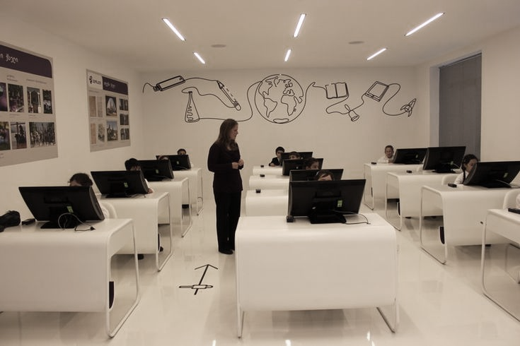
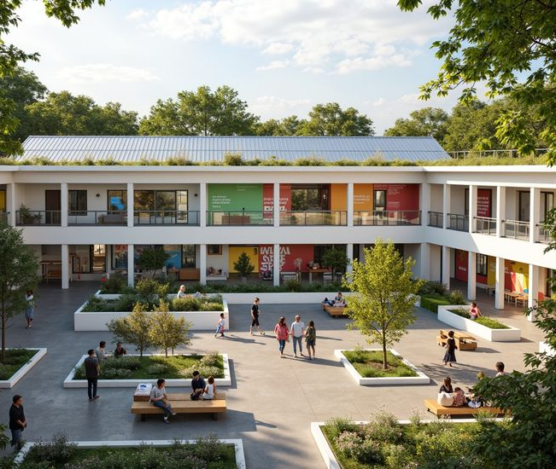
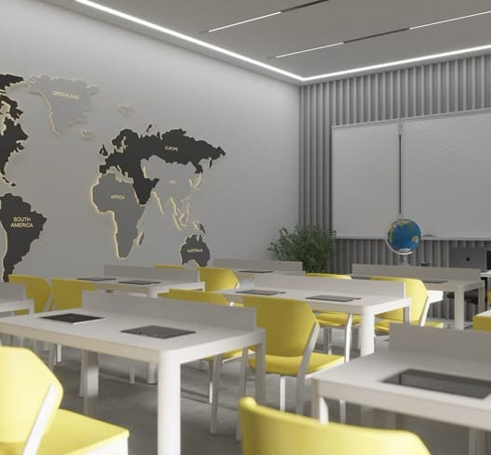
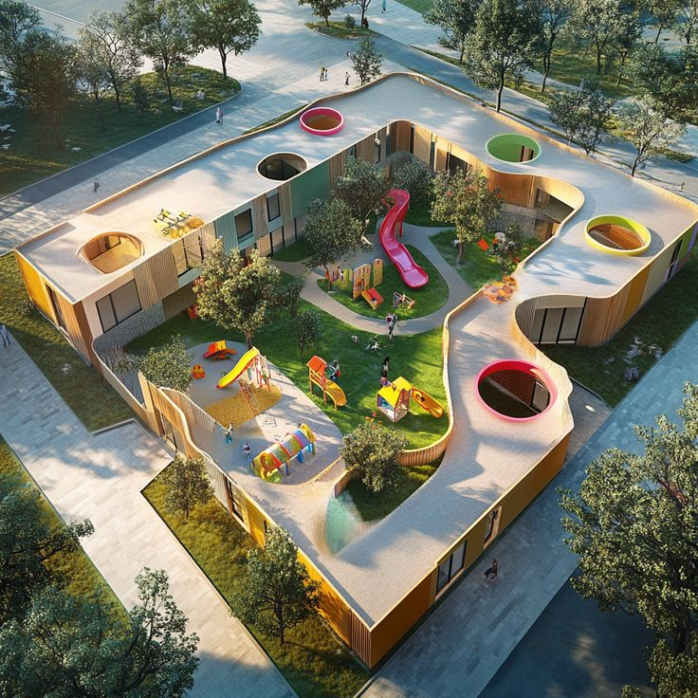
smarteduverse

Slide 4


Group Details
1. Roll no. : 2 Name : Bhalala Tulsi Mansukhbhai Contact no. : 9016768711 2. Roll no. : 4 Name : Bhatt Aastha Vijaybhai Contact no. : 9904137419 3. Roll no. : 51 Name : Odedara Leelu Khimabhai Contact no. : 6355494975

Slide 5


Internal Guide :
Prof. Dhruvi Suthar

Slide 6
Development tools & technologies
Front-end :- ASP.NET Core MVC forms, Bootstrap, HTML, CSS, Javascript
Back-end :- C#, SQL Server 16.0.1000.6.
IDE :- Visual Studio 2022
Software Requirement :- .NET Framework Operating system-windows 11(64 bits) or Above
Hardware Requirement :- Memory : 8 GB RAM, Processor : core i3, Ryzen 5 or Above

Slide 7
EXISTING SYSTEM
The current school management system includes only basic features for handling school related work. It gives general information about the school, search as a courses admission rules and available staff. Many tasks still need to be done manually, and students or staff often have to visit the school in person to get updates or complete activities. Earlier we had to come to the school every day to check our daily activities.

Slide 8
PROPOSED SYSTEM
SmartEduVerse to enhance the existing school management system website by introducing new features and functionalities. The proposed system provides parents log in portal. With the help of this portal parent’s can log in and can track day-to-day activities of their child.

Slide 9
MODULES
Admin
Login in system
Manage staff
VIEW PARENTS
Manage feeS
Manage gallery
Manage notification
Manage feedback
staff
Login in system
Manage profile
Manage PARENTS
Manage attendance
MANAGE TIME-TABLE
Upload material
MANAGE leave report
Post exam schedule
Post result
Manage faq’s
GET notification

Slide 10
MODULES
parents
Login in system
Manage profile
Pay fees
View attendance
VIEW TIME-TABLE
VIEW/DOWNLOAD MATERIAL
GIVE LEAVE REPORT
View exam schedule
View/DOWNLOAD RESULT
View GALLERY
Ask faq’s
GET notification
GIVE/ VIEW FEEDBACK
visitors
View gallery
Ask faq's

Slide 11
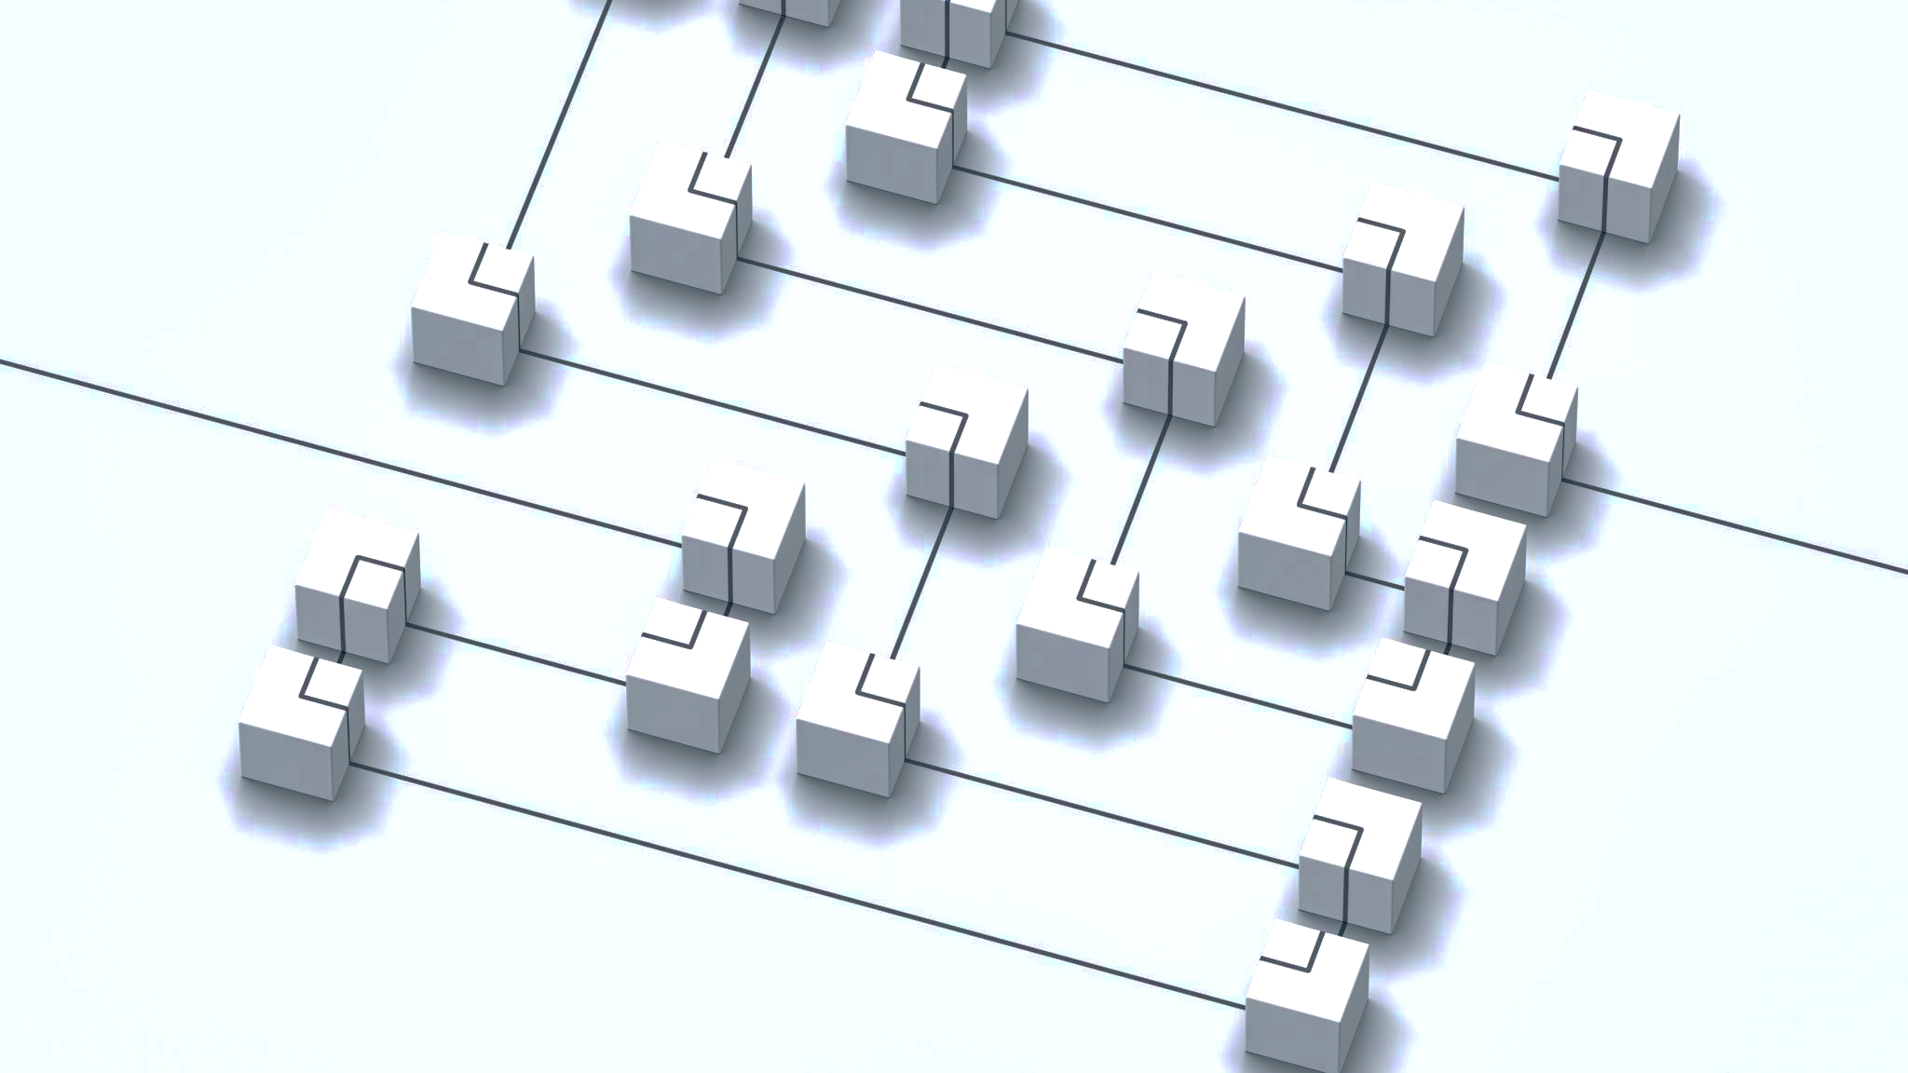
System flow diagram

Slide 12
Symbol of system flow diagram
Start/terminator
Decision
Process
Connector

Slide 13
Start
Admin
Staff
Parents
Visitors
No
Yes
No
Yes
No
Yes
Login
Login
Login
Manage profile
View gallery
Manage staff
Manage profile
Pay fees
Ask FAQ’s
View parents
Manage parents
View attendance
Manage fees
Manage attendance
View time-table
Manage gallery
Manage time-table
View/download
Material
Manage
Upload Material
Give leave report
Notification
Manage
Feedback
Manage leave report
View exam schedule
View/download
Result
Post exam schedule
View gallery
Post result
Ask FAQ’s
Manage FAQ’s
Get notification
Get notification
Give/view feedback
Logout
End

Slide 14
CLASS diagram

Slide 15




Symbol Of class DIAGRAM
Class
Generalization
Package
Interface

Slide 17
Symbol of USE CASE DIAGRAM
use-case
system boundary
relationship
actor

Slide 18
ADMIN USE CASE DIAGRAM :-
<<include>>
Username password
Log in
<<extend>>
Add, Update, Delete
Manage staff
Manage parents
Manage gallery
Manage fees
Manage notification
ADMIN
Manage feedback
Log out

Slide 19
STAFF USE CASE DIAGRAM :-
<<include>>
Email Username password
Log in
<<extend>>
Manage profile
Change password forget password
Manage parents
Manage attendance
Manage time-table
Upload material
Manage leave report
Post exam schedule
STAFF
Post result
Manage FAQ’S
get notification
Log out

Slide 20
PARENTS USE CASE DIAGRAM:-
Log in
<<include>>
Email username password
Manage profile
<<extend>>
Change password
Forget password
Pay fees
View attendance
View timetable
View/download material
Give leave report
View exam schedule
View/download result
View gallery
Ask FAQ’S
PARENTS
Get notification
Give /view feedback
Log out

Slide 21
VISITOR USE CASE DIAGRAM
View gallery
Ask FAQ’s
VISITOR

Slide 22
Sequence diagram

Slide 23

Symbol of Sequence diagram
Destruction
Actor
Message
Entity
Message(Return)
Boundary
Activation
Control

Slide 24
LOGIN :-
Admin / Staff / Parent
Login Form
Login Controller
Admin / Staff / Parent
Login details()
login details()
valid details()
alt
Check user details()
[valid]
login successful
return
[invalid]
login unsuccessful

Slide 25
MANAGE STAFF:-
Admin
Staff
Manage Controller
Staff
Update details()
Update details()
valid details()
alt
Update details()
[valid]
Update successful
return
[invalid]
Update unsuccessful

Slide 26
MANAGE PROFILE :-
Staff / Parent
Profile Form
Manage Profile Controller
Staff / Parent
Update details()
Update details()
valid details()
alt
Update details()
[valid]
Update successful
return
[invalid]
Update unsuccessful

Slide 27
MANAGE PARENTS :-
Staff
Parent page
Manage Controller
Parent
Update details()
Update details()
valid details()
alt
Update details()
[valid]
Update successful
return
[invalid]
Update unsuccessful

Slide 28
VIEW PARENTS :-
Admin
Parent page
View Parent controller
Parent
View Parent()
Parent details()
Valid details()
alt
View details()
[valid]
View gallery successful
return
[invalid]
View gallery unsuccessful

Slide 29
MANAGE FEES :-
Admin
Fees page
Fees controller
Fees
Get Payment details()
Get payment details()
Valid details()
alt
Update details()
View payment successful
return
[valid]
[invalid]
View payment unsuccessful

Slide 30
PAY FEES :-
Parent
Fees page
Fees controller
Fees
Set Payment details()
Get payment details()
Valid details()
alt
Add details()
[valid]
Payment successful
return
[invalid]
payment unsuccessful

Slide 31
MANAGE GALLERY :-
Admin
Gallery page
Gallery controller
Gallery
Update gallery()
Gallery details()
Valid details()
alt
Update details()
[valid]
Update details successful
return
[invalid]
Update details unsuccessful

Slide 32
VIEW GALLERY :-
Parent / Visitor
Gallery page
Gallery controller
Gallery
View gallery()
Gallery details()
Valid details()
alt
View details()
[valid]
View gallery successful
return
[invalid]
View gallery unsuccessful

Slide 33
ASK FAQ’s :-
Parent / Visitor
FAQ’s page
FAQ’s controller
FAQ’s
Ask FAQ’s()
FAQ’s details()
Valid details()
alt
Add details()
[valid]
Ask FAQ’s successful
return
[invalid]
Ask FAQ’s unsuccessful

Slide 34
MANAGE FAQ’s :-
Admin
FAQ’s page
FAQ’s controller
FAQ’s
Reply FAQ’s()
FAQ’s details()
Valid details()
alt
Add details()
[valid]
Reply FAQ’s successful
return
[invalid]
Reply FAQ’s unsuccessful

Slide 35
MANAGE ATTENDANCE:-
Staff
Attendance page
Attendance controller
Attendance
Check attendance()
Attendance details()
Valid details()
alt
Display details()
[valid]
Check attendance successful
return
[invalid]
Check attendance unsuccessful

Slide 36
VIEW ATTENDANCE :-
Parent
Attendance page
Attendance controller
Attendance
View Attendance()
Attendance details()
Valid details()
alt
Display details()
[valid]
View attendance successful
return
[invalid]
View attendance unsuccessful

Slide 37
MANAGE ATTENDANCE:-
Staff
Attendance page
Attendance controller
Attendance
Check attendance()
Attendance details()
Valid details()
alt
Display details()
[valid]
Check attendance successful
return
[invalid]
Check attendance unsuccessful

Slide 38
POST EXAM SCHEDULE :-
Staff
Schedule page
Schedule controller
Schedule
Post exam schedule()
Schedule details()
Valid details()
alt
Update details()
[valid]
Schedule update successful
return
[invalid]
Schedule update unsuccessful

Slide 39
VIEW EXAM SCHEDULE :-
Parent
Schedule page
Schedule controller
Schedule
View schedule()
Schedule details()
Valid details()
alt
Display details()
[valid]
View Schedule successful
return
[invalid]
View Schedule unsuccessful

Slide 40
UPLOAD MATERIAL:-
Staff
Material page
Material controller
Material
Upload Material()
Material details()
Valid details()
alt
Upload details()
[valid]
Upload Material successful
return
[invalid]
Upload Material unsuccessful

Slide 41
VIEW MATERIAL:-
Parent
Material page
Material controller
Material
View Material()
Material details()
Valid details()
alt
View details()
[valid]
View Material successful
return
[invalid]
View Material unsuccessful

Slide 42
POST RESULT:-
Staff
Result Page
Result Controller
Result
Post result()
Add result()
Valid details()
alt
Update details()
[valid]
Post result successful
return
[invalid]
Post result unsuccessful

Slide 43
VIEW RESULT:-
Parent
Result Page
Result Controller
Result
View result()
Result details()
Valid details()
alt
Display details()
[valid]
View result successful
return
[invalid]
View result unsuccessful

Slide 44
GIVE LEAVE REPORT:-
Parent
Parent page
Parent controller
Parent
Give leave report()
Give report details()
Valid details()
alt
Update details()
[valid]
Give leave report successful
return
[invalid]
Give leave report unsuccessful

Slide 45
VIEW LEAVE REPORT:-
Staff
Leave report page
Leave report controller
Leave report
View leave report()
Leave report details()
Valid details()
alt
Add details()
[valid]
View leave report successful
return
[invalid]
View leave report unsuccessful

Slide 46
GIVE FEEDBACK:-
Parent
Feedback page
Feedback controller
Feedback
Feedback report()
Feedback details()
Valid details()
alt
Update details()
[valid]
Give leave report successful
return
[invalid]
Give leave report unsuccessful

Slide 47
activity diagram

Slide 48
Symbol of Activity DIAGRAM
initial state decition
final state swimlane
state(action) fork
transition join

Slide 49
ADMIN ACTIVITY DIAGRAM :-
Log in
valid
No
yes
Manage staff
Manage gallery
Manage fees
Manage notification
Manage feedback
Insert
Update
Delete
Insert
Update
Delete
Insert
Update
Delete
Insert
Update
Delete
Insert
Update
Delete
View parents
Log out

Slide 50
STAFF ACTIVITY DIAGRAM :-
Log in
Valid
yes
No
Manage profile
Manage attendance
Upload material
Post exam schrdule
Manage FAQ’S
Add
Update
Delete
Add
Update
Delete
Add
Update
Delete
Add
Update
Delete
Add
Update
Delete
Manage
Parent
Manage
time-table
Manage leave report
Post result
Get notificaation
Add
Update
Delete
Add
Update
Delete
Add
Update
Delete
Add
Update
Delete
Log out

Slide 51
PARENTS ACTIVITY DIAGRAM :-
Log in
Valid
Yes
No
Manage profile
Ask FAQ’S
Give/view feedback
View attendance
View/download material
View/download result
Add
Update
Delete
Add
Update
Delete
Add
Update
Delete
View time-table
Give leave report
Pay fees
View exam schedule
View gallery
Get notification
Add
Update
Delete
Cash
Online
Log out

Slide 52
VISITOR ACTIVITY DIAGRAM :-
View gallery
Ask FAQ’s

Slide 53
state chart diagram

Slide 54
Symbol of state chart diagram
Initial state
Final state
State(action)
Transition

Slide 55
ADMIN STATE CHART DIAGRAM :-
Login
Manage staff
View parents
Manage feedback
Manage notification
Manage gallery
Manage fees
Log out

Slide 56
STAFF STATE CHART DIAGRAM :-
Login
Manage profile
Manage parents
Manage leave report
Upload material
Manage time-table
Manage attendance
Post exam schedule
Post result
Manage FAQ’s
get notification
Logout

Slide 57
PARENTS STATE CHART DIAGRAM :-
Login
Manage profile
Pay fees
View attendance
View exam schedule
Give leave report
View/download material
View time-table
View/download result
View gallery
Ask FAQ’s
Get notification
Logout
Give/ View feedback

Slide 58
VISITOR STATE CHART DIAGRAM :-
View gallery
Ask FAQ’s

Slide 59

Thank you

