Slide 1

Registration system
Boris Avdeev

Slide 2
Content:
The Main Menu
Part 1 The Login screen
Part 2 Registering guests
Part 3 The Guest management
Part 4 The report

Slide 3
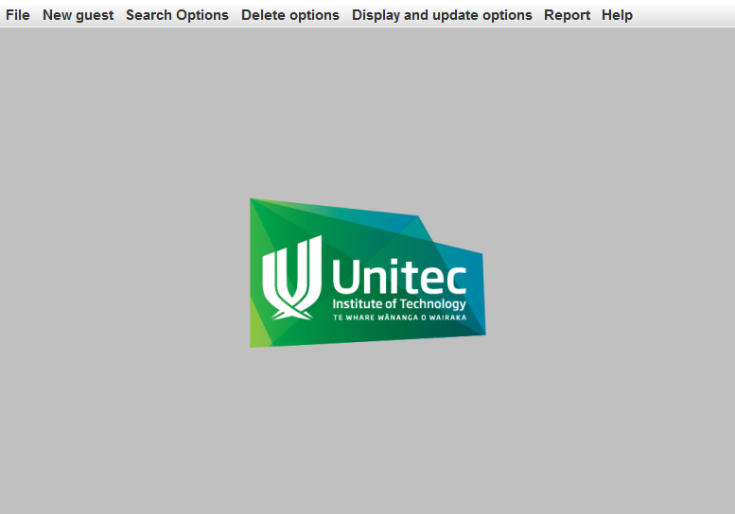
Main menu

Slide 4
Main menu
JPanel
JLabel
JMenuBar
JMenuItem
ActionListener

Slide 5
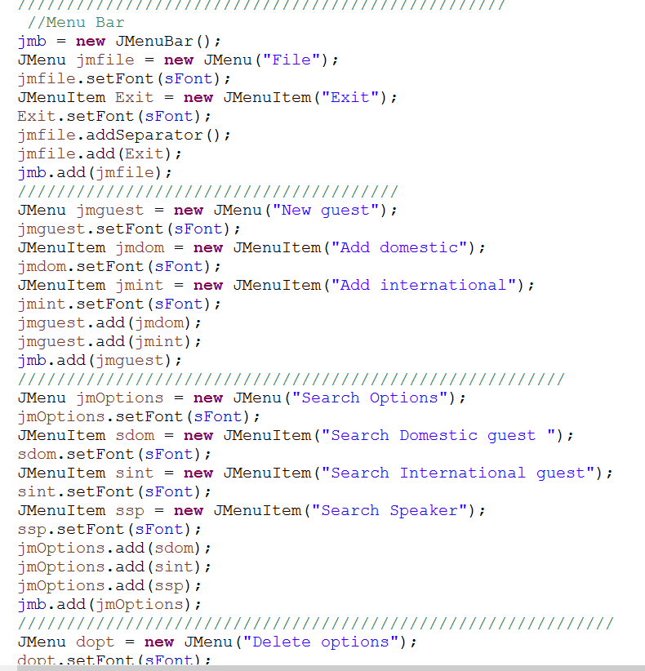
Main menu, GUI

Slide 6
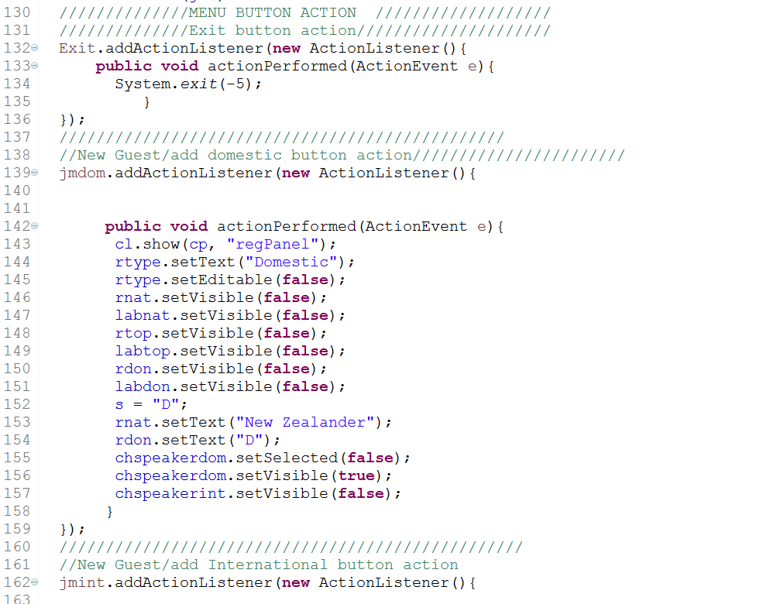
Main menu, Actions

Slide 7
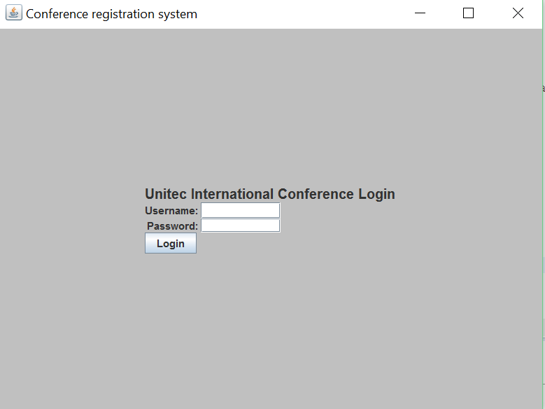
Part 1, Login screen

Slide 8
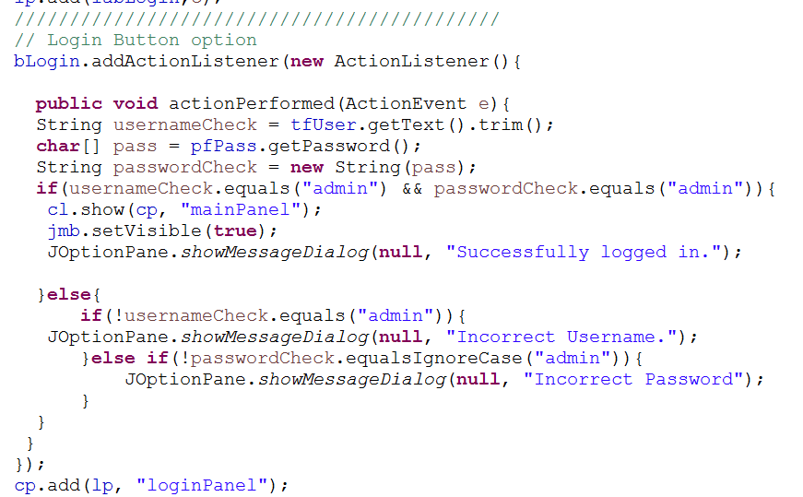
Login, Process

Slide 9
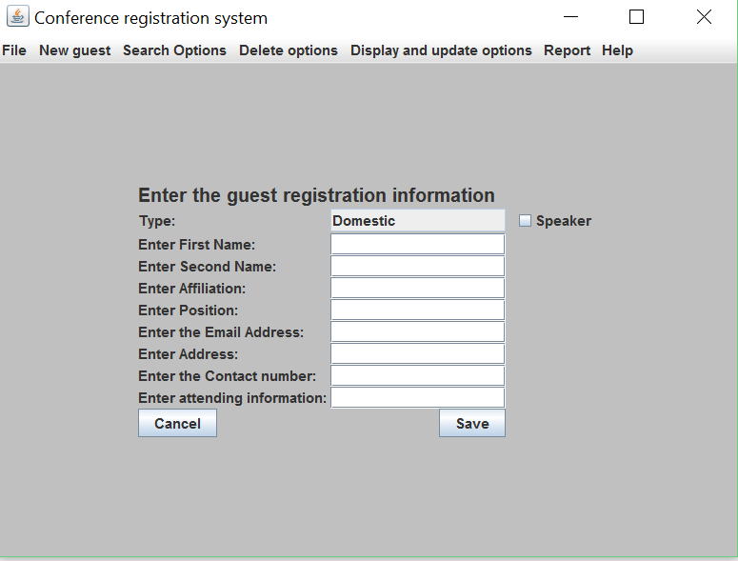
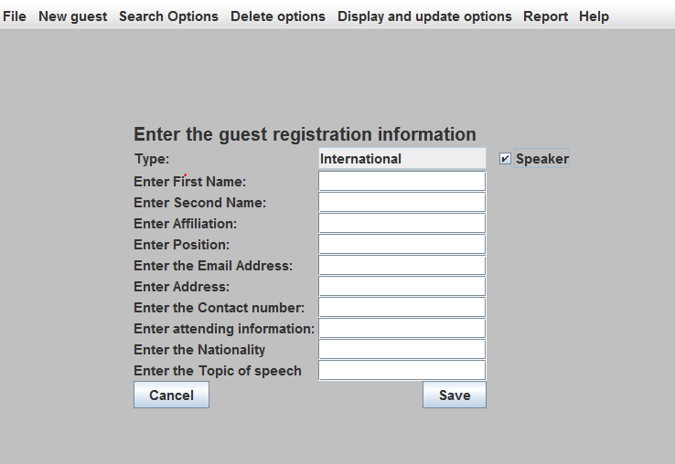
Part 2, Registering process, add New guest

Slide 10
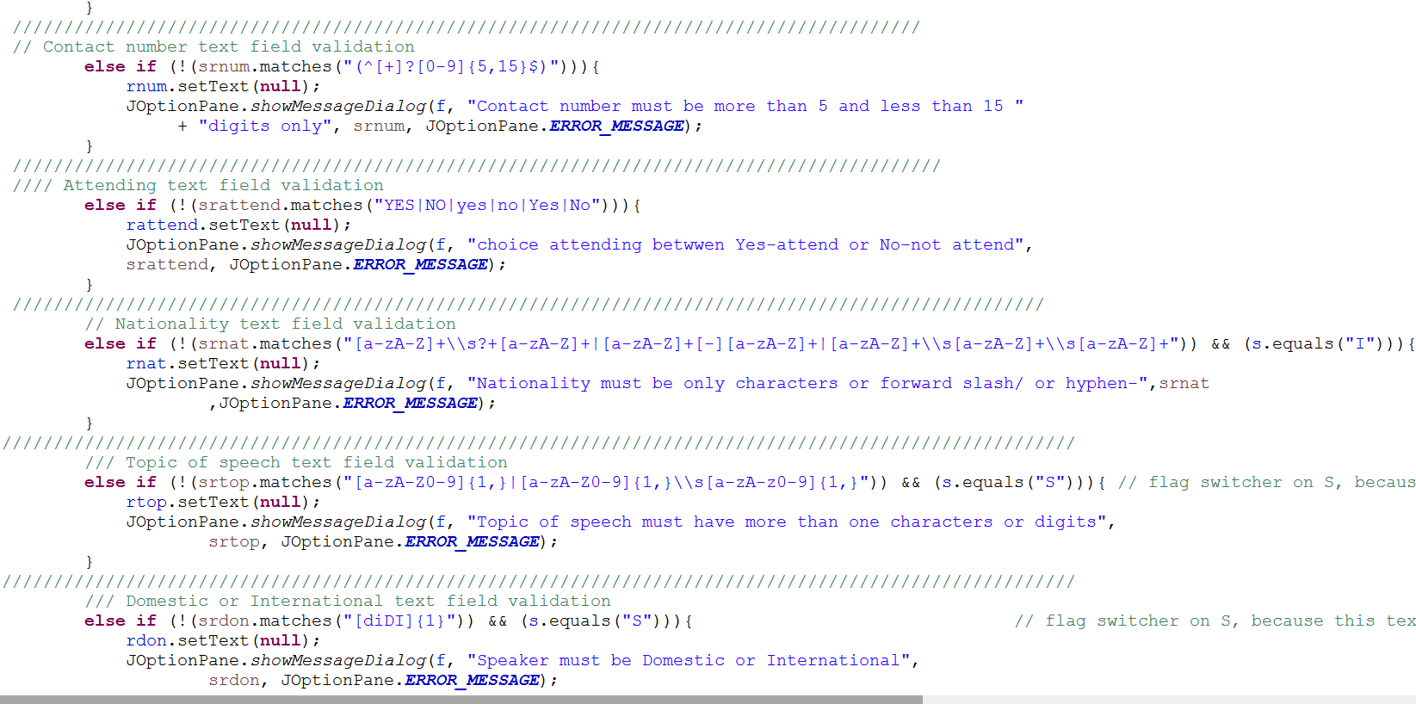
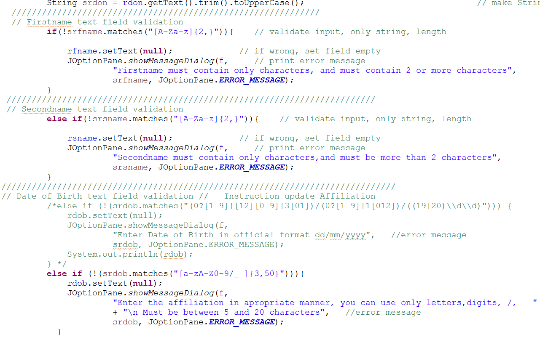
Part 2,1 Input validation, Using Regular Expressions

Slide 11
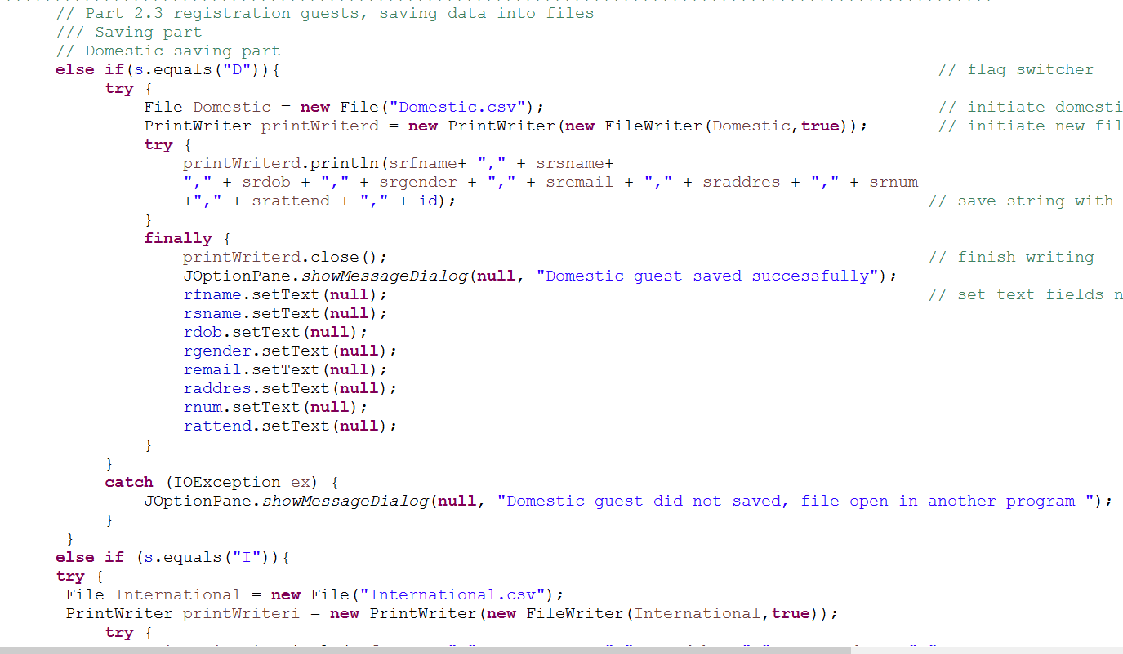
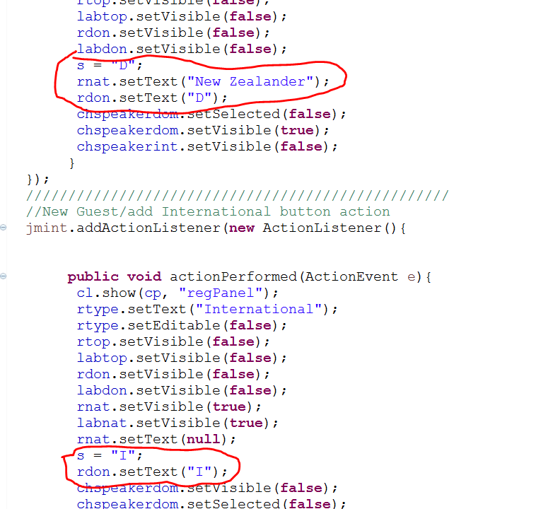
Part 2.2 Saving data into csv files

Slide 12
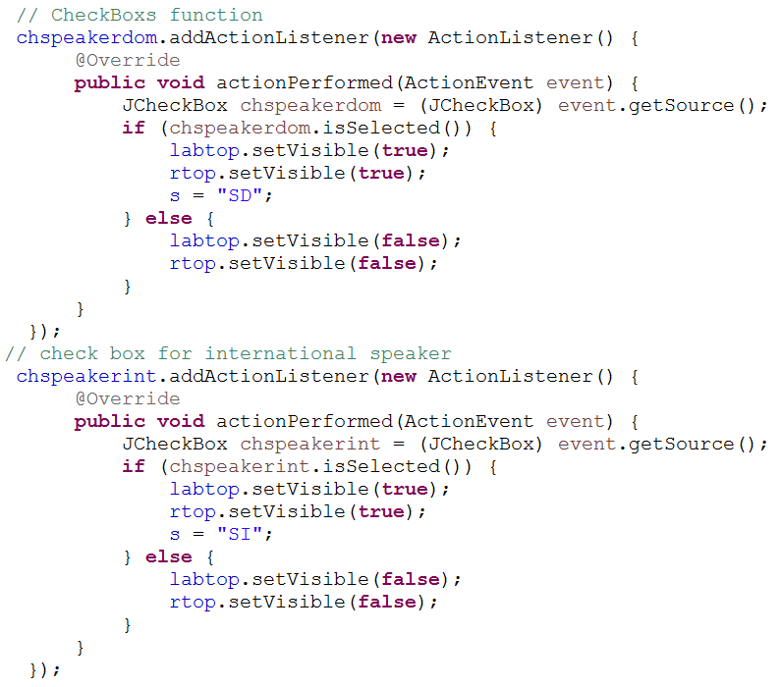
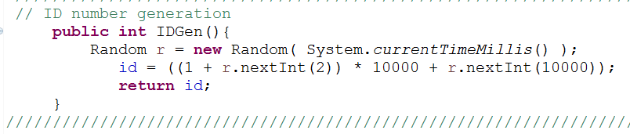
Part 2, Checkboxes options and ID generation

Slide 13
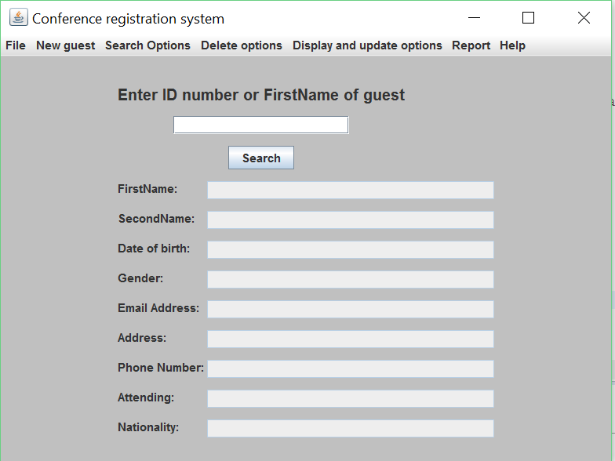
Part 3 Guest management Part 3.1 Search options, Search menu

Slide 14
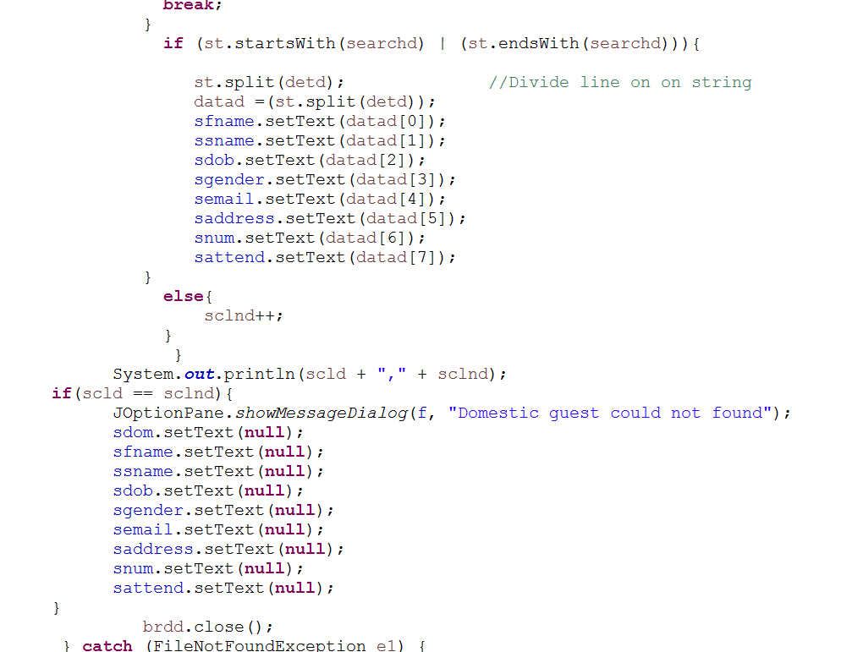
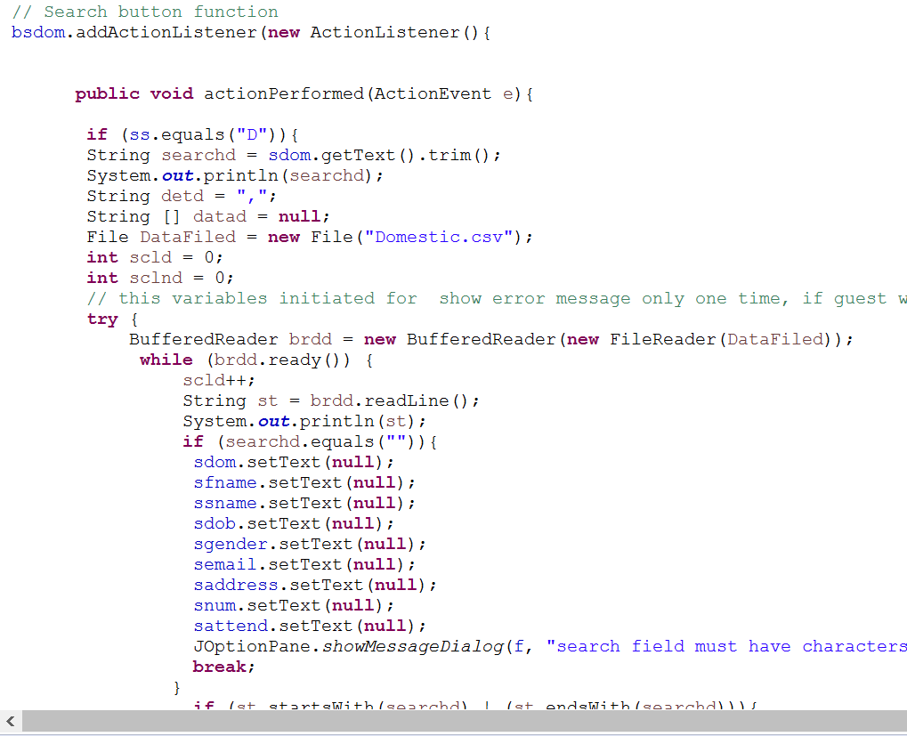
Part 3.1 Search action

Slide 15
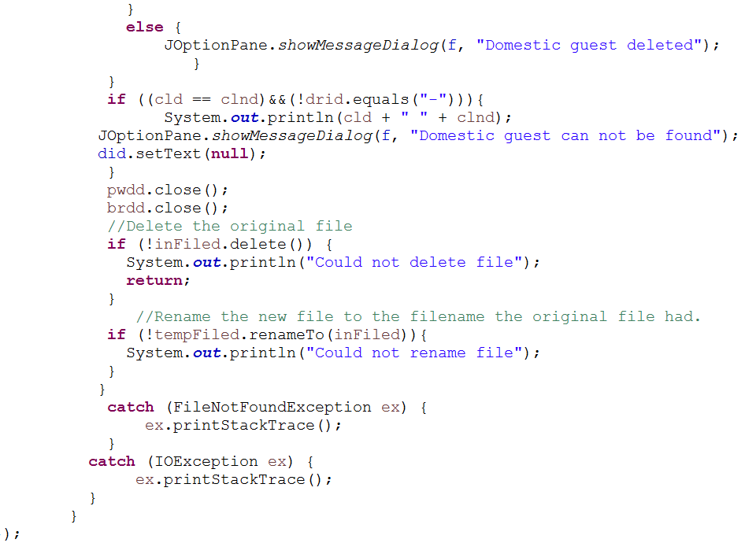
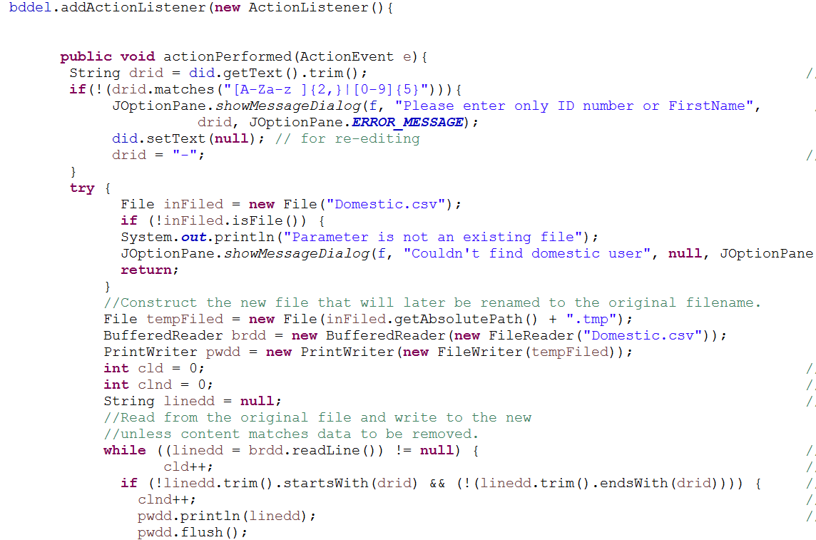
Part 3.2 Delete option

Slide 16
Part 3, Display guests
JTable
Abstract Table Model
Array lists
Array

Slide 17
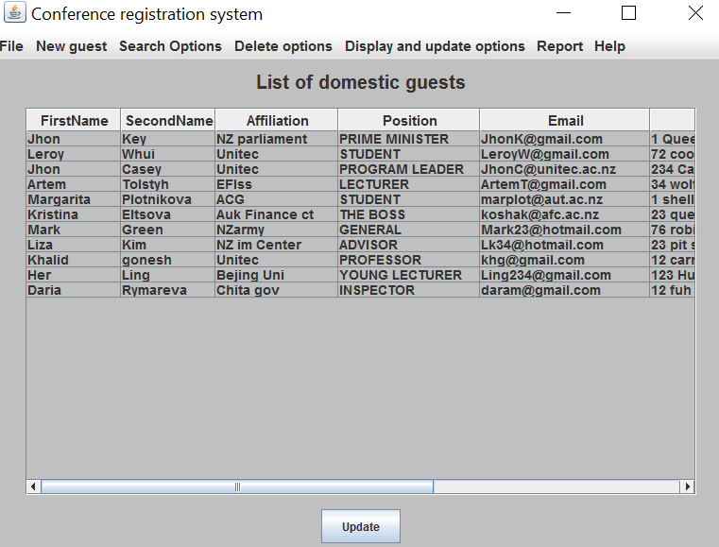
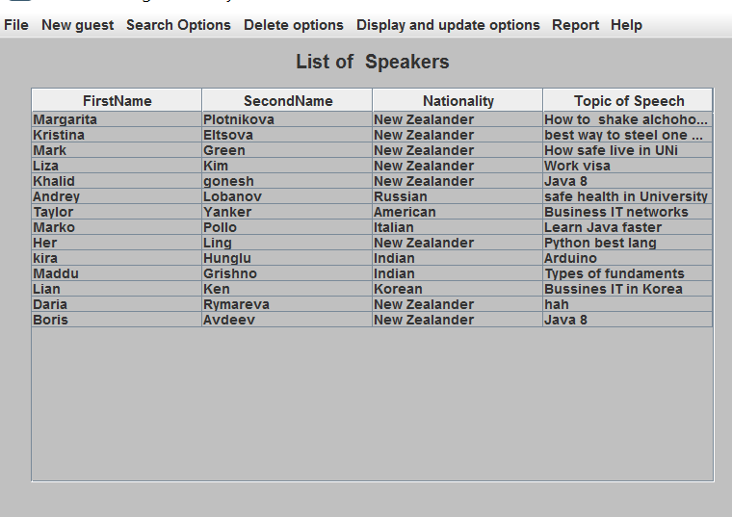
Part 3.3 Display guests menu

Slide 18
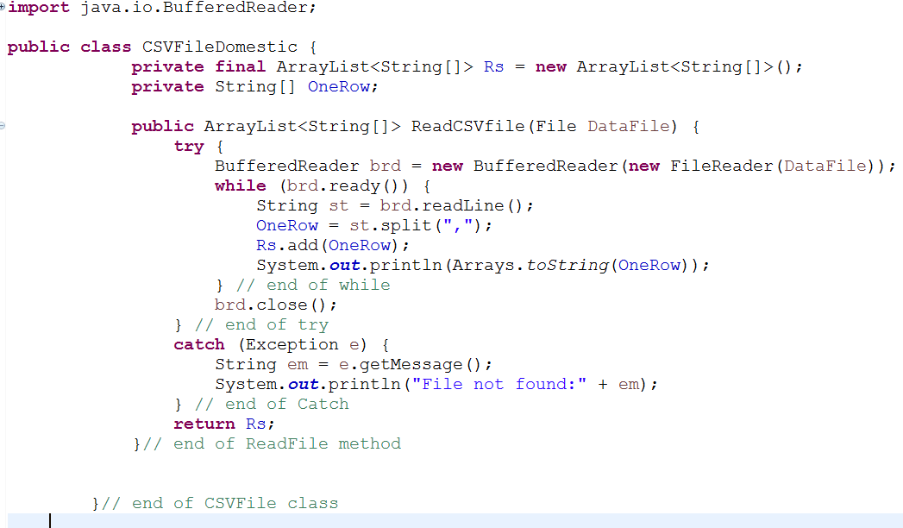
Part 3.3 Displaying guests actions. Read data from file

Slide 19
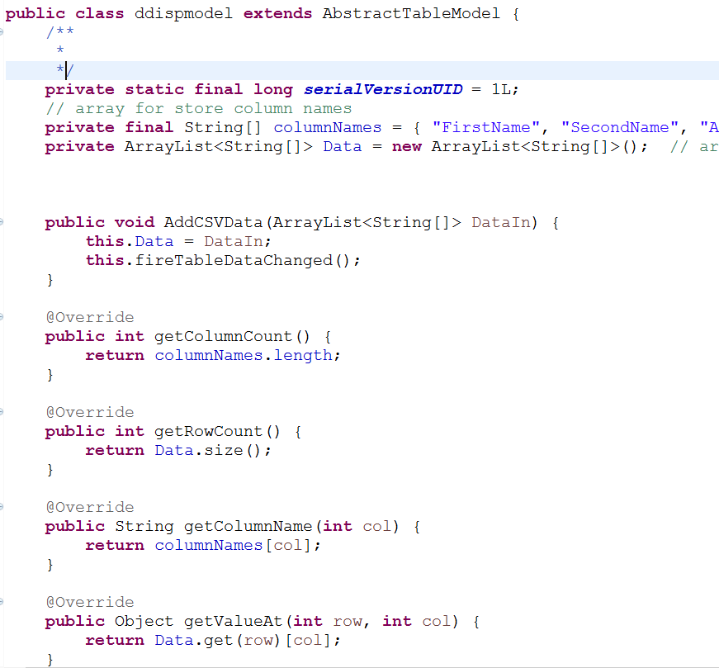
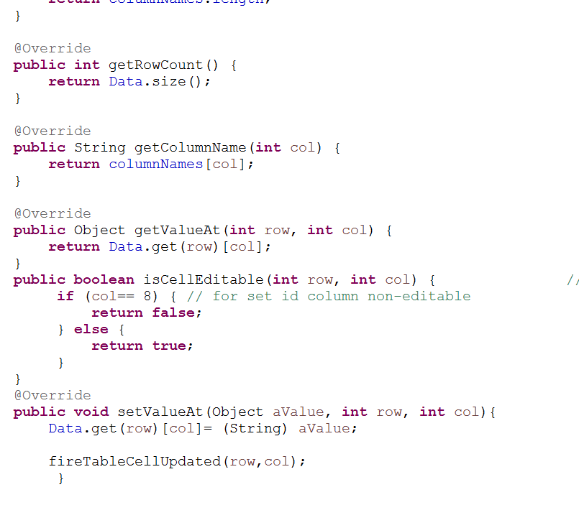
Part 3.3 Displaying guest, Abstract Table Model class

Slide 20
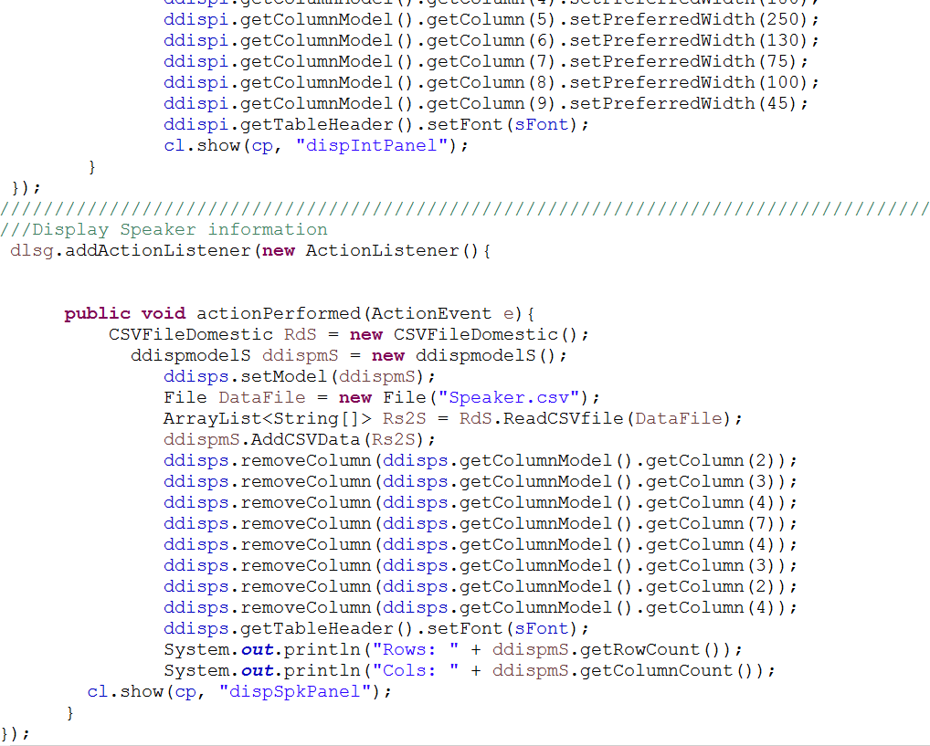
Part 3.3 Set Model for JTable

Slide 21
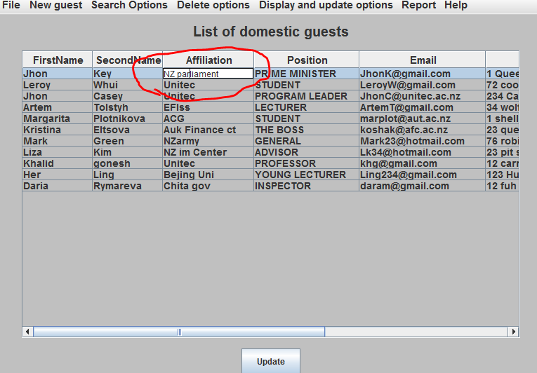
Part 3.4 Update guest information

Slide 22
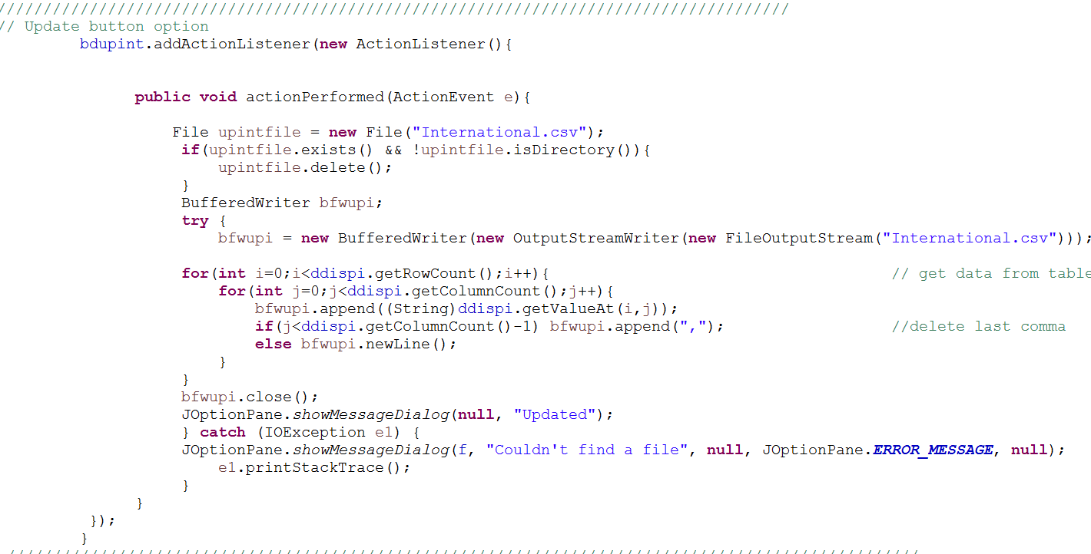
Part 3.4 Update guest information, Action

Slide 23
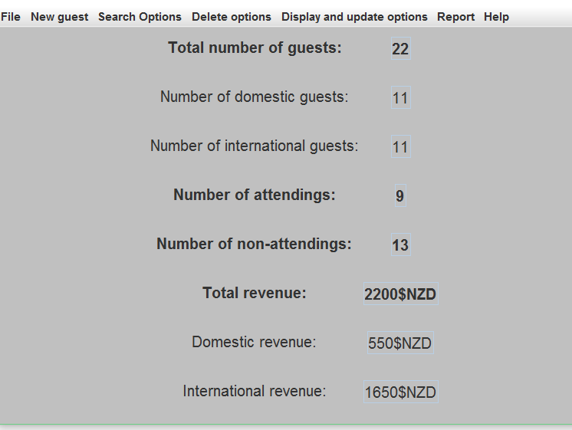
Part 4 The report

Slide 24
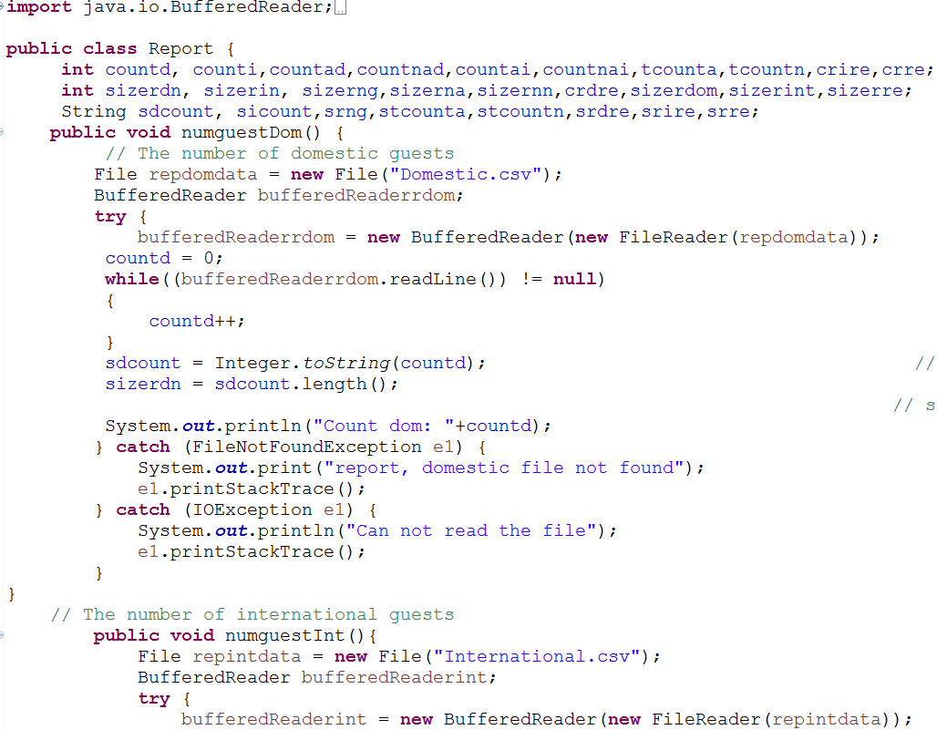
Part 4 The report action

Slide 25
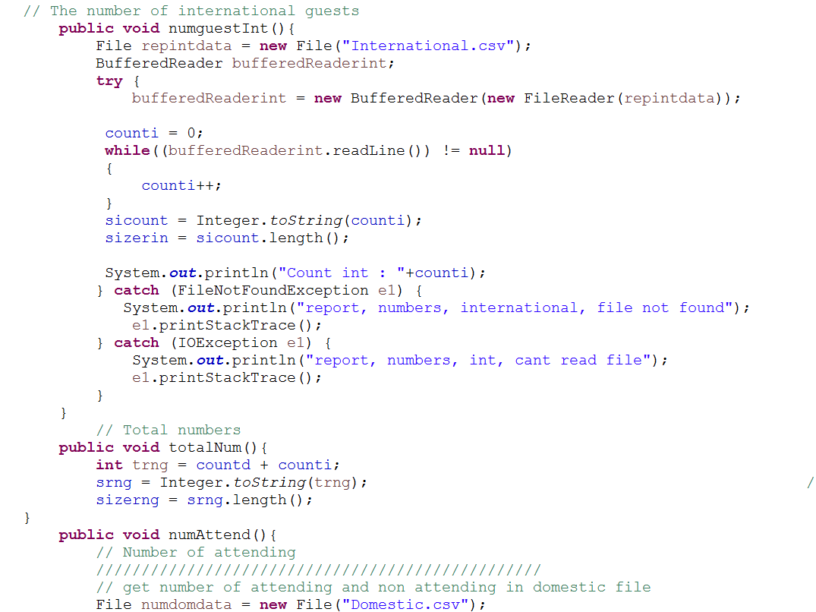
Part 4 The report action

Slide 26
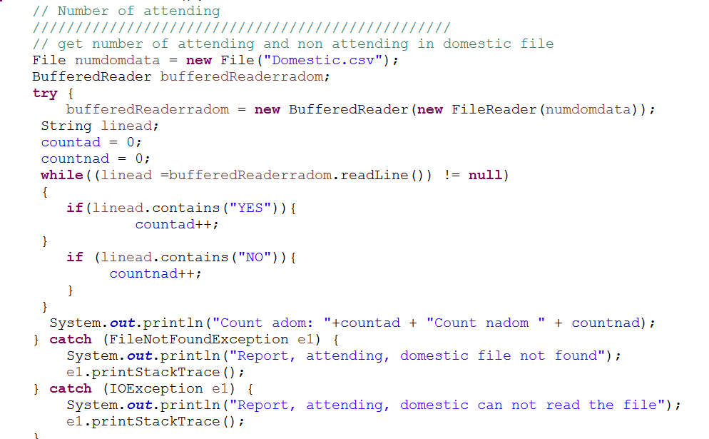
Part 4 The report action

Slide 27
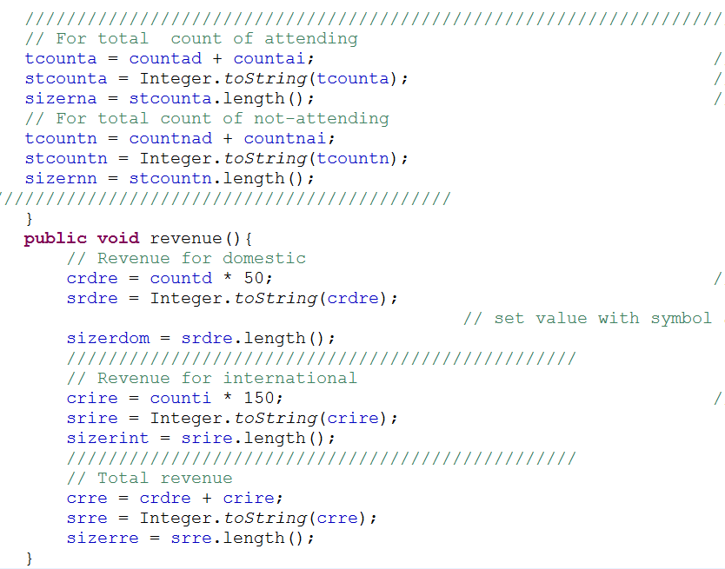
Part 4 The report action

