Slide 1
User Interaction Storyboard – Sliding Menu
Susan Smith – Mobile Web browser user
Susan is browsing a responsively-designed website, in portrait orientation, and needs to access a menu along the side of the screen that takes up more width than we really have on her smartphone.
Susan touches the arrow to the top left of the screen and the menu panel slides very quickly, then slowing down and stopping about halfway across the page. The arrow then rotates to point the opposite direction, allowing a way to close the panel again.

Slide 2
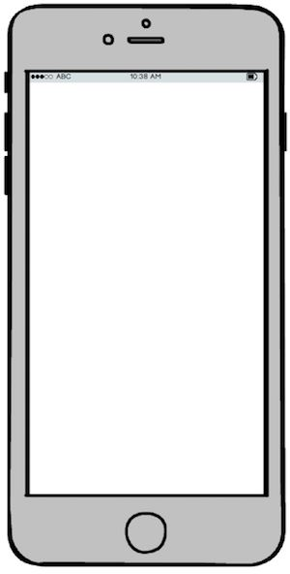
Susan clicks on the menu panel arrow button
Menu

Slide 3
The panel moves to the right quickly at first, then slowing down until it stops to reveal the menu panel content.
Menu

Slide 4
The menu arrow butgton rotates 180 degress once the panel has finished sliding to the right
Menu

Slide 5
Once the arrow buttgon is clicked again, the panel slides back, quickly at first, then slowly back into place. The arrow button then rotates back 180 degrees.
Menu

