Slide 1
Route Alignment using GIS, Remote Sensing and Deep learning
End Semester Presentation(STS_02)
By
Apurva Deshpande - 111903020
Ashlesha Joshi - 111903022
Riddhi Tharewal - 111903068
Under the Supervision of
Prof. Suraj Sawant
6th May 2023

Slide 2
Overview
Introduction
Related Work
Methodology
Experimental Setup
Results and Discussions
Conclusions
Timeline
Dataset
Evaluation Metrics
Base Line
Hyperparameter Setting
Problem Formulation
Proposed System
System Specification
References
Route Alignment
Motivation
Problem Statement
Objectives
Route Alignment using Deep learning
Route Alignment using QGIS

Slide 3
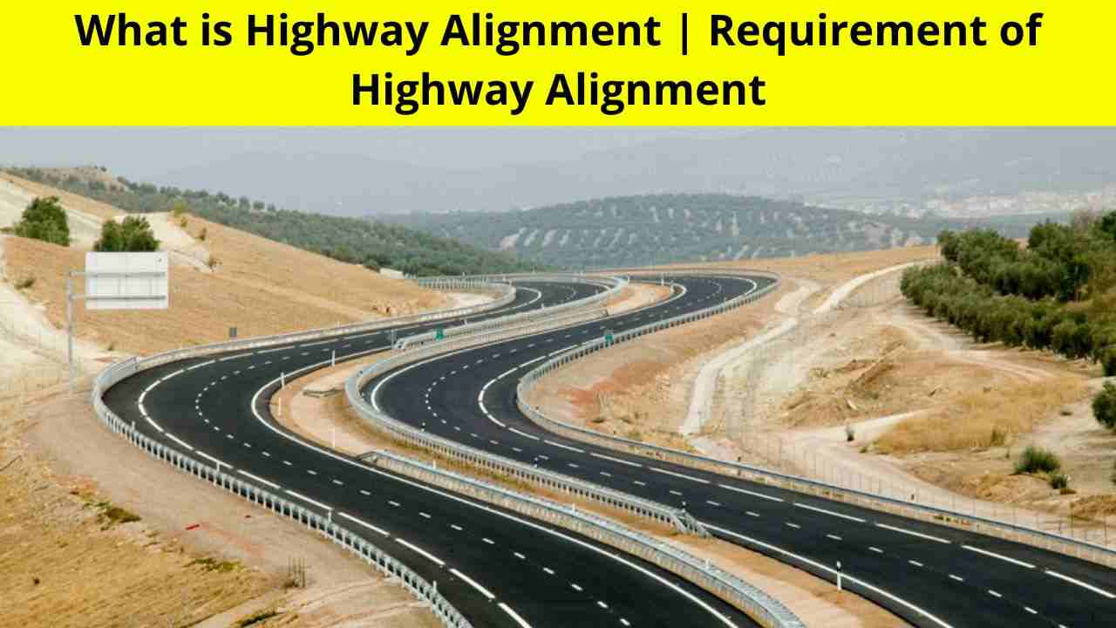
1. Introduction
Goal: Alignment of an optimal route between Pune and Mumbai.
Remote sensing, GIS, and Deep Learning technologies are used in to attain the goal.
Route alignment process is governed by several important factors.
LULC: Machine learning algorithms and Deep learning models.
Weighting and ranking of the elements are done using several approaches.
Route optimization algorithms to generate an optimal route.

Slide 4
1. Introduction
1.2. Motivation
The following problems motivated us to develop a route alignment that would address them:
Tedious and time-consuming traditional route construction methods.
The route is congested, and traffic is heavy.
Damage to the environment caused during route construction.
There is a high frequency of accidents on the route.
High maintenance and construction costs of the route.

Slide 5
1. Introduction
1.3. Problem Statement
To align the route between Pune and Mumbai with:
Less construction and maintenance costs.
Coverage of maximum points( intermediate cities, towns, and villages).
Optimal length.
Driving safety and comfort.
Reduced operation cost of vehicle.
Lesser complexity.
Reduced harm to the environment.

Slide 6
1. Introduction
1.4. Objectives
To effectively study the research region where the route has to be aligned using land use and land cover classification.
To rate the factors influencing route alignment for ranking using the AHP approach to achieve the anticipated route alignment design.
To study and use the route optimization algorithms to provide an optimal route in terms of length and speed.

Slide 7
2. Related Work
Prior to the 2000s, there was very little work on route alignment, and it gradually increased after that.
New developments in route alignment have occurred over the years.
In the form of a review paper titled "Route alignment system using remote sensing: systematic literature review with meta-analysis", all the related work has been documented using a systematic literature review.
The documentation of the related work can be viewed at: Review paper.

Slide 8
3. Methodology
3.1. Problem Formulation
Existing methods of designing route alignment(s) are carried out manually, considering economic and traffic costs.
Our research objective is to find optimal route between Pune and Mumbai considering multi-objective technique – to minimize environmental, social and utility costs
Perform a comparative study of route alignment using Deep learning techniques and existing GIS software.

Slide 9
3. Methodology
3.2. Proposed System
LULC
Map
Road Networks Map
Railway Network Map
Drainage Map
Slope
Map
Layer Stacking and Clipping
AHP
Weight Assignment and Ranking
Dijkstra's Algorithm
Route Alignment Optimization
Optimized Routes

Slide 10
3. Methodology
3.2 System Specification
Software specification:
TensorFlow
Keras
NumPy
Seaborn, Matplotlib
Hardware specification:
Windows Operating System
CUDA compatible GPUs with minimum 32 GB memory

Slide 11
4. Experimental Setup
4.1. Datasets
DeepGlobe LandCover Classification Dataset obtained from Kaggle – to prepare Land Use Land Cover Map
Digital Elevation Model (DEM) dataset obtained from USGS Earth Explorer – to prepare Slope and Aspect Map
Water Bodies dataset obtained from USGS Earth Explorer – to prepare Drainage Map
OpenStreetMap dataset – to prepare Road and Railway network Map
Sentinel2A images of the study area obtained using Google Earth Engine – to test the trained LULC models and perform Land Use Land Cover Classification of the study area

Slide 12
4. Experimental Setup
4.1 Land Use Land Cover Classification
Preprocessing of Sentinel2A image performed using QGIS
Dataset splitting into 80:20 for training and testing the LULC models
Hyperparameter Setup -
Number of epochs: 12
Batch size: 4
Learning rate: 1e-5
Loss function used: Dice Coefficient Loss
Optimizer used: Adam Optimization
ResNet50_UNet and UNet Models trained using Transfer learning
Using QGIS -
Semi-Automatic Classification Plugin and Processing Toolbox modules used
Training layers added and supervised image classification performed
Layer stacking performed using DEM, road and railways network datasets

Slide 13
4. Experimental Setup
4.2 Weight Assignment and Route Alignment
Weight Assignment of Factors:
Pairwise comparison matrix created for criteria selected
Priority vector for each criteria calculated using normalized pairwise comparison matrix
Consistency of weight assignment checked using Consistency Index (CI) and Consistency Ratio(CR), and factors are ranked
Route Alignment Optimization:
Dijkstra's algorithm used to find shortest path between Kiwale(Pune) and Kalamboli (Mumbai)
Optimal route obtained is printed on the image using NumPy and PIL module functions
Using QGIS:
Suitability analysis performed using MCDA plugin
OpenRouteService(ORS) tools plugin used to find alternative optimal routes on the LULC map according to specified criteria

Slide 14






4. Experimental Setup
4.2. Evaluation Metrics
Dice Coefficient :
Dice Loss:
Precision and
Recall
Consistency Ratio:

Slide 15
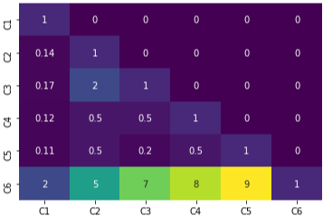
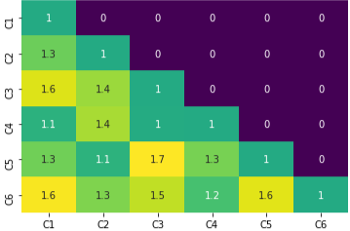
5. Results and Discussions
We have obtained the following results for the three phases:
The dice coefficient for the UNet model was 98.5%, while the dice coefficient for the ResNet-50 UNet model was 96.89%.
AHP executed weight assignment with a consistency ratio of 0.04 (less than 0.1).
Dijkstra's algorithm for route optimization.
AHP pairwise comparison matrix
Consistency Ratio matrix

Slide 16
Consistency Ratio: 5.08% and Consistency ratio of weighted: 4.40%
Criterion | Weights | Weights +/-
Urban Land | 34.5% | 11.41%
Agricultural Land | 6.2% | 1.71%
Range Land | 9.10% | 3.42%
Forest Land | 4.40% | 0.93%
Water | 3.00% | 1.02%
Barren | 42.80% | 16.91%

Slide 17
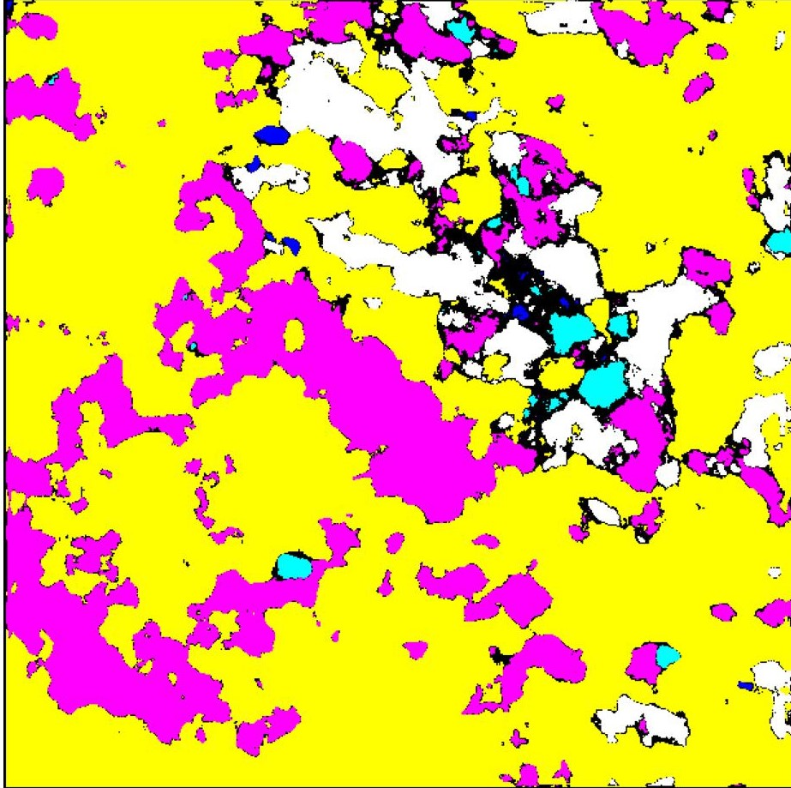
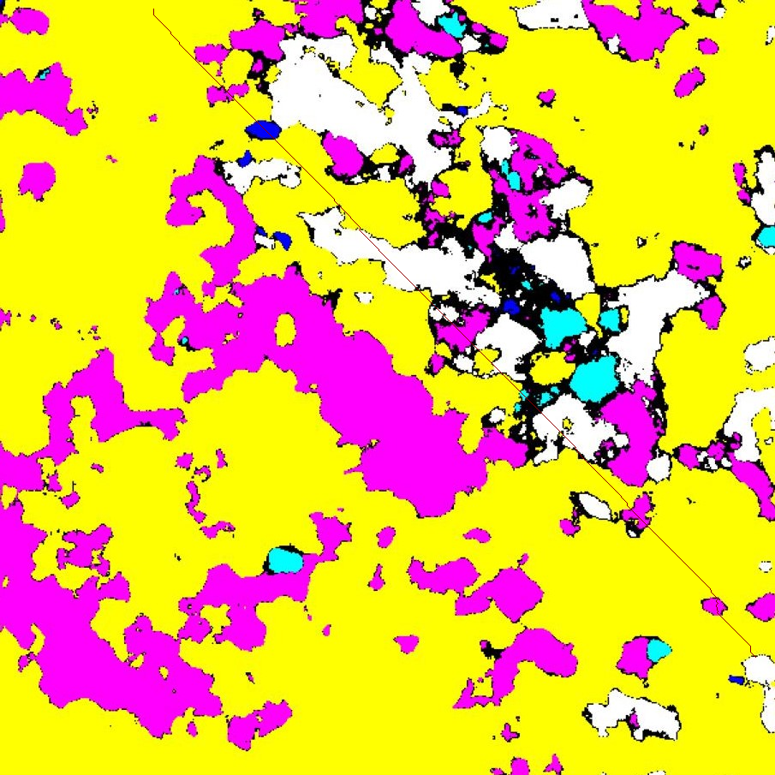
LULC
Aligned route on LULC covering total of 781 pixels

Slide 18
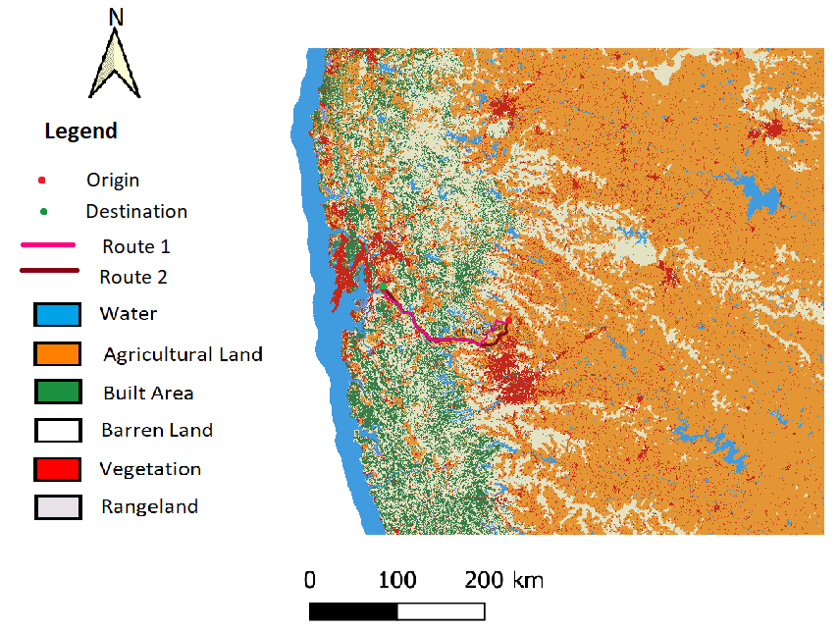
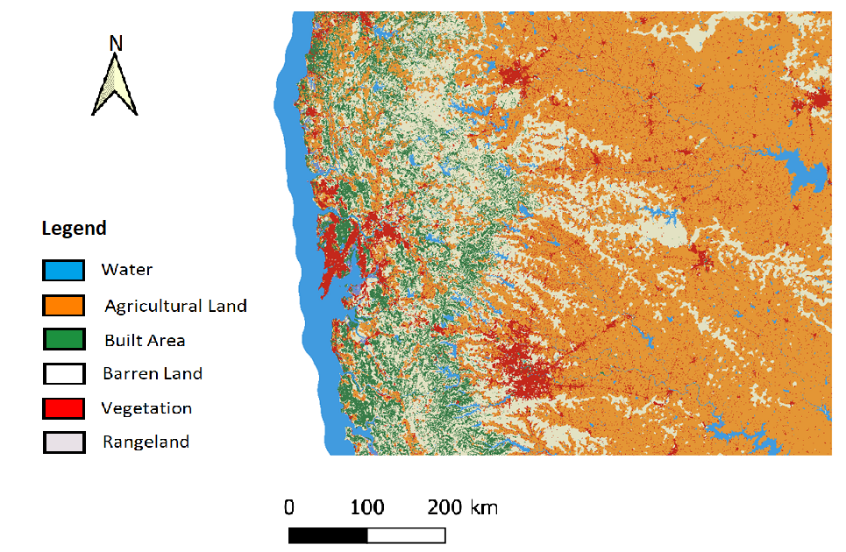
Using QGIS
LULC: 85% accuracy
Route alignment using ORS tools which internally uses Dijkshtra’s and A star algorithm
Optimum alternative route of 107Km and 113Km are obtained.
LULC
Route alignment on LULC

Slide 19
6. Conclusions
Deep learning models like UNet, Resnet50_uNet models are used to perform Land Use Land Cover Classification
AHP(Analytical Hierarchy Process) is used for weight assignment
Dijkshtra’s algorithm is used for route alignment optimization
Comparative study using QGIS tool and deep learning techniques.
Two alternative route of 107Km and 113Km are obtained.
Most of the part of the designed route is going from barren and urban lands and lesser from water and agricultural lands.
Future Scope:
Further this work can be generalized to any study area
Dataset to train deep learning models can be augmented using GANs

Slide 20
7. Publication details
Review Paper titled “Route Alignment System using Remote Sensing: Systematic Literature Review with Meta Analysis” submitted in “International Journal of Computing and Digital Systems”
Research Paper titled “Road Route Alignment System” submitted in “International Journal of Information Technology”

Slide 21
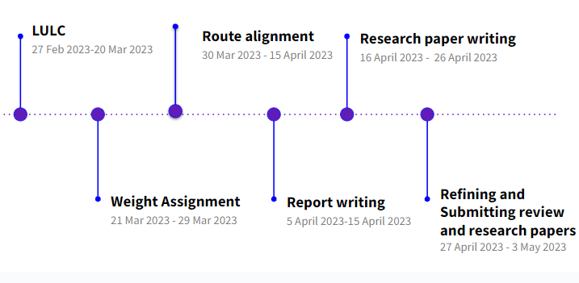
Timeline

Slide 22
References
[1] G. Triebel and T. Crouthamel, “Route selection based on a weighted ranking analysis,” in Pipelines 2019: Planning and Design, pp. 258–266, American Society of Civil Engineers Reston, VA, 2019.
[2] K. Rajadurai and J. C. Johnny, “Highway alignment using remote sensing and geographical information system,” International Journal for Innovative Research in Science & Technology, vol. 1, no. 9, pp. 2349–6010, 2015.
[3] M. K. Jha, “Optimizing highway networks: A genetic algorithms and swarm intel- ligence based approach,” in Computing in Civil Engineering (2002), pp. 76–89, 2003.
[4] T. Subramani and S. N. Kumar, “National highway alignment using gis,” Inter-
national Journal of Engineering Research and Applications (IJERA), vol. 2, no. 4,
pp. 427–436, 2012.
14

Slide 23
Thank You

