Slide 1
Twitter Sentiment Analysis of Product Reviews
By-
Anushka Tadphale - 111903019
Apurva Deshpande - 111903020
Ashlesha Joshi - 111903022

Slide 2

Problem Statement
Twitter Sentiment Analysis of Product Reviews
Our goal was to classify the sentiments of users for a particular product, by analysing their reviews.
Sentiment Analysis helps a company in improving their products and in understanding needs of customers.

Slide 3
Scrapping
Modules used - Tweepy and Selenium
Creation of query using suitable parameters to fetch the relevant data. In our case, the text query is ‘apple’. The tweets relevant to Apple products are thus extracted.
Fetching the data and storing in an suitable data structure i.e. array.
Creation of a Dataframe so that it can be used effectively for pre-processing.
Stored the data into an .csv file which can be used later.

Slide 4
Dataset
https://data.world/crowdflower/apple-twitter-sentiment
We used the following attributes for building the model
Sentiment - Binary Attribute, encoded during the pre-processing stage.(Values: 0 and 1)
Text - It consists of tweets from customers regarding different Apple products.

Slide 5
Preprocessing
In the Pre-Processing stage, we performed the following operations on the dataset
Removed rows with non-relevant and NaN values.
Dropped all the extra columns that were not required for building and training the model. For example - _golden, index, _unit_id, _unit_state, date etc.
Encoded the sentiments into binary values 0 and 1.
Clean data: Remove symbols: http://, #, @, etc
Tokenization and Stemming
Create bag of words and vectorize with TF-IDF
Module used - Pandas

Slide 6
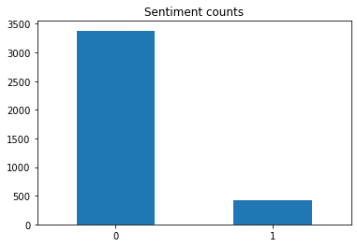
Visualisation
Distribution of tweets with positive and negative sentiments- Barchart
Sentence lengths- Histogram
Visualization of frequency of words in sentences- Scatter plot along with negative and positive sentiment label
Important words

Slide 7
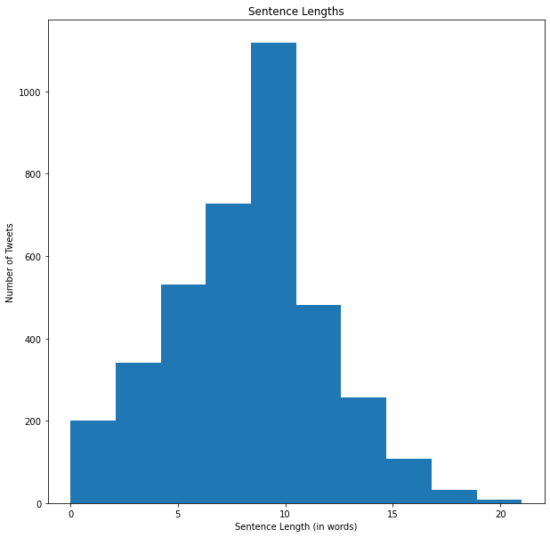
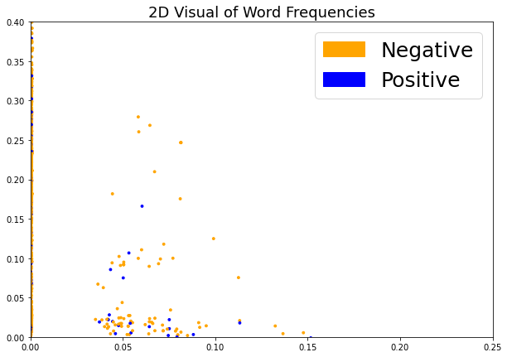

Slide 8
Models/ Algorithms Used
Model is implemented using 4 Machine Learning Algorithms :
Logistic Regression :
Uses a sigmoid function, which gives a probability 0 to 1.
Supervised algorithm because the model predictions are iteratively evaluated and corrected against the output values, until an acceptable performance is achieved.
Used generally in binary classification.
Random Forest :
Supervised Machine Learning Algorithm, used in Classification and Regression problems.
It builds decision trees on different samples and takes their majority vote for classification and average in case of regression.
It performs better results for classification problems.

Slide 9
Models/ Algorithms Used (Continued)
Multinomial Naive Bayes :
Bayesian learning approach popular in Natural Language Processing (NLP).
Guess the tag of a text, using the Bayes theorem.
Bayes Theorem estimates the likelihood of occurrence based on prior knowledge of the event's conditions.
It calculates each tag's likelihood for a given sample and outputs the tag with the greatest chance.
XgBoost :
Extreme Gradient Boosting, written in C++ which optimizes the training for Gradient Boosting.
Each predictor corrects its predecessor’s error.
Decision trees are created in sequential form by increasing the weight of variables predicted wrong by the tree and then fed it to the second decision tree

Slide 10
Testing
Dataset collected is divided in the ratio 80:20 for Training the Model and Testing it.
Models were tested on Testing dataset and Classification reports were obtained, which shows:
Accuracy of the model
Precision in predicting positive and negative emotions
macro average of the predicted values
weighted average of predicted values
Confusion Matrix is printed to find out True Positive, True Negative, False Positive, False Negative values predicted by each of the 4 algorithms.

Slide 11
Results
XGBoost algorithm shows greater accuracy as compared to other models applied.
Finding important words which are important for determining sentiments- Positive words and negative words
Sentiment analysis- important for market analysis and decision making.
Algorithm | Accuracy
Logistic Regression | 88.56%
Random Forest | 89.09%
Multinomial Naive Bayes | 84.88%
XGBoost | 90.60%

Slide 12
