Slide 1
Project: Booking System
SOFTWARE ENGINEERING LAB - CS303

Slide 2
Team members Team number : 12
191CS156 – Srinivas Bagadi
191CS219 – Darshan A V
191CS157 – Shyam Sundar N R
191CS161 – Thummala Lokeshwar Reddy
191CS222 – Karthik Chandra

Slide 3
Project Objective
The objective of this project is to create a web-based application to manage classroom bookings, Seminar Hall booking, Guest room booking, and sports court booking, and Mess selection at NITK.
The purpose of this project is to reduce manual work with papers and documents as well as to minimize the number of people involved in the process.

Slide 4
Project Description
The project is aimed to minimize the manual work, the number of people involved, and paperwork while booking a guest room, seminar hall, or a classroom in the institution. It also extends to features like booking a sports court and selecting a mess of the user's preference (once per month).
The project will be a web-based portal to make the booking system accessible on the go, making it multi-device compatible. The project is intended for the people of the Institution with a valid username and password provided by the institute.
A user can access the portal's functionalities only after authentication of username and password.
An admin will have the authority to accept or reject the booking slot request from a student or a faculty.
Once the booking is confirmed the user can access the booked room by showing the confirmation message from the website to the building in-charge at the booked time.

Slide 5
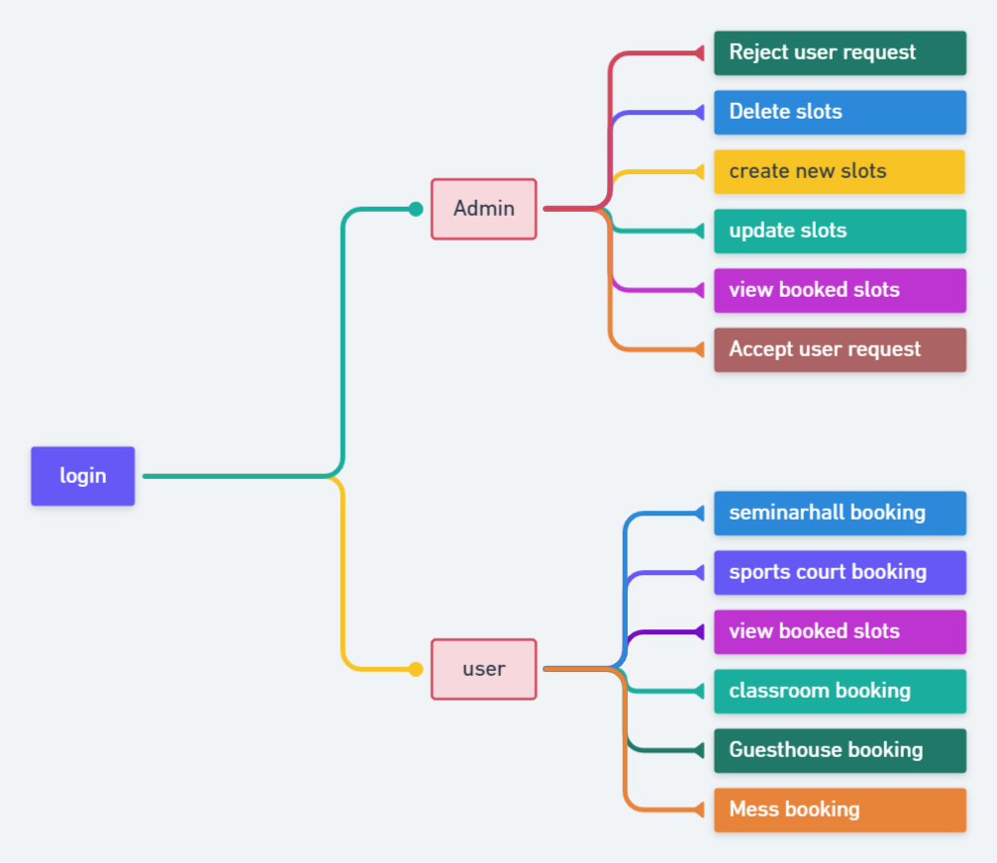
Flowchart overview of the project

Slide 6
Requirements and features
Functional Requirements
Users
Admin
The privilege to edit database data
Accept or Reject requested bookings
Student / faculty *
Basic requirements
Every user can login and logout of the system through a compatible browser.
All the users are required to signup to enjoy the services of our application.
*A faculty will be given higher preference in case of clashes for the same slot

Slide 7
Functional Requirements contd…
The project will have the following bookings
classrooms
seminar halls
sport Courts
Guest Houses
Mess
Classrooms
A user will be able to
View booked classrooms data
Select a classroom based on date of requirement and capacity of the classroom
Book a request for the classroom if available.
Cancel the booking if not required.
The admin who handles can
Approve or reject a requested classroom booking request
change the availability status of a classroom
Add/Remove a slot or a classroom data

Slide 8
Functional Requirements contd…
Seminar halls
A faculty or a user
In case of a seminar presentation, combined / mass lectures or a club event , etc. a faculty or a student can book a seminar hall by providing a valid purpose
Access capacity information and availability status by applying filter keywords or search keywords
The admin will
View the hall booked and view the available halls.
Update availability status of seminar halls
Accept or reject booking requests.
Guest Houses
The admin can verify and accept the guest house booking and send a confirmation message to the user.
The user can book a guest house according to the need and by selecting among the guest rooms which are available.

Slide 9
Functional Requirements contd…
Sport Courts
The admin page contains functionalities like
View the slot booked or the slots which are available for different sports.
The admin can forbid any user to book incase of any misconduct.
The user is able to
Book a slot for any particular sports based on the availability.
Cancel the slot prior to the allotted time if not required
Mess
A user can change his/her mess once in month by requesting for the same through the website
Choosing the mess based on food habits and the block number.
If the user haven’t requested for a mess change the former mess will be continued
At the beginning of the semester a user must choose a mess. If not chosen, a mess with more vacancy will be allotted
An admin will validate the requests and allot them based on vacancies.
In case a user’s request cannot be granted the former mess will be continued.

Slide 10
Functional Requirements contd…
During first time sign in / sign up email id and username will be stored.
All the requests will contain purpose of booking and the expected audience/ people using the particular room (or hall or a court) except for mess change requests
All the requests will be sent to admin of that module for verification
Every update in the status of a request will be communicated to the user through mail.
In case of mess change requests if the requested mess doesn’t have vacancy, the user will be prompted for choosing a different mess among the available messes or to use the existing mess.

Slide 11
Key Assumptions*
At least one Admin will be available all the time
Users use resources of a room in a friendly manner
Every user in the institute can access a web browser and internet facility.
*In the next build/version of the software admin work will be minimized by making most of the accept / reject process automated

Slide 12
Non functional requirements
Scalability: since we are using mySQL with proper data integrity models, scalability in terms of data management is achieved. Also scalability in terms of server management is taken care with Nodejs.
Reliability and Availability: This is taken care by Node.js, since Node.js increases performance and handles a lot of requests. It also overcomes large data processing challenges.
Maintainability and Manageability: This is satisfied properly as we are following a proper software engineering principles and also we are using frameworks like ReactJs which provided us to create different components to maintain the code properly.
Usability: This web based application is user friendly with best user interface.
Portability and Compatibility: Portability and Compatibility of the application on other devices or browsers or networks is possible, since we are using latest technologies and framework for the project.
Performance: Performance of the application is high, as the request time, response time and through output time is minimum.
Security: Application provide a proper data security using mySQLand security of proper data transfer is taken care by Node.js

Slide 13
Software Specifications
Operating system server
Windows 8 or newer
Mac OS X v10.7 or higher
Linux: Ubuntu
Tools
Microsoft Visual Studio code
Github to track progress and synchronization of work
Frameworks and technologies*
Front end: React JS, HTML, CSS
Backend: Node.JS, Express.JS
Database: MySQL
*May use other technologies and frameworks to overcome the implementation challenges in future

Slide 14
Hardware Specifications
Processor
Minimum: 1 GHz of X86 or X64 processor
Recommended: 2 GHz of X86 or X64
Main Memory
Minimum: 1 GB
Recommended: 4 GB
Hard drive Capacity
Minimum: 32 GB
Recommended: 64 GB

Slide 15
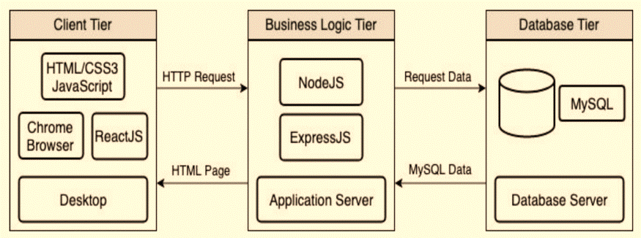
System architecture
We will be following a 3 tier system architecture for this project similar to the image

Slide 16
System Architecture contd…
The architecture of our application is based on a typical MVC model. Our Client tier (View) will be written in JavaScript, HTML, and CSS, using ReactJS as the framework. This level of the architecture is what the user will interact with to access the features of our application.
The Business Logic Tier (Controller) will be written using Node.JS and Express.JS, and this tier represents the Application Server that will act as a bridge of communication for the Client Tier and Database Tier. This tier will serve HTML pages to the user’s device and accept HTTP requests from the user and follow with the appropriate response.
Our Database Tier (Model) will be hosting MySQL or MongoDB. This is where we will store all of the crucial data our application needs to function.

Slide 17
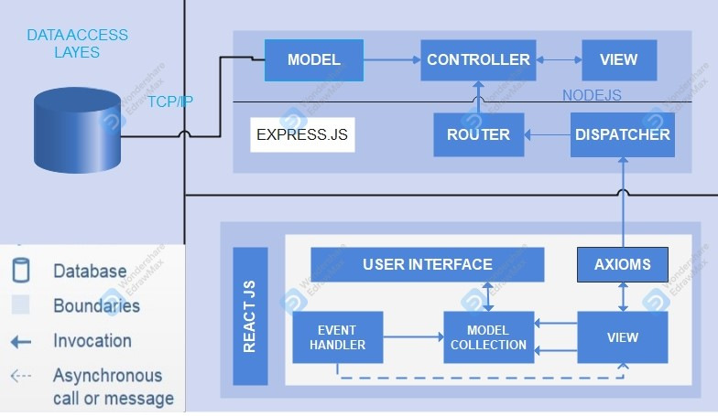
System Architecture contd…

Slide 18
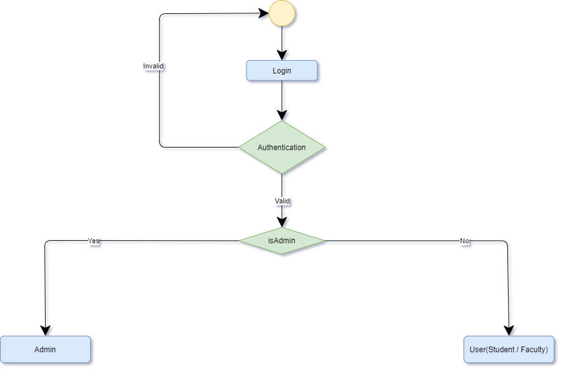
Activity flow diagrams
Home page

Slide 19
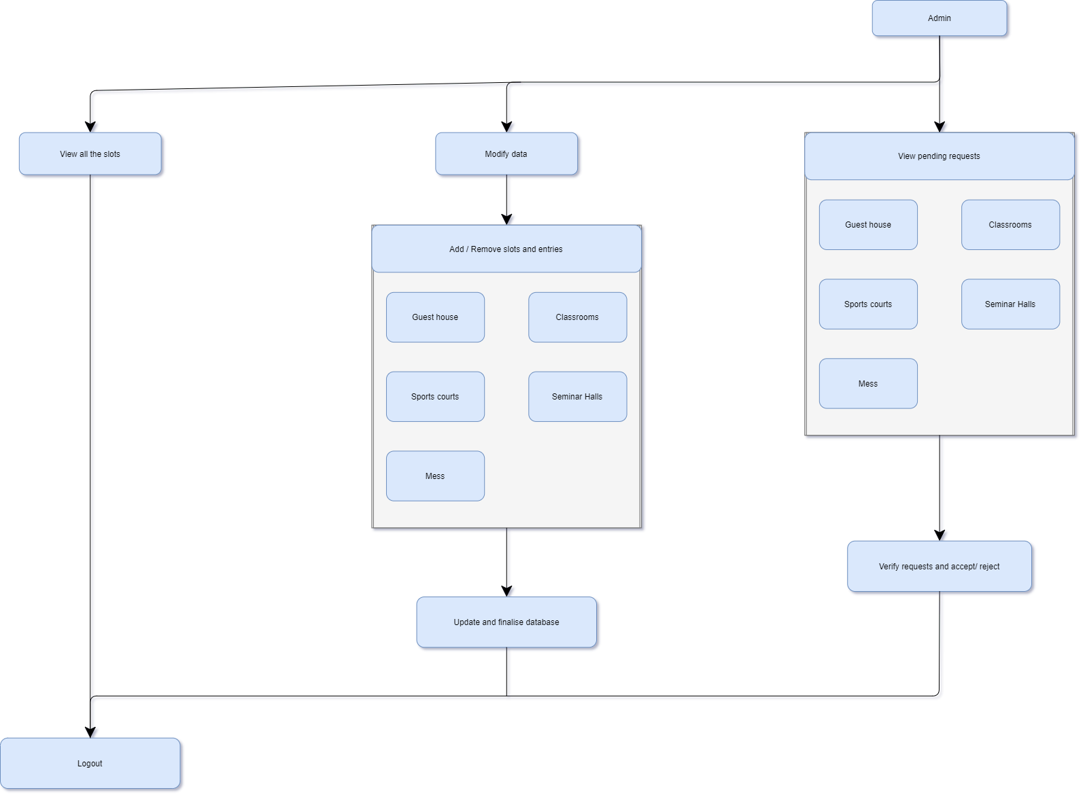
Admin module

Slide 20
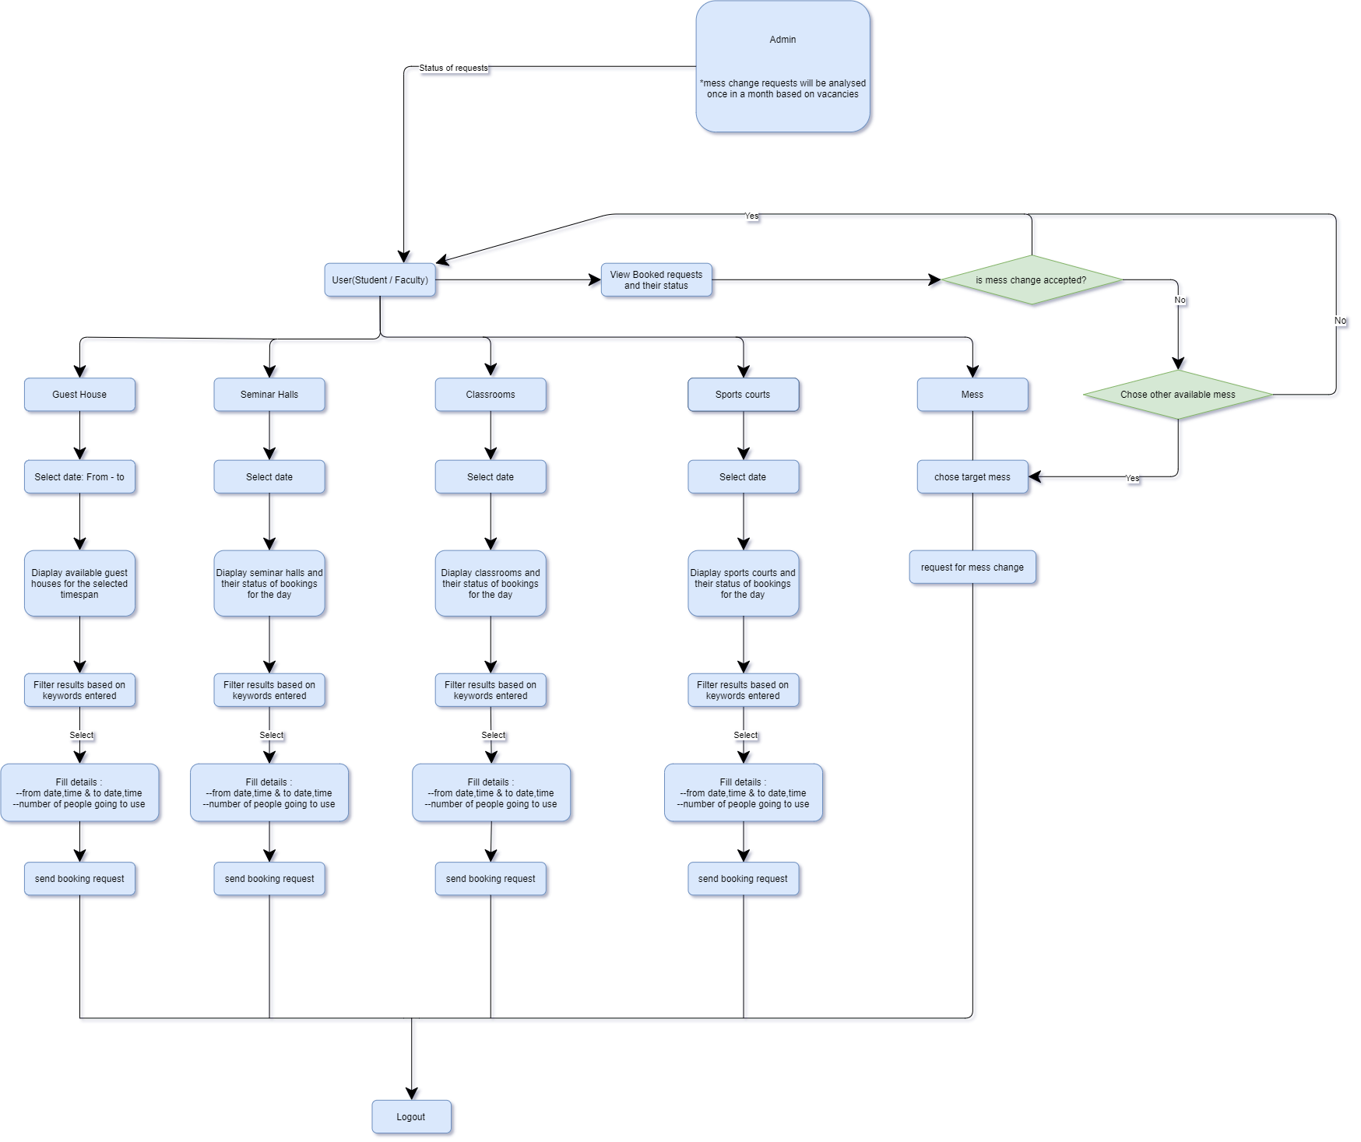
User module

Slide 21
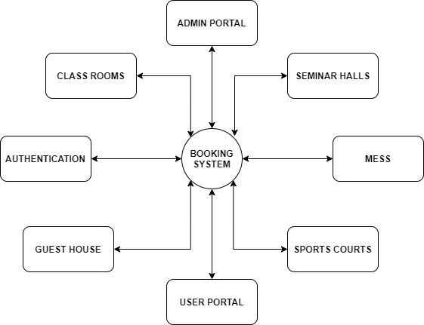
data flow diagrams
I.

Slide 22
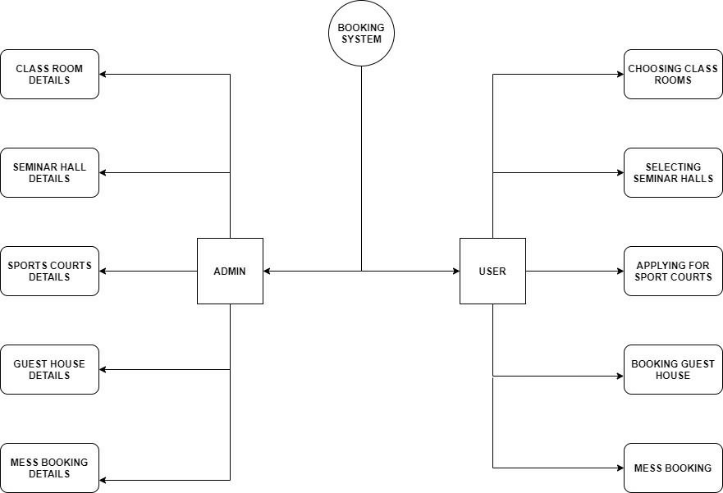
II.

Slide 23
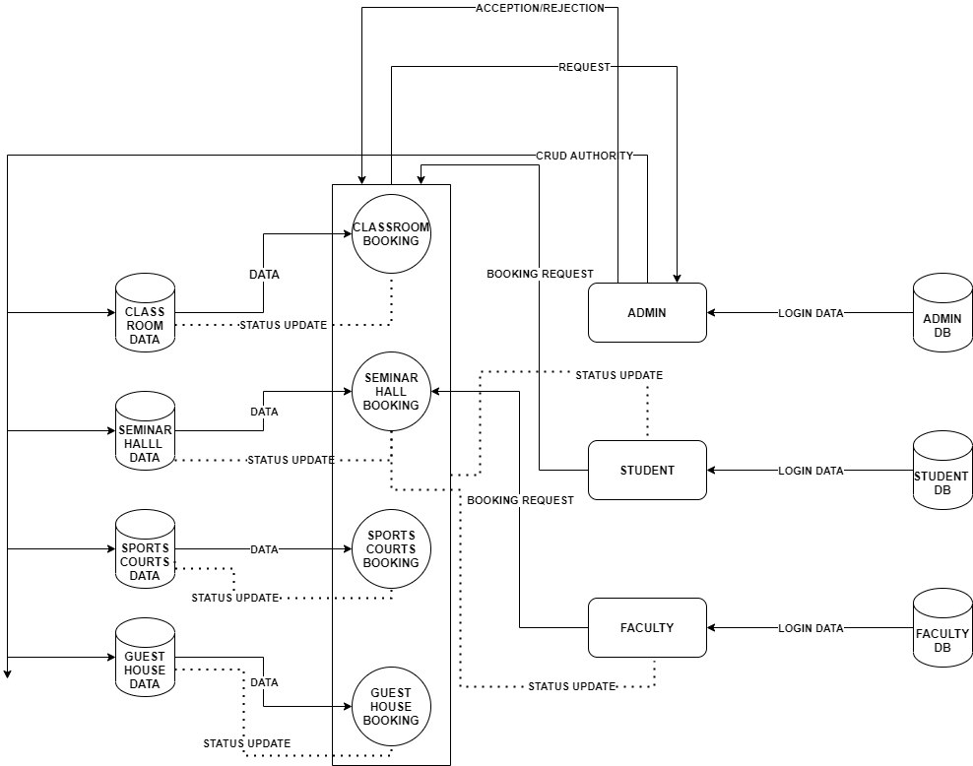
III.

Slide 24

Implementation Progress
User interface

Slide 25
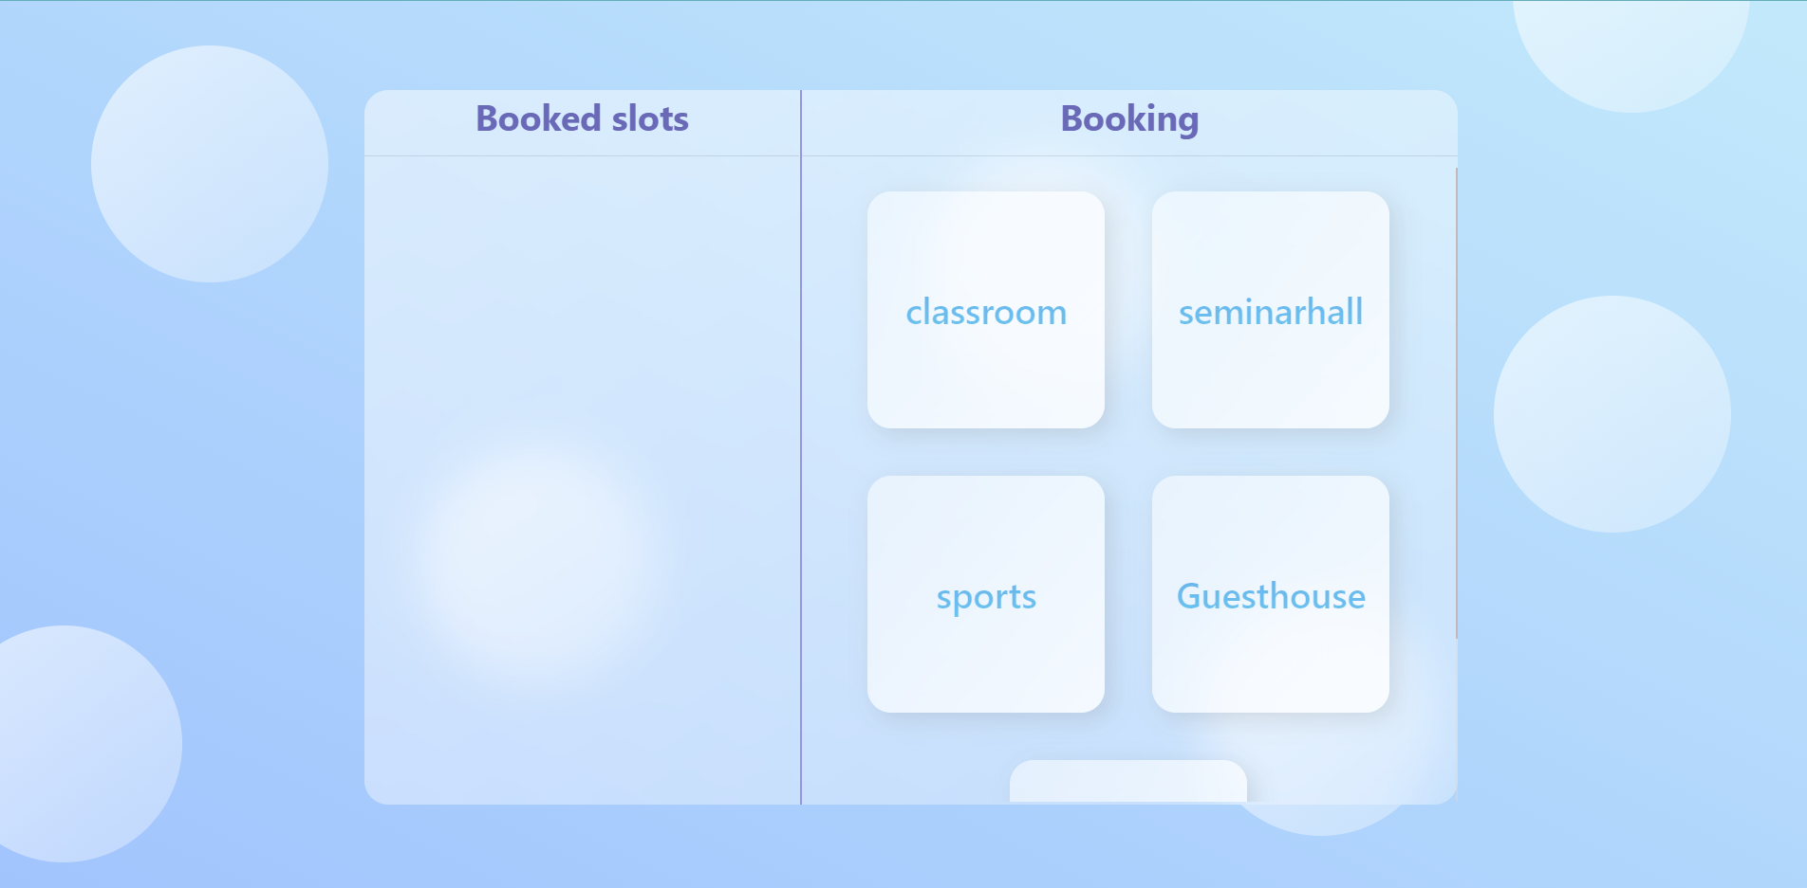
User interface

Slide 26
Thank YOU

