Slide 1
College Data Explorer
By: Apoorv Verma [AP]

Slide 2
About
Explore data about crime and college tuitions in an interactive dashboard
Insights gathering from data via exploration
Hand tested statistics
Cool themed charts

Slide 3
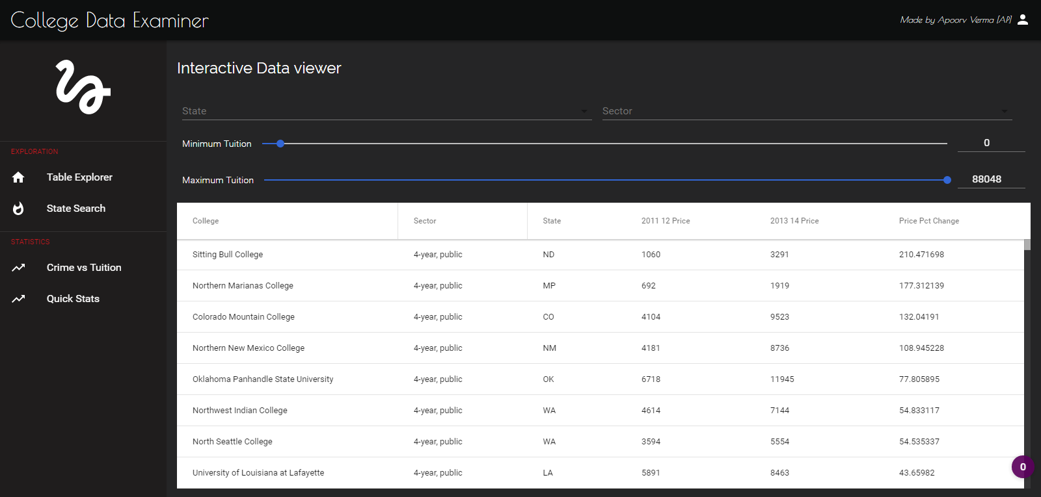
Screenshots

Slide 4
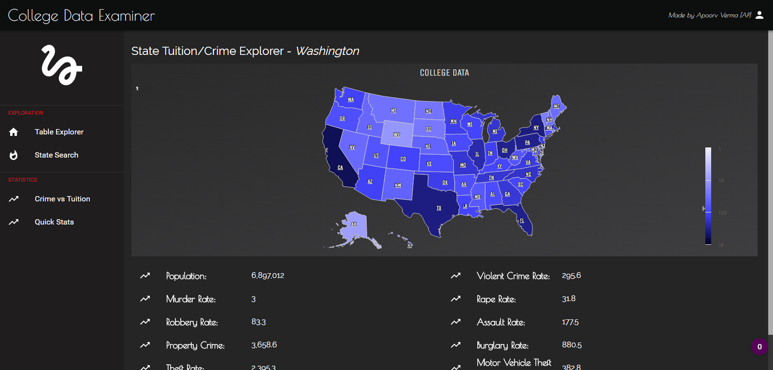
Screenshots

Slide 5
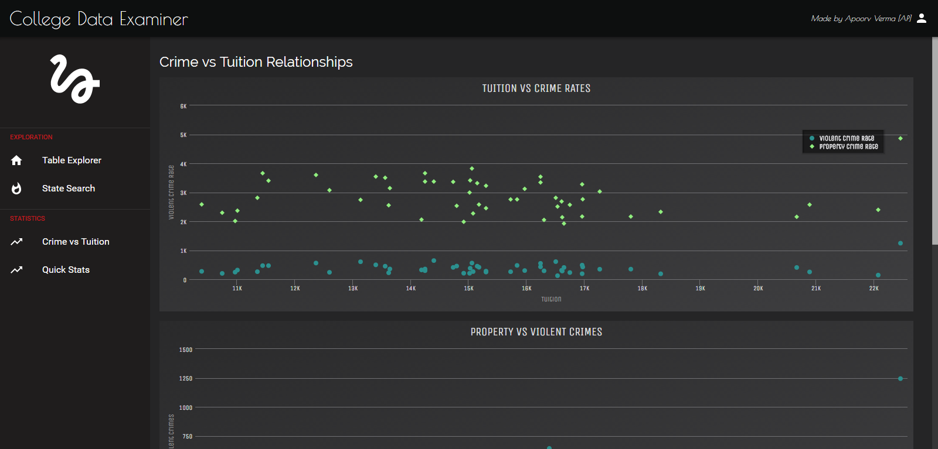
Screenshots

Slide 6
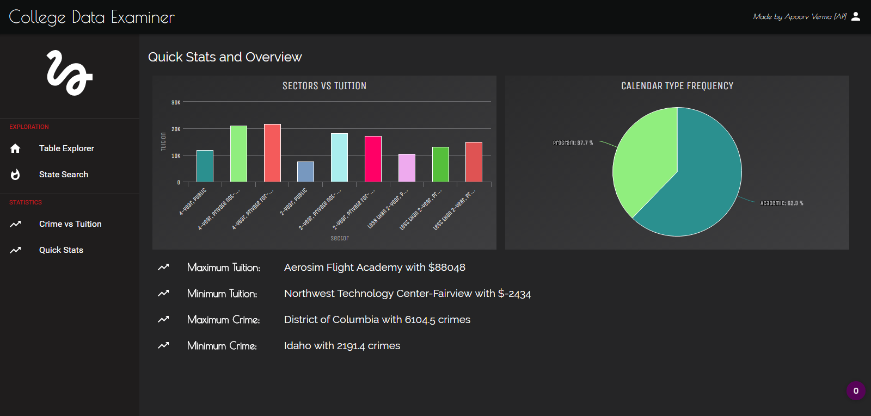
Screenshots

Slide 7
Tables and Schemas
Name | Rows
colleges | id*, sector**, name,state**, calendar_type, 2011_12_price, 2013_14_price, price_pct_change
sectors | id*, name
state_crime | abr*, name, population, violent_crime_rate, murder_rate, rape_rate, robbery_rate, aggravated_assault_rate, property_crime_rate, burglary_rate, theft_rate,motor_theft_rate, colleges, avg_tuition
* is Primary Key | ** is Foreign Key

Slide 8

Queries and Features
14 Queries
SQLi protection through parameterized querying
Promisified Async querying against DB to make multiple calls at the same time and the connect/close is black boxed to the code. Example:

