Slide 1

NIRMAN LAB SE-C2-60 (SH-2026)
PM-JAY CLAIM GPS
THE PROBLEM
Many eligible people do not know what PM-JAY covers. Some also struggle to find the right hospital or complete the claim process because they may have low literacy, a basic phone, or weak internet.
PROBLEM STATEMENT ID – PS 3
PM-JAY Awareness & Claims Navigation in Aspirational Districts
THEME – Healthcare / Public Service Accessibility
Name:- Avdhut Parish Madhavi
ID:- TU3S2627005
OUR IDEA
Tell us what treatment you need. We guide you to the PM-JAY help available and what to do next.

Slide 2
PM-JAY CLAIM GPS / OBJECTIVE
Objective
Make the first steps of healthcare support easier to understand and complete.
THE PROBLEM
OUR OBJECTIVE
People may be unsure what PM-JAY covers,
which hospital to approach, which documents
to carry, or how to move forward.
Language, literacy and weak internet can make
the process harder.
Let a person describe the healthcare help they
need, then provide understandable guidance,
hospital-finding support and a clear next step,
with human assistance when needed.
Design principle: start with “I need this treatment,” not “How do I use PM-JAY?”
02

Slide 3
PM-JAY CLAIM GPS / METHODOLOGY & PROPOSED SOLUTION
Methodology & Proposed Solution
A need-first workflow with clear hand-offs and honest limits.
01
Tell us the need
User types or speaks in a supported language.
02
Understand & confirm
The user reviews the captured request before continuing.
03
Find relevant help
Show guidance and hospital records from available sources.
04
Prepare next steps
Explain likely documents and how to confirm requirements.
05
Follow up or get help
Save a request reference and offer a human support route.
03

Slide 4
PM-JAY CLAIM GPS / TECHNICAL STACK
Technical Stack
Planned architecture for a functional, deployable application.
FRONTEND
React • CSS • JavaScript
BACKEND
Node.js + Express
Responsive forms, accessible navigation, local-language UI
REST APIs, validation, request workflows
DATABASE
MongoDB Atlas
ACCESSIBILITY
Voice input • Language controls
Persisted requests, hospital records and status history
Browser speech support with text fallback
LOW CONNECTIVITY
Service worker • Local drafts
DEPLOYMENT
Free-tier hosting options
Cache essentials and queue eligible requests safely
Frontend, backend and database configured separately
04

Slide 5
PM-JAY CLAIM GPS / QUESTIONNAIRE
Questionnaire & Primary Research
Topics covered by the questionnaire
~23
Basic respondent profile: name, phone number and age
responses represented
in the supplied charts
Previous hospitalization and existing health policy
Awareness of PM-JAY and how respondents heard about it
Ayushman Card ownership and understanding of eligibility
Interest in applying for the scheme
05

Slide 6
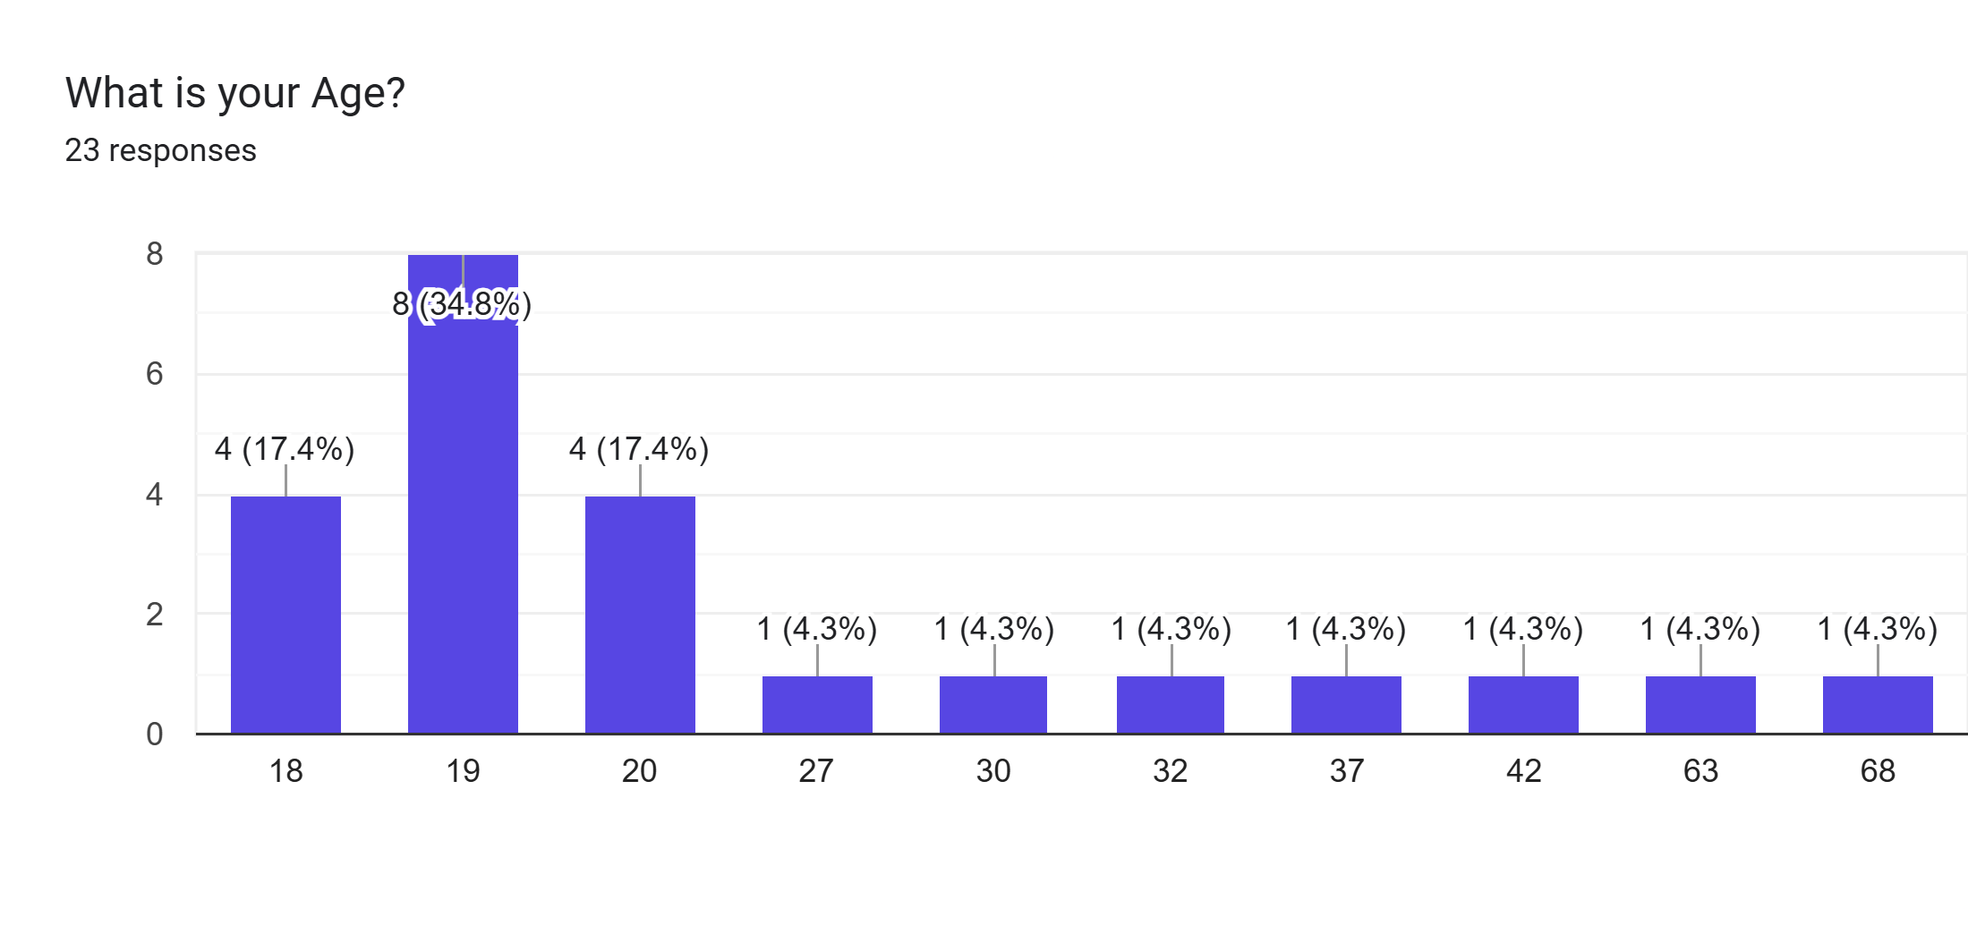
PM-JAY CLAIM GPS / QUESTIONNAIRE • RESPONSE CHARTS
Q1. What is your age?
08

Slide 7
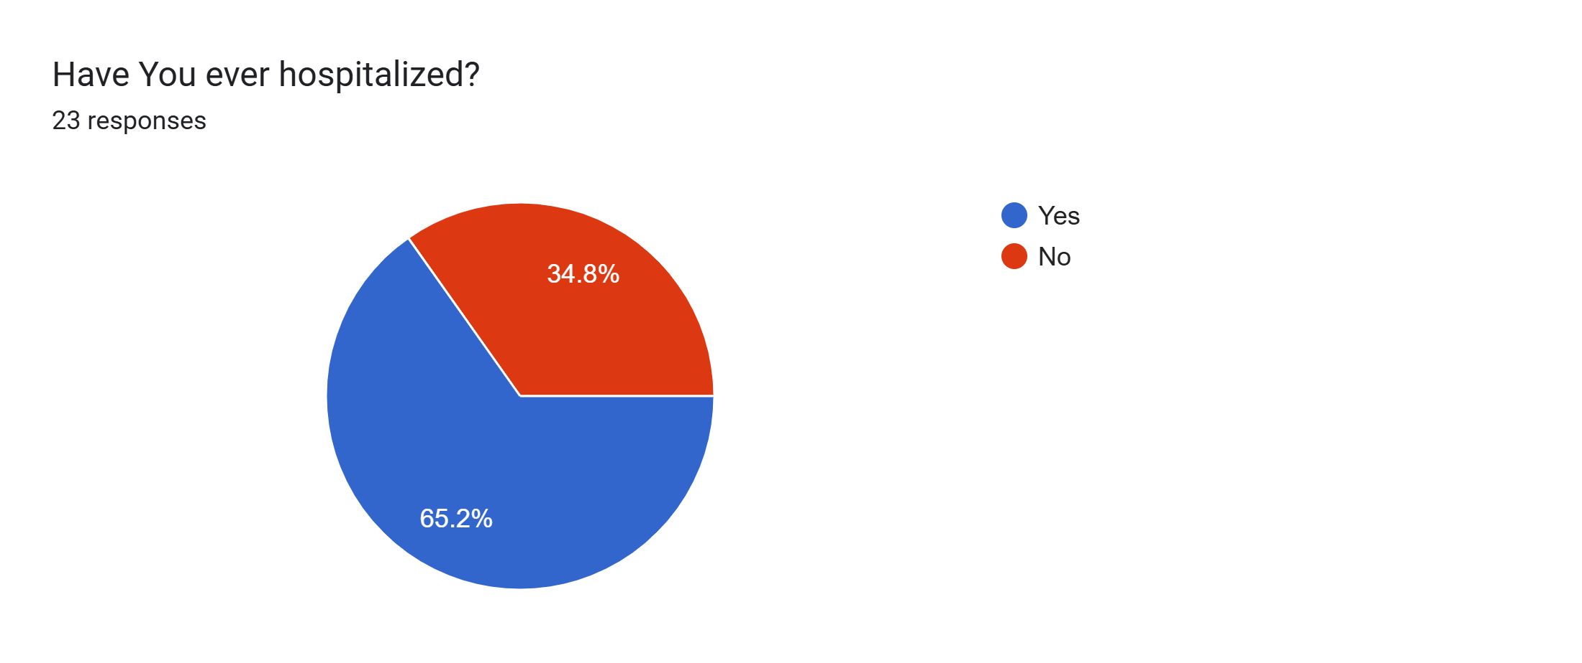
PM-JAY CLAIM GPS / QUESTIONNAIRE • RESPONSE CHARTS
Q2. Have you ever been hospitalized?
09

Slide 8
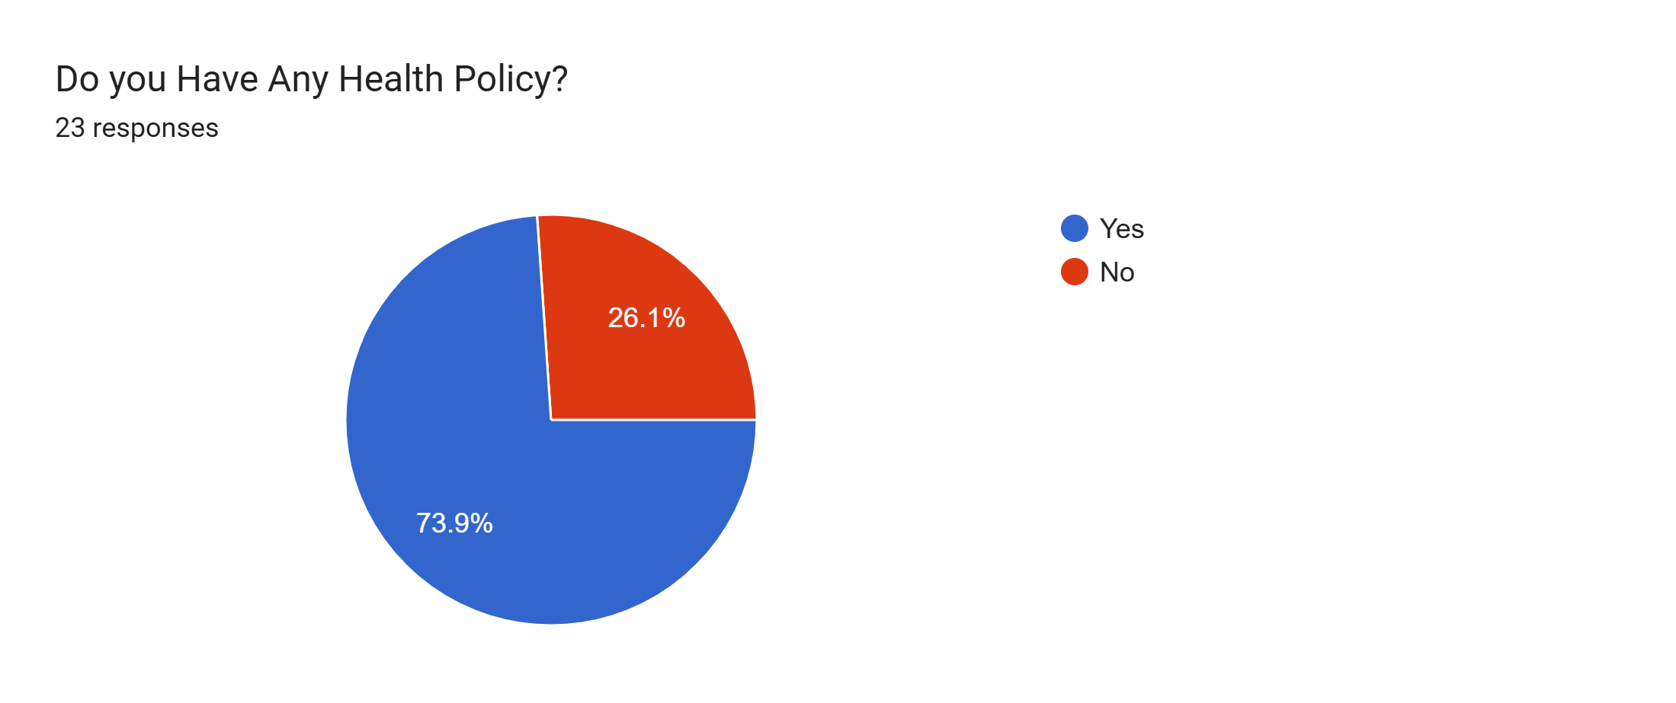
PM-JAY CLAIM GPS / QUESTIONNAIRE • RESPONSE CHARTS
Q3. Do you have any health policy?
10

Slide 9
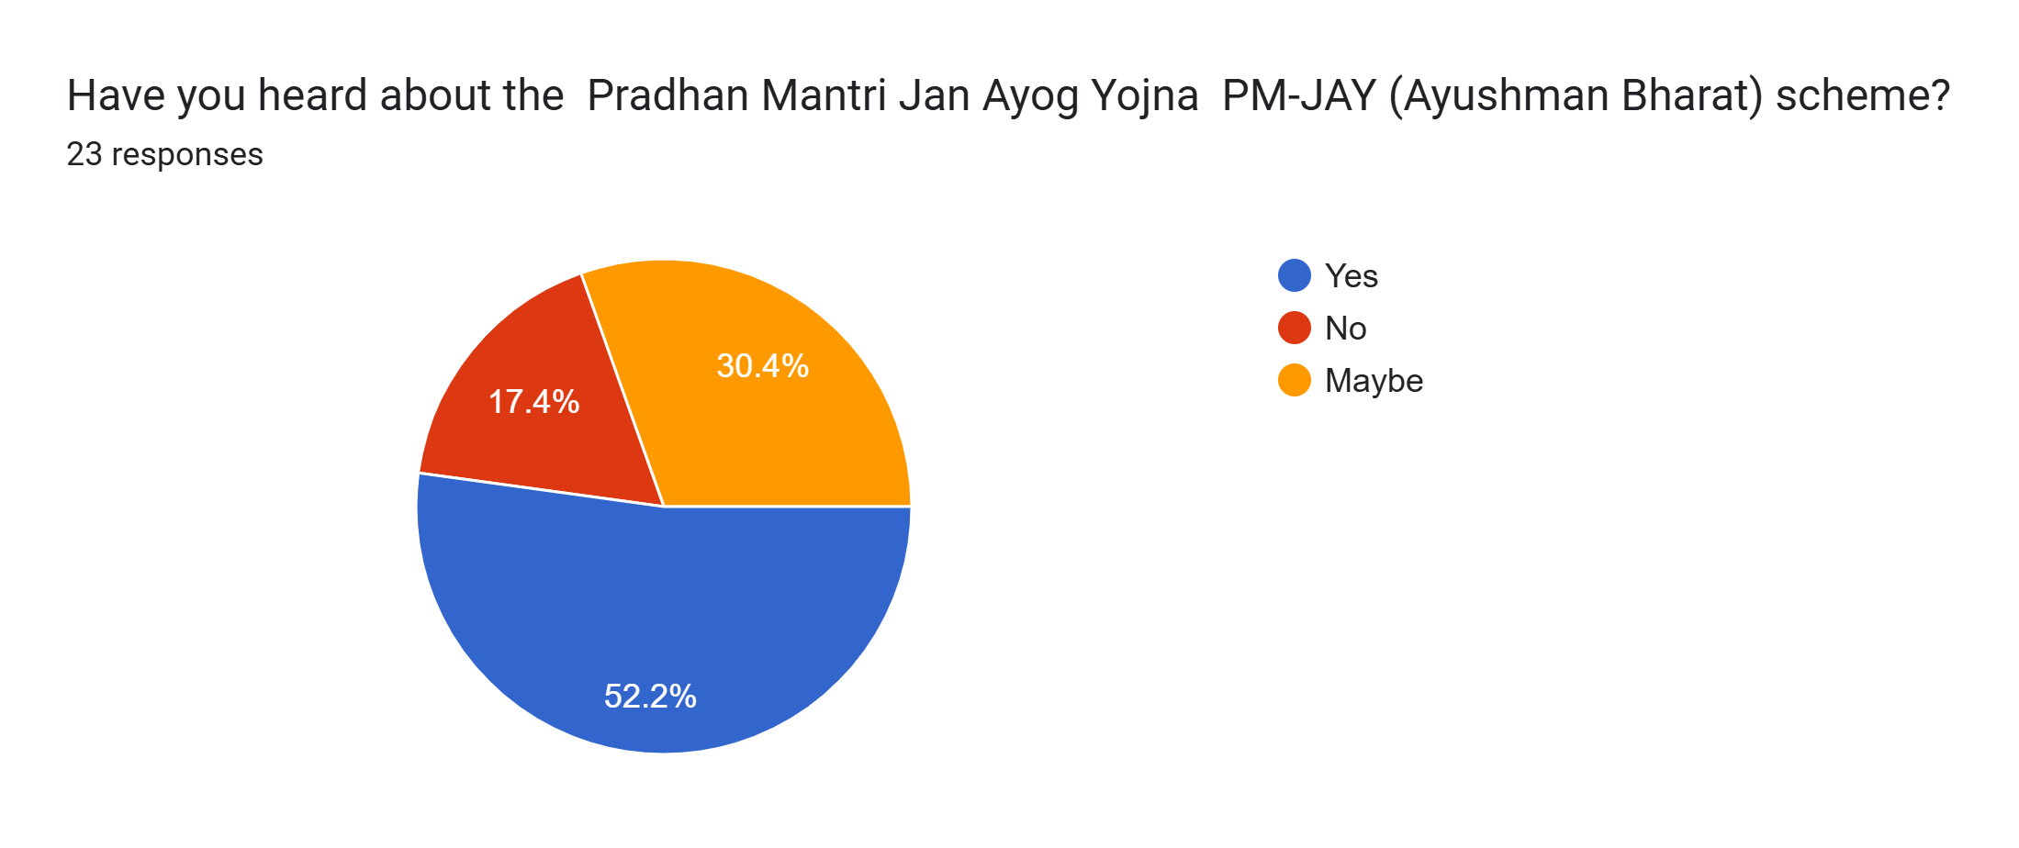
PM-JAY CLAIM GPS / QUESTIONNAIRE • RESPONSE CHARTS
Q4. Have you heard about PM-JAY?
11

Slide 10
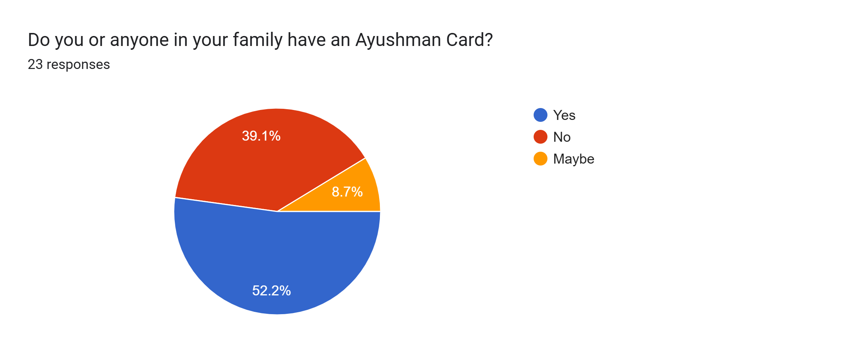
PM-JAY CLAIM GPS / QUESTIONNAIRE • RESPONSE CHARTS
Q5. Does anyone in your family have an Ayushman Card?
12

Slide 11
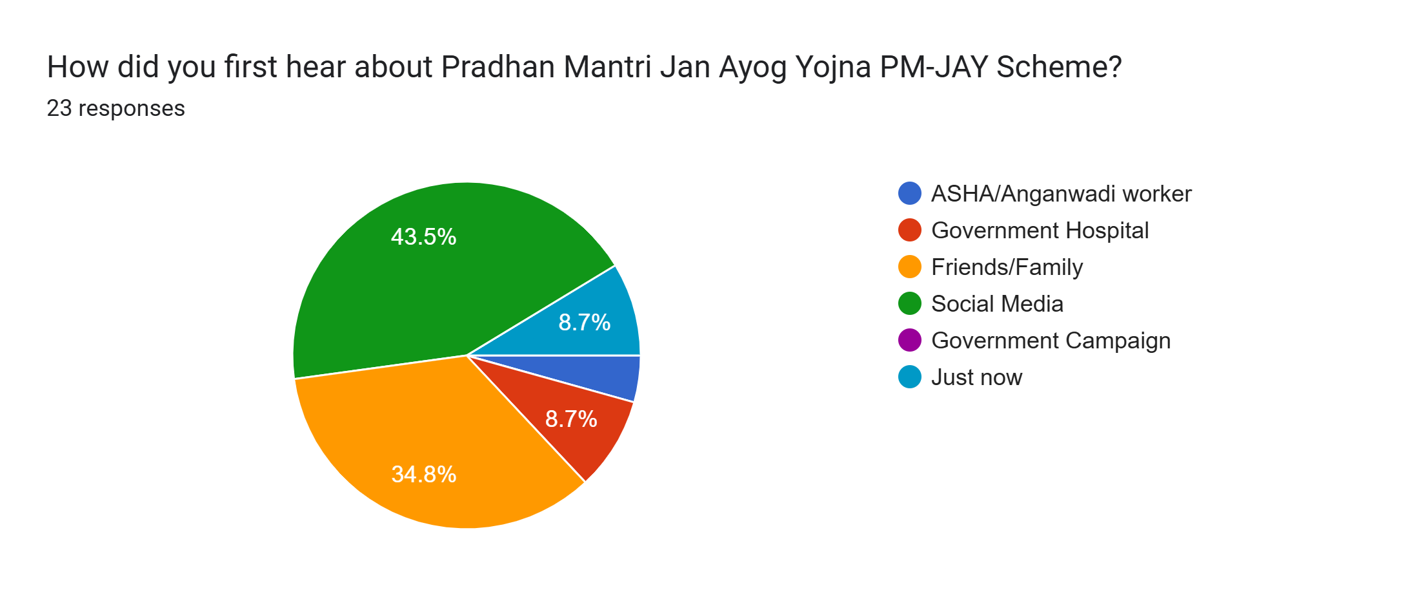
PM-JAY CLAIM GPS / QUESTIONNAIRE • RESPONSE CHARTS
Q6. How did you first hear about PM-JAY?
13

Slide 12
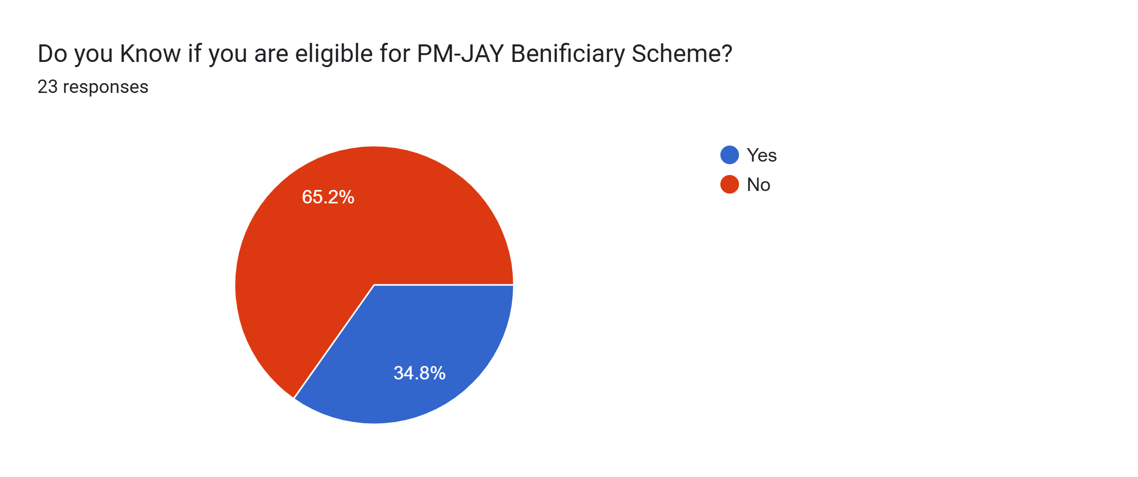
PM-JAY CLAIM GPS / QUESTIONNAIRE • RESPONSE CHARTS
Q9. Do you know if you are eligible for PM-JAY?
14

Slide 13
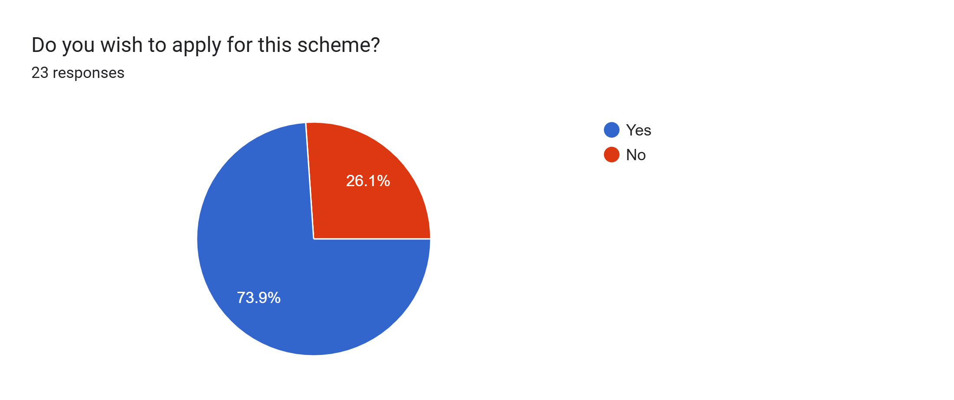
PM-JAY CLAIM GPS / QUESTIONNAIRE • RESPONSE CHARTS
Q10. Do you wish to apply for this scheme?
15

Slide 14
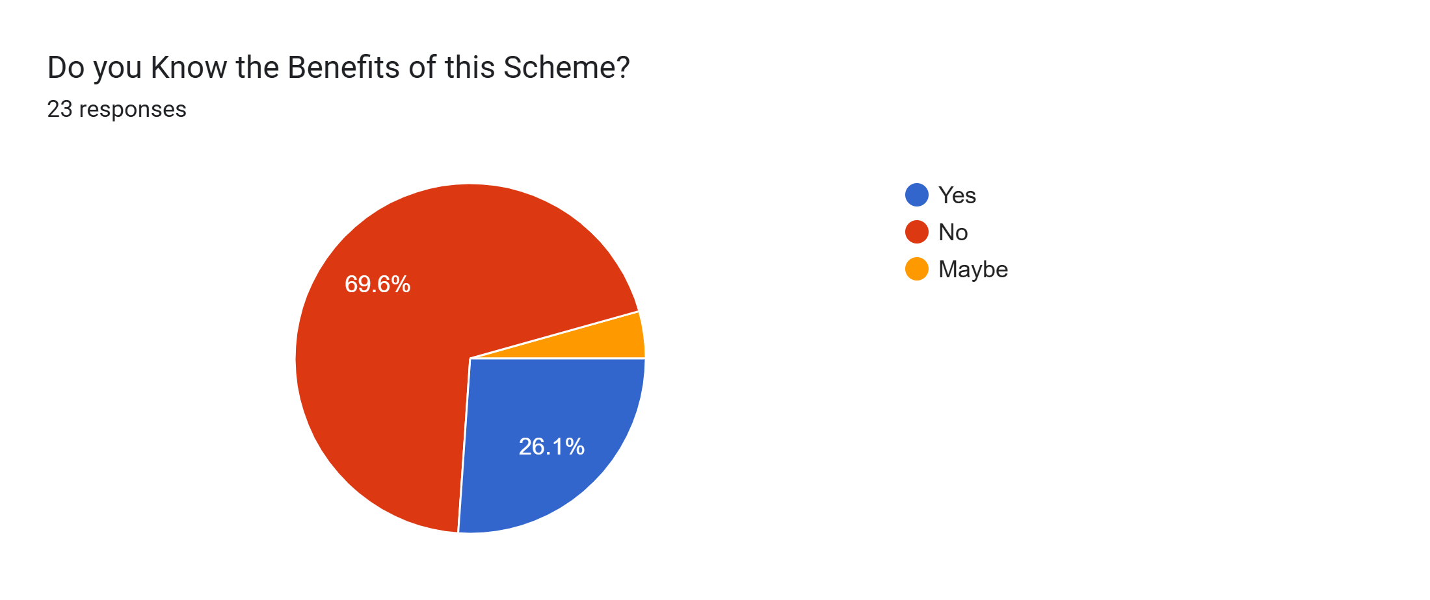
PM-JAY CLAIM GPS / QUESTIONNAIRE • RESPONSE CHARTS
Q10. Do you wish to apply for this scheme?
16

Slide 15
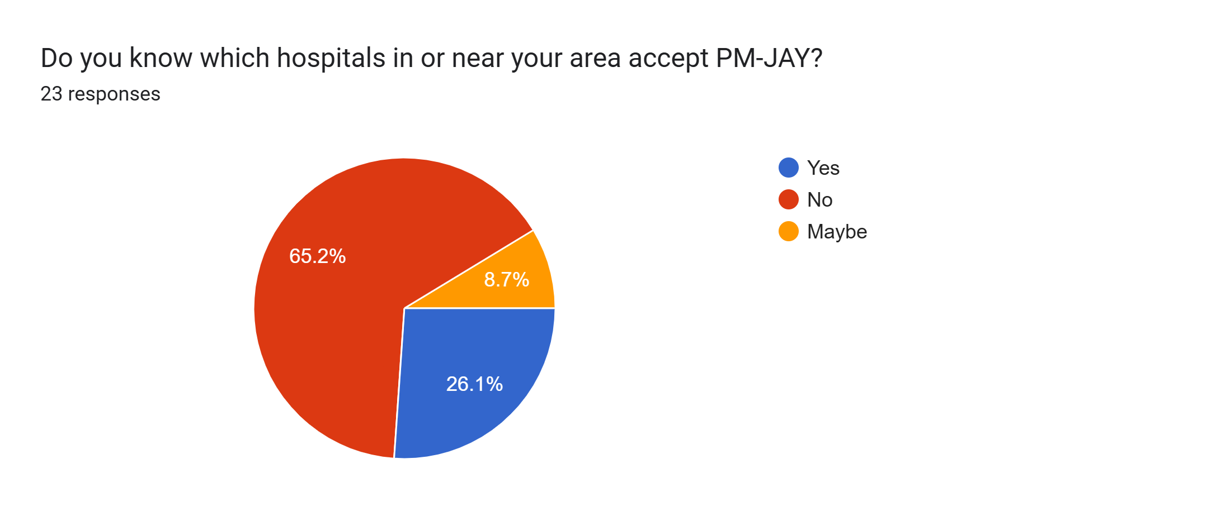
PM-JAY CLAIM GPS / QUESTIONNAIRE • RESPONSE CHARTS
Q11. Do you know which hospitals in or near your area accept PM-JAY?
16

Slide 16
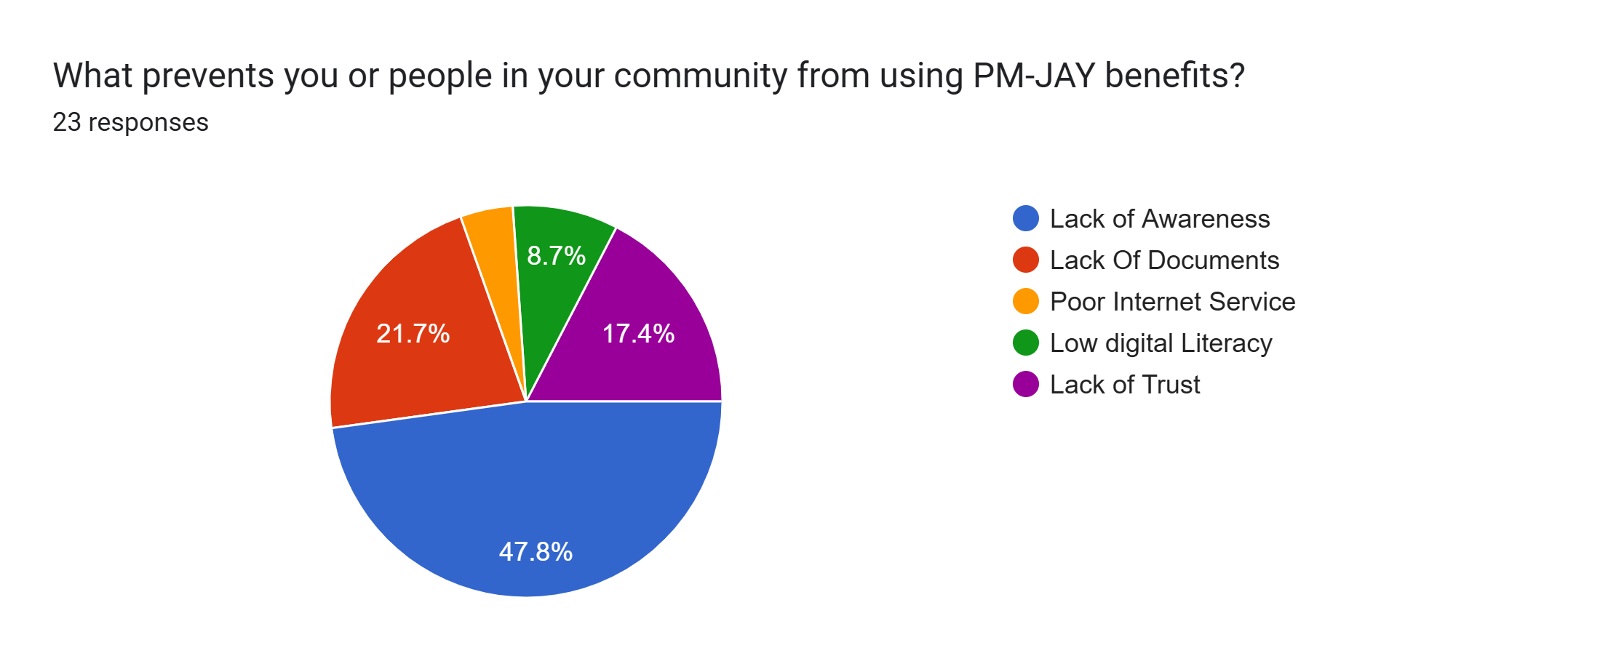
PM-JAY CLAIM GPS / QUESTIONNAIRE • RESPONSE CHARTS
Q11. What prevents you or people in your community from using
PM-JAY benefits?
16

Slide 17
PM-JAY CLAIM GPS / QUESTIONNAIRE • ANALYSIS
Survey Analysis
52%
Have heard of PM-JAY
65%
Do not know their eligibility
74%
wish to apply for PM-JAY
12 of 23 answered Yes; 7 Maybe; 4 No.
15 respondents answered No; 8 answered Yes.
17 answered Yes; 6 answered No.
70%
Do not know the scheme
benefits
65%
Do not know nearby PM-JAY
hospitals
48%
Lack of awareness as a barrier
16 answered No; 6 Yes; 1 Maybe.
15 answered No; 6 Yes; 2 Maybe.
11 respondents selected lack of awareness.
Interpretation: interest is high (74%), while eligibility, benefit awareness and hospital knowledge remain key gaps. This supports a simple, need-first guidance flow.
17

Slide 18
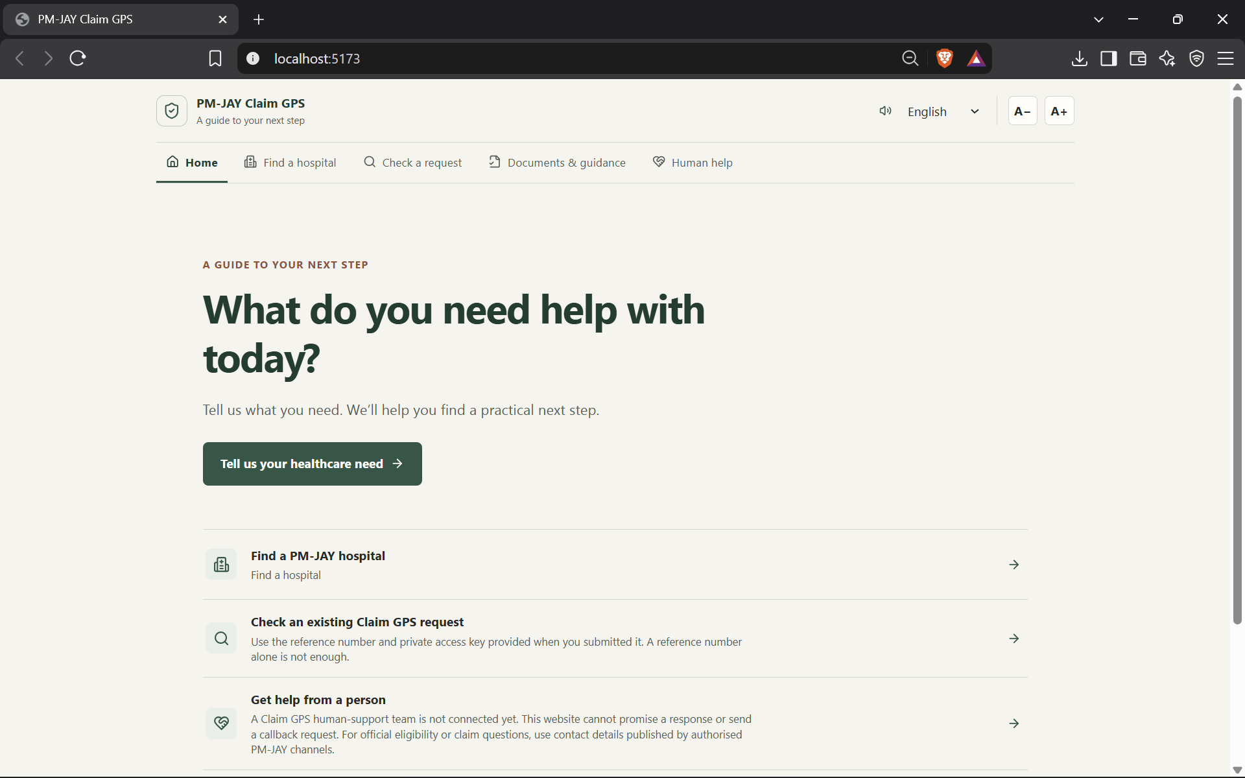
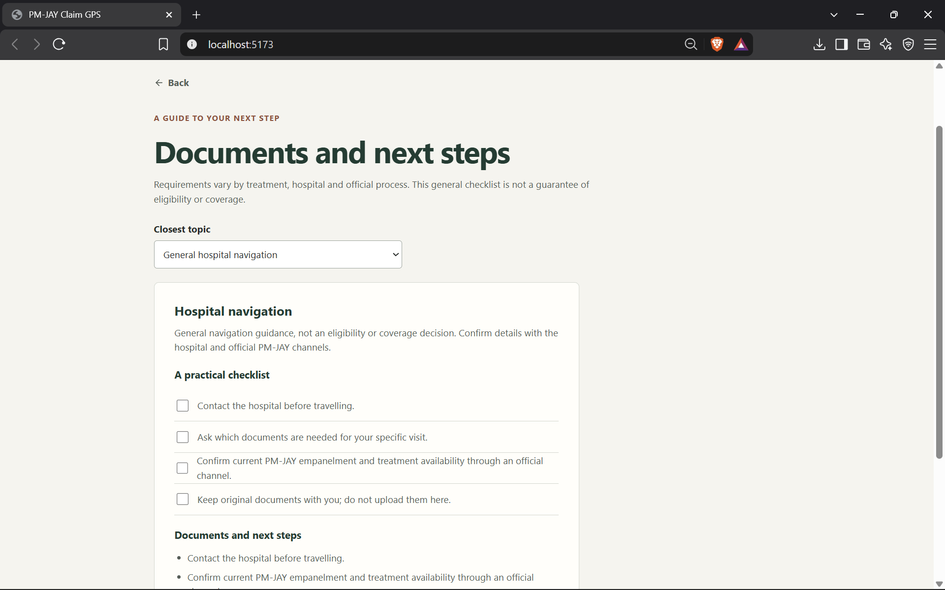
PM-JAY CLAIM GPS
Prototype Screenshots
HOME / LANDING PAGE
DOCUMENT GUIDANCE
Insert screenshot of the healthcare need form.
19

Slide 19
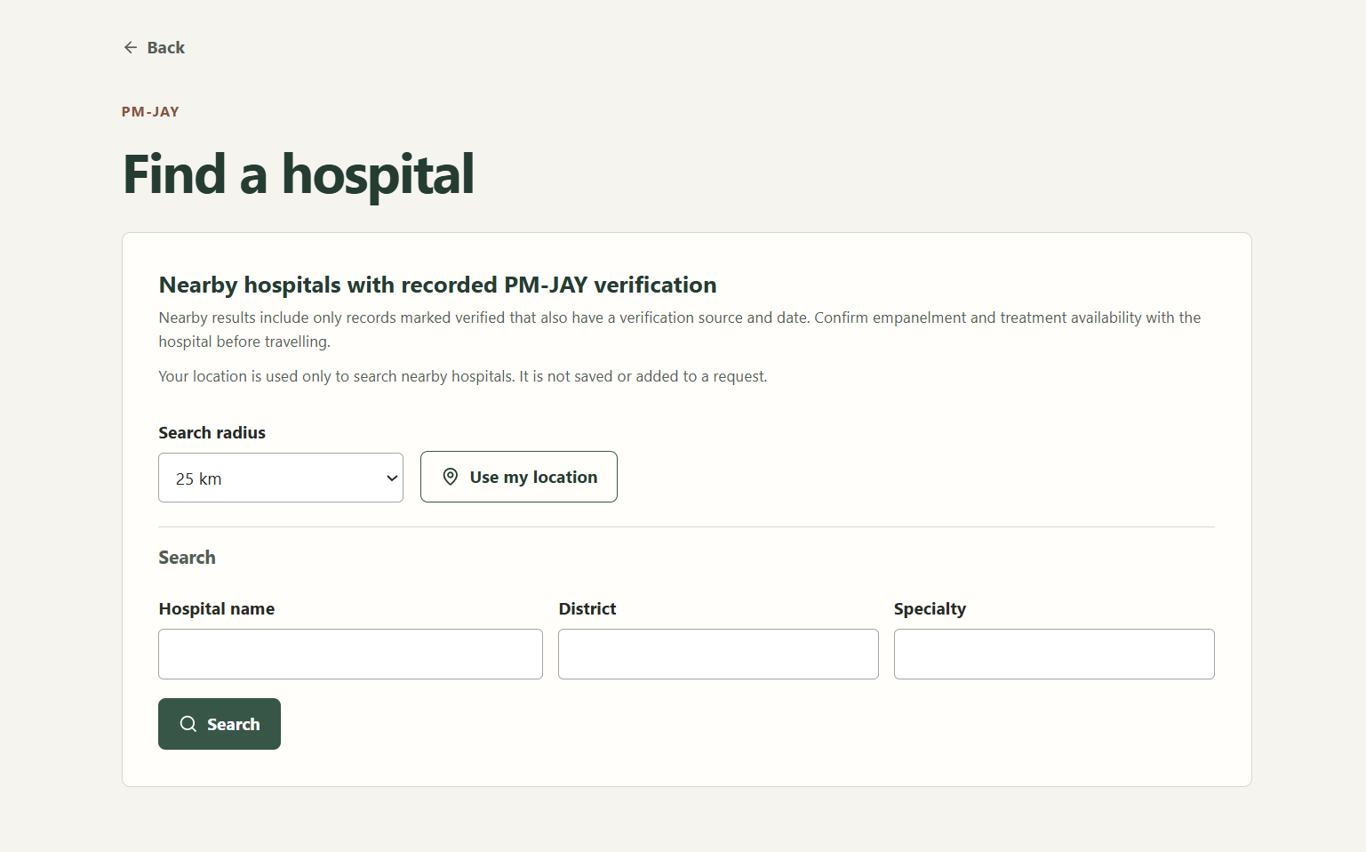
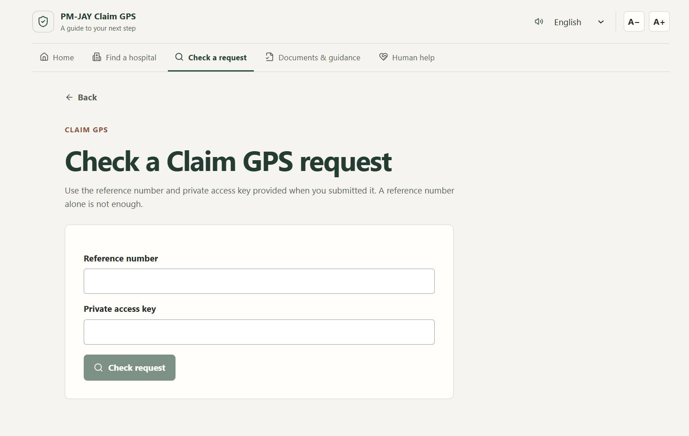
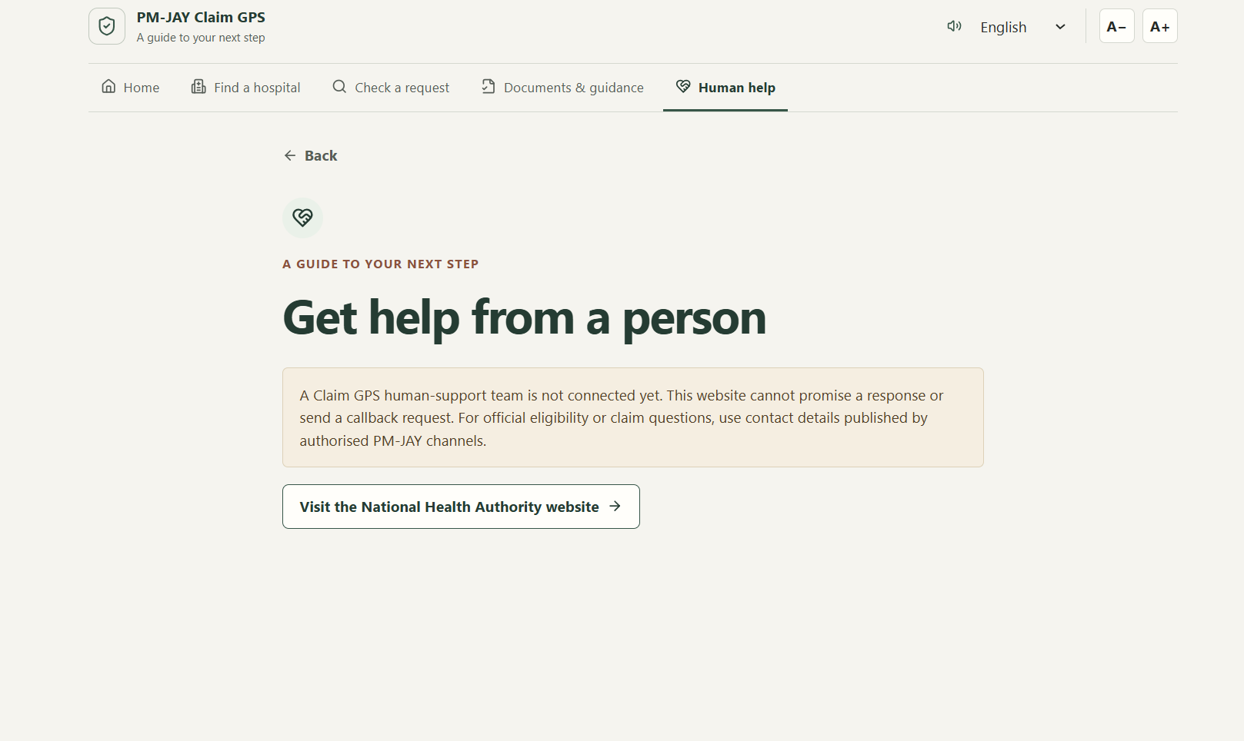
PM-JAY CLAIM GPS
Prototype Workflow & Interaction
HOSPITAL FINDER
REQUEST STATUS
HUMAN ASSISTANCE
20

Slide 20
PM-JAY CLAIM GPS / OUTCOME & CONCLUSION
Outcome and Conclusion
EXPECTED OUTCOME
CONCLUSION
Make the next step easier to understand.
The questionnaire points to a practical need for
clearer PM-JAY guidance. Claim GPS proposes a
need-first navigation experience that can help users
move from a healthcare question to a clear next step.
A pilot with verified hospital information and local
support should be tested before wider use.
Help users locate relevant hospital information.
Provide clear document and assistance guidance.
Offer a low-connectivity and human-help path.
21

Slide 21
PM-JAY CLAIM GPS / REFERENCES & NEXT STEPS
References & Next Steps
Sources listed in the original project presentation.
National Health Authority (NHA) – PM-JAY Operation Manual.
National Health Authority – official PM-JAY portal and hospital information.
NITI Aayog – Aspirational Districts Programmed.
NITI Aayog – Stories of Change.
Primary research – team Google Form questionnaire and supplied response charts.
22

