Slide 1
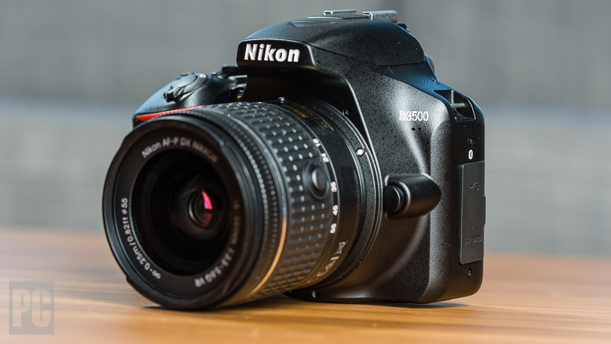
DIGITAL CAMERA

Slide 2
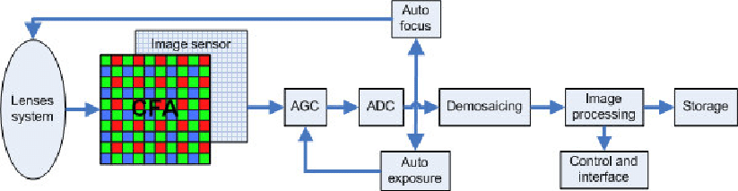

Slide 3
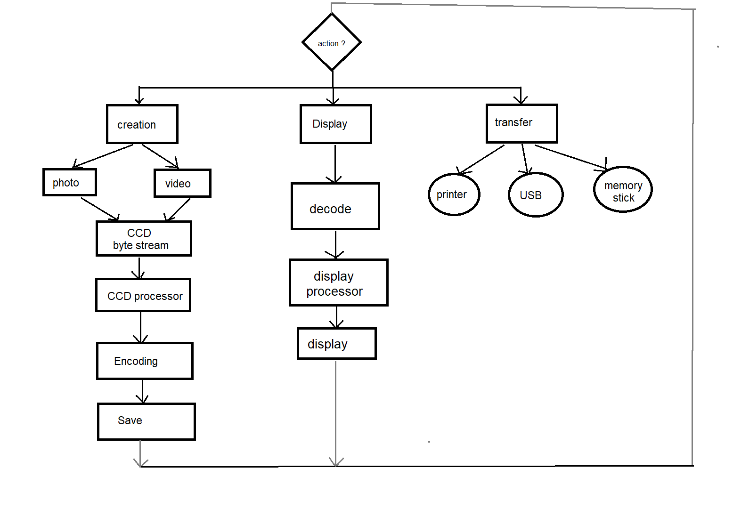

Slide 4
Code for persons detection in scene
warning('off'); %ignoring all warnings
detector = vision.CascadeObjectDetector(); %Create a detectorusing Viola-Jones
detector.MergeThreshold=15;
img_o=imread('group2.jpg'); %reading image
img=rgb2gray(img_o); %converting to gray
bbox=step(detector,img); %applying detector on image
out=insertObjectAnnotation(img_o,'rectangle',bbox,'face'); % mixing detected boxes of faces and original image
figure(1),imshow(out);

