Slide 1


Bubble Binfo
Simon Gourdon, Alex Bouchentouf, Avdusinovic Sadin
Software Engineering Project

Slide 2



Table of content
2nd Sprint
Achieved
Not completed
Gameplay
Quiz
Final presentation

Slide 3
2nd Sprint
Achieved:
->new design for the webgame
->Quiz
->Docker
Not completed:
-> add the second semester (list->optional)
->video
->commercial video
->documentation

Slide 4
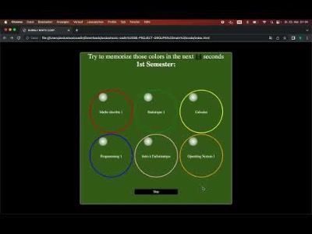
Gameplay
https://youtu.be/WF1rkXAJz98

Slide 5
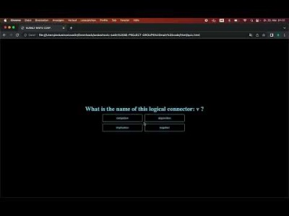
Quiz
https://www.youtube.com/watch?v=0NMQMab3sYM

Slide 6
Final presentation
Finish the commercial video
Finish the explainer video & documentation
Some debugging on the webgame

Slide 7



Thanks for your attention

