Slide 1
Proxy design pattern
Tutorial

Slide 2
OVERVIEW
Intent of the Proxy design pattern
Proxy types
Participants
Consequences
Dynamic Proxy

Slide 3
Intent of the Proxy design pattern
Provide a surrogate or placeholder for another object to control access to it.

Slide 4
Proxy pattern describes how to solve such problems:
How can the access to an object be controlled?
How can additional functionality be provided when accessing an object?

Slide 5
Proxy types
Remote proxy
Virtual proxy
Protection proxy
Smart Proxy

Slide 6
Participants of the Proxy pattern:
Client
Subject
RealSubject
Proxy

Slide 7
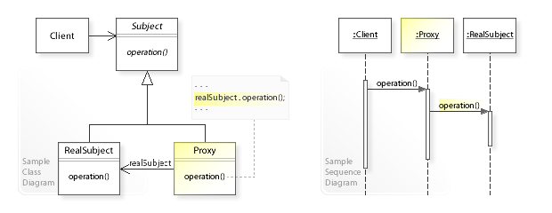
UML class and sequence diagram

Slide 8
Proxy classes can implement many things
logging when a method starts and stops
perform extra checks on arguments
mocking the behavior of the original class
implement lazy access to costly resources

Slide 9
Real world example of proxy pattern
In aspect oriented programming (AOP), an object created by the AOP framework in order to implement the aspect contracts (advise method executions and so on).
In hibernate, we write the code to fetch entities from the database. Hibernate returns an object which a proxy (by dynamically constructed by Hibernate by extending the domain class) to the underlying entity class. The client code is able to read the data whatever it needs to read with the proxy.

Slide 10
Consequences
Advantages
Simplifies clients
A proxy hides implementation details from clients, which makes them easier to implement, change, test, and reuse
Disadvantages
Proxy is coupled to real subject.
A proxy implements the Subject interface and (usually) has direct access to the concrete RealSubject class.
But if Proxies are going to instantiate RealSubjects (such as in a virtual proxy), then they have to know the concrete class

Slide 11
DYNAMIC PROXY
JDK proxy
cglib
Javassist
Byte Buddy

Slide 12
JDK proxy
JDK dynamic proxy is available since JDK 1.3
JDK dynamic proxy approach requires the target objects implement one or more interfaces
JDK proxies are implemented naively with only one interception dispatcher

Slide 13
CGLIB
CGLIB - Byte Code Generation Library, is built on top of ASM (ASM is a Java bytecode manipulation framework)
In 2002 CGLIB defined a new standard to manipulate bytecode
cglib is no longer under active development.
mockito has replaced CGLIB by Byte Buddy in version 2.1.0.

Slide 14
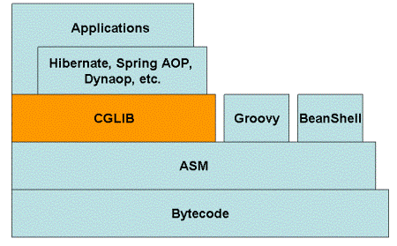
CGLIB

Slide 15
JAVASSIST
Javassist (Java programming assistant)
Javassist provides two levels of API: source level and bytecode level.
Using the source-level API, programmers can edit a class file without knowledge of the specifications of the Java bytecode
Using the bytecode-level API allows the users to directly edit a class file as other editors.
Javassist is recognized to be slower than Cglib

Slide 16
Byte Buddy
Byte Buddy is a code generation and manipulation library for creating and modifying Java classes
Highly configurable
Quite fast
Very well documented
Lots of example
Clean code, ~94% test coverage

Slide 17
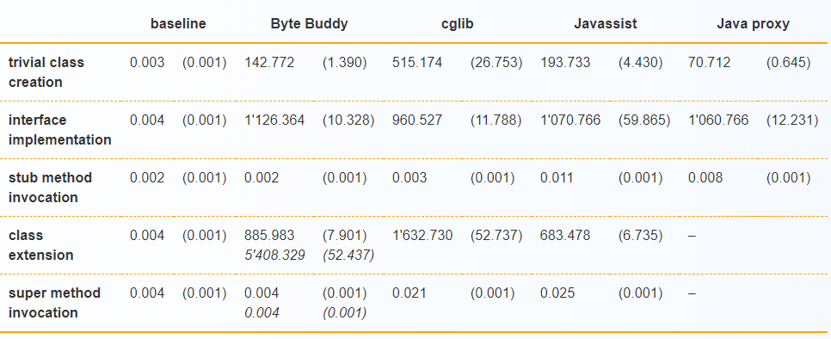
Performance Comparison of JDK Proxy, cglib, Javassist and Byte Buddy

Slide 18
References
https://dzone.com/articles/java-dynamic-proxy
https://howtodoinjava.com/design-patterns/structural/proxy-design-pattern/
https://github.com/cglib/cglib/wiki
https://www.javassist.org/
https://bytebuddy.net/#/
https://dzone.com/articles/java-dynamic-proxy
https://www.jrebel.com/blog/java-code-generation-libraries-comparison

Slide 19
Questions

Slide 20

Thank you!

