Slide 1
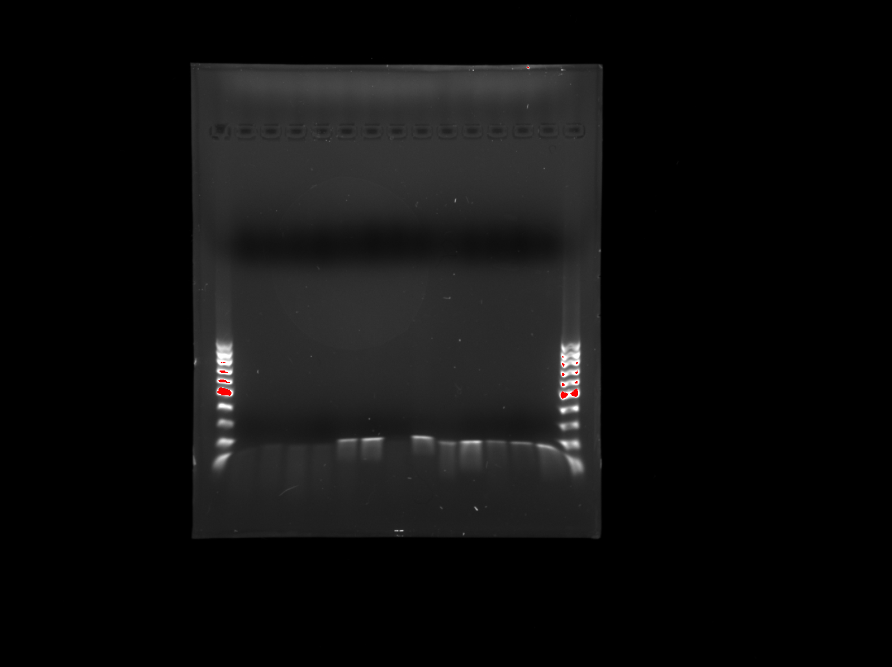
Here
100
Here
Here
Here
Here
Here
Here
Here
Here
Here
Here
Here
Here
1. Ladder
2. E1
3. E3
15. Ladder
4. G1
5. E2
6. B1
7. C1
8. A5
12. E 11
9. C4
11. D10
13. E12
10. A8
14. A8

