Slide 1
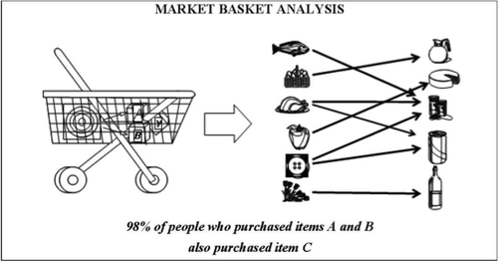
Market Basket Analysis
Presented By
Sayantony Dey
Sanjit Sadhukhan
Subham Banerjee
Aveepsit Chowdhury
Kheya Mondal

Slide 2
Topics to be discussed
Introduction to Market Basket Analysis
Technique used : Apriori Algorithm
Hardware and Software requirements
Applications in some other areas
Description of sample data set
Future improvements

Slide 3
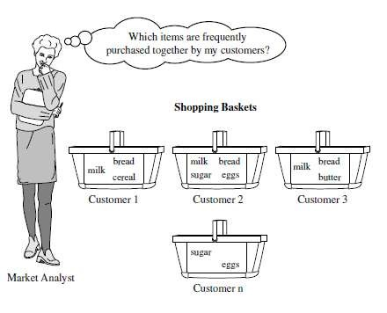
Introduction
A large number of people
use to visit shopping malls
and shopping centers.
Massive amounts of data continuously being collected and stored as transactions
Those collected data can be useful for business strategy planning.
3

Slide 4
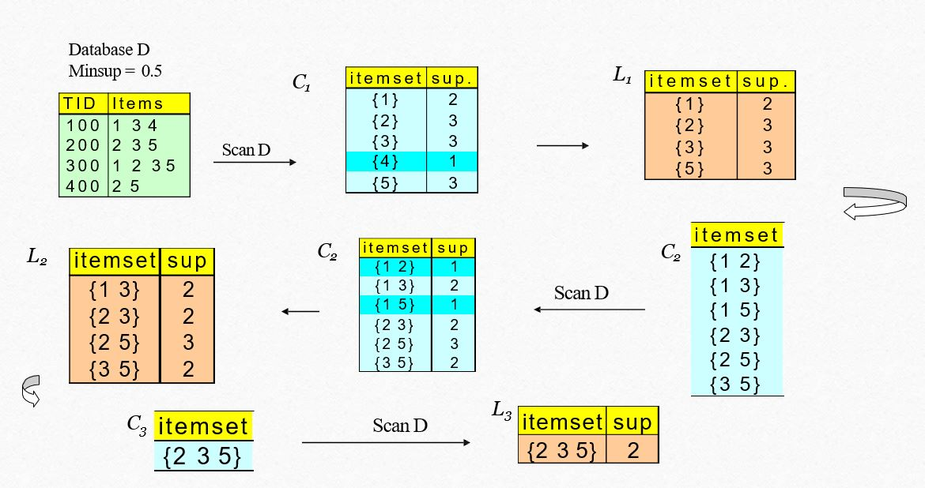
Definition of Apriori algorithm
The Apriori Algorithm is an influential algorithm for mining frequent itemset for Boolean association rules.
Apriori uses a "bottom up" approach, where frequent subsets are extended one item at a time (a step known as candidate generation, and groups of candidates are tested against the data.
Apriori is designed to operate on database containing transactions (for example, collections of items bought by customers, or details of a website frequentation).

Slide 5
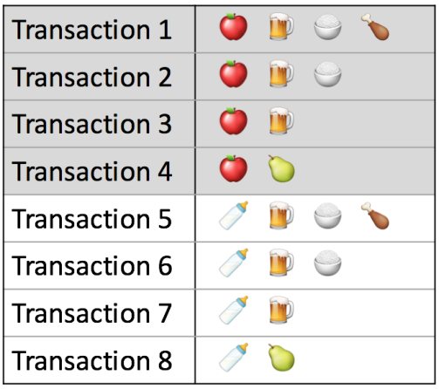
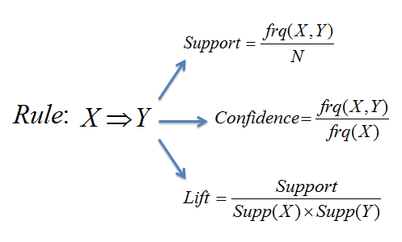
Association Rule Analysis
Association analysis uses a set of transactions to discover rules that indicate the likely occurrence of an item based on the occurrences of other items in the transaction
An implication expression of the form X ® Y, where X and Y are item sets
Example: {Apple, Beer} -> {Rice}
Here X is {Apple, Beer] -> Y which is {Rice}

Slide 6



Support (S) = Fraction of transactions that contain both X and Y i.e. how often Milk, Diaper and Beer occur together in the transactions.
Confidence (C) = Measures how often each item in Y appears in transactions that contain X
i.e. how often beer occurs in the transactions which contain milk and diaper.
C = Support (X + Y)/Support (X)
Lift (L) = The Lift of the rule is X=>Y is the confidence of the rule divided by the expected confidence, assuming that the item sets are independent
L = Support (X + Y)/(Support (X)* Support (Y))

Slide 7
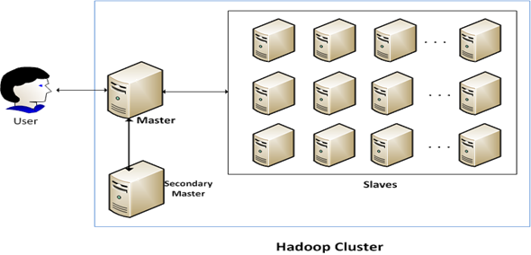
Hardware and Software Requirement
Hardware Requirement
Master Computer need more Memory Space (Approx 120GB)and less Disk Space(Approx 2TB).
Slave Computer need less Memory Space (Approx 20GB) and more Disk Space (Approx 16TB).
Software Requirement
Hadoop 2.2.0
JAVA 1.7.0
Notes:
The entire project has been developed in SUDO Distributed environment.

Slide 8
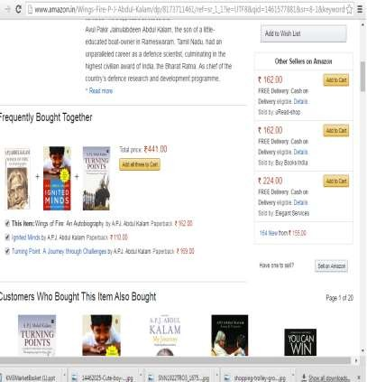
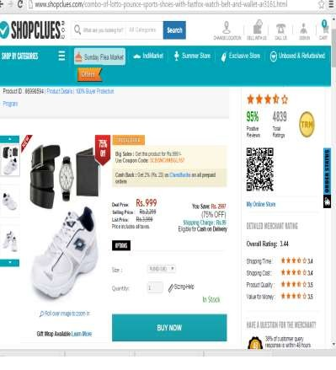
Applications
Cross Selling of the Items

Slide 9
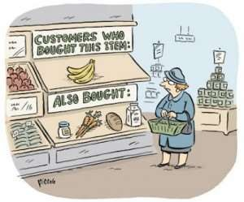
Applications
Proper Placement of Items.
Fraud detection.
Customer Behavior.

Slide 10
Data Set Description
hering corned_b olives ham turkey bourbon ice_crea
baguette soda hering cracker heineken olives corned_b
avocado cracker artichok heineken ham turkey sardines
olives bourbon coke turkey ice_crea ham peppers

Slide 11
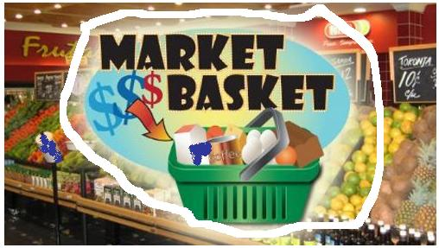
Future Improvements
The future work would be some modification of other algorithms to generate the association rules that can be adopted on existing recommendation system to make them functionally more effective.
Better and effective rule mining techniques can be used for better performance of the recommendation system.
Effective Neural Network techniques can be incorporated with the Association Rule Mining to increase the accuracy of the recommendation system.

Slide 12
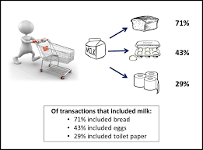
Conclusion
We have shown how Market basket analysis using association rules works in determining the customer buying patterns. This can be further extended using , to add dimensions and cube to identify other measures like costs, revenue and quantity.

Slide 13
Thank You

