Slide 1
WEB DEVELOPMENT SEMESTER PROJECT
AI CHAT-BOT & ASSISTANT
ABHIYAN ACHARYA
NCCSCSIT448

Slide 2
INTRODUCTION TO THE PROJECT
AI powered chatbot and assistant webapp designed to flirt with people
Minimal, lightweight and straighforward
Redefining AI interactions and application for connections
Unique combination of entertainment with practicality
  Fun conversations
  Witty pickup lines
  Crafting a perfect response

Slide 3


PROJECT IDENTITY: SENORIZZTA
Combination of two terms
  Señorita (an unmarried Spanish or Spanish-speaking girl or woman)
  Rizz (slang, an ability to charm and woo a person)

Slide 4
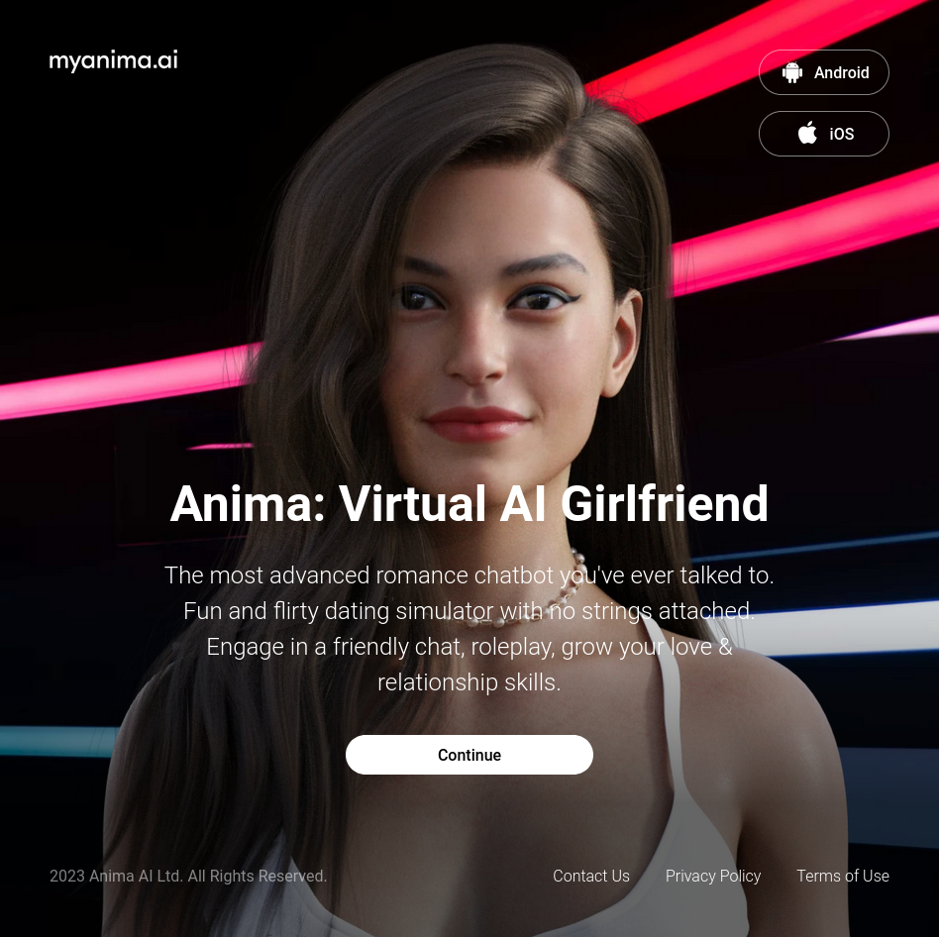
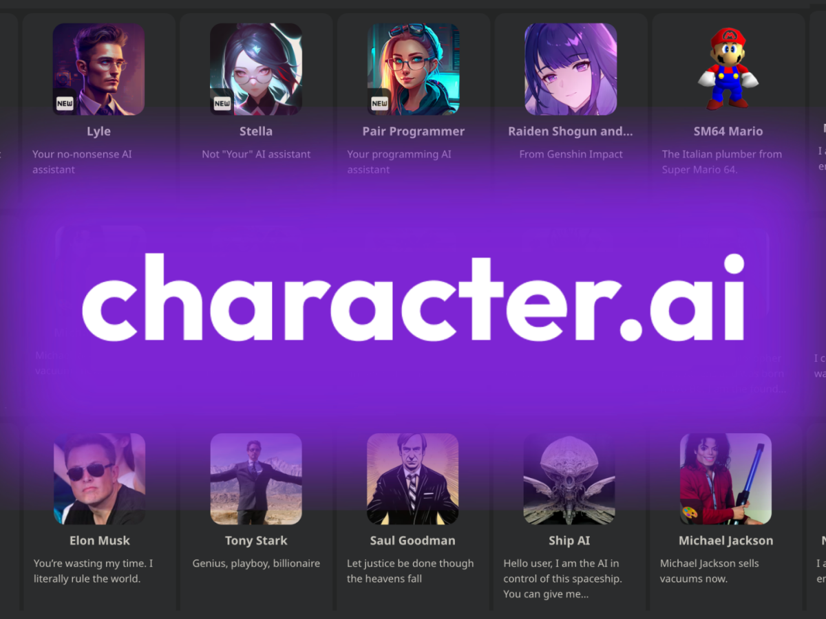

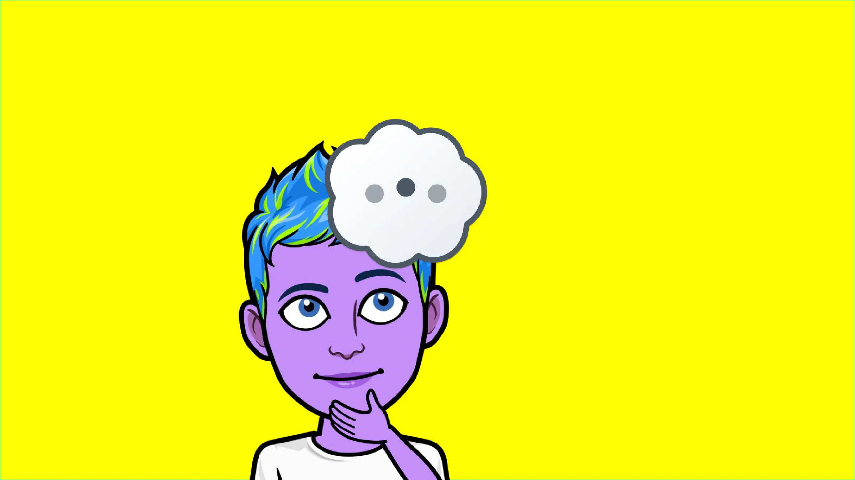
INSPIRATIONS
My AI (Snapchat)
character.ai
Anima: AI Girlfriend
ChatGPT
lmarena.ai

Slide 5
DEVELOPMENT STACK
Frontend
  HTML
  CSS (Bootstrap)
  JavaScript
Backend
  Python3 (Flask Server)
    langchain
    opencv
    tesseract
    pytest
  Ollama
    Llama3

Slide 6
FEATURES OVERVIEW
Chatbot
Rizz Me (Pickup Line Generator)
AI Assist (for the GOAL)

Slide 7
FEATURES OVERVIEW: CHATBOT
Select from three options
  Male
  Female
  Boeing 737 Max
Download chat-log after the conversation is over
Conversations handled by pretrained models with the use of prompts
Simple chat interface, with Send and End Conversation buttons

Slide 8
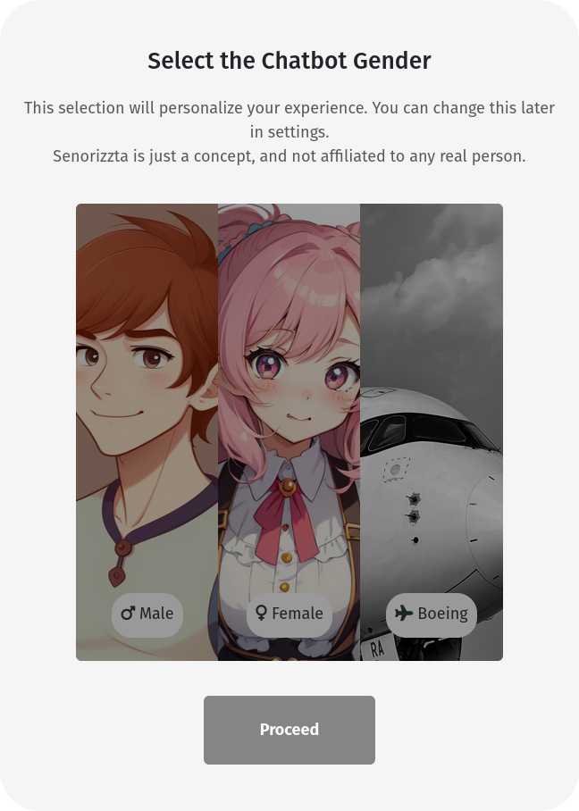
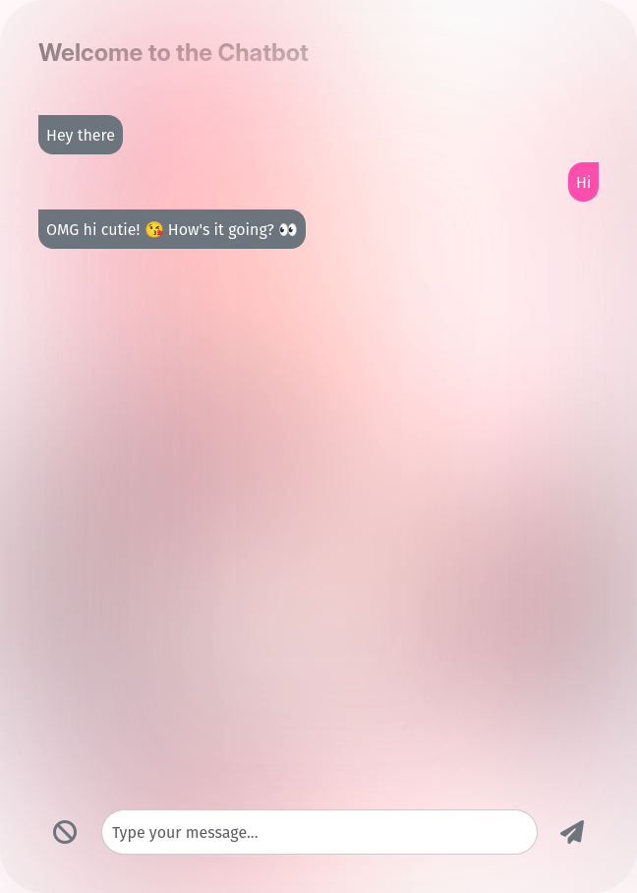
FEATURES OVERVIEW: CHATBOT

Slide 9
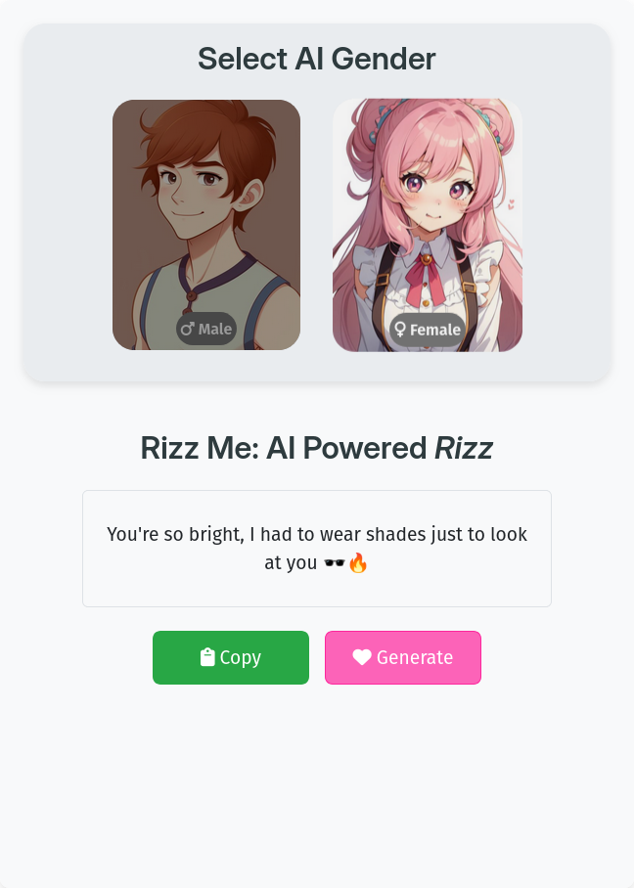
FEATURES OVERVIEW: RIZZ ME
Select from two AIs
  Male
  Female
Generate pickup lines, regenerate if you want another
Copy to Clipboard option

Slide 10
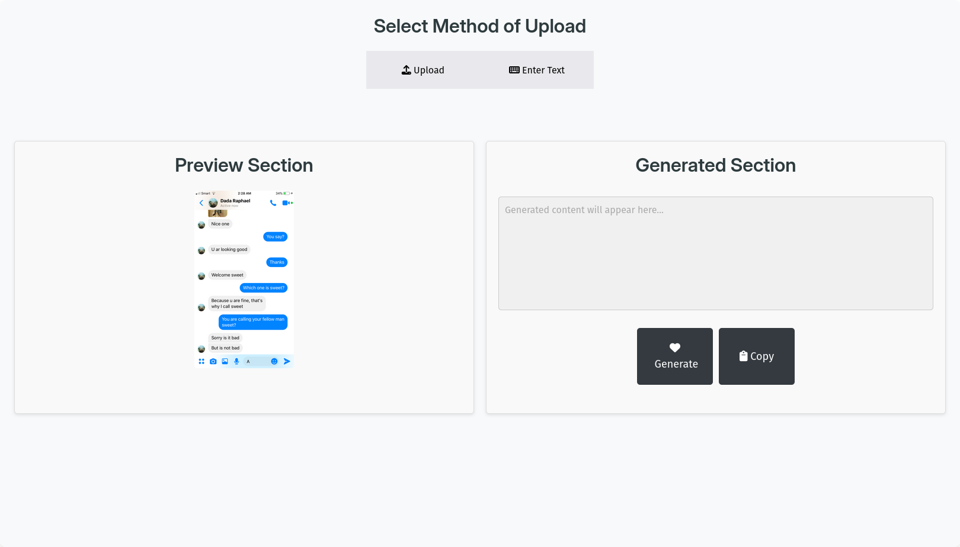
FEATURES OVERVIEW: AI Assist (for the GOAL)
Select from two options
  Upload screenshots/images
  Enter Text manually
Preview your input choice
Generate (or regenerate) your perfect response
Copy to Clipboard option available

Slide 11
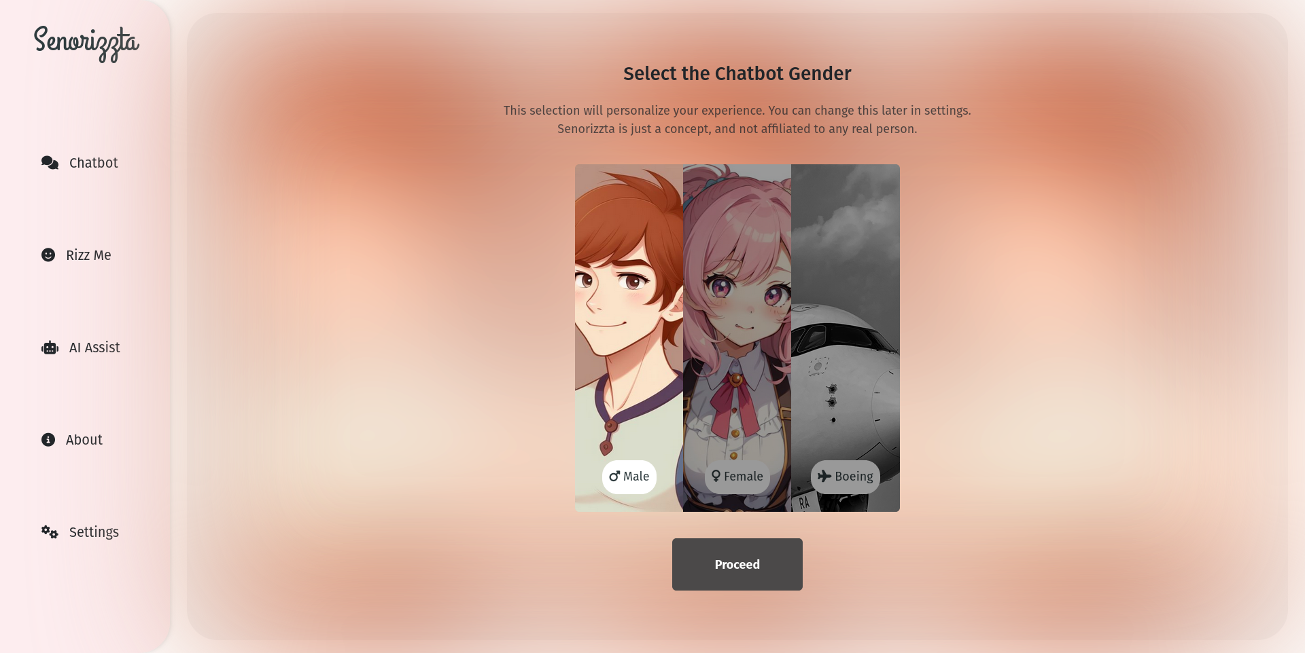
UI/UX DESIGN
Minimal approach
Not focused on traditional website design
Responsiveness and touch screen friendly design
Vertical Navbar

Slide 12
WORKING PRINCIPLE: HTTP RESPONSE AND REQUEST
Client sends the request
  {
  “id”: UNIQUE_ID,
  “gender”: SELECT_GENDER, “message”: USER_MSG
  }
Server verifies the request and sends a response
  {
  “status_code”: STATUS_CODE,
  “response”: RESPONSE_JSON or ERROR_MSG
  }

Slide 13
WORKING PRINCIPLE: BACKEND SCRIPTS
Consists of three core backend scripts
  chat_logic.py:
    Handles chat requests and provides a response
    Actual response in response key of response dictionary
  rizz_logic.py:
    Request = id, gender
    Response = JSON (actual text in “response” key)
  ai_assist.py:
    Receives image file or text (strings)
    text_to_process = (file → image) ? preprocess(file) : text
    Generate response from text_to_process

Slide 14
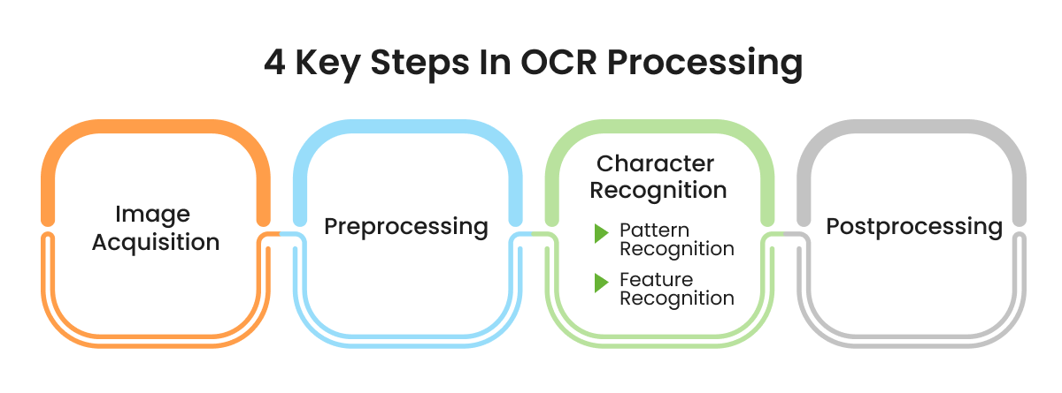
WORKING PRINCIPLE: OPTICAL CHARACTER RECOGNITION

Slide 15
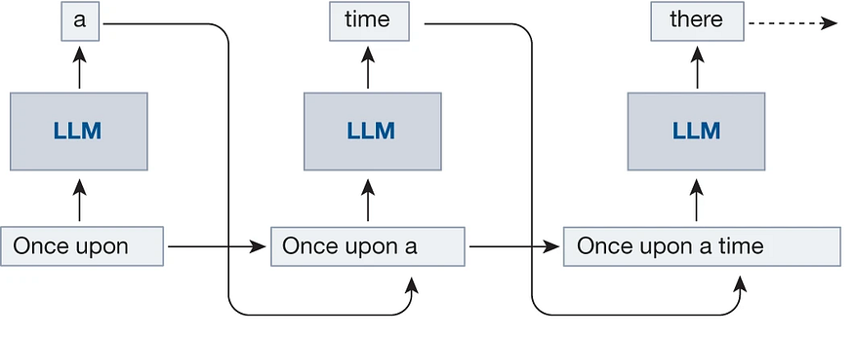
WORKING PRINCIPLE: TEXT GENERATION BY LLMs

Slide 16
FEATURE TO BE IMPLEMENTED
Completion of Settings section
  Set AI intensity (fine tune from settings)
  Dark Mode
  Multilingual Support (requires more intense resources)
Erasing AI memory after each conversations
Customization of Characters
Improved OCR detection feature
Components for user experience (typing, notification sounds, etc.)
Adding vocals to AI with Text to Speech

Slide 17
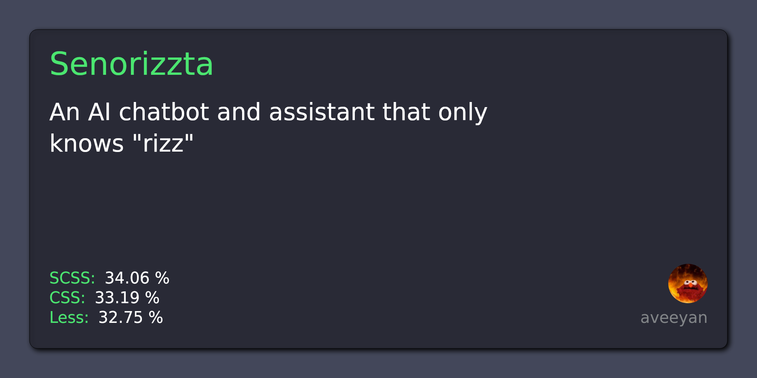
GITHUB REPOSITORY

