Slide 1

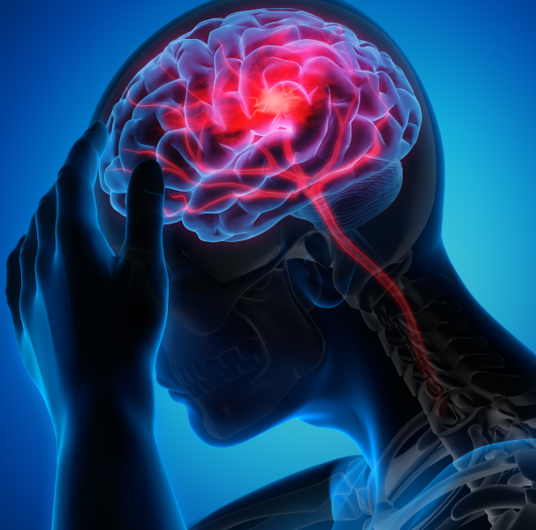
Stroke prediction Data set Evaluation
Exploratory data analysis

Slide 2
Introduction
Stroke is the fifth leading cause of death and disability in the United States according to the American Heart Association.
Every 40 seconds in the US, someone experiences a stroke, and every four minutes, someone dies from it according to the CDC. A recent figure of stroke-related cost almost reached $46 billion.
With my interest in healthcare, I wanted to explore which are important factors that contribute to stroke to help patients and health providers minimize the risk and cost.
For this presentation I wanted to evaluate the viability of the dataset before using it for prediction.

Slide 3
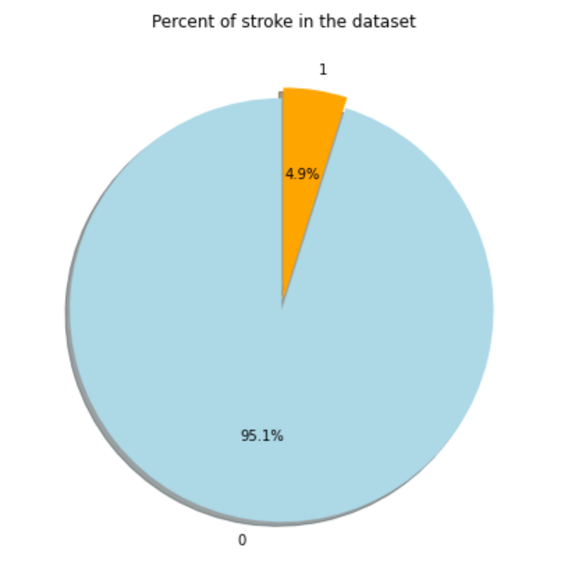
Dataset description
This presentation uses the a Kaggle dataset which consists of 5110 observations:
Three numerical features
Eighth Categorical features
The percentage of stroke in the dataset is 4.9 %
Key observation: The overall sampling of the data set is imbalanced towards patients with no strokes.

Slide 4
Questions to ask Based on the features
1) Male/Female who has more risk for strokes.
2) People of which age group are more likely to get a stroke.
3) Is hypertension a cause?
4) A person with heart disease is more likely to get a stroke?
5) Does being married play a role in causing a strokes?
6) Does the type a job have an impact on the risk of stroke due to stress perhaps?
7) People living in urban areas have more chances of getting stroke?
8) Is the Glucose levels a factor for the risk of stroke?
9) Does the BMI have an impact in the risk of stroke?
10) Is the smoking status a high factor on the risk of stroke?

Slide 5
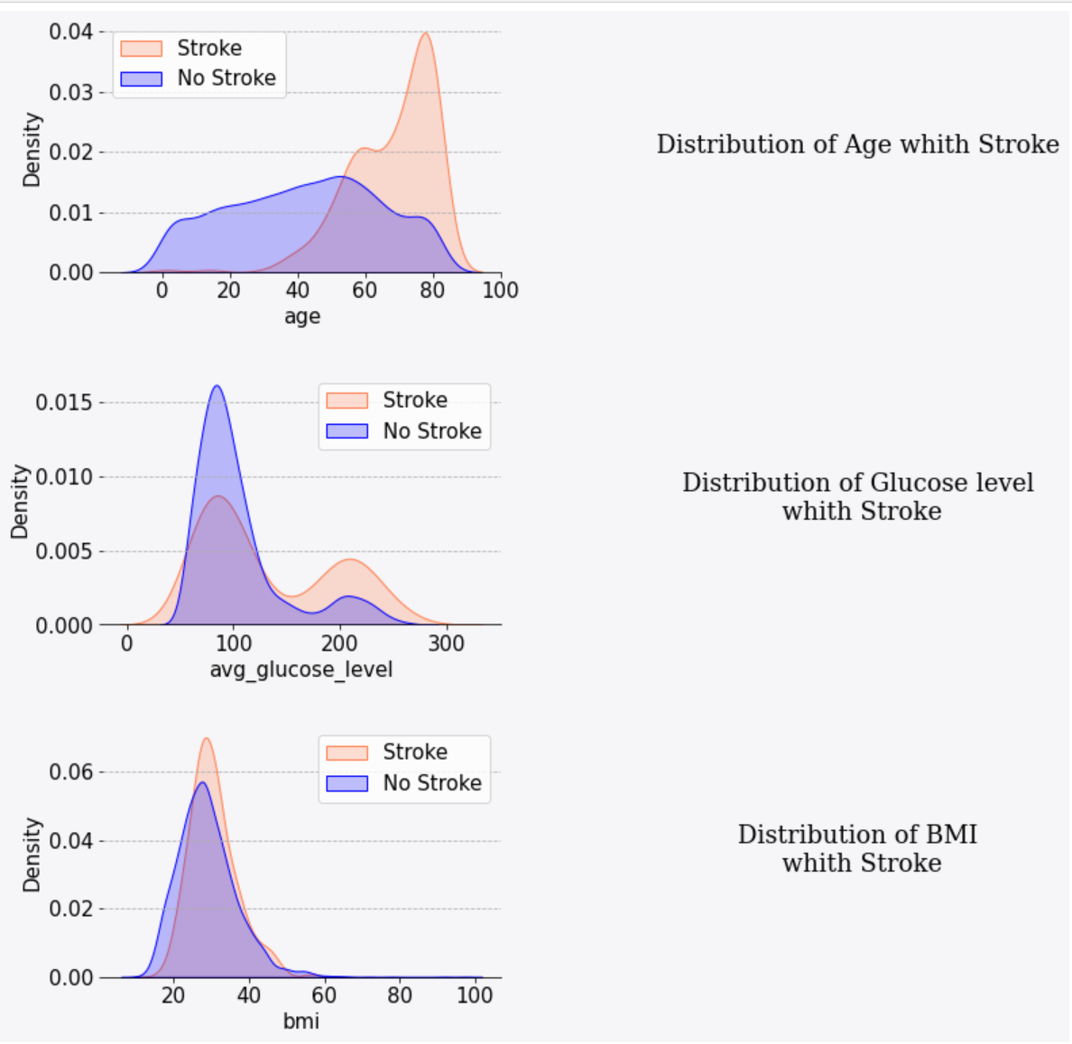
numerical Features
Age
Show high risk for stroke for older than 50
Glucose Level
Risk for stroke for prediabetes and diabetes
BMI
High BMI is not necessarily a significant factor?
There were 201 missing values for this feature.
Which corresponded to 16 percent of stroke data
(should not be removed)
71-90 means blood sugar no normal
90-140 means normal
140-199 indicates prediabetes
200 and higher indicates diabetes
A BMI <18.5 means that a person is underweight
A BMI between 18.5 and 24.9 is ideal
A BMI between 25 and 29.9 is overweight
A BMI >30 indicates obesity

Slide 6

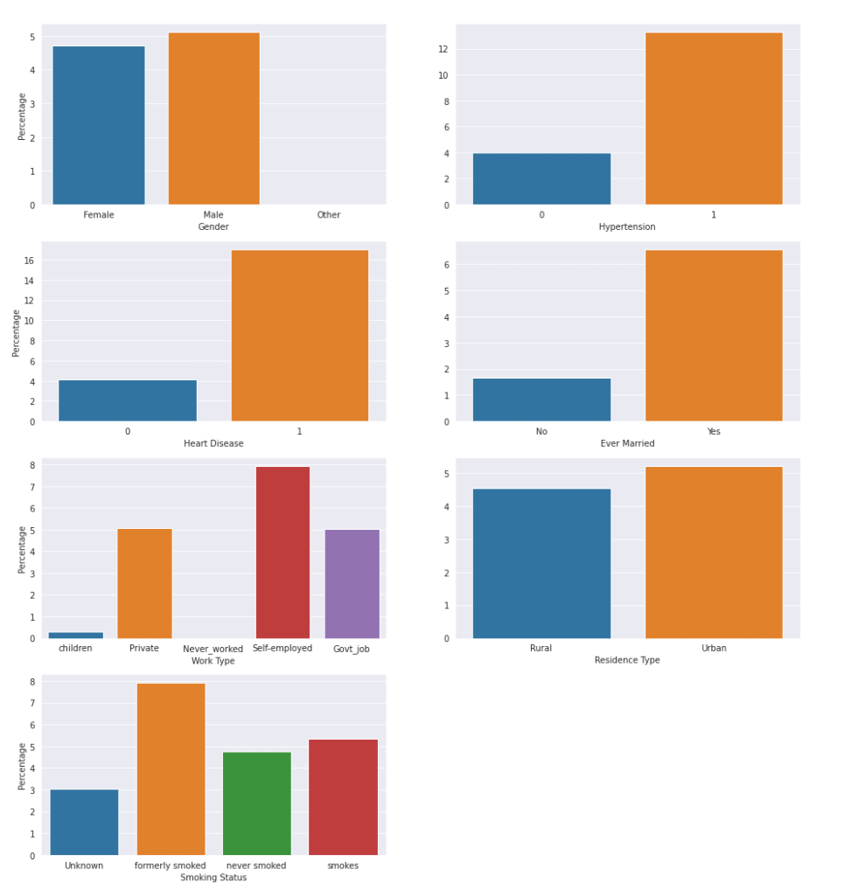
Categorical features percentage visualization
Gender
Heart Disease
Work type
Smoking Status
Hypertension
Ever married
Residence type

Slide 7
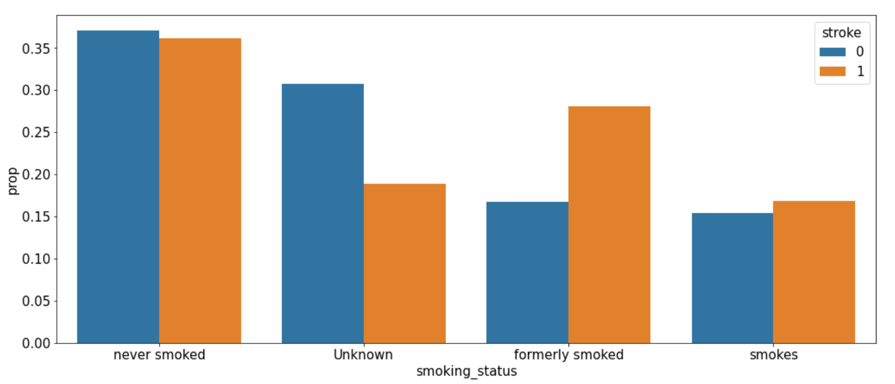
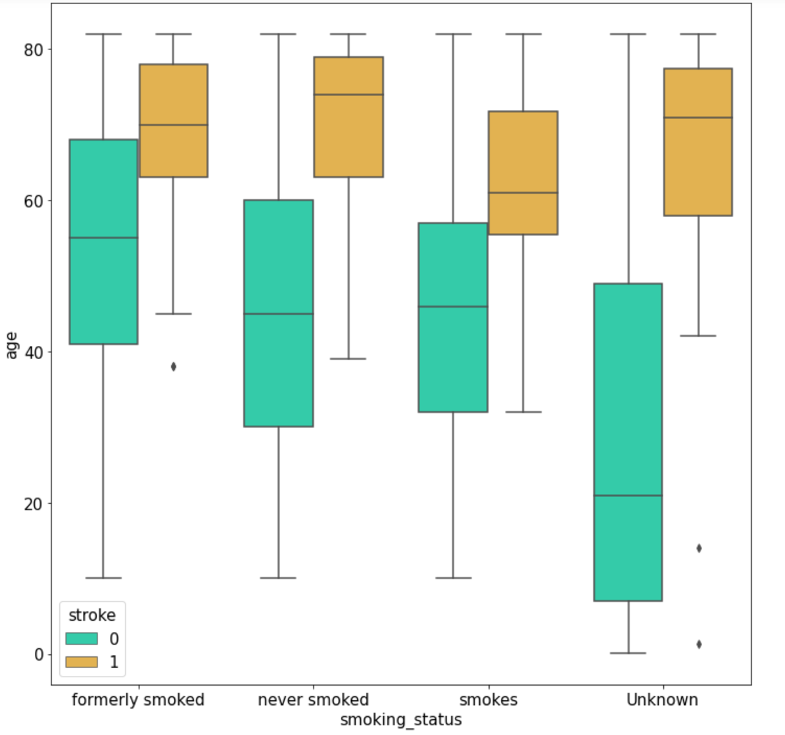
Smoking status
For the people that smoke - a stroke will happen at an earlier age
Formerly smoked - higher risk for same age range than never smoked
Never smoked -stroke driven by age

Slide 8
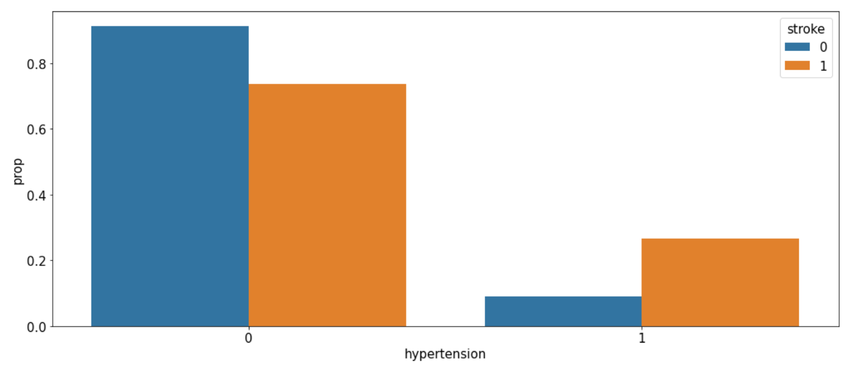
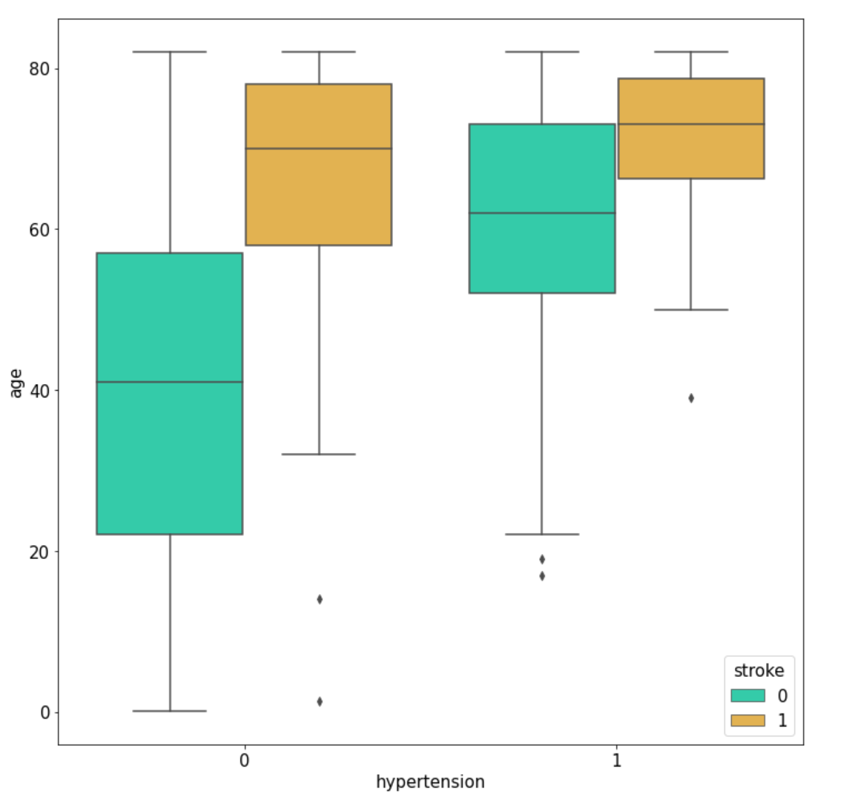
hypertension
Hypertension occurs at older age
Stroke might be driven by both age and hypertension (collinearity ?)

Slide 9
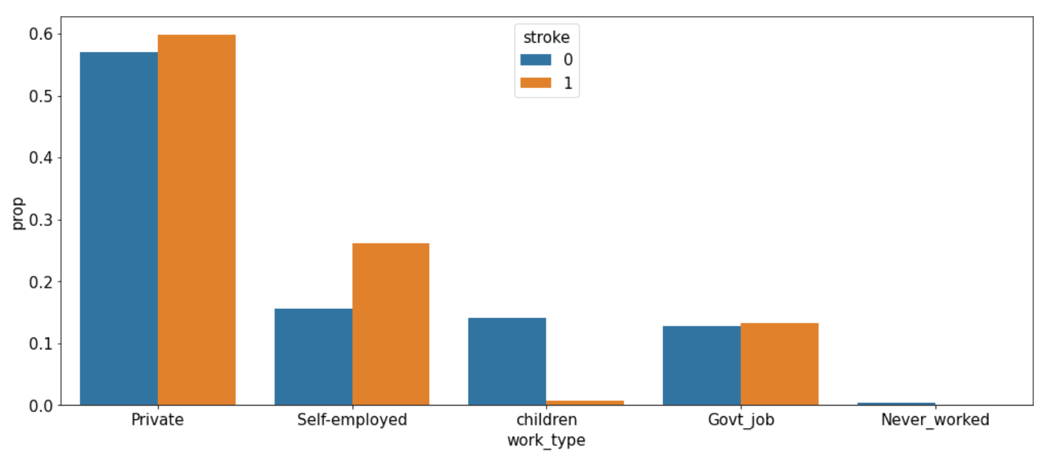
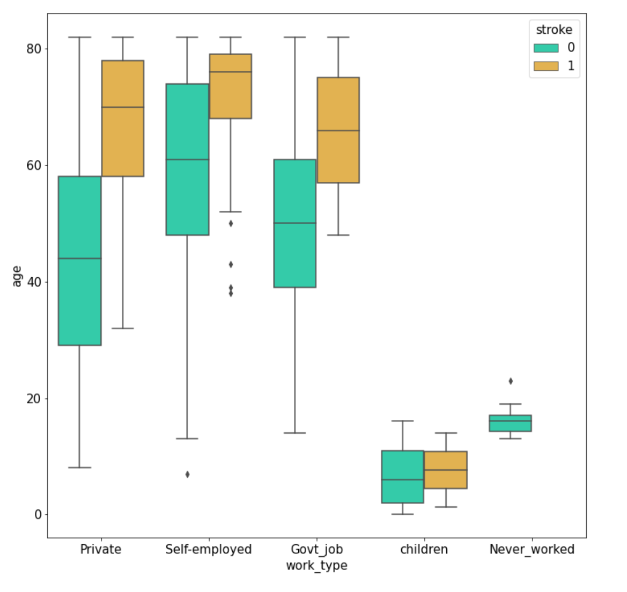
Work type
Work type
The risk of stroke appears to be age related, not related to work type

Slide 10
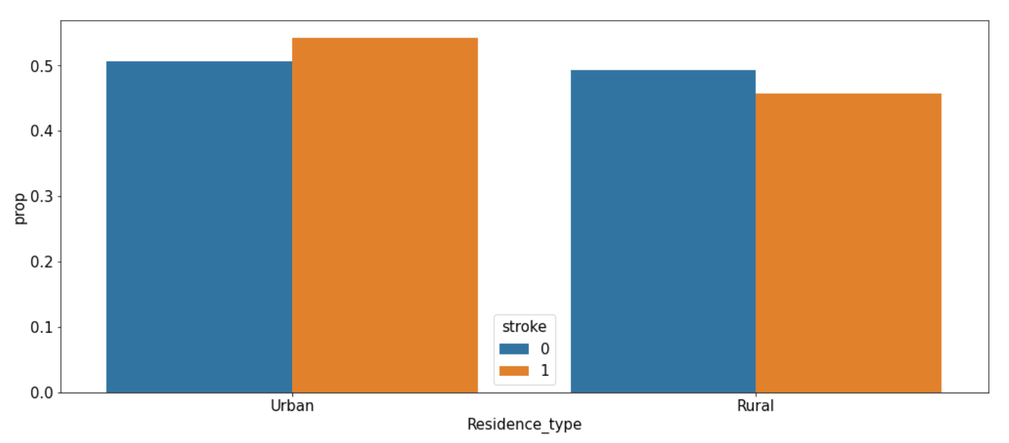
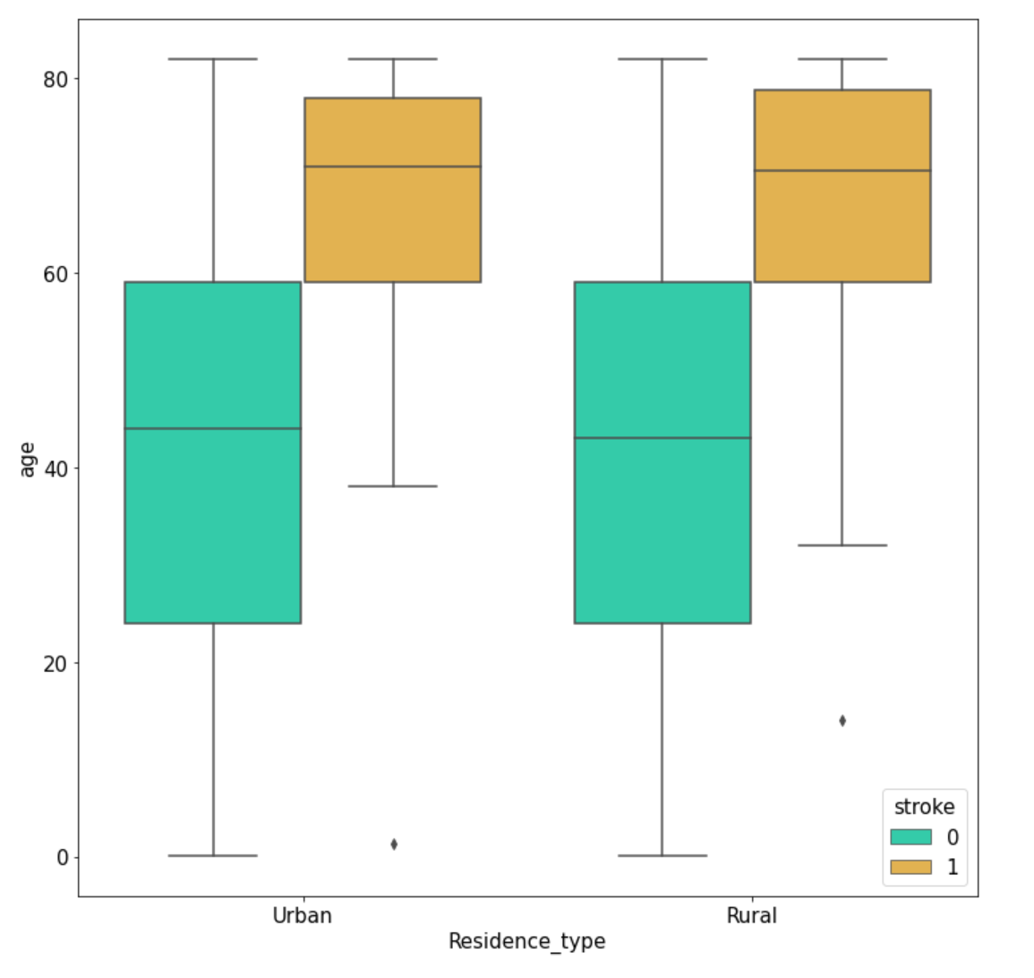
Residence type
Stroke in this case is only driven by age Urban or Rural has no impact in the risk of stroke

Slide 11
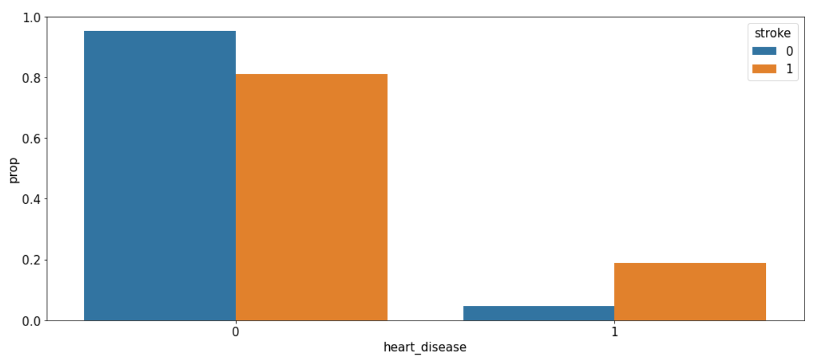
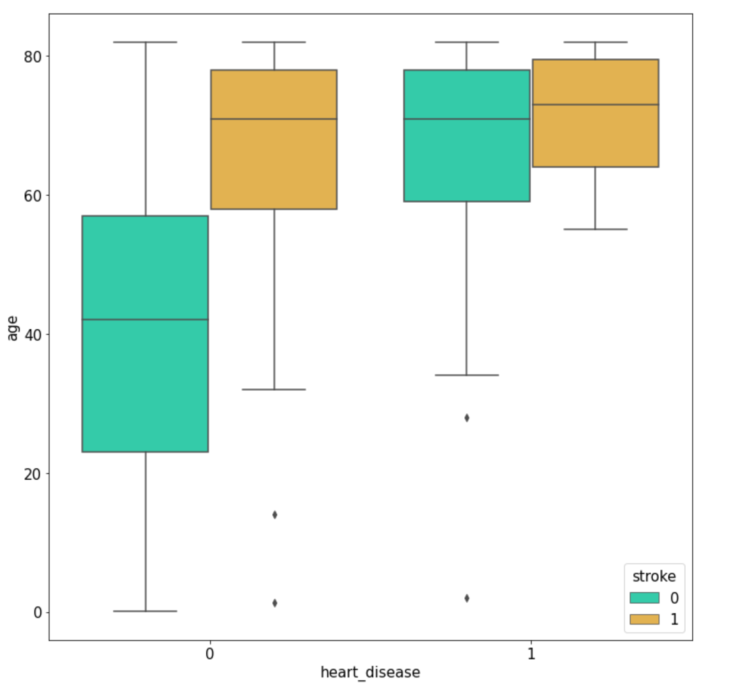
Heart disease
Heart disease and old age higher risk of stroke

Slide 12
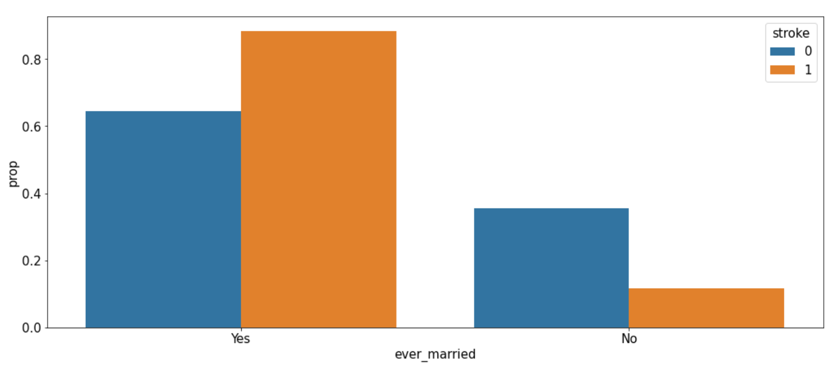
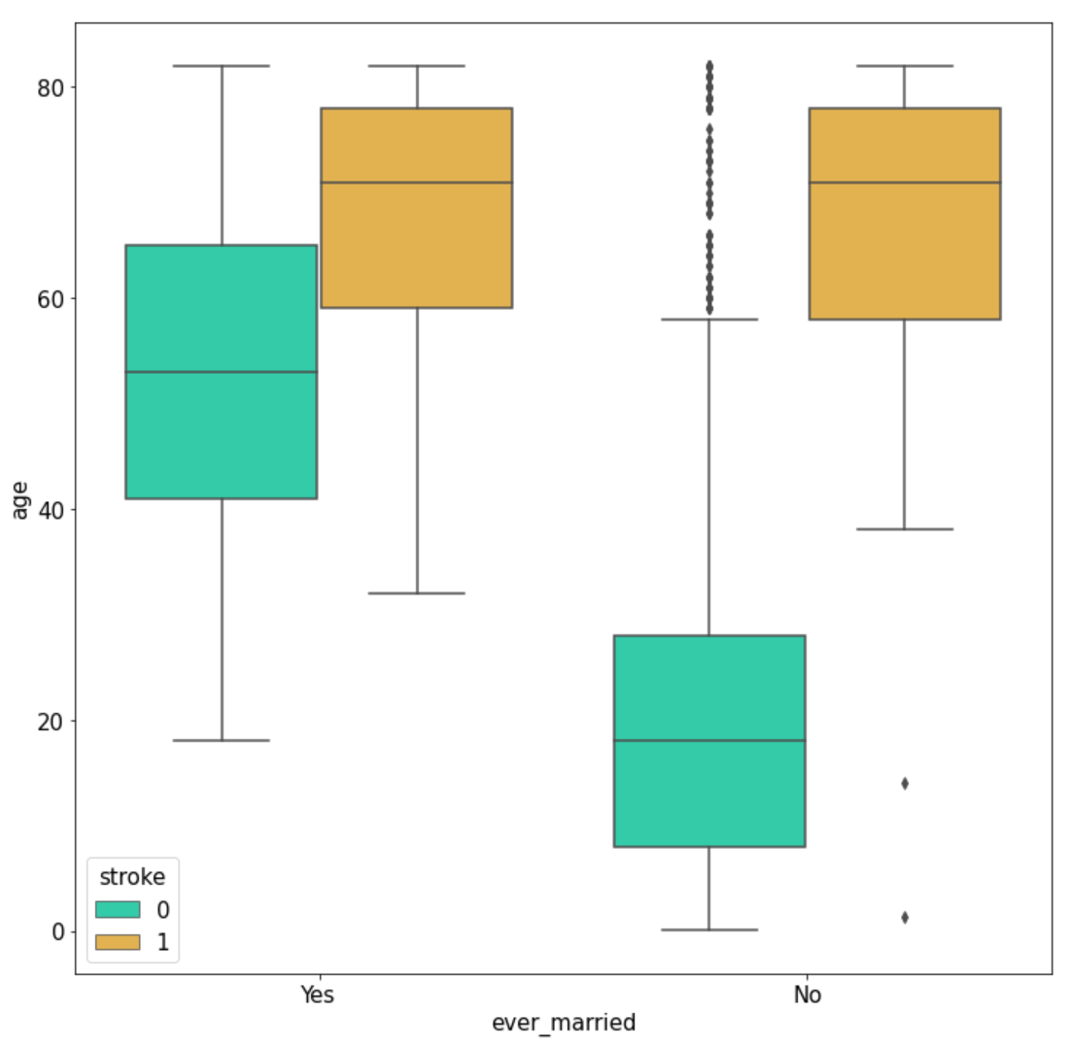
Marriage status
Marriage status does not show to be a factor on the risk of stroke.
For the people that smoke - a stroke will happen at an earlier age
Formerly smoked - higher risk for same age range than never smoked
Never smoked -stroke driven by age

Slide 13
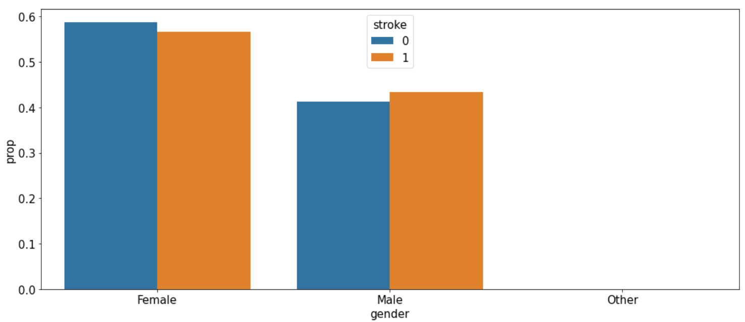
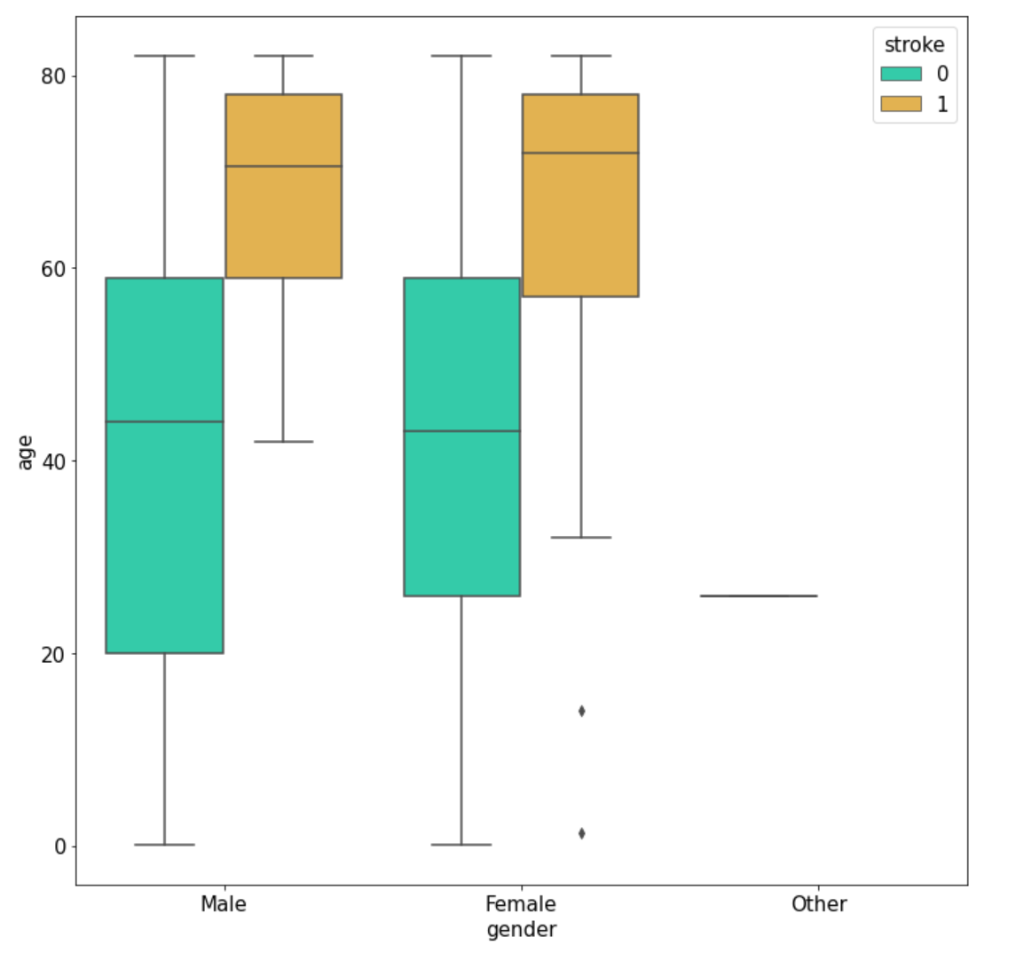
gender
Gender is not a strong factor to determine risk for stroke.

Slide 14
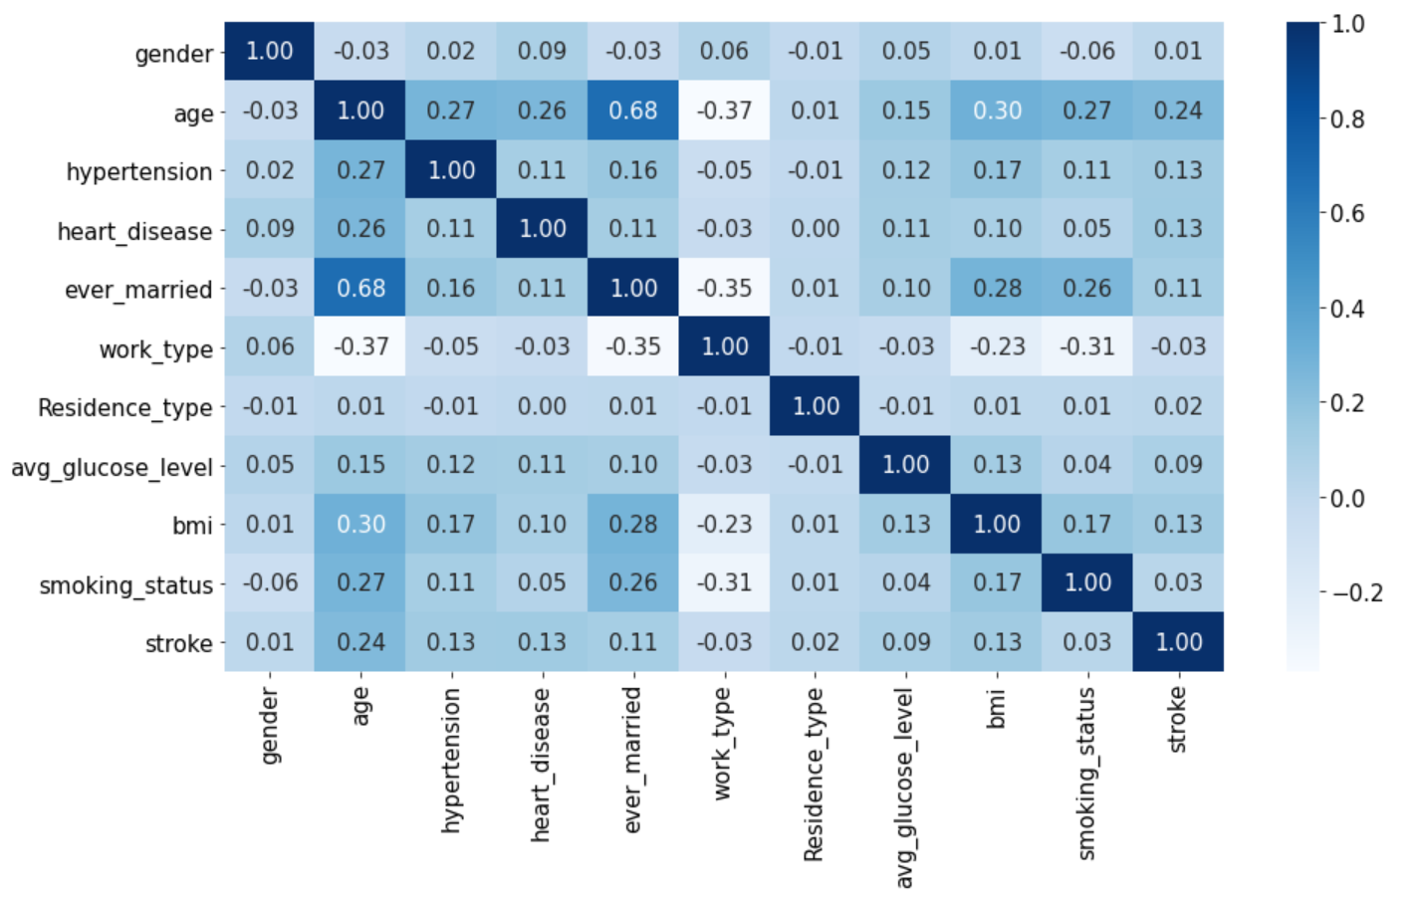
Correlation matrix
No strong correlation between any of the features except age and ever_married

Slide 15
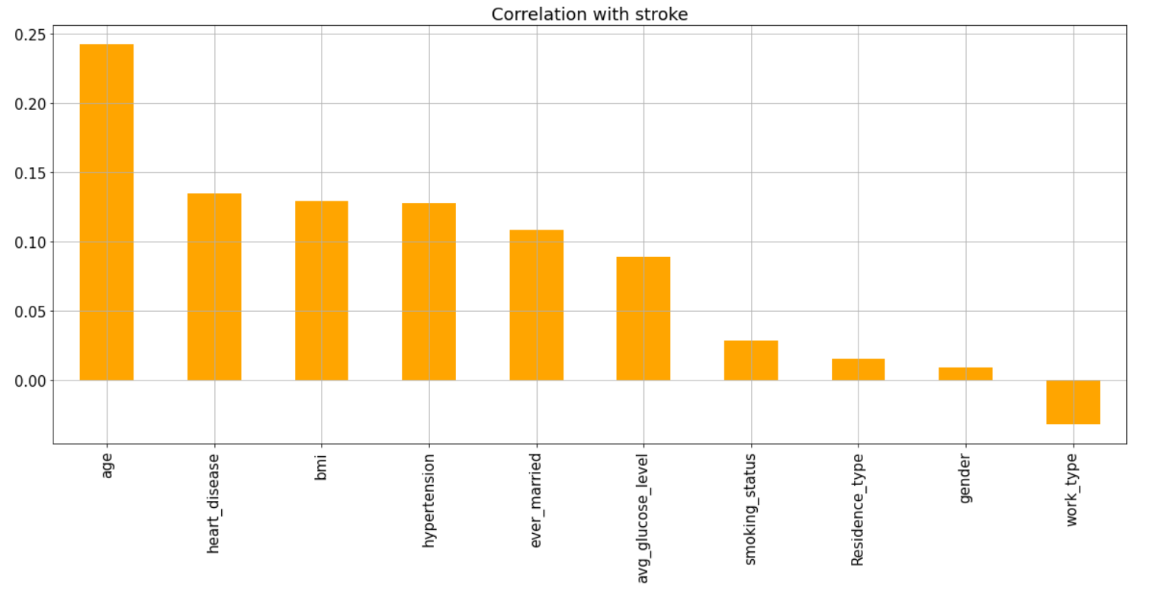
Correlation with the target
This visualization shows that age is the main factor for stroke.
Smoking doesn’t show a high correlation which is troublesome as it is well known that smoking is a strong risk factor for stroke

Slide 16
Conclusion
Age is a strong driving factor for the risk of stroke.
BMI was not highly correlated to risk of Stroke which is surprising?
Diabetes is a risk factor for stroke.
Smoking status is a factor to determine the risk of having a stroke.
Attributes like Heart disease, hypertension, ever married and employment status pointed more to be age related risk for stroke .
Residence type has no correlation with the risk of stroke.
Gender does not appear to be a strong factor for stroke in this dataset although according to several studies Women suffer about 55000 more strokes each year than men.

Slide 17
Conclusion (cont.)
Data set concerns:
The data set is imbalanced – only 4.9 percent belongs to stroke.
Some of the features such work type are ambiguous ( children is this working with children?), is this related to stress?
Future Work
Balance the data.
Perhaps limit the age range for the study .
Find a Better dataset?

