Slide 1
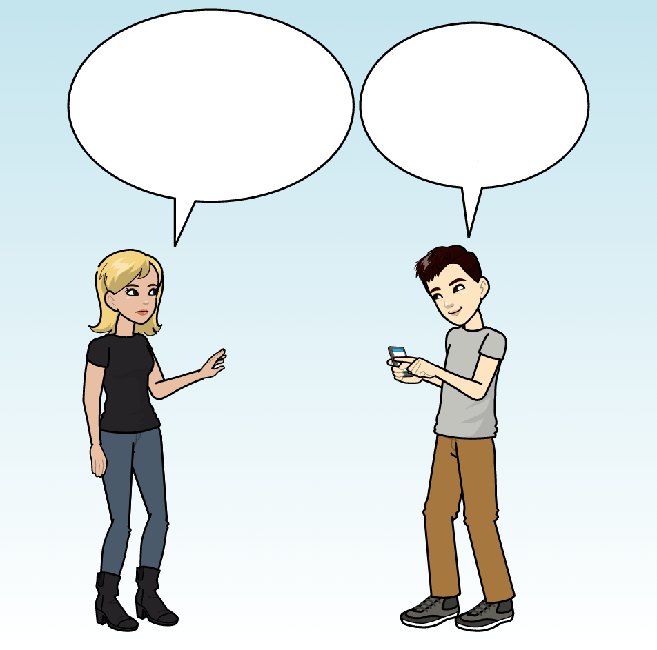

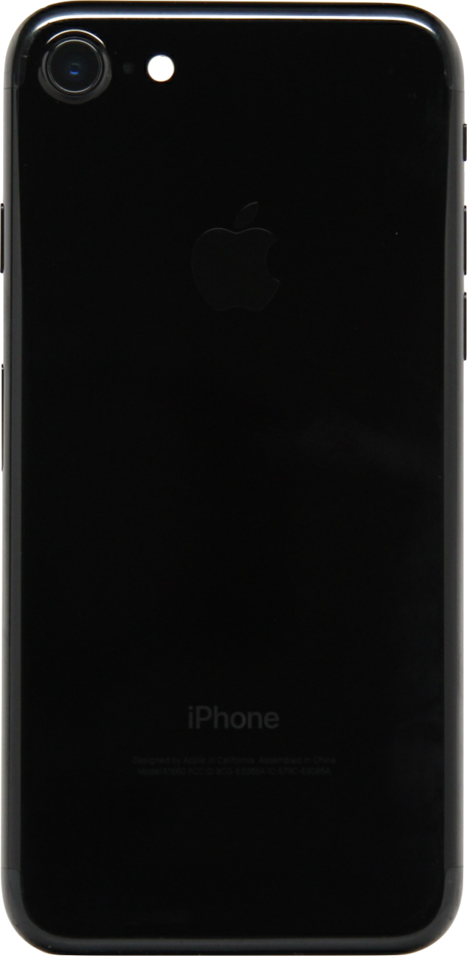
Hey, is any metro line running?
Some are.
L1: running
L2: closed
L3: running
F
J

Slide 2
Hey, what metro lines are running?
None are running.
L1: running
L2: closed
L3: running
F
J

Slide 3
L1: running
L2: closed
L3: running
L1: running
L2: closed
L3: running
F
J
F
J

Slide 4
Hey, what metro lines are running?
They are all running.
L1: running
L2: running
L3: running
F
J

Slide 5
L1: running
L2: running
L3: running
L1: running
L2: running
L3: running
F
J
F
J

Slide 6
Hey, are any of the metro lines running?
Some of them are.
L1: closed
L2: closed
L3: closed
F
J

Slide 7
L1: closed
L2: closed
L3: closed
L1: closed
L2: closed
L3: closed
F
J
F
J

Slide 8
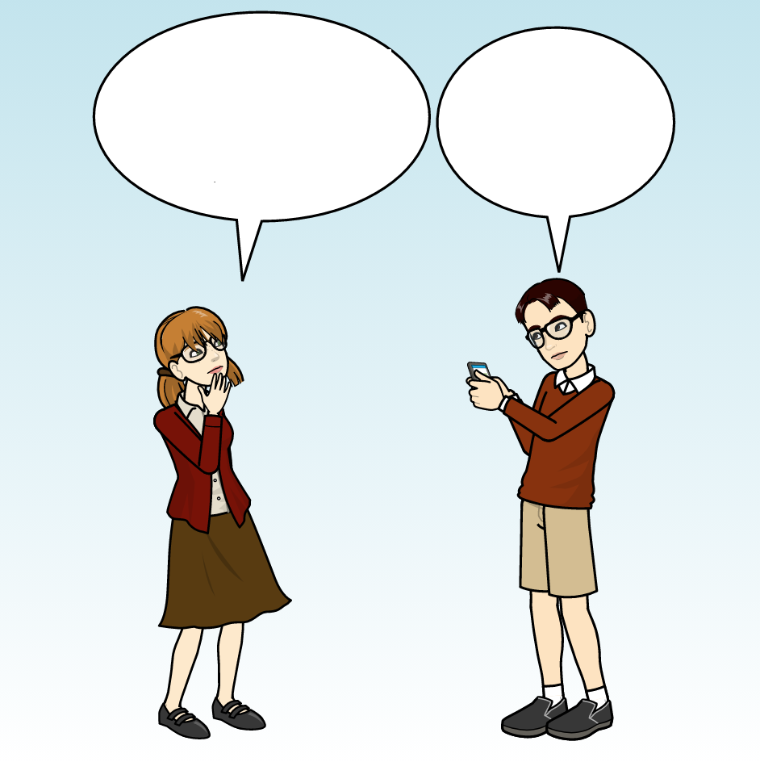
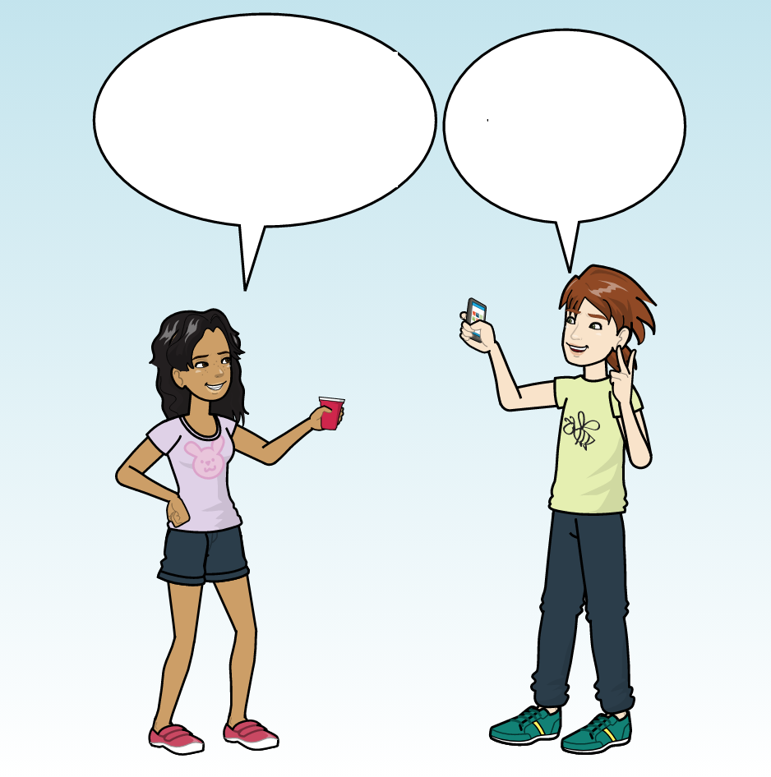
Do you have the time?
Do you have the time?
It’s 3.
It’s 3.

Slide 9

3:00
2:58
F
J
F
J

Slide 10
2:53
1:12
F
J
F
J

Slide 11
Do you have the time?
Do you have the time?
It’s 2:30.
It’s 2:30.

Slide 12
2:30
2:32
F
J
F
J

Slide 13
2:37
7:55
F
J
F
J

Slide 14
What’s the time?
What’s the time?
It’s 5.
It’s 5.

Slide 15
5:00
5:03
F
J
F
J

Slide 16
5:09
9:55
F
J
F
J

Slide 17
Hey, do you have the time?
Hey, do you have the time?
It’s 5:30.
It’s 5:30.

Slide 18
5:30
5:27
F
J
F
J

Slide 19
5:21
11:14
F
J
F
J

Slide 20
What’s the time?
What’s the time?
It’s 11:30.
It’s 11:30.

Slide 21
11:30
11:34
F
J
F
J

Slide 22
11:41
4:11
F
J
F
J

Slide 23
Hey, do you have the time?
Hey, do you have the time?
It’s 6:30.
It’s 6:30.

Slide 24
6:30
6:26
F
J
F
J

Slide 25
6:19
4:11
F
J
F
J

Slide 26
What’s the time?
What’s the time?
It’s 7.
It’s 7.

Slide 27
7:00
7:05
F
J
F
J

Slide 28
7:13
2:11
F
J
F
J

Slide 29
What’s the time?
What’s the time?
It’s 4.
It’s 4.

Slide 30
4:00
3:55
F
J
F
J

Slide 31
3:47
9:10
F
J
F
J

Slide 32
So, how much is a roundtrip ticket?
So, how much is a roundtrip ticket?
It’s $300.
It’s $300.

Slide 33
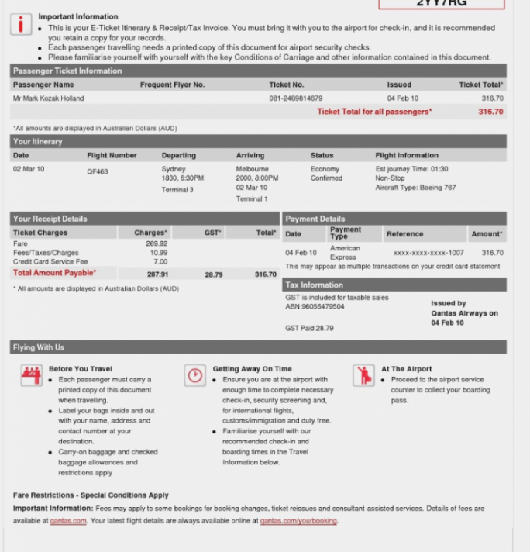
$300.03
$295.03
F
J
F
J

Slide 34
$288.03
$788.03
F
J
F
J

Slide 35
So, how much is the cheapest place?
So, how much is the cheapest place?
It’s $200.
It’s $200.

Slide 36
$200.05
$205.05
F
J
F
J

Slide 37
$212.05
$678.05
F
J
F
J

Slide 38
So, how much is the quote?
So, how much is the quote?
It’s $300.
It’s $300.

Slide 39
$300.04
$306.04
F
J
F
J

Slide 40
$314.04
$760.04
F
J
F
J

Slide 41
How much would it cost to take a train?
How much would it cost to take a train?
It’s $200.
It’s $200.

Slide 42
$200.09
$194.09
F
J
F
J

Slide 43
$186.09
$500.09
F
J
F
J

Slide 44
How much is the cheapest flight?
How much is the cheapest flight?
It’s $300.
It’s $300.

Slide 45
$300.03
$292.03
F
J
F
J

Slide 46
$284.03
$788.03
F
J
F
J

Slide 47
So, how much is the cheapest place?
So, how much is the cheapest place?
It’s $200.
It’s $200.

Slide 48
$200.05
$208.05
F
J
F
J

Slide 49
$216.05
$492.05
F
J
F
J

Slide 50
So, how much does it cost?
So, how much does it cost?
It’s $300.
It’s $300.

Slide 51
$300.04
$309.04
F
J
F
J

Slide 52
$318.04
$760.04
F
J
F
J

Slide 53
How much would it cost to rent a car for three days?
How much would it cost to rent a car for three days?
It’s $200.
It’s $200.

Slide 54
$200.09
$191.09
F
J
F
J

Slide 55
$182.09
$500.09
F
J
F
J

Slide 56
How far out does she live?
How far out does she live?
200 miles.
200 miles.

Slide 57
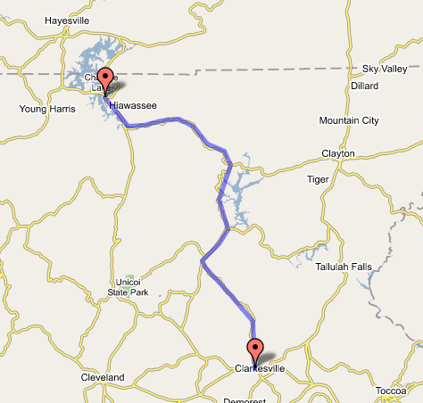
200.2
191.2
F
J
F
J

Slide 58
182.2
688.2
F
J
F
J

Slide 59
How far out does she live?
How far out does she live?
It’s 150 miles from here.
It’s 150 miles from here.

Slide 60
150.2
155.2
F
J
F
J

Slide 61
162.2
542.2
F
J
F
J

Slide 62
So, how far is the closest state park?
So, how far is the closest state park?
It’s 250 miles away.
It’s 250 miles away.

Slide 63
250.3
256.3
F
J
F
J

Slide 64
264.3
712.3
F
J
F
J

Slide 65
How far is the closest airport?
How far is the closest airport?
It’s 300 miles away.
It’s 300 miles away.

Slide 66
300.2
294.2
F
J
F
J

Slide 67
286.2
610.2
F
J
F
J

Slide 68
Hey, can you check how far it is from here?
Hey, can you check how far it is from here?
It’s 200 miles.
It’s 200 miles.

Slide 69
200.1
192.1
F
J
F
J

Slide 70
186.1
692.1
F
J
F
J

Slide 71
Hey, how far is the closest orchard?
Hey, how far is the closest orchard?
It’s 300 miles away.
It’s 300 miles away.

Slide 72
300.1
308.1
F
J
F
J

Slide 73
316.1
658.1
F
J
F
J

Slide 74
So, how far is the venue?
So, how far is the venue?
It’s 300 miles away.
It’s 300 miles away.

Slide 75
300.2
309.2
F
J
F
J

Slide 76
318.2
767.2
F
J
F
J

Slide 77
So, how far is her hometown?
So, how far is her hometown?
It’s 300 miles away.
It’s 300 miles away.

Slide 78
300.1
295.1
F
J
F
J

Slide 79
288.1
588.1
F
J
F
J

Slide 80
Hey, are any of the lines delayed?
Some of them are.
L1: delayed
L2: delayed
L3: on time
F
J

Slide 81
Hey, do we have to pay tolls?
Some routes are toll free.
Route 1: free
Route 2: toll
Route 3: free
F
J

Slide 82
Hey, is it possible to take our bike on the train?
It’s possible on some trains.
Train 1: yes
Train 2: yes
Train 3: no
F
J

Slide 83
Are any of these hotels pet-friendly?
Some of them are.
Hotel 1: yes
Hotel 2: yes
Hotel 3: no
F
J

Slide 84
Are any of these restaurants vegan friendly?
Some of them are.
Rest 1: yes
Rest 2: no
Rest 3: yes
F
J

Slide 85
Do these cafes have wi-fi?
Some of them do.
Cafe 1: yes
Cafe 2: no
Cafe 3: yes
F
J

Slide 86
Are these recipes gluten free?
Some of them are.
Rec 1: yes
Rec 2: yes
Rec 3: no
F
J

Slide 87
Do any of these beaches allow smoking?
Some of them do.
Beach 1: yes
Beach 2: yes
Beach 3: no
F
J

Slide 88
Do any of these hotels have cable TV?
Some of them do.
Hotel 1: yes
Hotel 2: no
Hotel 3: yes
F
J

Slide 89
Do any of these have in-unit wash and dry?
Some of them do.
Apt 1: yes
Apt 2: yes
Apt 3: no
F
J

Slide 90
Do these parks allow camping?
Some of them do.
Park 1: yes
Park 2: yes
Park 3: no
F
J

Slide 91
Are these lakes wheelchair accessible?
Some of them are.
Lake 1: no
Lake 2: no
Lake 3: no
F
J

Slide 92
Do these apartments have a parking garage?
Some of them do.
Apt 1: no
Apt 2: no
Apt 3: no
F
J

Slide 93
Can you fish in these lakes?
You can on some of them.
Lake 1: no
Lake 2: no
Lake 3: no
F
J

Slide 94
Do any of these restaurants allow smoking?
Some of them do.
Rest 1: no
Rest 2: no
Rest 3: no
F
J

Slide 95
Do any of these sectors have tickets left?
Some of them do.
Sector 1: no
Sector 2: no
Sector 3: no
F
J

Slide 96
Are these venues available for our dates?
Some of them are.
Venue 1: yes
Venue 2: yes
Venue 3: yes
F
J

Slide 97
Do any of these rentals have a van available?
Some of them do.
Rent 1: yes
Rent 2: yes
Rent 3: yes
F
J

Slide 98
Do any of these hotels have a gym?
Some of them do.
Hotel 1: yes
Hotel 2: yes
Hotel 3: yes
F
J

Slide 99
Do any of these restaurants serve Italian food?
Some of them do.
R1: yes
R2: yes
R3: yes
F
J

Slide 100
Do any of these bars have happy hour?
Some of them do.
Bar 1: yes
Bar 2: yes
Bar 3: yes
F
J

Slide 101
Do these trains have wi-fi?
Some of them do.
Train 1: yes
Train 2: yes
Train 3: yes
F
J

Slide 102
Do any of these have in-unit wash and dry?
Some of them do.
Apt 1: yes
Apt 2: yes
Apt 3: yes
F
J

Slide 103
Are any of these cars hybrid?
Some of them are.
Car 1: yes
Car 2: yes
Car 3: yes
F
J

