Slide 1
QP1 05_forced_choice
phone pictures

Slide 2
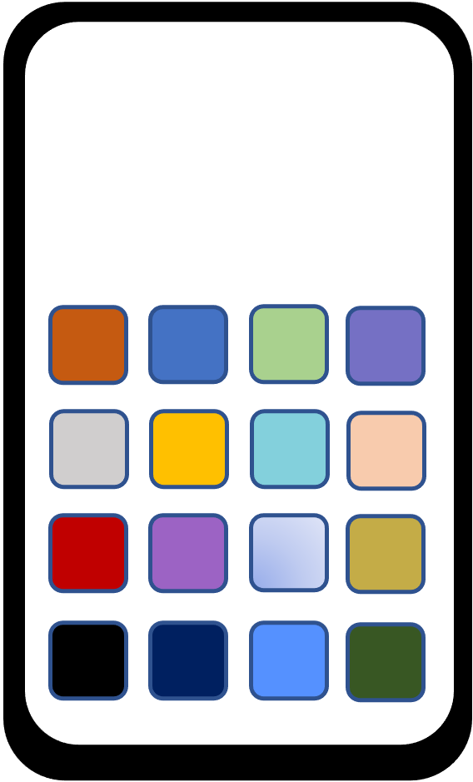
3:00
2:59
2:51
11:22

Slide 3











3:00
2:59
2:51
11:22

Slide 4
1:30
1:33
1:33
1:41
8:45

Slide 5
1:30
1:33
1:41
8:45

Slide 6
8:00
8:02
8:13
5:34

Slide 7
8:00
8:02
8:13
5:34

Slide 8
9:30
9:26
9:23
3:18

Slide 9
9:30
9:26
9:23
3:18

Slide 10
café 1: 19 min
café 2: 10 min
café 3: 12 min
store 1: 4 mi
store 2: 7 mi
store 3: 8 mi
salon 1: none
salon 2: none
salon 3: none
airline 1: yes
airline 2: yes
airline 3: no
filler phones

Slide 11
rest. 1: yes
rest. 2: no
rest. 3: yes
rest. 1: yes
rest. 2: no
rest. 3: yes
rest. 1: yes
rest. 2: yes
rest. 3: yes
rest. 1: no
rest. 2: no
rest. 3: no
intro phone
training phones

Slide 12
rest. 1: yes
rest. 2: no
rest. 3: yes
rest. 1: yes
rest. 2: yes
rest. 3: yes
rest. 1: no
rest. 2: no
rest. 3: no

Slide 14
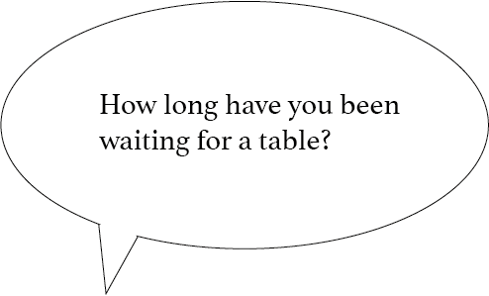
I have to be at work soon. Do any of those cafes have wait times less than 15 minutes?
We’re already late, but we need something to take to the party. Are any of the stores within 10 miles of here?

Slide 15
I’m thinking of taking a vacation sometime this year. Do any of those airlines fly to Hawaii?
I’m thinking of going to get a haircut later. Do any of those salons have appointments open today?

Slide 16
Do any of those restaurants have tables available?

Slide 17
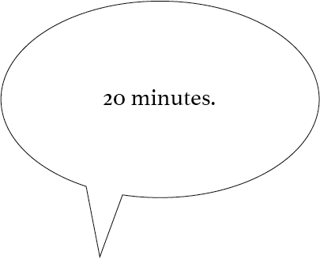
Some of them do.
Some of them are.

Slide 18
Some do.
Some of them do.

Slide 19
None of them do.
All of them do.

