Slide 1
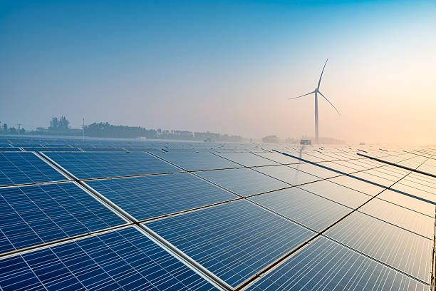
ANOMALY DETECTION IN SOLAR PANELS
IDENTIFYING TRENDS IN SOILING
AVENA CHENG
In collaboration with Sho Kawano & New Sun Road P.B.C
12/05/2019
Notes:
Good afternoon everyone! My name is Avena and this semester I worked on an anomaly detection project! If you’re unfamiliar with anomaly detection, it’s essentially finding data points that deviate from the norm and usually indicate some kind of weird event going on. Some classic examples include fraud detection or classifying spam emails. In my project we focused on detecting soiling in solar panels, but our anomalies are slightly different from the traditional problems you may know, and I’ll expand on that in a bit.

Slide 2
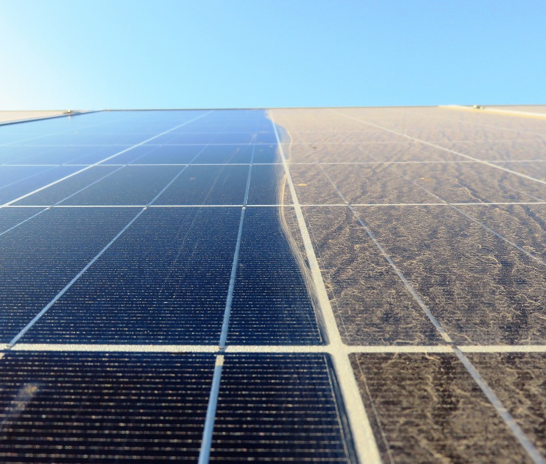
Intro to Problem
Solar panels have a 15-20% efficiency rate
Soiling, the buildup of debris, dust, or snow on solar panels, can affect the panel’s efficiency around 40%
We want to detect when soiling occurs so we can provide recommendations for when the companies should clean their panels
Notes:
So, many of you probably know what solar panels are. On average they have a 15 – 20% efficiency rate. Soiling is the process of building dirt and other debris that affect its efficiency. This picture compares a clean versus soiled panel. My project was to identify when soiling occurs so that companies can clean them and save energy. One thing that makes this a slightly different anomaly detection problem is that you often see anomalies as a single event, but since soiling is a buildup, we have to detect the event over time.

Slide 3
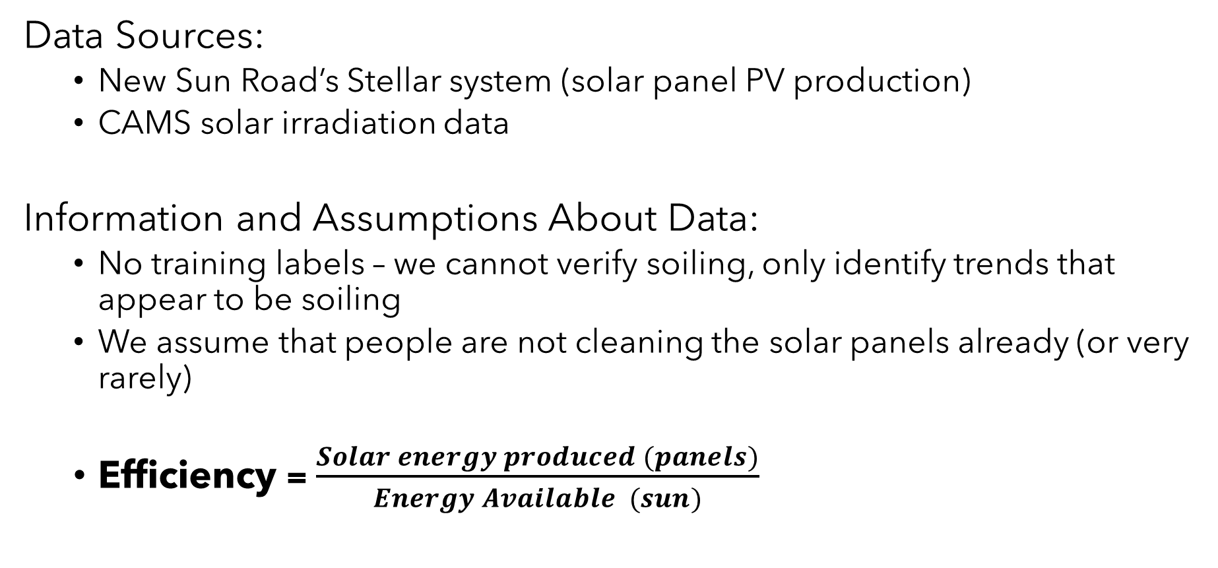
Background and Assumptions
Data Sources:
New Sun Road’s Stellar system (solar panel PV production)
CAMS solar irradiation data
Information and Assumptions About Data:
No training labels – we cannot verify soiling, only identify trends that appear to be soiling
We assume that people are not cleaning the solar panels already (or very rarely)
Efficiency = $\frac{Solar energy produced (panels)}{Energy Available (sun)}$
Notes:
So here’s a bit of background and information about the data. I got data on the solar panels from New Sun Road, which is the company I worked with this semester. We also used a third party source called CAMS to get data on sun irradiance. A few things to note is that we don’t have training labels. We don’t know for sure there’s soiling, but we have a good idea of what it looks like. We assume that people are not cleaning their panels or very rarely.
Finally, throughout this problem we looked at efficiency as our main metric.
We wanted to measure efficiency because solar power itself can vary greatly with the weather. Since efficiency is a ratio, it is theoretically consistent. So on a cloudy day, we get less sun and less power, but the ratio should be the same if there was a clear day. Putting that all together, we calculate efficiency as solar energy produced by panels divided by the energy available from the sun.

Slide 4
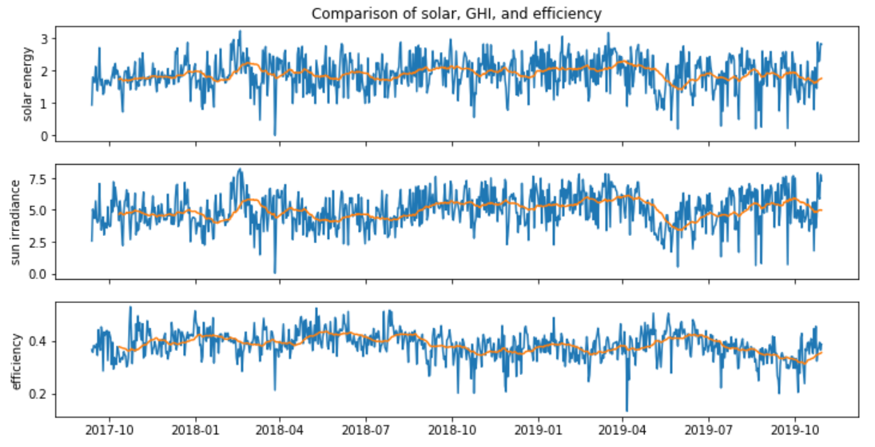
Initial Time Series Analysis
Notes:
Our first step was to do some basic analysis of our data. We wanted to see how energy, irradiation, and efficiency looked over time. The blue is the daily data and the orange is the rolling average. As you can see the daily data is very noisy and it can be hard to tell what’s an anomaly, thus we looked at the rolling average with a window of 30 days and that gave us more promising results.
For those who may not know, a rolling average is calculated by taking the first 30 days and finding the mean of that, and that mean is our first data point. Then the second data point is the 30 days after the first day. The third data point is the 30 days after the second day, and so on. Hence why the orange line starts a bit after the blue one.
You might be thinking that the rolling average is a good way to detect anomalies, but let’s look at a more zoomed in photo.

Slide 5
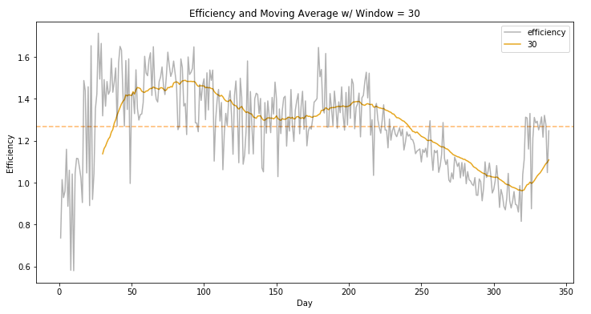
Notes:
Let’s take a closer look at the efficiency graph.
The light gray line is the daily data. As you can see, it’s still a bit noisy. We want to look for a gradual downward trend, which is kinda what we see here. But at what point do we decide it’s soiling? We need some clear point to indicate soiling so we can tell companies to clean their panels.

Slide 6
Solution – Rolling efficiency as a “Percentage of Max"
“Percentage of Max” Methodology:
Calculate 30 Day
Moving Averages
Take the Max of each period
Divide each point by the corresponding Max of that period
0.39, 0.38, 0.35; 0.41, 0.39, 0.32; 0.49, …. 0.45, 0.42, 0.42
0.39, 0.38, 0.35; 0.41, 0.39, 0.32; 0.49, …. 0.45, 0.42, 0.42
1.00, 0.97, 0.90; 1.00, 0.95, 0.78; 1.00, …. 0.91, 0.86, 0.86
Notes:
Rather than using the rolling average directly, we decided to use a different metric. We chose to use percentage of a max so that we could find a more representative and consistent data point within a time frame to indicate soiling. Using this metric would also account for degradation of the panels over time. The way it works is we:
Calculate the 30 day moving average (30MA) of the efficiency measure
The “max” sets itself as the first data point in the 30MA
As we move along the time axis, whenever we encounter a value greater than the max, the max is set to that value.
This results in a time series of maximums.
We take the 30 day MA, which is also a time series, and divide by the time series of maxes to create the “efficiency %”.

Slide 7
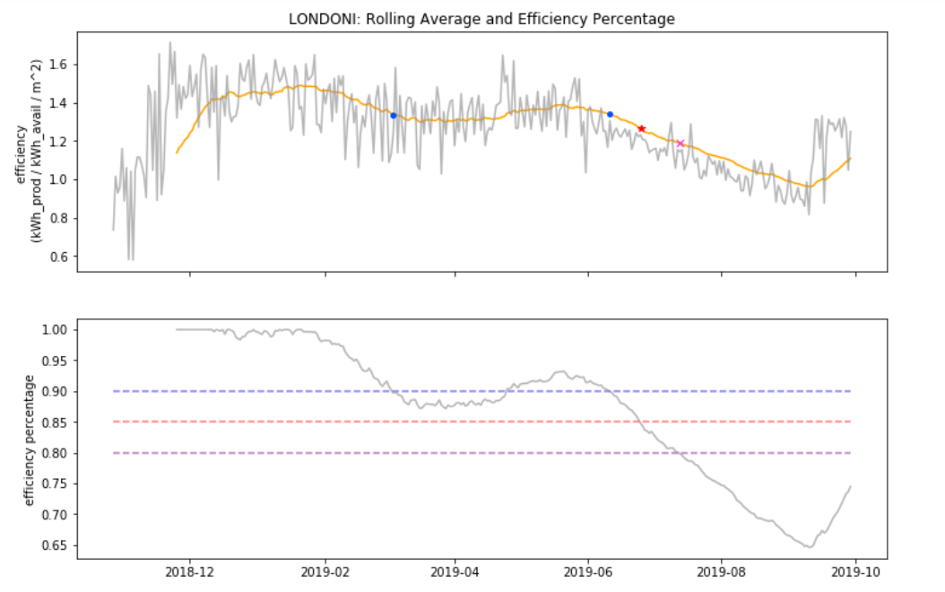
Results
Example Site:
Thresholds:
Alerts at 90%
Alerts at 80%
Alerts at 70%
Notes:
And these are the results! The top graphs are what we’ve seen before and the bottom graph is how the efficiency percentage changes over time. The blue points are when the efficiency percentage is below 90%, followed by the red being 80%, and the pink being 70%. As you can see, it can get as low as 65% which isn’t very good.
Notes: emphasize that the second graph is generated from slide 6

Slide 8
Impact – By the Year, Threshold = 0.80
20
Sites
12%
Days below threshold
Solar Panel Energy Saved
25%
1 to 4
Alerts
Notes:
So we tested this on 20 solar panel sites with a threshold of 80%, meaning we alert sites of soiling when our metric reaches below 80%. We found on average that in a given year, ¼ of the time panels will be producing below threshold, so sites will receive between 1 and 4 alerts. However, if we can use our model, we can save about 12% of solar energy, assuming that companies clean their panels after receiving an alert. Of course, there’s still a lot that can be done to improve this model. The next step would be to confirm our predictions, and perhaps try other signal processing methods, but for now we think 12% is a good start to solving this problem.

Slide 9
APPENDIX

Slide 10
Other methods we tried
Rolling Median (it was the same)
Using rain to detect soiling directly
Butterworth filter
Notes:
And these are the results! The blue points are when the efficiency percentage is below 90%, followed by the red being 80%, and the pink being 70%. The top graphs are what we’ve seen before and the bottom graph is how the efficiency percentage changes over time. As you can see, it can get as low as 65% which isn’t very good.

Slide 11
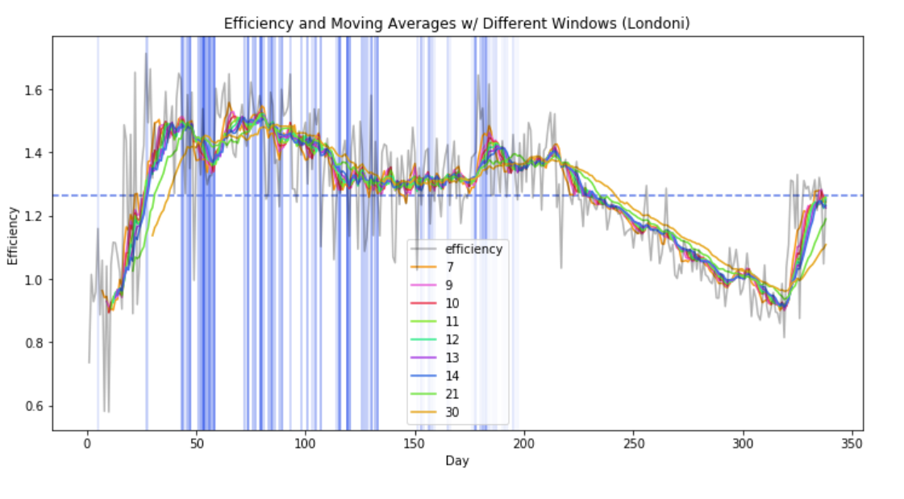
Notes:
The idea behind the rain was that if it rained a certain amount of inches, it would be enough to clean the panels. However after further exploration and testing, we found there wasn’t a significant difference. Either there wasn’t soiling or there wasn’t enough rain.
One reason we abandoned this idea was because of the reliability of the data. We got our data from the darksky API forecast which is supposed to be highly accurate, but the problem is it doesn’t tell us if it actually rained, only the probability of rain. Thus, we don’t know for sure if it rained, and if it did rain, we don’t know how many inches. After graphing the rain we couldn’t find a clear relationship between that and the efficiency so we decided not to use this method.

Slide 12
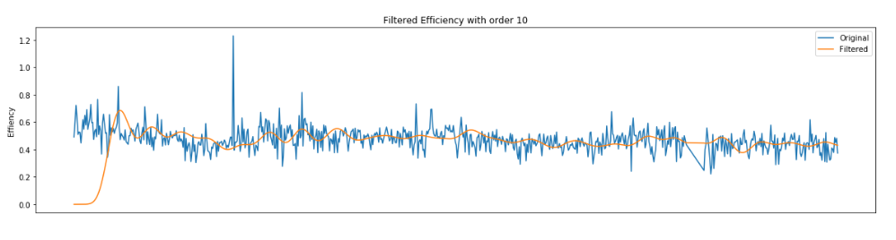
Butterworth Filter
A low pass filter designed to process signals so that they appear flatter,
Often used in audio circuits: think of music that gets muffled.
We built it but still have to compare with current method.

Slide 13
Citations
Power Loss From Soiling:
https://jrenewables.springeropen.com/articles/10.1186/s40807-017-0043-y
https://www.researchgate.net/publication/292275071_Power_Loss_Due_to_Soiling_on_Solar_Panel_A_review
New Sun Road:
https://www.newsunroad.com
CAMS Irradiation Data:
http://www.soda-pro.com/web-services/radiation/cams-radiation-service

